Slide 1

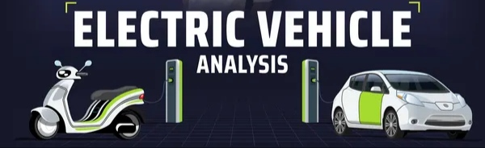

Slide 2

Problem Statement
AtliQ Motors
AtliQ Motors is an automotive giant from the USA specializing in electric vehicles (EV). In the last 5 years, their market share rose to 25% in electric and hybrid vehicles segment in North America. As a part of their expansion plans, they wanted to launch their bestselling models in India where their market share is less than 2%. Bruce Haryali, the chief of AtliQ Motors India wanted to do a detailed market study of existing EV/Hybrid market in India before proceeding further. Bruce gave this task to the data analytics team of AtliQ motors and Peter Pandey is the data analyst working in this team.
Notes:
Problem Statement

Slide 3
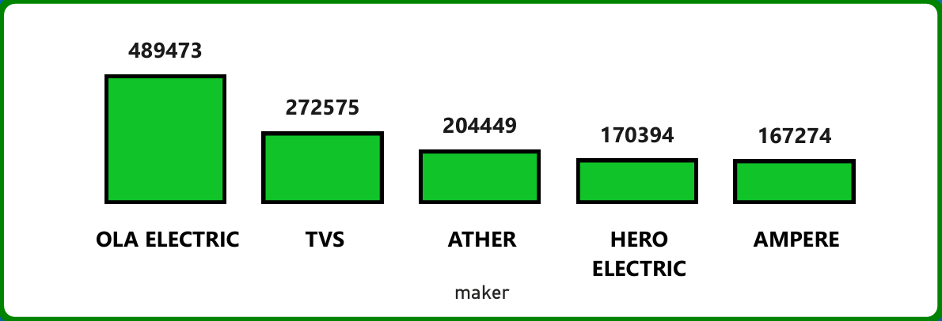
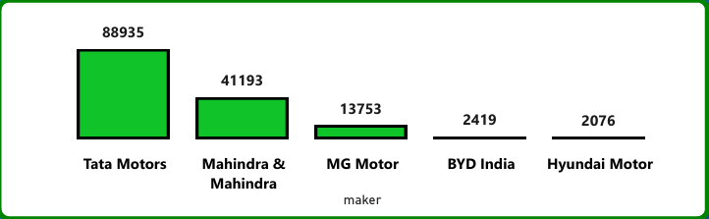
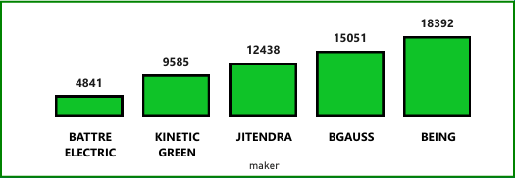
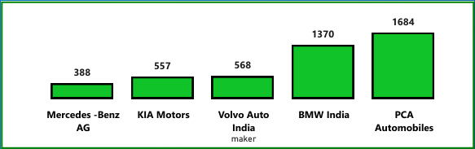
1. List the top 3 and bottom 3 makers for the fiscal years 2023 and 2024 in terms of the number of 2-wheelers sold.
Top 5 Makers of 2-Wheelers EVs
Top 5 Makers of 4-Wheelers EVs
Bottom 5 Makers of 2-Wheelers EVs
Bottom 5 Makers of 4-Wheelers EVs
Notes:
1. List the top 3 and bottom 3 makers for the fiscal years 2023 and 2024 in terms of the number of 2-wheelers sold.

Slide 4
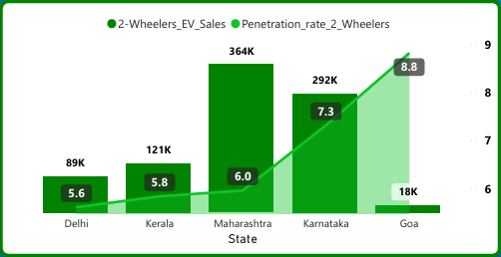
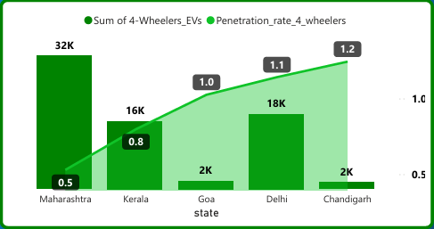
2. Identify the top 5 states with the highest penetration rate in 2-wheeler and 4-wheeler EV sales in FY 2024.
Top 5 States with Highest Penetration Rate in 2-Wheelers in 2024
Top 5 States with Highest Penetration Rate in 4-Wheelers
Notes:
Top 5 States with Highest Penetration Rate in 4-Wheelers

Slide 5
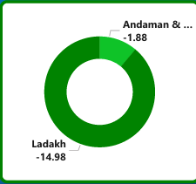
3. List the states with negative penetration (decline) in EV sales from 2022 to 2024?

Slide 6
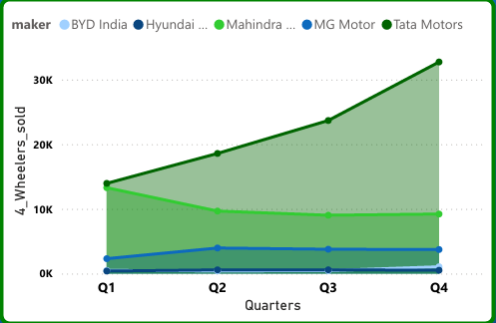
4. What are the quarterly trends based on sales volume for the top 5 EV makers (4-wheelers) from 2022 to 2024?

Slide 7
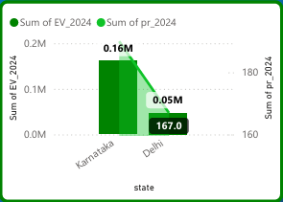
5. How do the EV sales and penetration rates in Delhi compare to Karnataka for 2024?

Slide 8
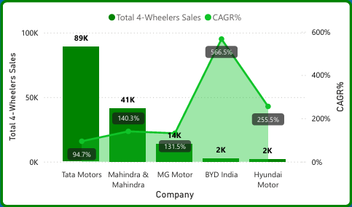
6. List down the compounded annual growth rate (CAGR) in 4-wheeler units for the top 5 makers from 2022 to 2024.

Slide 9
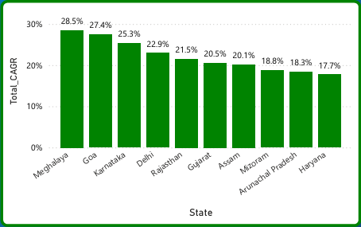
7. List down the top 10 states that had the highest compounded annual growth rate (CAGR) from 2022 to 2024 in total vehicles sold.

Slide 10
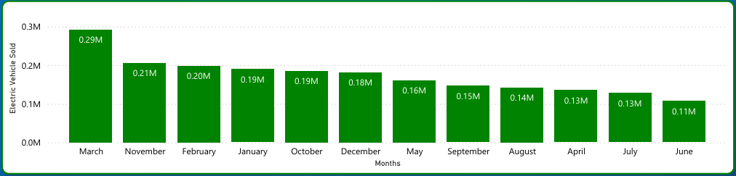
8. What are the peak and low season months for EV sales based on the data from 2022 to 2024?

Slide 11
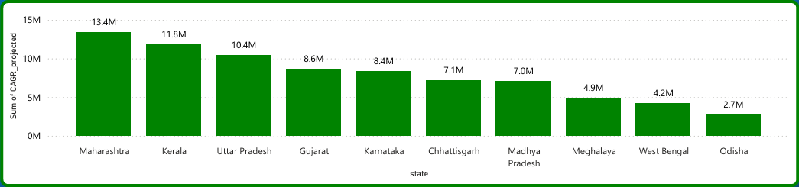
9. What is the projected number of EV sales (including 2-wheelers and 4 wheelers) for the top 10 states by penetration rate in 2030, based on the compounded annual growth rate (CAGR) from previous years?

Slide 12
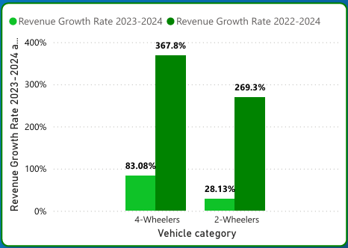
10. Estimate the revenue growth rate of 4-wheeler and 2-wheelers EVs in India for 2022 vs 2024 and 2023 vs 2024, assuming an average unit price. H

Slide 13
Solutions For the Secondary Research Questions
Notes:
Solutions For the Secondary Research Questions

Slide 14
1. What are the primary reasons for customers choosing 4-wheeler EVs in 2023 and 2024 (cost savings, environmental concerns, government incentives)?
# Government Incentives and Policies-
FAME or Faster Adoption and Manufacturing of (hybrid and) Electric Automotive in India is an incentive programme for government subsidy on electric vehicles
The FEMA 2 (which is the EV incentive program second phase, which went live on April 1, 2019) scheme provides a subsidy of upto 10,000 rupees per kwh of battery capacity, This translates to varying amounts depending in the battery size and type of vehicle. For instance a vehicle with 30kwh battery capacity could potentially receive a subsidy of 3 lakh rupees.
In most states implementing the subsidy policy, the road tax for electric 4 wheelers is completely exempted, with the exception of Kerala, Gujarat, and Uttar Pradesh.
Registration fees for all kinds of EVs are waived countrywide. The Ministry of roads and transport and highways announced that all battery powered vehicles are exempt from fees for issuing or renewing registration certificate.
Notes:
In most states implementing the subsidy policy, the road tax for electric 4 wheelers is completely exempted, with the exception of kerala, Gujarat, and Uttar Pradesh.

Slide 15
Reduction of GST on EVs – GST on EV has been reduced from 12% to 5% GST on chargers stations for EVs has been reduced from 18% to 5%
Ministry of Road Transport and High announced that battery operated vehicle will be given green license plates and be exempted from permit requirements for carrying passengers or goods.
# Monatery Benefit to customers-
The running cost of an EV is much lower than an equivalent petrol or diesel vehicle.
Electric vehicles have very low maintenance costs because they don’t have as many moving parts as an internal combustion vehicle.
Electric vehicles don’t have gears and are very convenient to drive. There are no complicated controls, just accelerate, brake, and steer.
Convenience of charging at home.
No noise pollution

Slide 16
2. How do government incentives and subsidies impact the adoption rates of 2-wheelers and 4-wheelers? Which states in India provided most subsidies?
Strategies made by the government have made EVs accessible, affordable, and attractive to many customers. These initiatives are facilitating technological advancements and increasing domestic manufacturing without being dependent on imports. This is helping to reshape the entire electric two-wheeler ecosystem in India.
Government Policies such as FAME, Production Linked Incentives(PLI), and Electric Mobility Promotion Scheme 2024 (EMPS 2024) have a crucial role in generating the awareness among people leading to rise in the adoption of Electric Vehicle.
To prove the above statements I have insights from my Electric vehicle analysis report-
Total 2-Wheelers sold in 2023 were 728K and this number grew to 933K in 2024.
Total 4-Wheelers sold in 2023 were 47K and this number grew to 87k in 2024.
Notes:
Government Policies such as FAME, Production Linked Incentives(PLI), and Electric Mobility Promotion Scheme 2024 (EMPS 2024) have a crucial role in generating the awareness among people leading to rise in the adoption of Electric Vehicle.
To prove the above statements I have insights from my Electric vehicle analysis report-
Total 2-Wheelers sold in 2023 were 728K and this number grew to 933K in 2024.
Total 4-Wheelers sold in 2023 were 47K and this number grew to 87k in 2024.

Slide 17
3. How does the availability of charging stations infrastructure correlate with the EV sales and penetration rates in the top 5 states?
The availability of accessibility of charging infrastructure represent a linchpin in the widespread adoption of electric vehicles. In the realm of electric mobility the phrase “range anxiety has long been a deterrent for perspective EV buyers. The fear of running out of battery power without a nearby charging station has been a significant psychological barrier. Hence, the expansion and optimization of charging infrastructure play pivotal role in increasing EV sales and penetration rate. There are 12,146 public EV charging stations operational across the country.
States having most Charging Stations are –
Maharashtra – 3079
Delhi - 1889
Karnataka – 1041
Kerala – 852
Tamil Nadu - 643
Notes:
The availability of accessibility of charging infrastructure represent a linchpin in the widespread adoption of electric vehicles. In the realm of electric mobility the phrase “range anxiety has long been a deterrent for perspective EV buyers. The fear of running out of battery power without a nearby charging station has been a significant psychological barrier. Hence, the expansion and optimization of charging infrastructure play pivotal role in increasing EV sales and penetration rate. There are 12,146 public EV charging stations operational across the country.
States having most Charging Stations are –
Maharashtra – 3079
Delhi - 1889
Karnataka – 1041
Kerala – 852
Tamil Nadu - 643

Slide 18
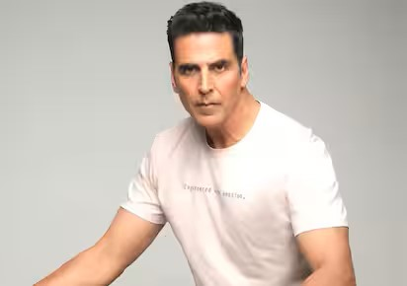
4. Who should be the brand ambassador if AtliQ Motors launches their EV/Hybrid vehicles in India and why?
Akshay Kumar
According to me Akshay Kumar should be the brand ambassador od AtliQ Motors in India, because the main perception about EVs in people is that they are Environment friendly and cheaper especially in terms of vehicle running cost. And Akshay Kumar have a very good image and popularity in creating awareness among people in India. Till now Akshay kumar is not a brand ambassador of any EV making company, so it will be an excellent move to approach Akshay Kumar for being the Brand Ambassador of AtliQ Motors.
Notes:
According to me Akshay Kumar should be the brand ambassador od AtliQ Motors in India, because the main perception about EVs in people is that they are Environment friendly and cheaper especially in terms of vehicle running cost. And Akshay Kumar have a very good image and popularity in creating awareness among people in India. Till now Akshay kumar is not a brand ambassador of any EV making company, so it will be an excellent move to approach Akshay Kumar for being the Brand Ambassador of AtliQ Motors.

Slide 19
5. Which state of India is ideal to start the manufacturing unit? (Based on subsidies provided, ease of doing business, stability in governance etc.)
Gujarat can be the ideal state to the manufacturing unit because it can fulfill all three factors - ease in doing business, subsidies provided and stability in government.
Gujarat have a stable government from a very long period of time and the promote its business friendly environment.
The state has become a hub for EV manufacturing, attracting both new investments and expansions from existing car manufacturers. MG Motors has recently begun manufacturing its newly launched EV at its plant in Halol and has announced plans for a second plant with a Rs 5,000 crore investment. Maruti Suzuki, India's largest car maker, will roll out its first electric vehicle from its plant in Gujarat this year. Tata Motors has also operationalized its newly acquired car manufacturing plant in Sana ..
Subsidies given in Gujarat for EVs-
Two-Wheeler: Maximum up to Rs. 20,000
Three-Wheelers: Benefit up to Rs. 50,000
Four-Wheelers: Benefits up to Rs. 1.5 lakhs
Notes:
Subsidies given in Gujarat for Evs-
Two-Wheeler: Maximum up to Rs. 20,000
Three-Wheelers: Benefit up to Rs. 50,000
Four-Wheelers: Benefits up to Rs. 1.5 lakhs.

Slide 20
6. Your top 3 recommendations for AtliQ Motors.
AtliQ Motors should play very strategically while starting EV business in India, because the demand for electric vehicles is increasing because of increasing competition, variety in technology and designs of vehicles, government support, etc. My recommendation for AtliQ motors are-
Company must do a Quality Analysis of the Top Electric vehicle makers in India i.e. Ola, TVS, Ather, TATA, Mahindra and Mahindra, MG motors, etc.
Company should work on inventing, upgrading or bringing a cheaper substitute of Lithium battery because customer have to make the battery of their electric vehicle replace after a fixed period of time and it cost them way to much.
It ranges between 20,000 to 50,000 for 2-Wheelers and 2,00,000 to 5,00,000 for 4-Wheelers.
3. With establishment of their business in India, the company should focus on building Charging Infrastructure in India especially in the areas where there are potential customers for EV and have less Charging stations in their area.
Notes:
AtliQ Motors should play very strategically while starting EV business in India, because the demand for electric vehicles is increasing because of increasing competition, variety in technology and designs of vehicles, government support, etc. My recommendation for AtliQ motors are-
Company must do a Quality Analysis of the Top Electric vehicle makers in India i.e. Ola, TVS, Ather, TATA, Mahindra and Mahindra, MG motors, etc.
Company should work on inventing, upgraging or bringing a cheaper substitute of Lithium battery because customer have to make the battery of their electric vehicle replace after a fixed period of time and it cost them way to much.
It ranges between 20,000 to 50,000 for 2-Wheelers and 2,00,000 to 5,00,000 for 4-Wheelers
3. With establishment of their business in India, the company should focus on building Charging Infrastructure in India especially in the areas where there are potential customers for EV and have less Charging stations in their area.

Slide 21
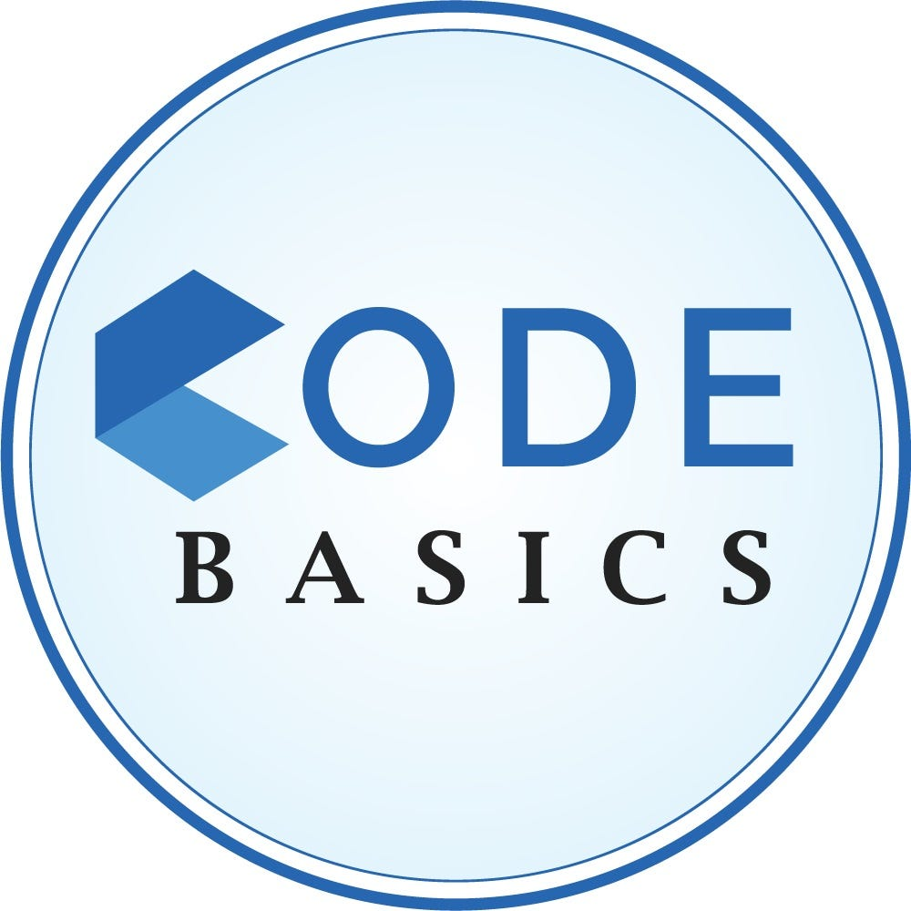
THANK YOU TO -
Notes:
Thank you to-

