Slide 1
Tech Instagram Influencer Analysis

Slide 2

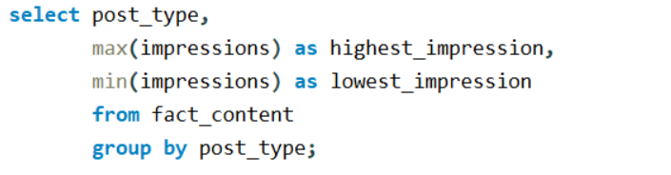
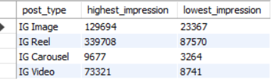
1. How many unique post types are found in the 'fact_content' table?
2. What are the highest and lowest recorded impressions for each post type?

Slide 3

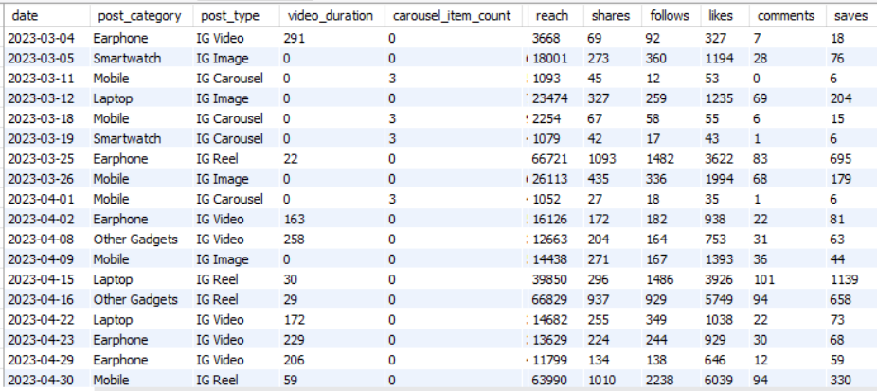
3. Filter all the posts that were published on a weekend in the month of March and April and export them to a separate csv file.

Slide 4
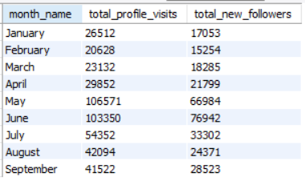
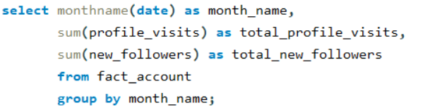
4. Create a report to get the statistics for the account. The final output includes the following fields:
• month_name
• total_profile_visits
• total_new_followers

Slide 5
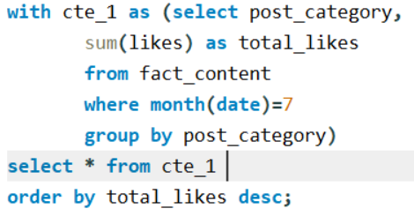
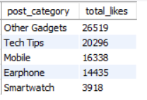
5. Write a CTE that calculates the total number of 'likes’ for each 'post_category' during the month of 'July' and subsequently, arrange the 'post_category' values in descending order according to their total likes.

Slide 6
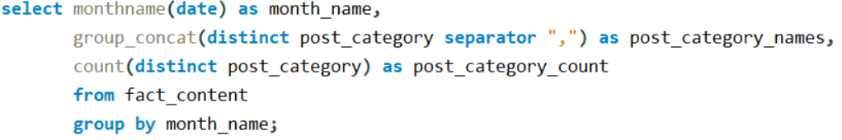
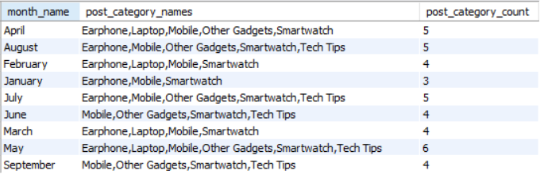
6. Create a report that displays the unique post_category names alongside their respective counts for each month. The output should have three columns:
• month_name
• post_category_names
• post_category_count
Example:
• 'April', 'Earphone,Laptop,Mobile,Other Gadgets,Smartwatch', '5’
• 'February', 'Earphone,Laptop,Mobile,Smartwatch', '4'

Slide 7
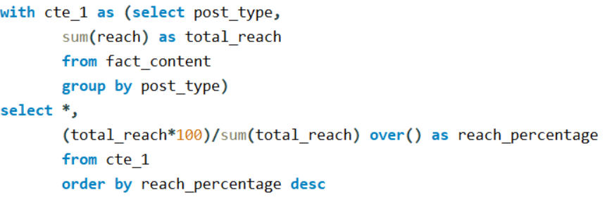
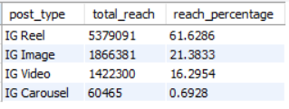
7. What is the percentage breakdown of total reach by post type? The final output includes the following fields:
• post_type
• total_reach
• reach_percentage

Slide 8
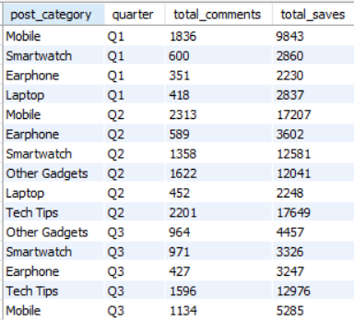
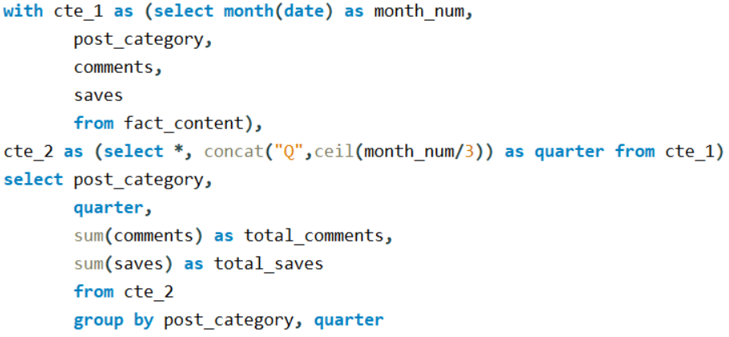
8. Create a report that includes the quarter, total comments, and total saves recorded for each post category. Assign the following quarter groupings:
(January, February, March) → “Q1”
(April, May, June) → “Q2”
(July, August, September) → “Q3”
The final output columns should consist of:
• post_category
• quarter
• total_comments
• total_saves

Slide 9
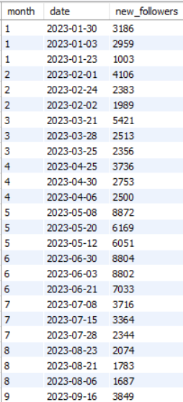
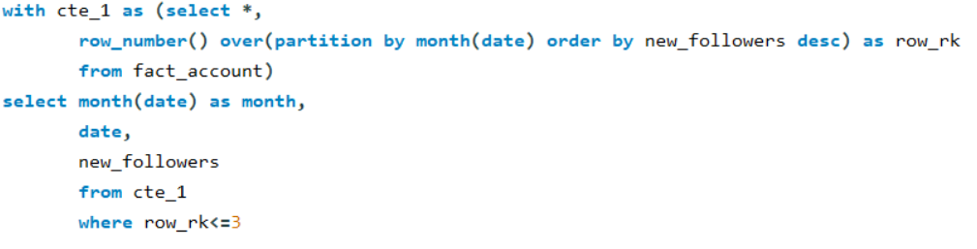

9. List the top three dates in each month with the highest number of new followers. The final output should include the following columns:
• month
• date
• new_followers

Slide 10
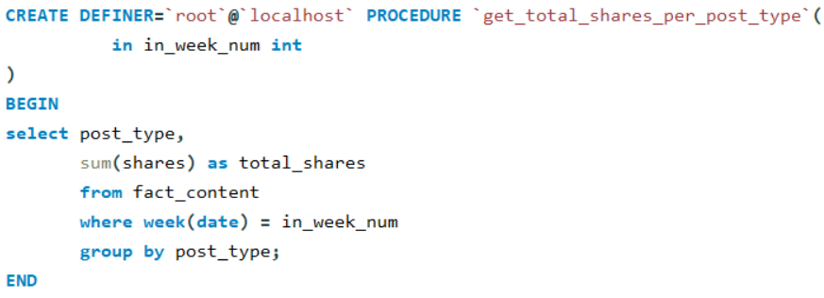
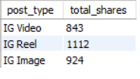
10. Create a stored procedure that takes the 'Week_no' as input and generates a report displaying the total shares for each 'Post_type'. The output of the procedure should consist of two columns:
• post_type
• total_shares

Slide 11
Thankyou

