Slide 1
Navigating the Rink: Analyzing Zone Entry Sequences and Expected Threat in Ice Hockey
Priyansh Gupta
Vignesh Aswathanarayana
Ragini Gunda
Linköping university, Sweden
Photo by Pexels

Slide 2
Table of Contents
1 | Introduction
2 | Thesis statement
3 | Rink grid division
4 | Expected Thread
5 | Entry sequence analysis
6 | Result
7 | conclusion
8 | Future work

Slide 3
3
Introduction
Ice hockey , renowned for its intense pace and complex strategies revolves around critical moments that finishes in scoring goals.
There were many factors that can be considered for predicting the outcome(scoring goals) of a team.
Among these factors, we look closely at offensive zone entries.
Strategies that enable a team to advance the puck beyond the blue line and into the opposition´s defensive zone.
Notes:
T20 cricket-
Cricket is played in 3 different format, Test (5 days game), One day internationals ( 50 Overs per inning) and T-20 format. This research is based on the t20 format of the game. The game consist of 20 overs per side of the inning. It was introduced in 2003 but got its popularity with World Cup 2007, and then IPL which started in 2008 and later many such leagues has emerged in different countries. In each inning first 6 overs are termed as powerplay. which has field restriction of only 2 fielder allowed outside 30-yard circle. 2 breaks.

Slide 4
4
Thesis statement
While passing the puck, entering the offensive zone from center of rink is more effective and danger-reducing.

Slide 5
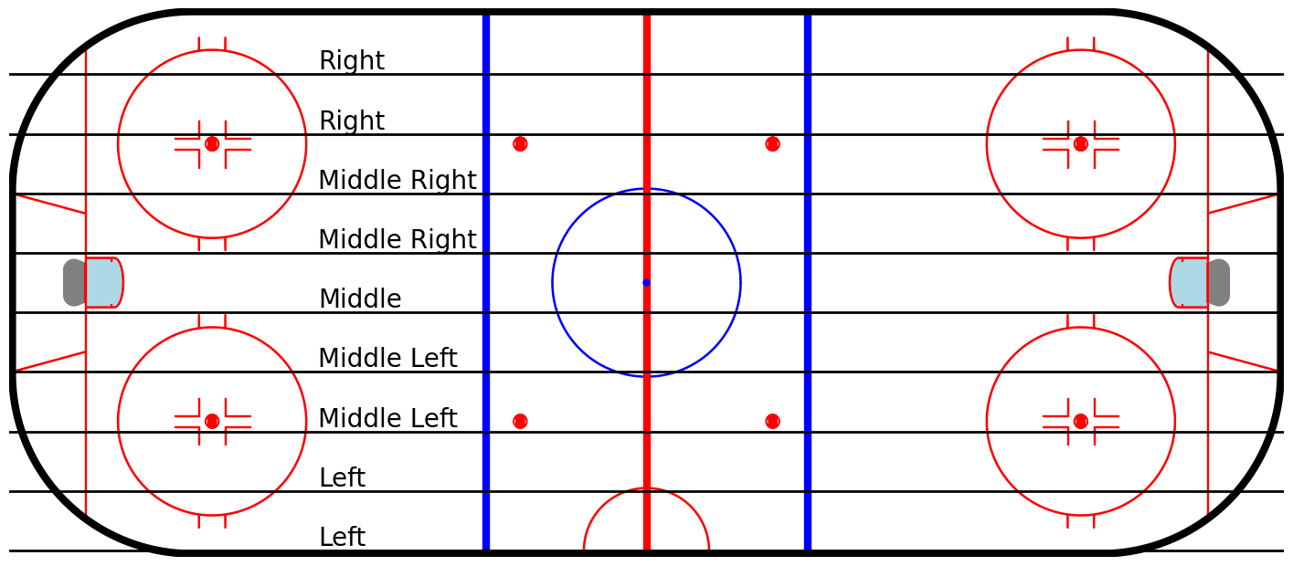
5
Rink Grid division
Fig. 1. Ice hockey rink lane division
Photo by Pexels
Notes:
Duckworth -

Slide 6
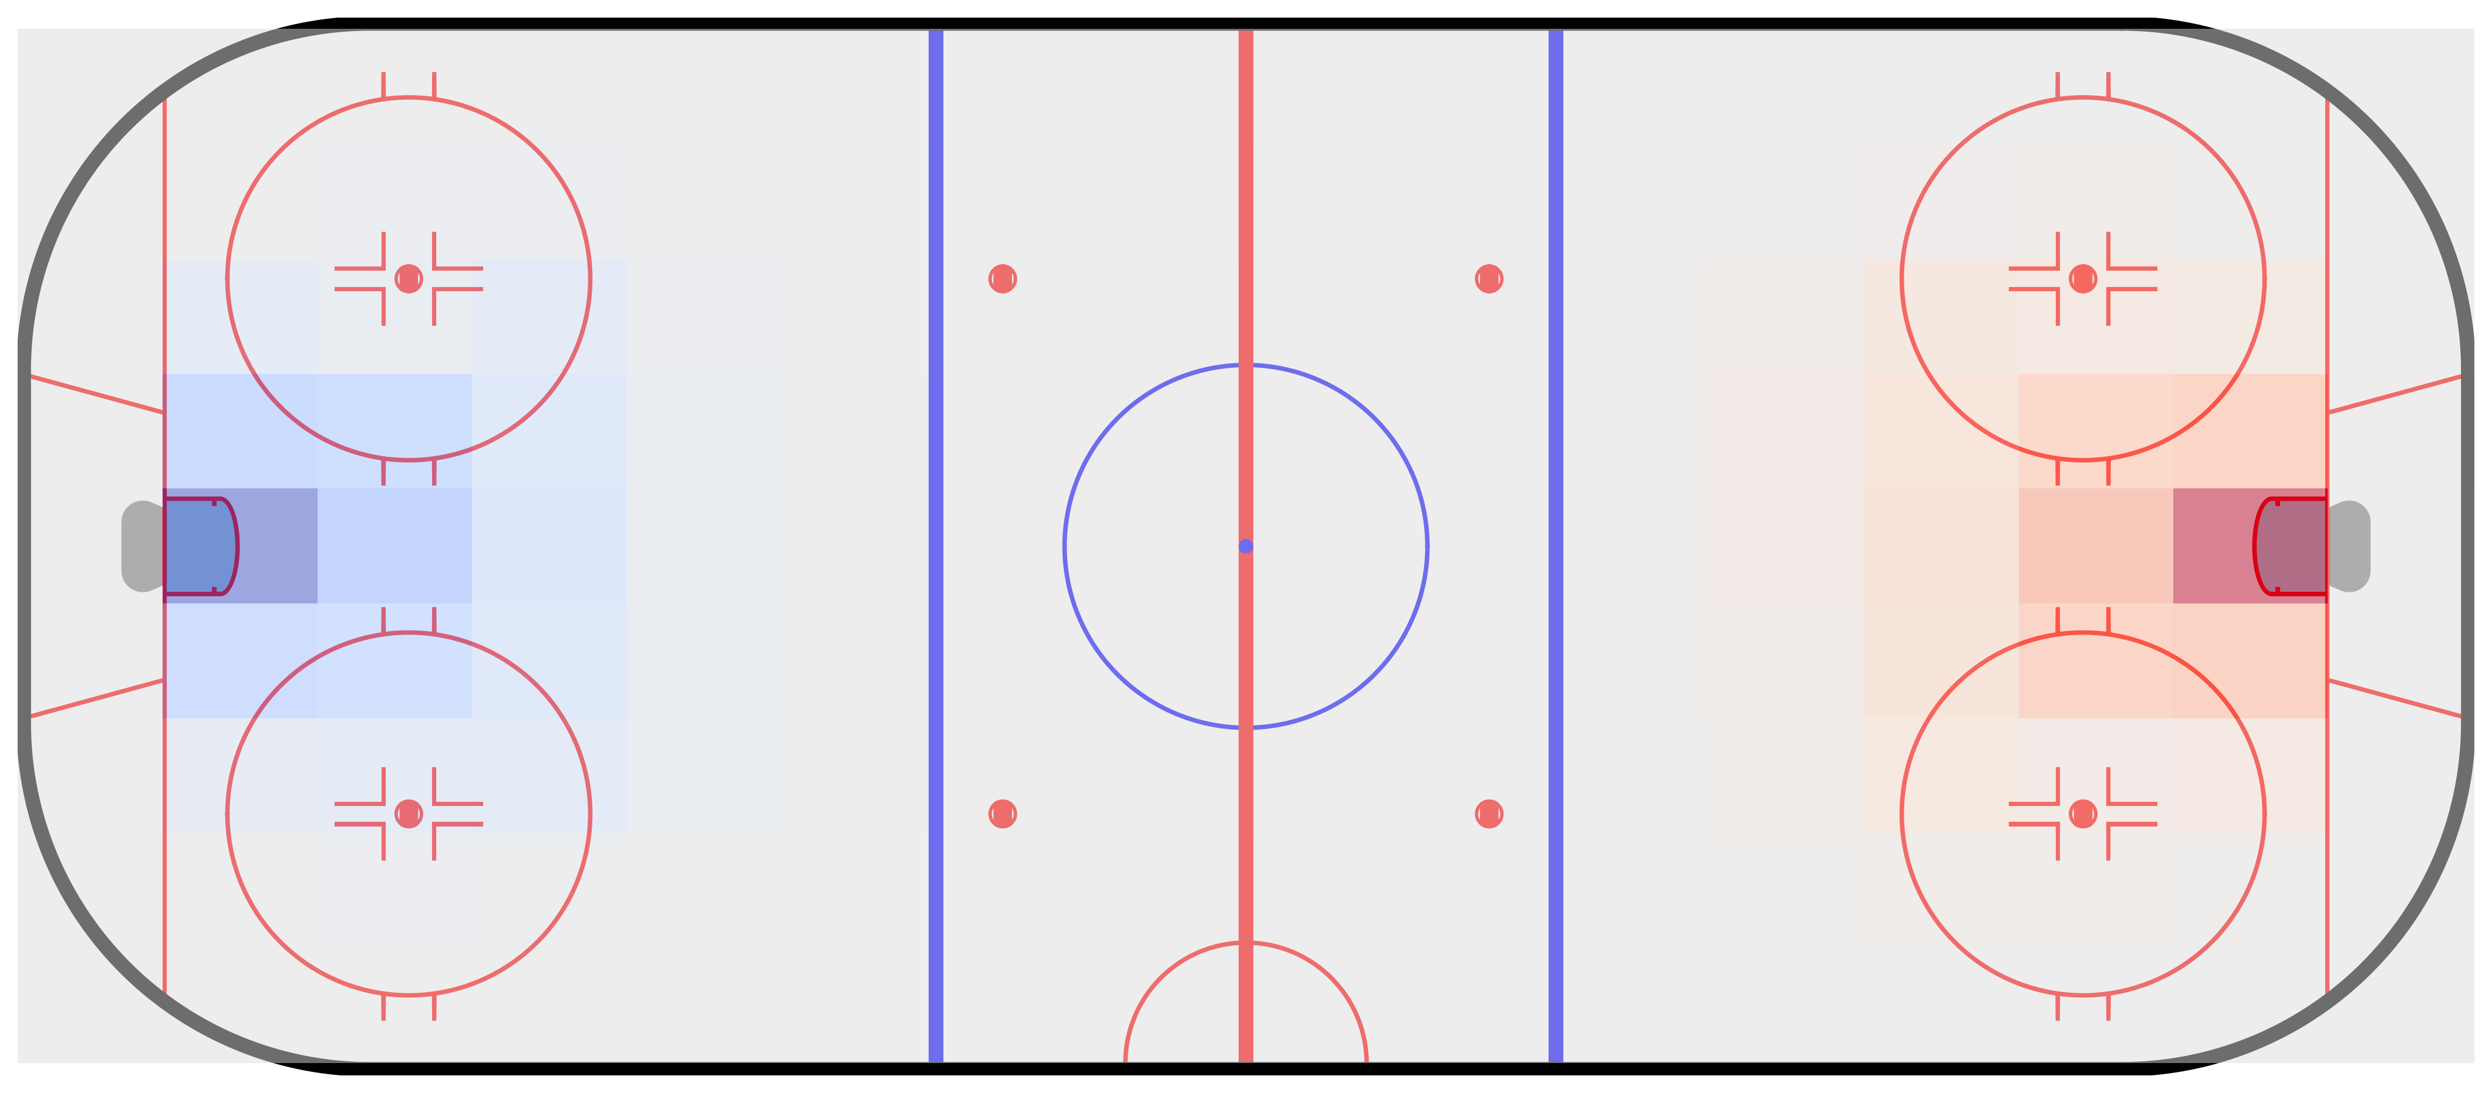
6
Expected threat
Adapted from its original application in soccer metrics
Allows us to assess the likelihood of scoring opportunities leading to specific offensive plays.
Quantifying the probabilities of transitions between events to calculate the offensive threat
Flipped negative values of offensive threat to obtain defensive threat.
Net threat is summation of offensive and defensive threat.
Fig. 2. Expected threat matrix at different position of rink
Photo by Pexels

Slide 7
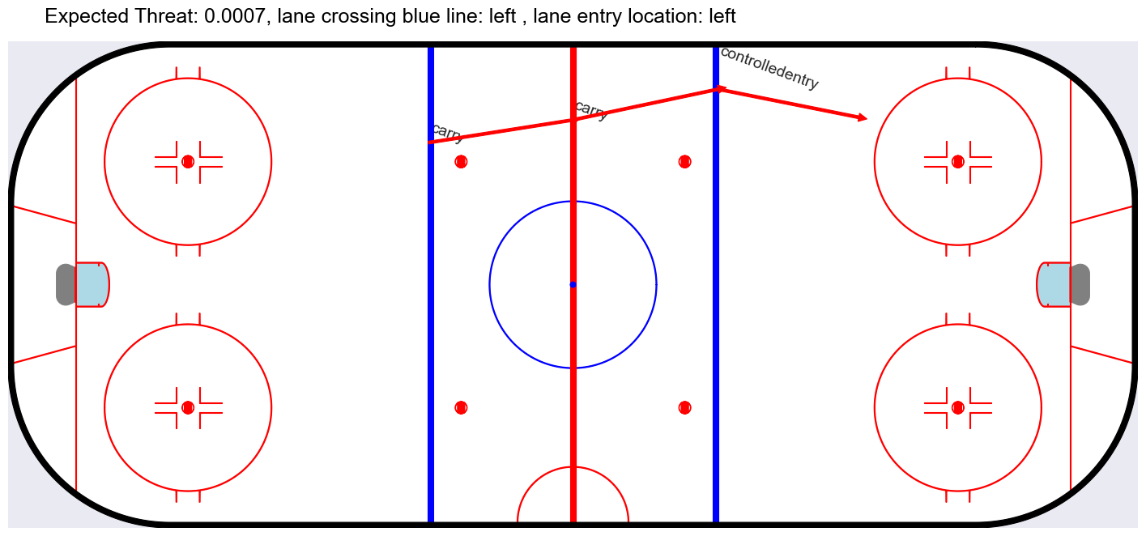
7
Entry sequence analysis
A custom method that is employed to analyse entry sequences.
This includes tracking the puck possession and events such as Pass and Carry, leading to controlled zone entries.
The methodology involves data preprocessing to isolate entry sequences.
Fig. 3. An example entry sequence into offensive zone
Photo by Pexels

Slide 8
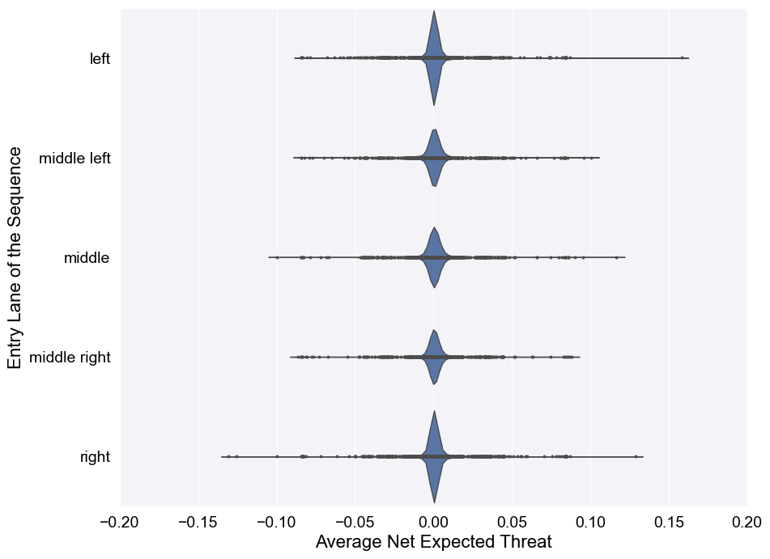
8
Result
Fig. 4. Violin plot with Average expected threat for different lanes
Photo by Pexels

Slide 9
9
Lanes | Xt for Pass
Middle | 0.002503
Middle Left | 0.001492
Middle Right | 0.001092
Right | 0.000332
Left | 0.000048
Lanes | Xt for Carry
Right | -0.000411
Left | -0.000466
Middle Left | -0.01649
Middle Right | -0.002539
Middle | -0.009637
Table1: Xt for Pass on different lanes
Table2: Xt for Carry on different lanes
Photo by Pexels

Slide 10
10
Conclusion
Offensive zone entry through centre of rink while passing, possess high threat on opposition. However, making offensive zone entry while carrying the puck induce a risk of losing possession.
Photo by Pexels

Slide 11
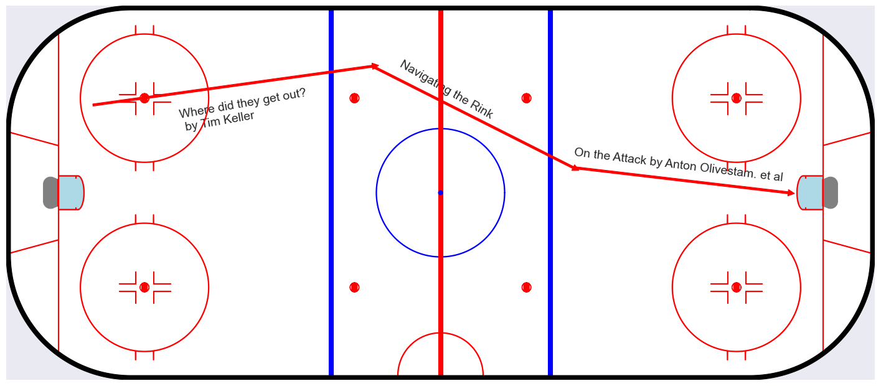
11
Future work
What happen after Zone entry?
How can we convert a Zone entry to a successful goal?
How can teams can reduce risk of penalties?
Fig. 5. A Example Attacking sequence after combining three different research
Photo by Pexels

