Slide 1

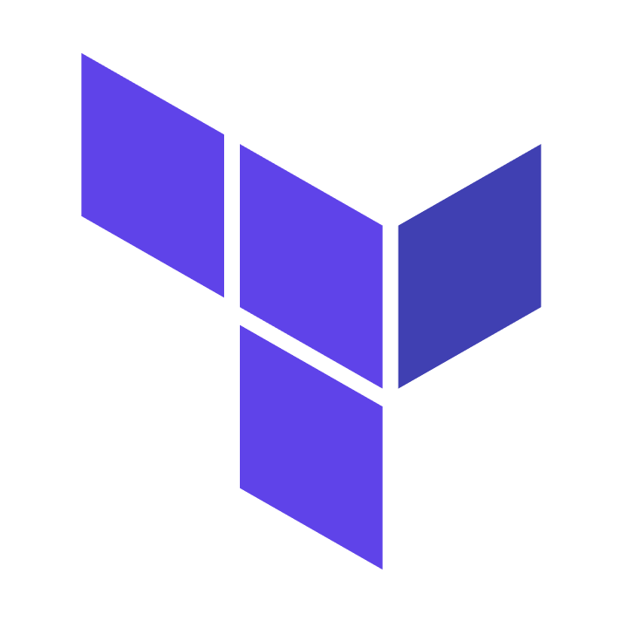

Priyansh Gupta
SDE 1 at AIS

Slide 2
Terraform ?
Terraform is an open-source tool used for deploying, managing and versioning our infrastructure
Can manage existing and popular cloud service providers as well as custom on-premise solutions.
Terraform can manage both low-level components as well as high-level components

Slide 3
Alternatives of Terraform
Azure ARM Templates
Azure Bicep
AWS Cloud Formation
Salt stack
Ansible

Slide 4
Advantage of Terraform :?
Easily portable
Works with multiple cloud providers.
Uses a declarative syntax
Maintains a .tfstate, making it smart enough to deal updates, deletion, and failovers.
Can do orchestration and configuration of resources
Supports Client only architecture

Slide 5
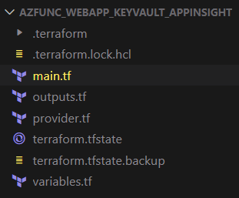
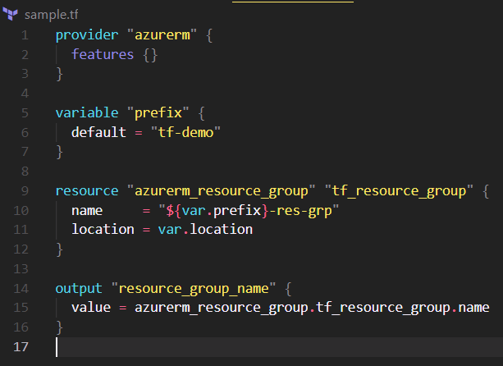
Components of a .tf config files
Fig 1:
Module and State
Module
Provider
State
Resources
Variables
Output
Fig 2:
Terraform configuration

Slide 6
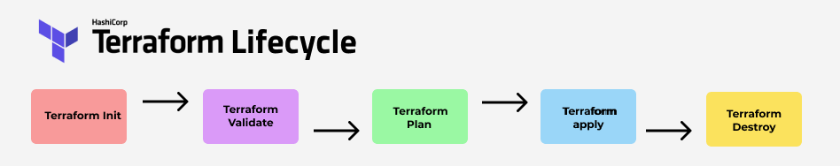
Terraform Lifecycle

Slide 7
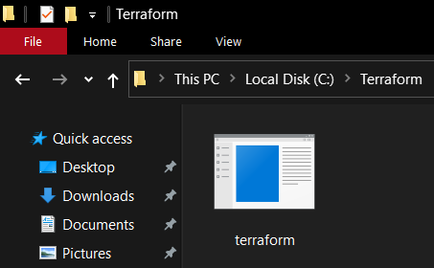
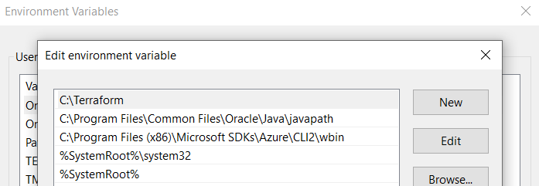
How to install Terraform locally
Step 1: Download the terraform executables from the below mentioned link
Link to blog: https://learn.hashicorp.com/tutorials/terraform/install-cli
Step 2: Extract this folder in C:// drive in a new folder named Terraform
Step 3: Add this folder path to your environment variables
You are good to go now !!
To verify your installation, open a CMD and type “terraform –version” and it will show terraform version installed

Slide 8
Pre-requisite for hands-on exercise
Azure Subscription
Link: https://bit.ly/3yqFopo
Terraform CLI installed locally
Link: https://bit.ly/3dNVOQF
Azure cloud shell
Link: https://bit.ly/36mwInH
Azure Cli
Link: https://bit.ly/36mwInH
Vscode
Link: https://bit.ly/3qMh1zC

Slide 9






Resources deployed in this hands-on demo
Storage Account
Key Vault + Secret
App Service Plan
Resource Group
App Service
App Function

Slide 10
Let’s do hands-on now :!

