Slide 1
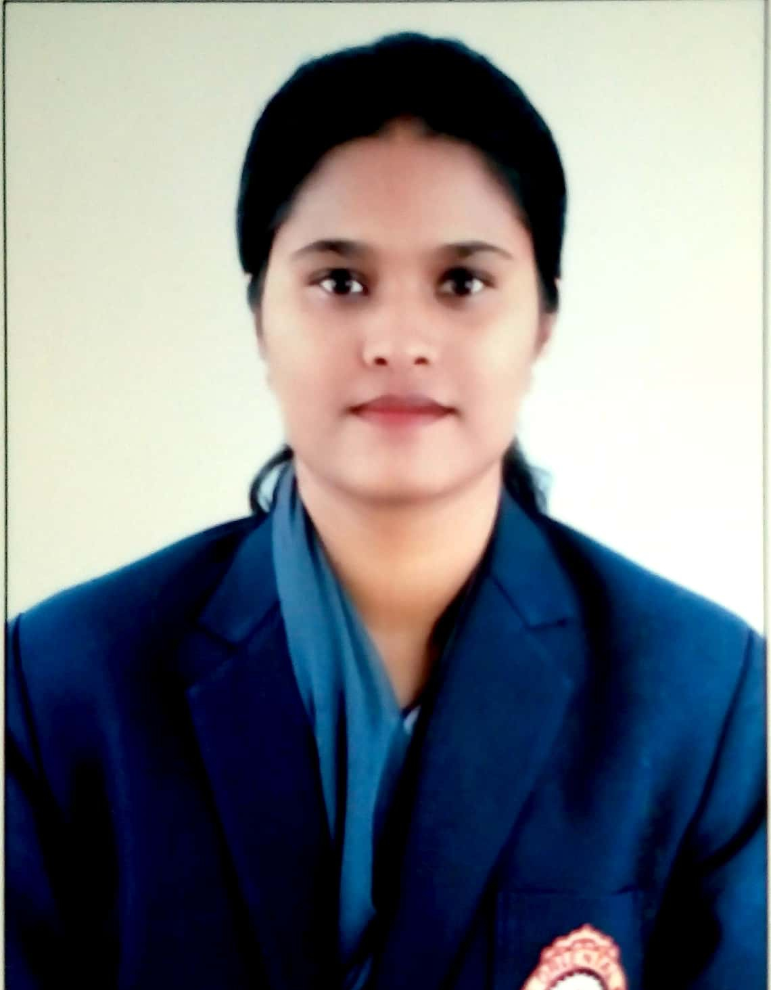

Priyanshi Singh
Analyst/Software Engineer
Bachelor of Engineering
Computer Science : 2016 - 2020
Skills Java 8 /J2EE
Spring Boot
Spring MVC
JPA CRUD
Bootstrap
Angular
Database
No SQL database – MongoDB
Web Technologies
HTML5
CSS3
Javascript
AddOns
Github
Maven
Postman
Additional Details
Leadership
Excellent Communication Skills
Team management
Bangalore
priyanshi.singh@capgemini.com
+91 9893284442
A4
Software Engineer who is Strong in design and integration with intuitive problem-solving skills. Passionate about implementing and launching new projects.
Ready to learn new technologies and implement them to further improve my knowledge.
Eager to work in a team of dedicated people and serve a key role in the enhancement and development of the project.
Has working knowledge on Angular and Java Microservice Development using Spring framework on an intermediate level.
Hands On experience in creating Spring Boot, Spring Security, Zuul Api Gateway, Eureka Server.
Hands on experience in connecting Mongo DB with Spring and Spring with Angular.
Online Flight Booking System
Completed end to end case study of Shopping Cart Application along with JWT authentication, Swagger and payment testing using SpringBoot. Angular Material-UI and React Bootstrap used for user interface.
HTML CSS JAVASCRIPT for web developers at Degreed
Completed this course with 98.6% and Designed responsive Restaurant website using HTML5 CSS3 Bootstrap and Javascript
Angular, Spring Boot and MongoDB
Learned and completed all the concepts of Frontend, Middleware and Backend at Capgemini Degreed Platform.
Check out my work on GitHub

