Slide 1
ONLINE JOB PORTAL
Guided by :
Ms.Deepa Basantani
Presented by :
Anubhav Dagar(cse)
Arjun Chaudhary(cse)
Anukriti Vashishth(cse)
Jyoti(cse)
Priyanshi Tyagi(cse)

Slide 2
ABSTRACT
This paper presents the design and implementation of Online Job Portal.
… The importance of placement system is increasing day by day. Thousands of applicants are depending on the placement cell. But the applicants are facing so many problems. This project is an attempt to minimize the problems of an applicant to find a correct job.
… The job seekers can put their whole details and they can view, which helps them to modify. Through this they can edit their qualification. They can apply to their needed post.
… The job providers can give the details clearly of their need. They can post the matched candidates for
their company through this job portal. The user can modify or edit their details and needs.

Slide 3
->Modules :
-- Job Seeker Module:
… This module provides functionalities for job seekers. Applicants can post their resumes with personal
and professional details. They can also update the resume as frequently as required. The applicant can
also browse through the present vacancies available. Job seekers can also get mail alerts when their
resumes are selected by employers.

Slide 4
… Employer Module:
… This module provides functionalities related to employers. Employers can post vacancy details and
update the details as and when necessary. Employers can search through applicant resumes based on
different criteria.
…Employer need to pay certain amount per month to the site administration for posting there jobs on
the site. All this functions will be handled by the administration module.
…Administration Module:
…This module provides administrator related functionalities. Administrator manages entire application
and maintains the profiles of applicants and employers.

Slide 5
… “Job-a-Fair” is a web-based application, which brings the right recruiters and right
job seekers meet.
… Computerized online Job Search System is developed to facilitate the General
Administrative system.
… There are many respective facilities given to :
... Employer :
1. Create/Edit Profile Information
2. Post Job vacancies.
3. Select Employee as per requirement match.
…Employee :
1. Search preferred job as per his area of interest.
2. Apply for a job
3. EDIT information and update CV.

Slide 6
Literature survey-Existing System
… “Naukri.com”, “Shine.com”, etc . brought the revolution of
transforming traditional way of job search into technological
advancement called “Online job Portal”.
… Initially, less number of trusted clients and improvement through
advertisements and branding.
Demerits :
1. No value for money services.
2. Increased unwanted duplication in Job Posts.
3. Lack of preferred advance search option.
4. Increased Spam mails.

Slide 7
LOGIN
Literature Survey-proposed System
Job Seeker
Company
LOGIN
Choose Field
Company Requirement
Advance
Filtering
For Job seeker
STORED
STORED
Registration Table
MATCH
Record Table
Details Of candidate sent to company representative

Slide 8
Literature Survey:PROPOSED SYSTEM
1. Simple and professional GUI for users of all qualification groups.
2. Increased filtering for employees seeking job as a Fresher Or as an
Experienced individual.
Advantages :
1. No cost, Cost effective service.
2. Cover letter
3. 24 X 7 Online support system for employee as well as employer.
4. No duplication of Jobs.
5. SPAM REPORTING

Slide 9
SOFTWARE REQUIREMENT
…Tomcat Server
…Editor :Eclipse java
…HTML 5
…CSS 3
…JEE
… MySql (Backend)

Slide 10
APPLICATION
…Can be used widely by Job seekers to find suitable job.
…Can be accessible on Tabs and PDA’s.
…Online recruiting allows far better targeting of candidates than does
advertising in general newspapers, resulting in a greater percentage of
qualified applicants.
… Offer and demand could be automatically matched and a ranking of best job
positions and candidates obtained , by considering also concepts not explicitly
mentioned by the end users.
…As non-IT students are not concerned with the in-depth knowledge
regarding the information or web technology but are fairly concerned with using
…the technology, the proposed system is highly user-friendly.

Slide 11
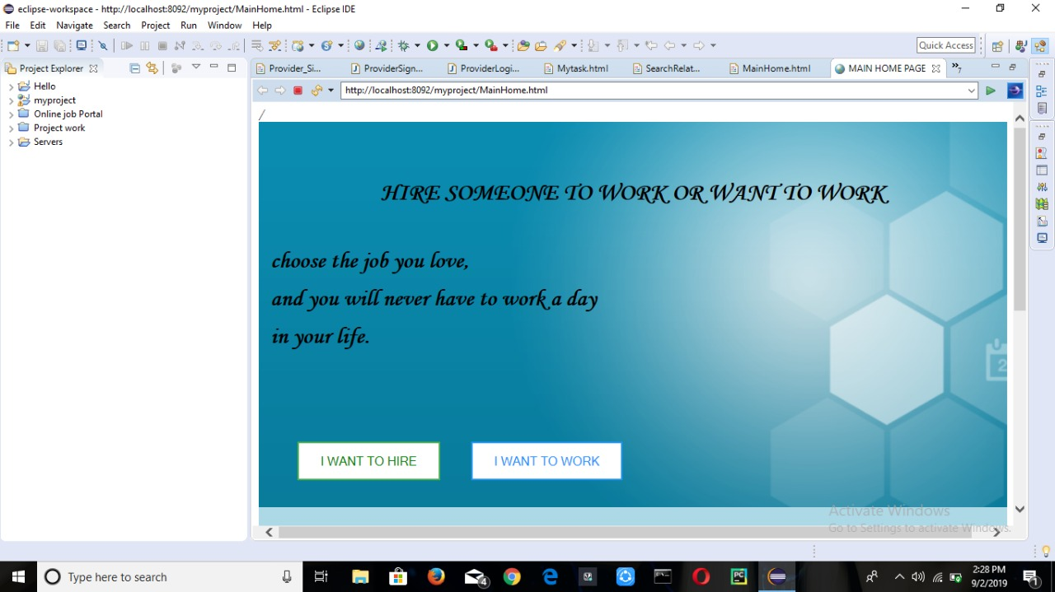
HOME PAGE

Slide 12

LOGIN for Job Seeker

Slide 13
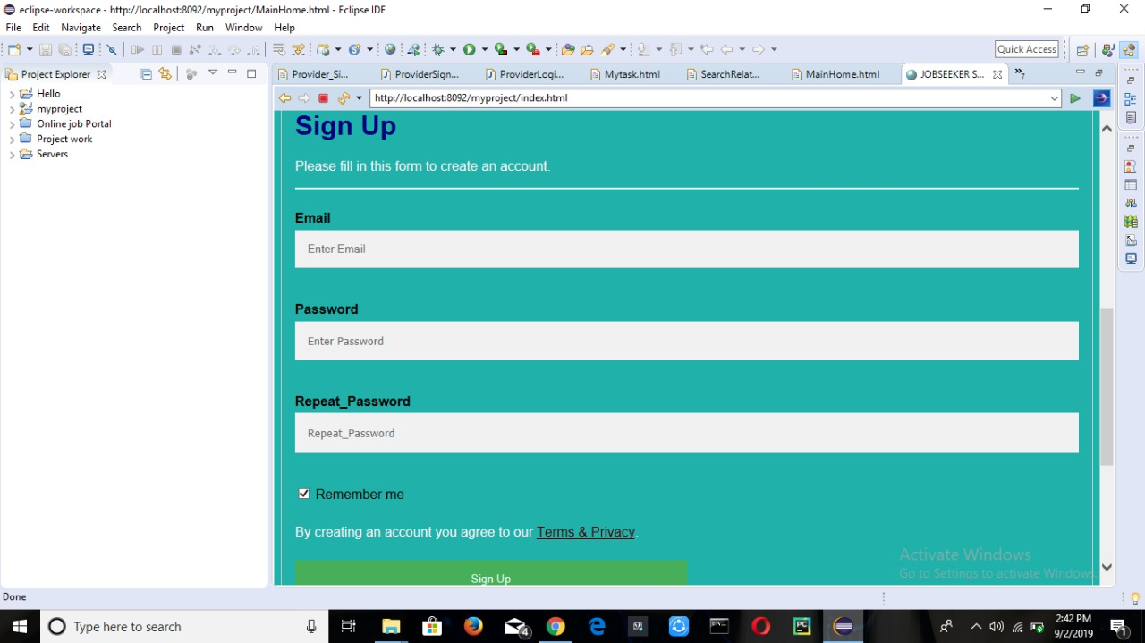
SIGN UP PAGE FOR JOB SEEKER

Slide 14
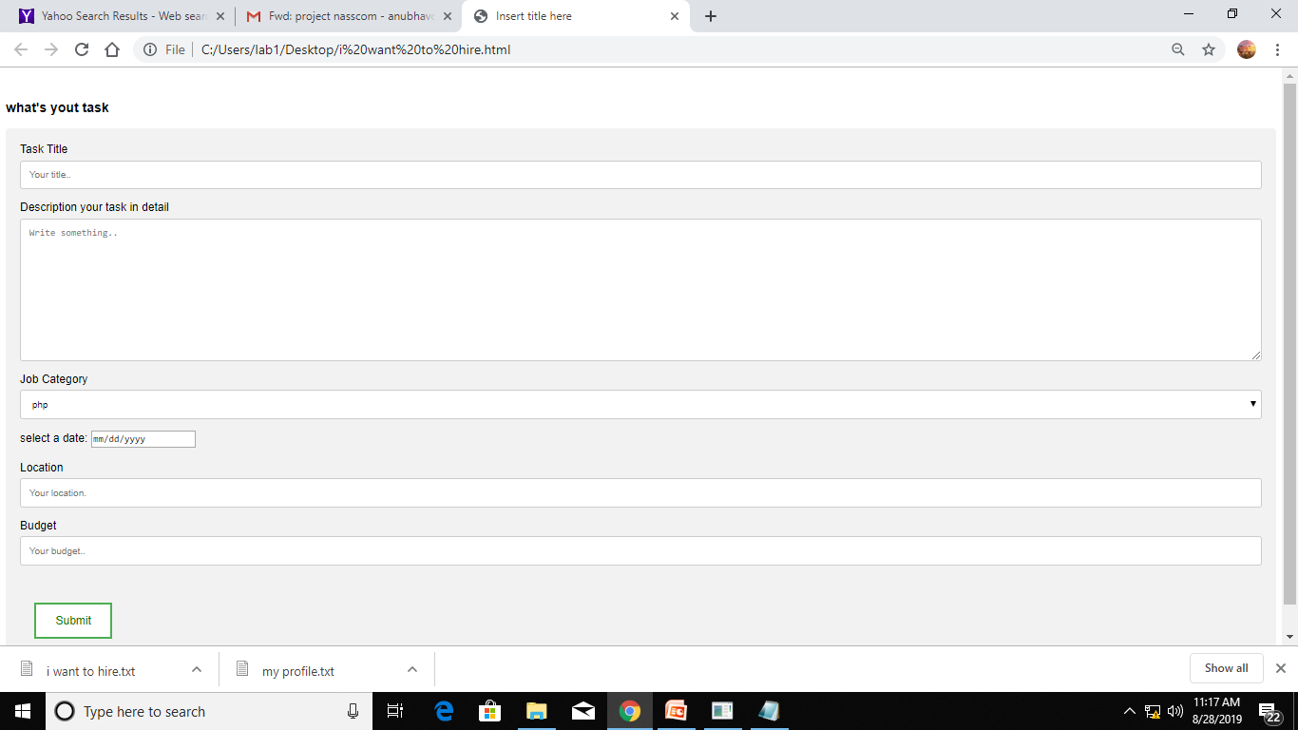
I WANT TO HIRE

Slide 15
CONCLUSION
…Job matchmaking is an important issue in today’s global, distributed and heterogeneous market. We have briefly explored how available technology
can possibly help how job recruitment and job seeking processes are
implemented.
We strongly believe that, due to its high social impact, research has
to look with “Job Matchmaking” not only with the goal to propose advances
in the scientific knowledge, but because this is an application area capable of
bringing direct and immediate benefits to humanity.

Slide 16
THANK YOU

