Slide 1

Urban Environment and Perceived Safety in Cities
Applied Data Science
by Shalmali, Patrick, Akshay, Achilles, Priyanshi

Slide 2
PROJECT BRIEF
Fact - Social science literature has shown a strong connection between the visual appearance of a city’s streets and the behavior and health of its citizens.
Question? What makes people feel that a street is safe, and what do those perceptions tell us about different streets, neighborhoods or cities?
Why? - The quality of our surroundings – is it down to the architecture, the width of the street, the amount of greenery? Or are there other, subconscious factors at play on our perceptions?
Objective? The study explores the elements of physical environment and contributes to the perceived safety of the streets, neighborhoods and cities

Slide 3
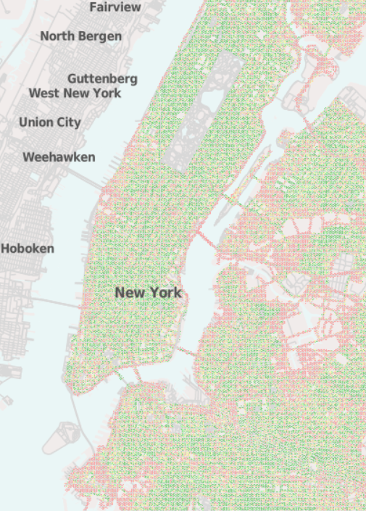
APPROACH
Data Science Problem Solving Approach
Data Identification
Data Collection, Data Wrangling*
Exploratory Data Analysis
Supervised Learning Techniques
Multi-variate Regression

Slide 4


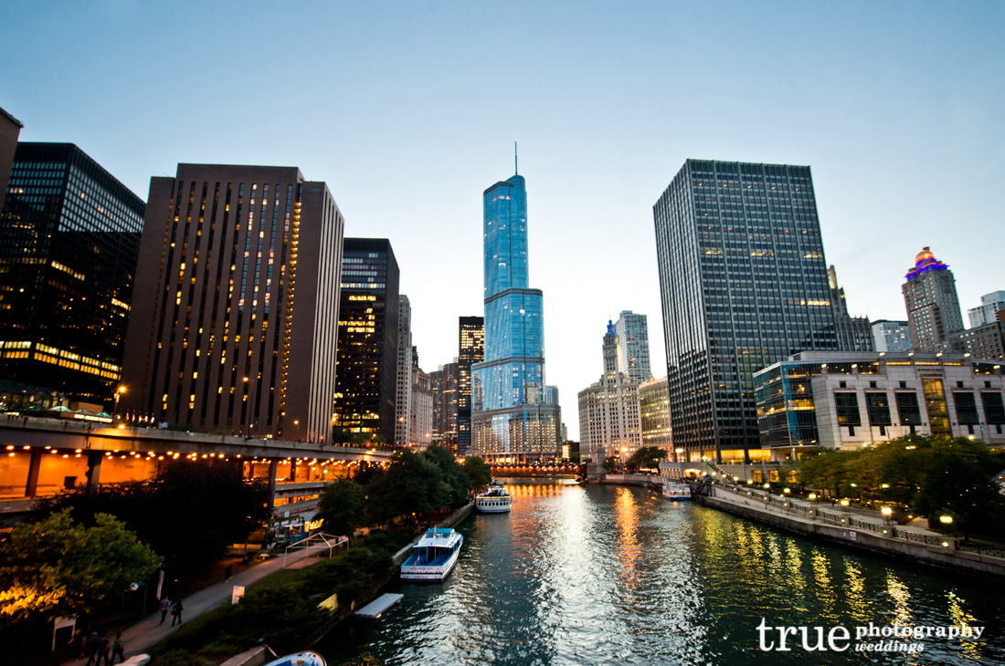

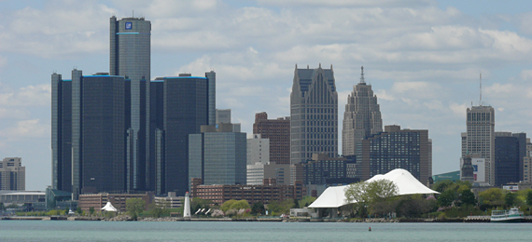
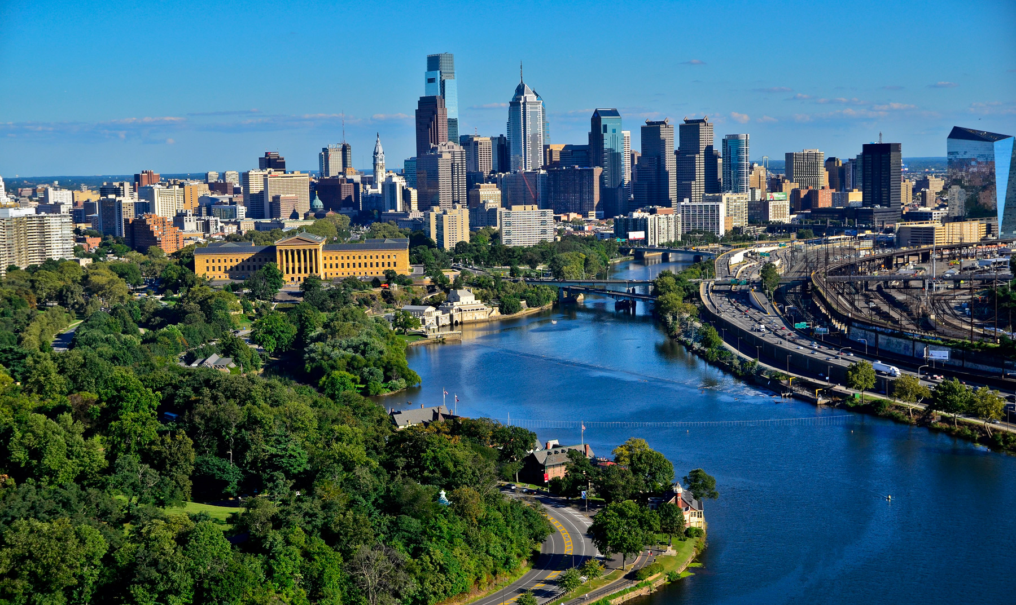
OPEN DATA
MIT Media Lab
Datasets identified:
Census Data
Crime Data
Road Incidents Data
Economic Data
Pedestrian Count Data
New York
Boston
Chicago
Detroit
Philadelphia

