Slide 1
IBM PBEL 3.0 INTERNSHIP PROGRAM
SMS-SPAM
DETECTOR
Using Machine Learning to Detect
Spam and Ham Messages
Presented by
PRIYANSHI SHARMA

Slide 2
Introduction Spam SMS messages are unwanted messages that usually contain fake offers, lottery scams or harmful links. These messages waste time and can sometimes lead to fraud. Machine Learning helps in identifying these messages automatically. 1.Spam messages are common. 2.Manual filtering takes time. 3.Machine Learning improves accuracy. 4.This project detects Spam and Not Spam messages.
Hi Priyanshi,
See you tomorrow!
Congratulations!
You won ₹50,000.

Slide 3
Problem Statement
Spam SMS messages are increasing rapidly.
Some messages contain fake offers and scams.
Manual filtering is time-consuming.
A smart system is needed to detect spam automatically.
💡 Solution
Use Machine Learning to classify SMS messages into Spam and Not Spam automatically.

Slide 4
Objectives
🛡️ Detect Spam Messages
Identify unwanted SMS messages automatically.
📩 Detect Normal Messages
Classify genuine SMS messages correctly.
⚡ Fast Prediction
Generate results within a few seconds.
📊 Display Confidence Score
Show the prediction confidence.
📝 Save Prediction History
Store recent prediction results.
💻 Simple User Interface
Provide an easy and user-friendly interface.

Slide 5
Technologies Used
Python
Programming Language
Used to develop the complete Machine Learning application.
Flask
Web Framework
Used to build the backend and connect the model with the website.
Scikit-learn
Machine Learning Library
Used to train and test the Naive Bayes model.
Pandas
Data Processing
Used to load, clean and manage the SMS dataset.
HTML
Frontend Structure
Used to create the structure of the web pages.
CSS
User Interface Design
Used to design and style the website.
Naive Bayes
Classification Algorithm
Used to classify SMS messages as Spam or Not Spam.

Slide 6
Project Workflow
1
2
3
4
5
6
7
🧹
User
Input Message
Text Processing
CountVectorizer
Naive Bayes Model
Prediction Result
Save History
User enters an SMS message.
User enters
an SMS.
Clean and
prepare the
text.
Convert text
Into
vectors.
Predict Spam
or Not Spam.
Show the
result and
confidence.
Store the
prediction
history.

Slide 7
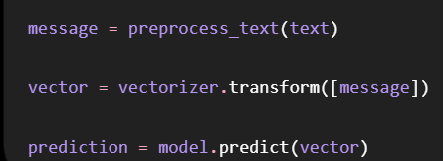
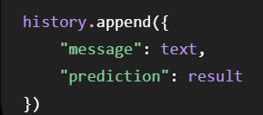
Code Explanation
Model Prediction
Cleans the input message.
Converts text into numerical features.
Predicts Spam or Not Spam.
Save Prediction
Stores the message.
Saves the prediction result.
Display it in the history table.

Slide 8
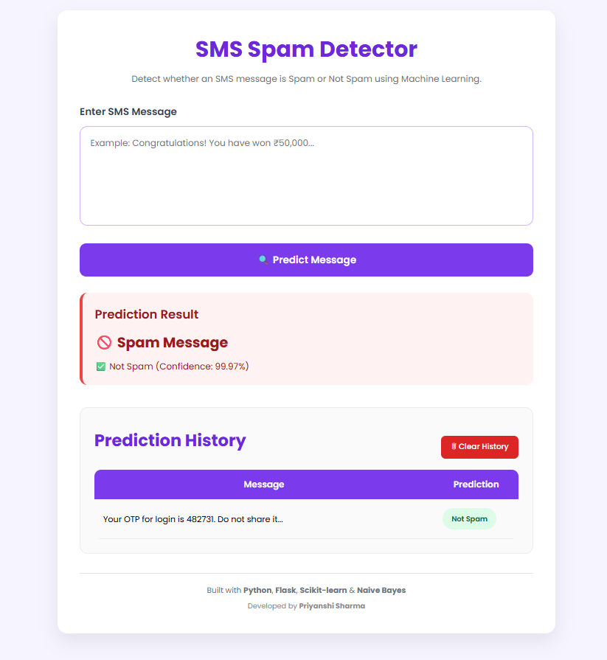
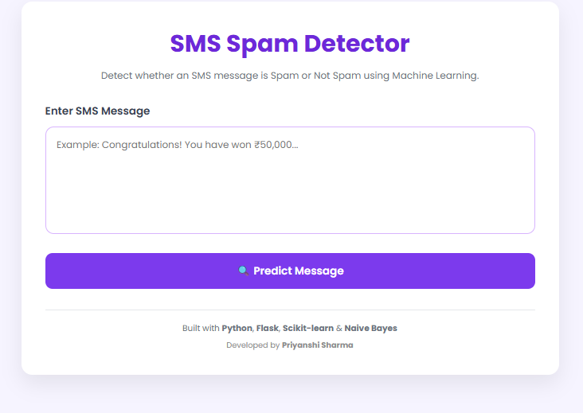
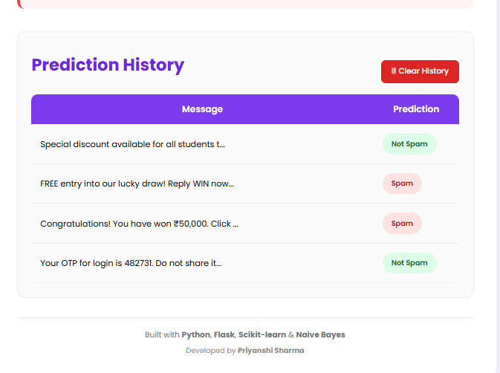
Project Screenshots
Prediction
Home Page
History saved

Slide 9
Result
Model Accuracy
98%
High prediction accuracy on the test dataset.
Timer
Real-Time
Results
Generates results within a few seconds.
98%
Overall Accuracy
Successfully detects Spam messages.
Correctly identifies Normal(Not Spam) messages.
Displays prediction confidence score.
Saves recent prediction history.
User-friendly and easy to use interface.

Slide 10
Future Scope
📧 Email Spam Detection
Extend the system to detect spam emails.
🌍 Multi-language Support
Support SMS messages in multiple languages.
📱 Mobile Application
Develop an Android or iOS application.
☁️ Cloud Deployment
Deploy the project online for public use.
🧠 Deep Learning Models
Improve accuracy using advanced AI models.
🗄️ Database Integration
Store prediction historyq in a database.

Slide 11
Conclusion
The SMS Spam Detector successfully classifies SMS messages as Spam or Not Spam using the Naive Bayes algorithm. It provides fast predictions through a simple web interface and stores recent prediction history. This project shows how Machine Learning can be used to solve a real-life problem in a simple and effective way.
Detects Spam and Not Spam messages accurately.
Provides fast and reliable predictions.
Stores recent prediction history.
Simple and easy-to-use web application.

Slide 12
Thank You

