Slide 1

Focus Detection for ADHD / Learning Disorders
School of Computer Science and Engineering
Department of Computer Science and Engineering
Submitted By:
PRIYANSHI SHARMA
2427030746
Supervised By:
AMIT KUMAR SIR

Slide 2
Presentation Roadmap
Introduction
Literature Review
Problem Statement
Proposed Solution
Objectives
Experimental Results
Achievements & Future Scope

Slide 3
Introduction
Background
• Cognitive overload reduces comprehension and increases mental fatigue.
• Traditional learning platforms do not adapt to real-time attention levels.
Gap
• Existing solutions rely on expensive EEG or eye-tracking hardware.
• There is a need for a low-cost, accessible alternative.
Our Approach
• Develop a browser-based behavioral monitoring system
• Estimate focus and cognitive load using interaction patterns

Slide 4
Literature Review
Study 1: EEG-based Focus Detection in E-learning (Smith et al., 2022) – achieved 85% accuracy in predicting learner attention using brainwave signals.
Study 2: Eye-Tracking for ADHD Learners (Chen et al., 2021) – identified visual focus loss patterns that correlate with task disengagement.
Study 3: Cognitive Load Theory in Learning Design (Sweller, 1988) – provided the theoretical foundation for adaptive learning based on mental effort and working memory.

Slide 5
Study 4: EEG and eye-tracking studies have demonstrated that physiological indicators like brain waves, blink rate, and gaze patterns can be used to measure cognitive load and attention levels (Assessing Cognitive Load Using EEG and Eye-Tracking, MDPI, 2025: https://www.mdpi.com/2414-4088/9/9/99).
Study 5: According to research, people with ADHD exhibit more performance variability when faced with a higher cognitive load (Cognitive and Perceptual Load Effects in ADHD, Network Neuroscience, 2023: https://pmc.ncbi.nlm.nih.gov/articles/PMC10727773/)
Study 6: Non-invasive methods for identifying attention states include behavior-based techniques like tracking eye movement, interaction patterns, and task engagement (Measuring Attentional Distraction with Eye-Tracking, PubMed, 2022: https://pubmed.ncbi.nlm.nih.gov/35601272/).

Slide 6
Problem Statement
During learning tasks, students with learning disorders and ADHD experience increased cognitive load and erratic attention. Real-time systems to identify attention lapses or mental overload are absent from current educational platforms. EEG and eye tracking are examples of physiological detection systems that are too expensive and impractical for general use.
In order to enhance learning outcomes, a low-cost, non-invasive system that uses behavioral signals to estimate focus and cognitive load and offers adaptive feedback is required.

Slide 7
Objectives
Main Goal: Design a system that detects when attention drops or cognitive load increases, and responds accordingly.
Specific Objectives:
1. Monitor physiological and behavioral indicators of focus.
2. Provide real-time feedback or environmental adjustments.
3. Enhance engagement and reduce cognitive fatigue.

Slide 8
Proposed Methodology
Step 1: Data Collection
Behavioral data is collected from the user during learning tasks, such as:
Typing speed
Mouse movement
Idle time
Tab switching frequency
Software / Tools Used:
HTML (for webpage interface)
CSS (for layout design)
JavaScript (for tracking keyboard, mouse, and tab activity)
Browser APIs (visibility API for tab switching detection)

Slide 9
Step 2: Feature Analysis
The collected behavioral signals are analyzed to identify patterns that indicate:
Focused state
Attention lapse
Cognitive overload
Software / Tools Used:
JavaScript logic functions
Browser event listeners

Slide 10
Step 3: Focus Score Calculation
A rule-based scoring mechanism is applied to compute a Focus Score based on:
Interaction frequency
Inactivity duration
Distraction indicators
Step 4: Cognitive Load Estimation
Cognitive load level (Low / Medium / High) is estimated based on behavioral patterns and engagement changes.
Software / Tools Used:
JavaScript conditional logic
Threshold-based classification

Slide 11
Step 5: Adaptive Feedback
The system provides real-time feedback such as:
Break suggestions
Attention alerts
Content simplification
Interactive prompts
Software / Tools Used:
JavaScript alert functions
CSS animations
HTML pop-ups or modal boxes

Slide 12
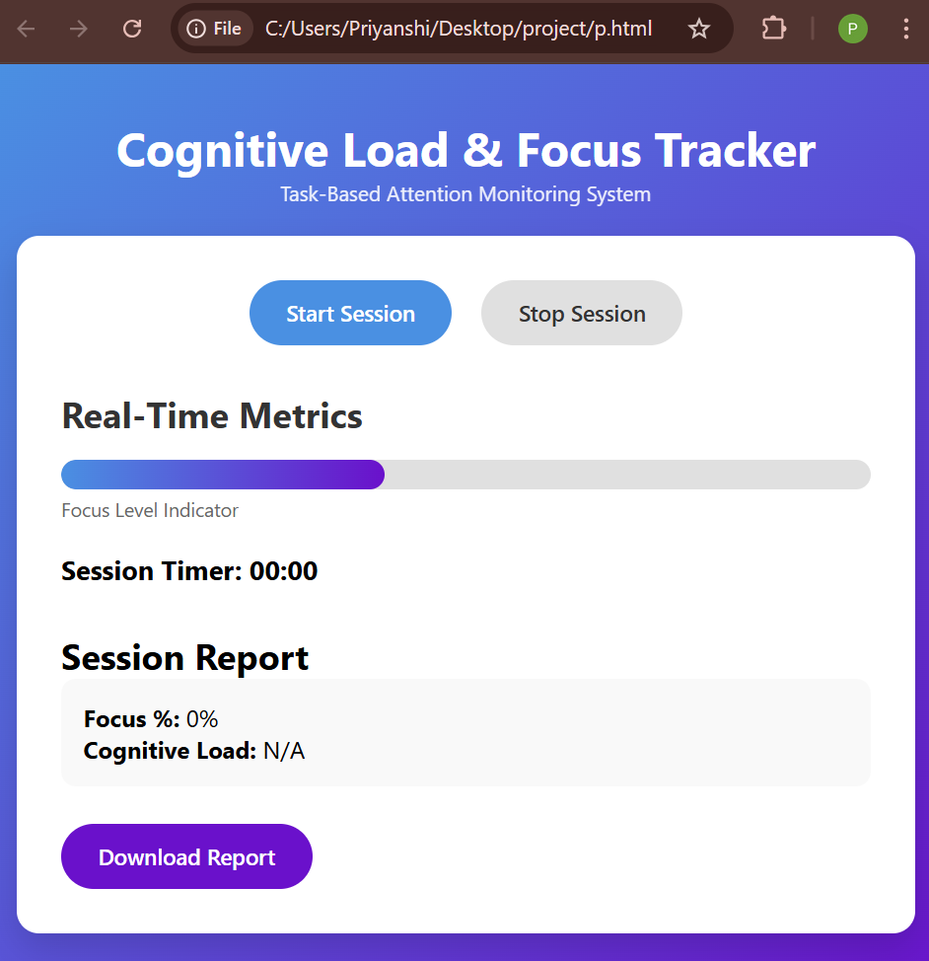
Result

Slide 13
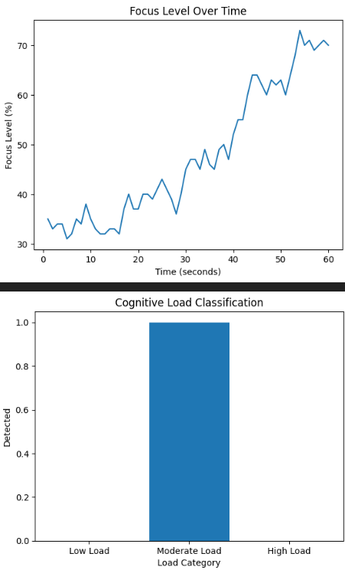
Focus Level Over Time
– Shows how focus changes during the session
– X-axis → Time (seconds)
– Y-axis → Focus %
Cognitive Load Classification
– Shows detected load category
– Based on final focus value
Result will be downloaded as the following graphs

Slide 14
Outcome
Achievements Completed in Current Semester
Working UI Prototype Developed
  Designed and implemented a responsive front-end interface using:
  Created a professional dashboard-style layout.
Data Visualization
  Generated graphical representation of:
    Focus level over time
    Cognitive load classification
  Used plotting techniques to visualize session performance.
Git Version Control Integration
  Project structured and updated using Git.
  Version tracking implemented for incremental improvements.

Slide 15
Outcomes to Be Achieved by Next Semester
Real-Time Sensor Integration
Integration of real-time biometric or behavioral data:
  Eye tracking
  Keystroke analysis
  Attention monitoring techniques
  Improve accuracy of focus detection.
Automated Report Generation
Generate downloadable PDF session reports.
Include performance summary and analytics.

Slide 16
Conclusion & Future Scope
• Cognitive Load Detection can transform how ADHD and learning disorders are managed.
• Future developments:
- Emotion-aware AI tutors
- Non-invasive
• Goal: Create a more inclusive, personalized, and effective learning environment.

Slide 17
Thank You

