Slide 1
JK Lakshmipat University, Jaipur
Health Risk Analysis using
Machine Learning & Environmental Data
Minor Project — End Term Presentation
Presented By
Supervisor
Department
Priyanshi Mehta
2023Btech061
Dr. Amit Sinhal
Dept. of CS&E
CS & AI Engineering
April 2026
Keywords: AQI Forecasting • CNN-BiLSTM • XGBoost • Streamlit Dashboard • Real-Time Integration

Slide 2
Presentation Outline
01
Abstract & Introduction
05
Results & Dashboard
Problem, motivation, objectives
Live AQI, forecasts, health advisory
02
Literature Review
06
Key Findings
Gap analysis of 5 research papers
City rankings, pollutant analysis
03
Dataset & Methodology
07
Conclusion & Future Scope
26 cities, 44 features, pipeline
Summary and next steps
04
Model Architecture
CNN-BiLSTM + Attention + XGBoost

Slide 3
Abstract & Problem Statement
Abstract
Air pollution is a critical public health challenge in Indian cities. This project proposes an end-to-end intelligent system for AQI forecasting and personalized health risk analysis using a hybrid CNN-BiLSTM model with temporal attention, trained for 26 Indian cities. Live data from OpenWeatherMap and Open-Meteo APIs powers a Streamlit dashboard delivering 7-day hourly forecasts and personalized health advisories.
Problem Gaps Addressed
Our Solution
Existing systems focus on historical analysis — no city-specific forecasts
(a) City-specific deep learning models for AQI forecasting
No personalized health guidance for vulnerable groups
(b) Live environmental data for real-time monitoring
Single-location models — lack multi-city coverage
(c) Personalized health advisories via interactive dashboard
No real-time integration with live environmental APIs
(d) Covers 29 Indian cities with hourly 7-day forecasts

Slide 4
Literature Review
Paper / Author | Methodology | Limitations / Gap
Gupta & Kumar (2023) | ML models for AQI prediction | Limited models, no deep learning
Kumar et al. (2024) | Regression-based PM2.5 prediction — Delhi | Location-specific, no hybrid models
Singh & Suthar (2025) | Random Forest + Linear Regression — Jaipur | No real-time prediction
Zhang et al. (2020) | LSTM deep learning for pollution prediction | High complexity, low explainability
Devarakonda et al. (2018) | SVM, Decision Tree — real-time AQI | Limited features, no health risk analysis
▶ Gap Identified: No existing system provides multi-city AQI forecasting + personalized health advisory + real-time live integration together.

Slide 5
Dataset Description
842,015
26
44
2022–2025
Records (after cleaning)
Indian Cities
Input Features
Data Period
Feature Categories (Source: CPCB Air Monitoring)
Location
City, State, Latitude, Longitude
Atmospheric
Pressure_MSL_hPa, Surface_Pressure_hPa
Time
Datetime, Year, Month, Day, Hour, Day_of_Week, Season
Solar/Cloud
Solar_Radiation, Cloud_Cover, Sunshine_Seconds
Weather
Temp_2m_C, Humidity_Percent, Dew_Point_C
Pollution
PM2.5, PM10, CO, NO2, SO2, O3 (µg/m³)
Wind
Wind_Speed_10m_Kmh, Wind_Dir_10m, Wind_Gusts_Kmh
AQI Indicators
US_AQI, EU_AQI, AQI_Category
Rainfall
Precipitation_mm, Rain_mm, Is_Raining
Special Conditions
Temp_Inversion, Festival_Period, Crop_Burning_Season

Slide 6
Proposed Methodology
01
Data Collection
02
Data Preprocessing
03
Feature Engineering
04
Model Training
CPCB air quality & weather data — 26 cities, 2022–2025
Forward/backward fill, datetime parsing, MinMaxScaler per city
44 features: cyclical time, lag (1–48h), rolling stats, interaction terms
CNN-BiLSTM + Attention (per city); XGBoost baseline; RF classifier
05
Live Data Integration
06
Dashboard Deployment
07
Health Risk Output
OpenWeatherMap + Open-Meteo APIs refreshed every 30 min
Streamlit dashboard: forecast, health advisory, AQI map, analytics
Personalized advisories by age, health conditions, planned activity

Slide 7
Model Architecture — CNN-BiLSTM with Attention
Input Layer
Training Configuration
48-hour sequence, 44 features
Loss Function:
Huber Loss (robust to outliers)
Conv1D Block
Optimizer:
Adam (lr=8e-4, grad clip=1.0)
2× Conv1D (64 filters, kernel=3) + BatchNorm + Dropout(0.2)
Early Stopping:
Patience = 12 epochs
BiLSTM Block 1
128 units bidirectional (256 combined) + Dropout(0.25)
LR Scheduler:
ReduceLROnPlateau (patience=5)
BiLSTM Block 2
Sequence Length:
48 hours (SEQ_LEN=48)
64 units bidirectional (128 combined) + Dropout(0.2)
Train/Val/Test:
80% / 10% / 10% split
Attention Layer
Dense(1,tanh) → Softmax → weighted context vector
Batch Size:
32 | Max Epochs: 120
Dense Head
Hardware:
Google Colab (GPU-accelerated)
128→64→32→1 (linear) with BatchNorm & Dropout
XGBoost Baseline: n_estimators=500, lr=0.05, max_depth=6, subsample=0.8 — trained for comparative benchmarking.

Slide 8
Random Forest Classifier — Results
71.69%
71.30%
71.69%
71.28%
Accuracy
Precision
Recall
F1 Score
Why Random Forest?
Top Feature Importances
Ensemble of 100+ decision trees — reduces overfitting
Handles non-linear relationships between pollutants & AQI
Works well with mixed feature types (numeric + categorical)
Provides feature importance — identifies key pollutants
Robust to outliers in weather data
AQI Classes: Good | Moderate | Unhealthy for Sensitive | Unhealthy | Very Unhealthy | Hazardous

Slide 9
CNN-BiLSTM Model Performance — All 26 Cities
City | RMSE | MAE | R² Score | City | RMSE | MAE | R² Score
Agartala | 1.84 | 0.87 | 0.9980 | Chennai | 2.25 | 1.08 | 0.9930
Ahmedabad | 1.46 | 0.75 | 0.9982 | Dehradun | 2.50 | 1.24 | 0.9862
Aizawl | 0.74 | 0.55 | 0.9965 | Delhi | 9.91 | 2.51 | 0.9802
Bengaluru | 0.86 | 0.59 | 0.9991 | Gurugram | — | — | —
Bhopal | 0.92 | 0.56 | 0.9994 | Hyderabad | 1.12 | 0.62 | 0.9989
Bhubaneswar | 0.99 | 0.63 | 0.9994 | Imphal | 0.54 | 0.41 | 0.9990
Chandigarh | 2.82 | 1.39 | 0.9891 | Jaipur | 1.55 | 0.88 | 0.9975
✓ Most cities achieve R² > 0.990 — CNN-BiLSTM outperforms XGBoost for long-horizon temporal forecasting due to sequential memory.

Slide 10
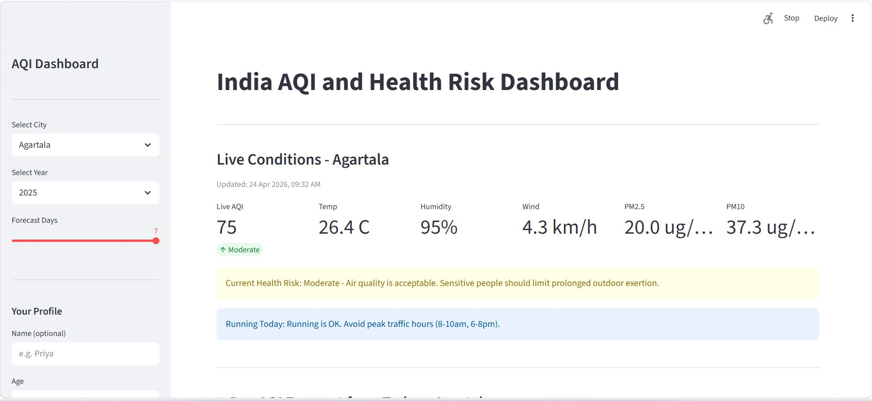
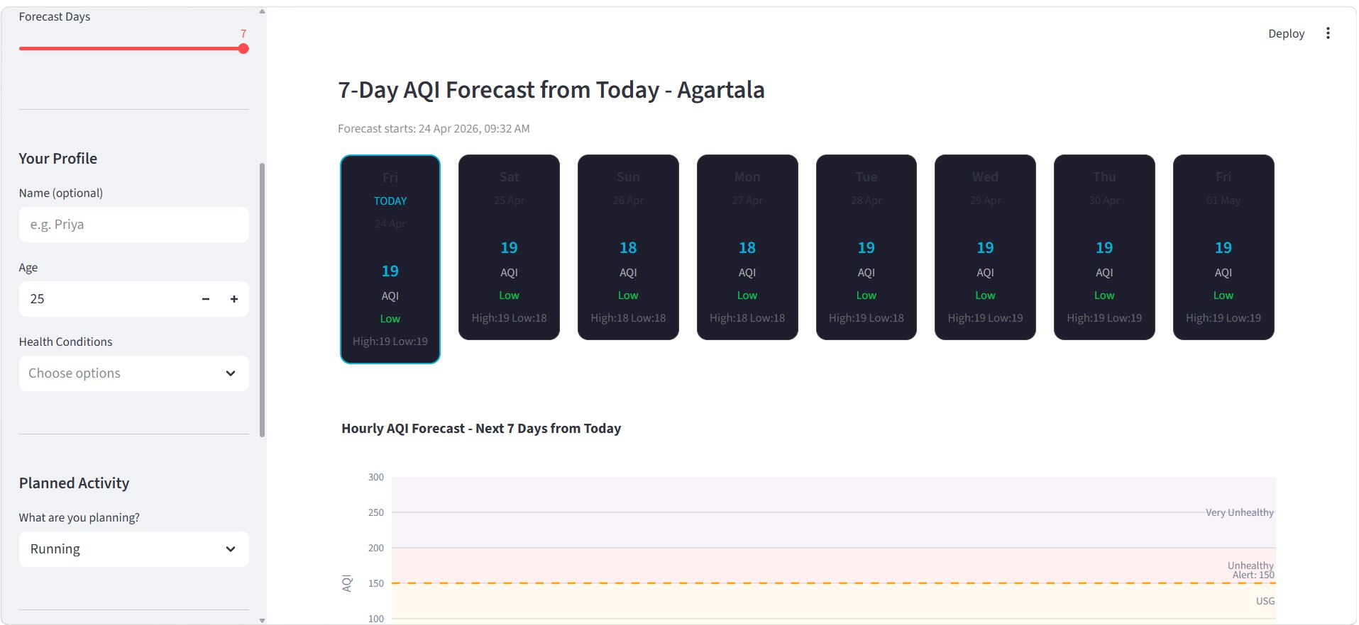
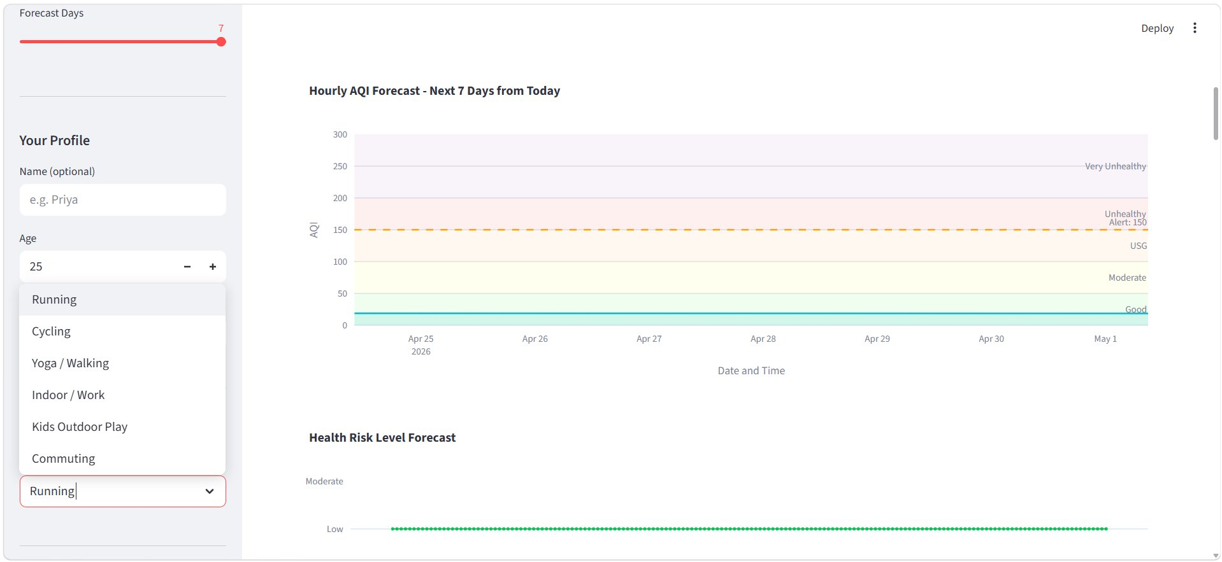
Streamlit Dashboard — Live AQI & 7-Day Forecast
Fig 1: Live Conditions Dashboard
(Agartala — 24 Apr 2026)
Fig 2: 7-Day AQI Forecast with Daily Cards
Fig 3: Hourly AQI Forecast Chart and Health Risk Level Timeline (Next 7 Days)

Slide 11
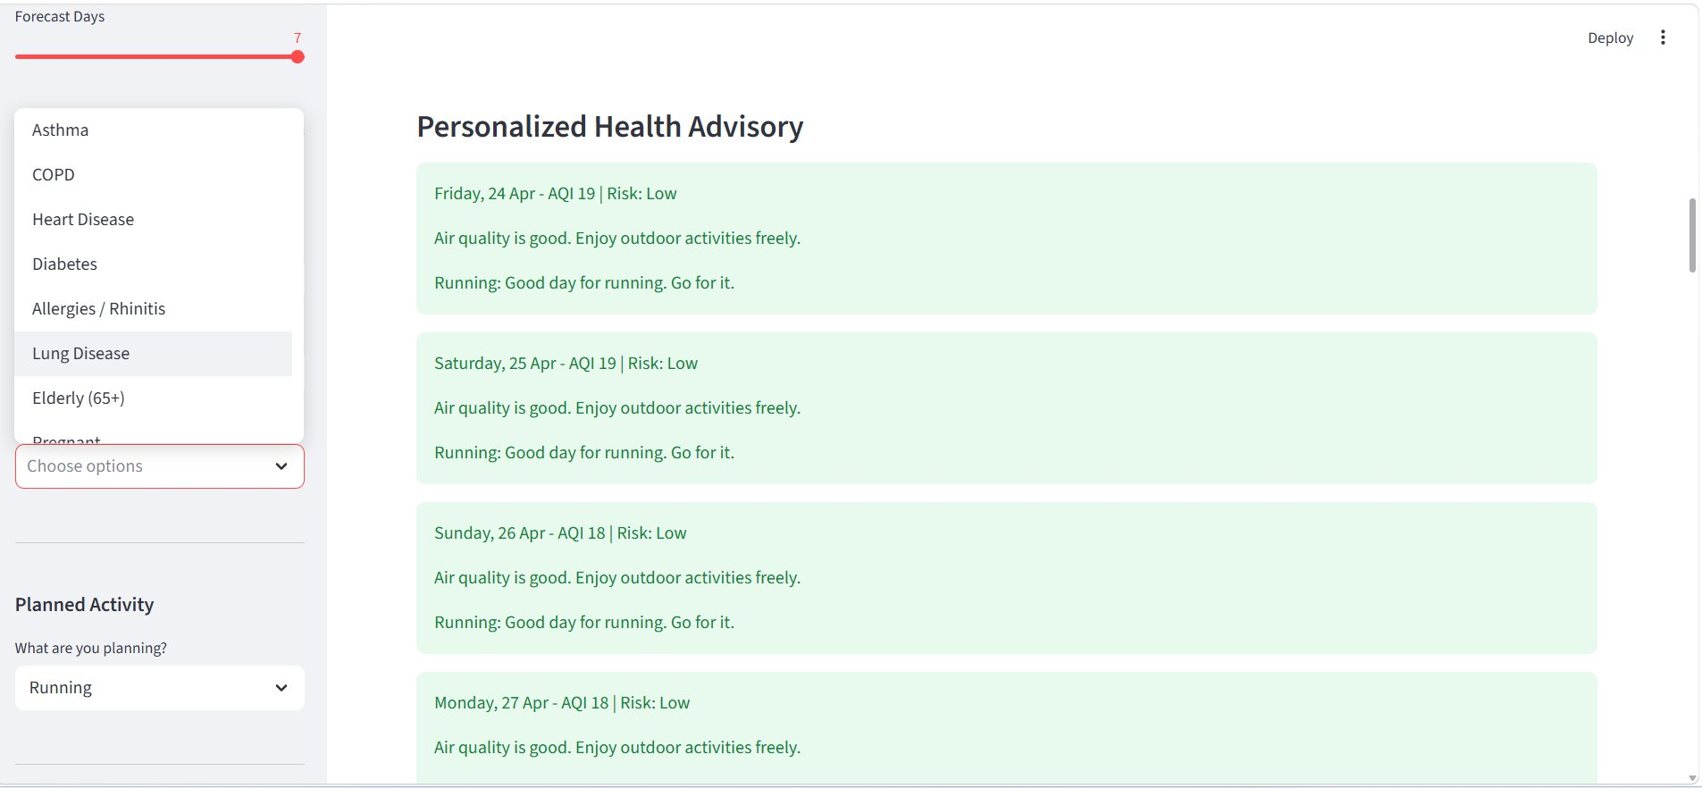
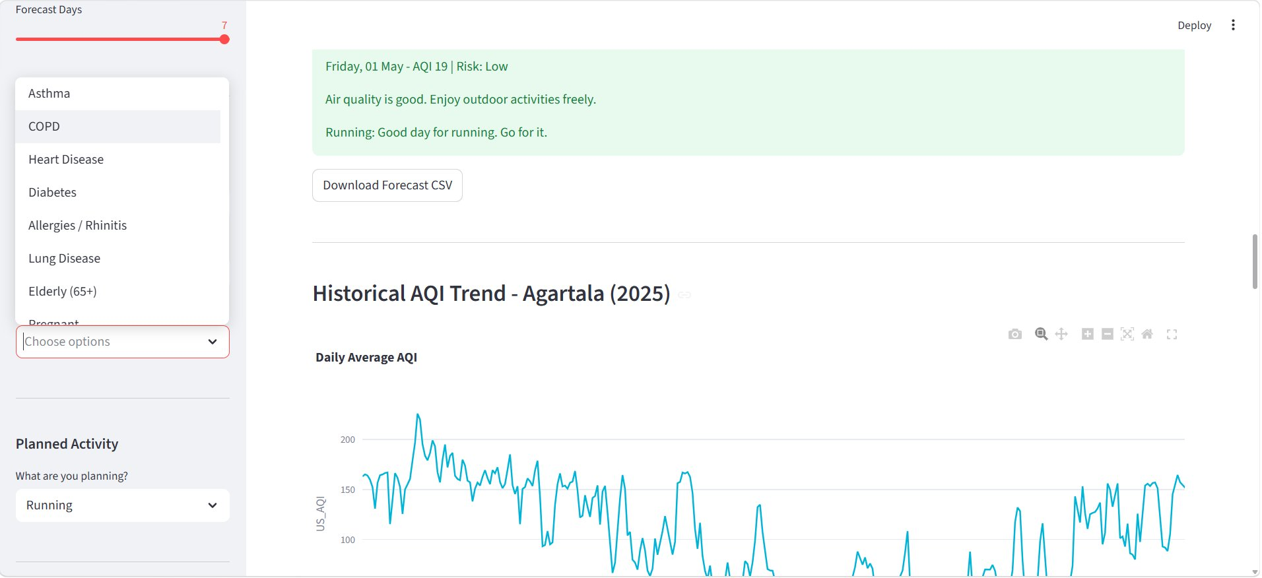
Personalized Health Advisory Module
Fig 4: Day-by-Day Personalized Advisory
(by AQI Risk Level & Planned Activity)
Fig 5: Historical AQI Trend — Jaipur (2025)
& Forecast CSV Download
Advisory Module Features:
Input: User age, health conditions (Asthma, COPD, Heart Disease, Diabetes), planned activity
Output: Day-specific guidance — 'Air quality is good. Go for it!' or 'Avoid outdoor exposure'
Covers: Running, Cycling, Yoga/Walking, Indoor/Work, Kids Outdoor Play, Commuting

Slide 12
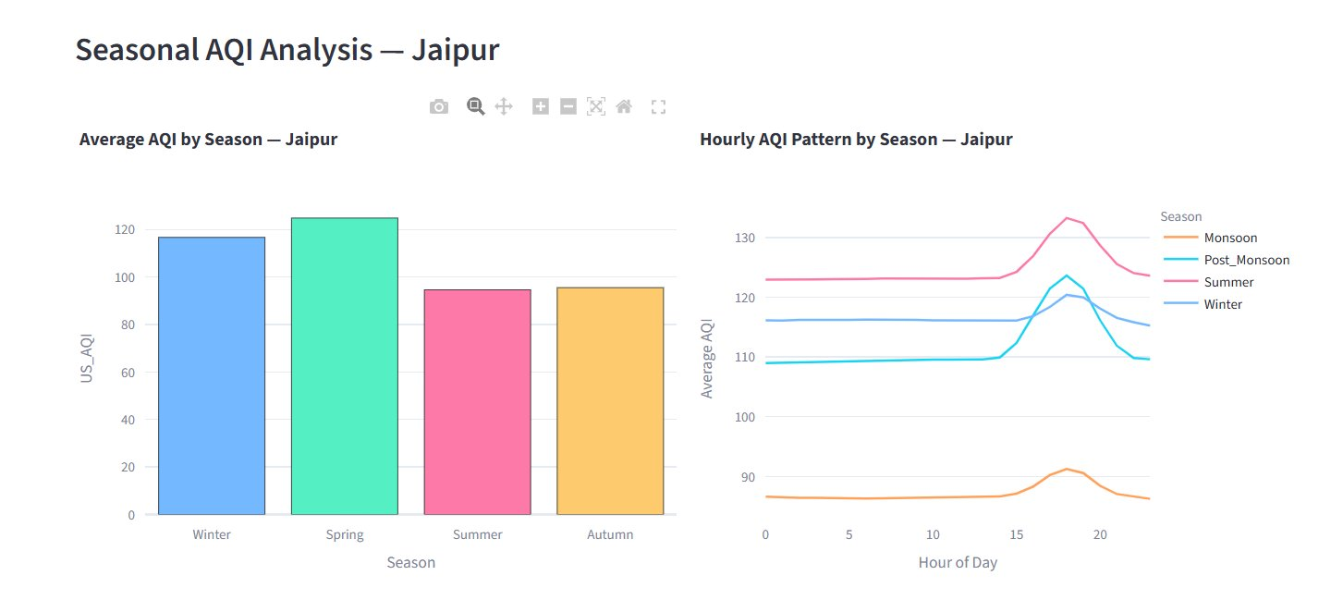
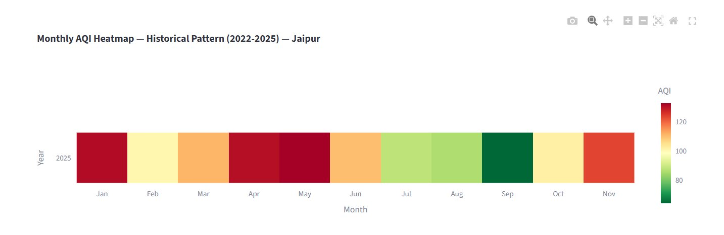
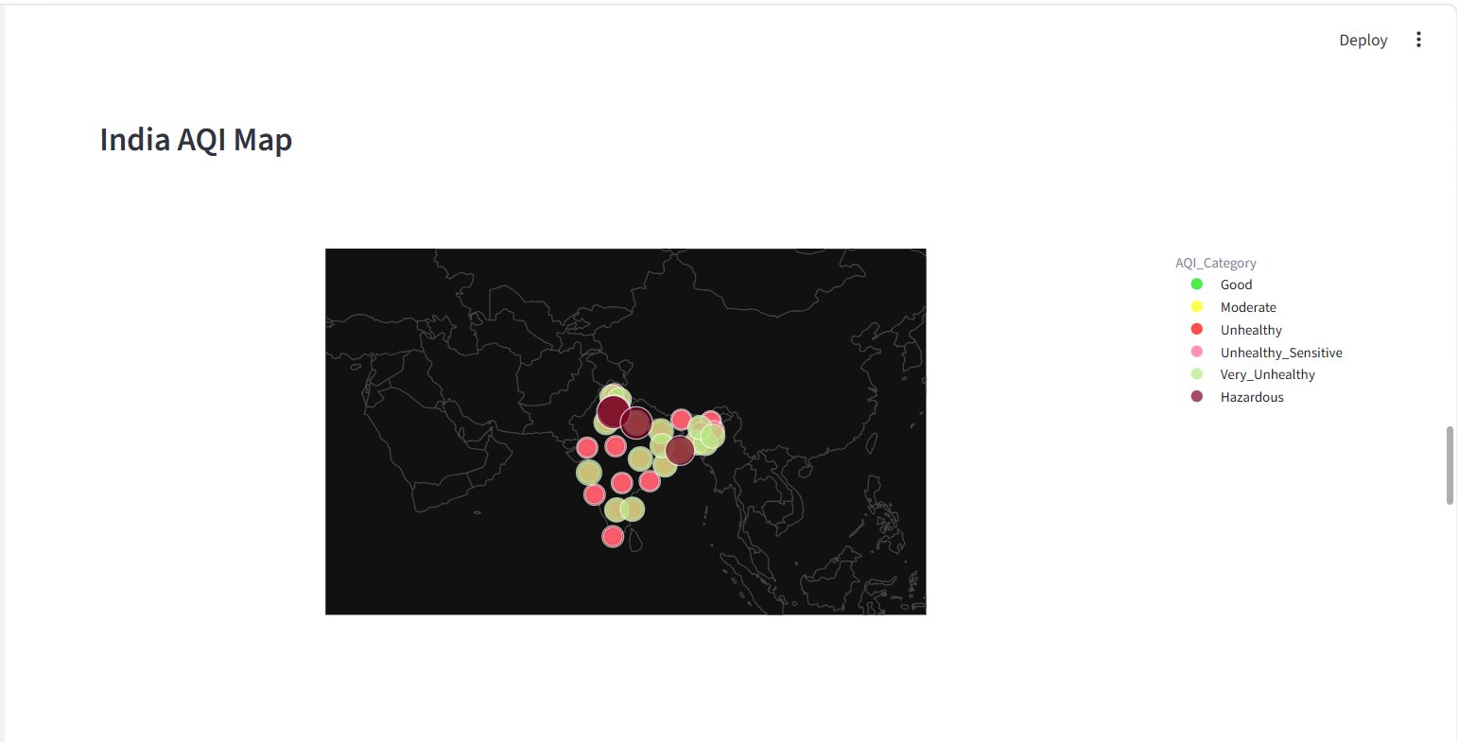
Seasonal & Historical AQI Analysis
Fig 6: Seasonal AQI Analysis — Average by Season & Hourly Pattern (Jaipur)
Fig 7: Monthly AQI Heatmap
2022–2025, Jaipur
Fig 8: India AQI Map — City-wise
AQI Category Visualization

Slide 13
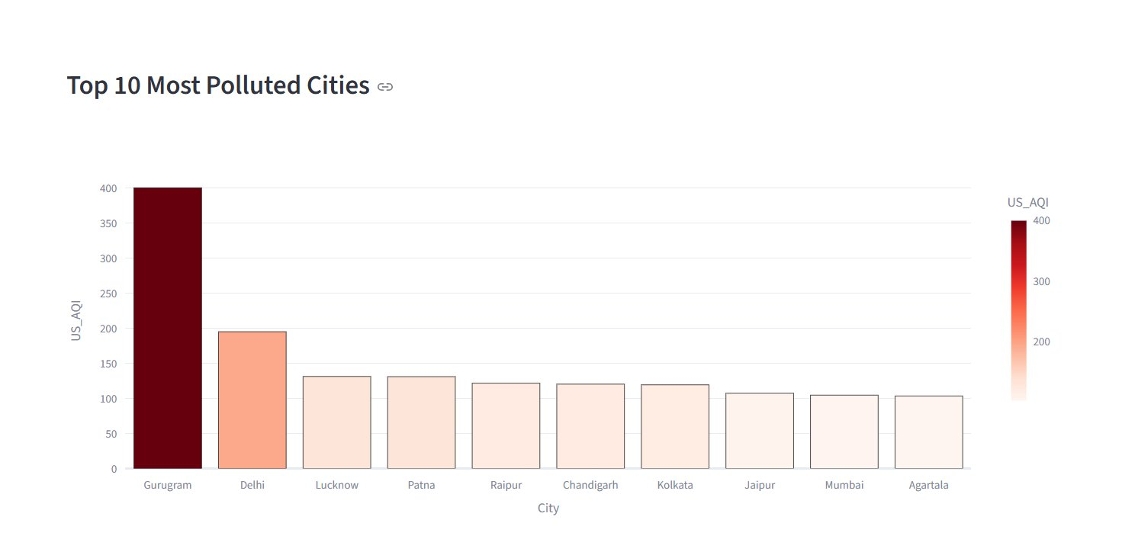
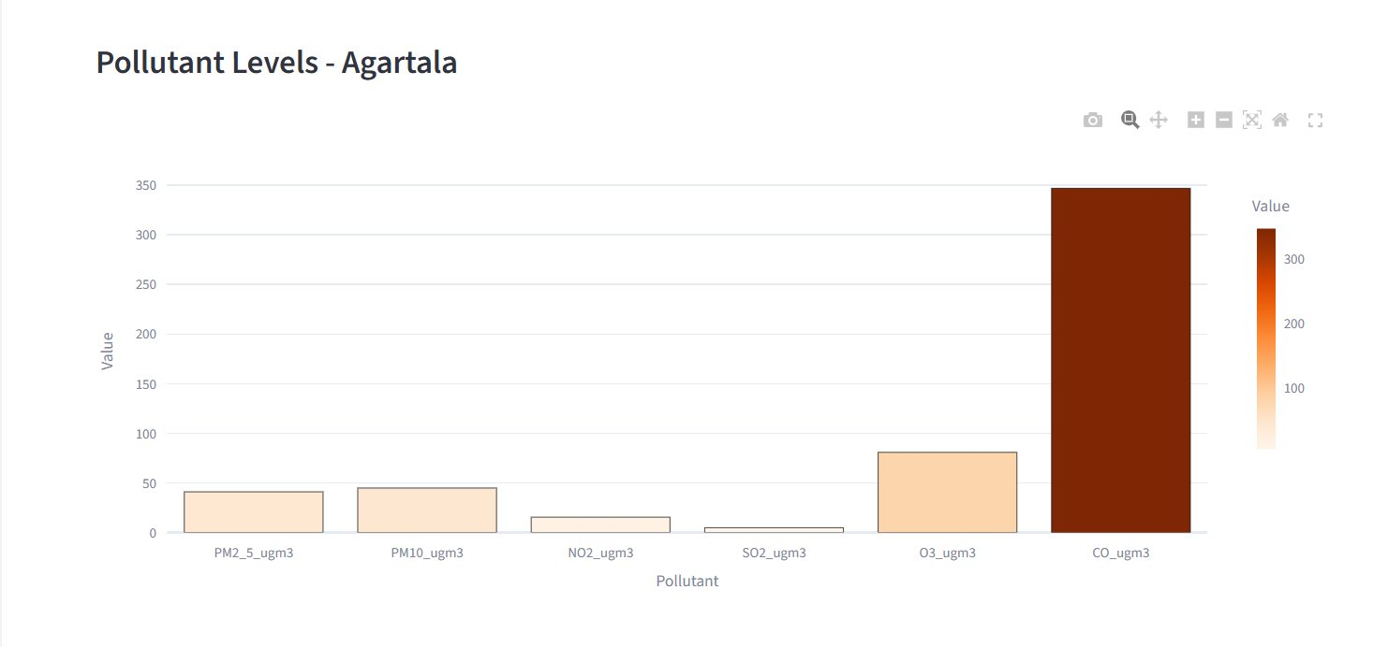
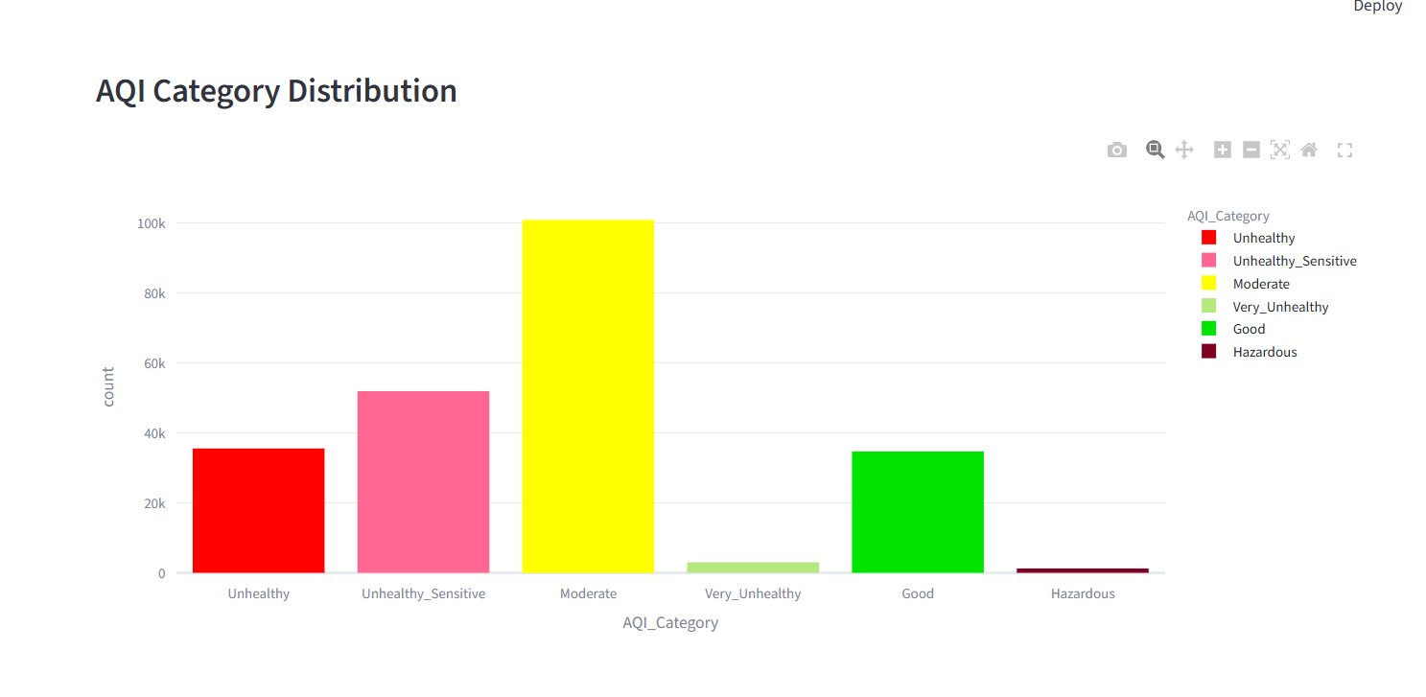
City Rankings & Pollutant Analysis
Fig 9: Top 10 Most Polluted Cities
by Average AQI
Fig 10: Pollutant Levels — Agartala
(PM2.5, PM10, NO2, SO2, O3, CO)
City Ranking (Average AQI)
Rank | City | Avg AQI
1 | Gurugram | 399.99
2 | Delhi | 194.90
3 | Lucknow | 131.17
4 | Patna | 130.87
5 | Raipur | 121.58
6 | Chandigarh | 120.22
7 | Kolkata | 119.25
8 | Jaipur | 107.20
9 | Mumbai | 104.56
Fig 11: AQI Category Distribution
across Dataset

Slide 14
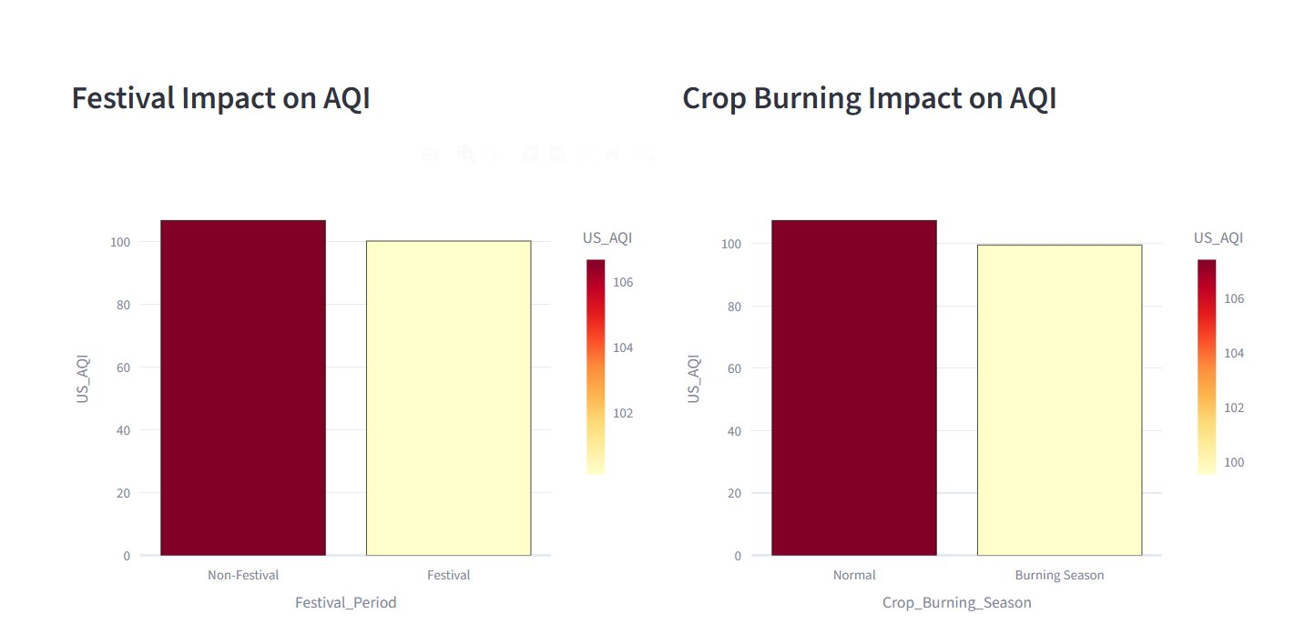
Environmental Impact Analysis
Fig 12: Festival & Crop Burning Impact on AQI
🎆 Festival periods show AQI spikes — firework emissions significantly elevate PM2.5 and PM10
🌾 Crop burning season causes notable increase in pollution across North Indian cities (Oct–Nov)
❄️ Winter months (Nov–Jan) record highest average AQI — temperature inversions trap pollutants
☀️ Monsoon season (Jun–Sep) shows lowest AQI — rainfall cleanses particulate matter

Slide 15
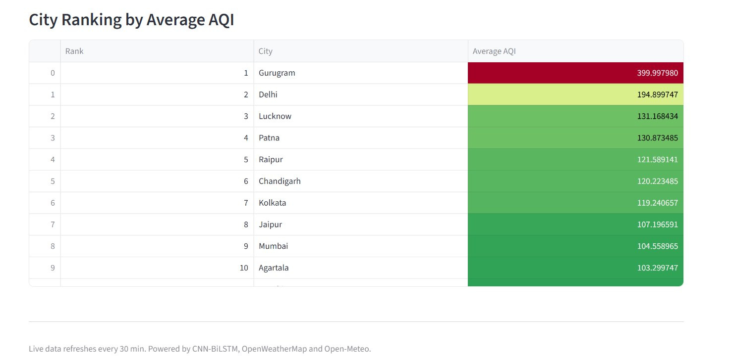
XGBoost Model Performance — Comparative Analysis
Fig 14: XGBoost R² Score & RMSE — All Cities (Higher R² = Better | Lower RMSE = Better)
Model | Strength | Best For
CNN-BiLSTM + Attention | Sequential memory, temporal patterns | Long-horizon hourly forecasting
XGBoost | Speed, flat feature analysis, interpretability | Short-horizon & feature importance
Random Forest | Robustness, mixed feature handling | AQI risk category classification

Slide 16
Key Findings
Gurugram Most Polluted
North-East Cleanest
01
Highest avg AQI of 399.99, followed by Delhi (194.90) — NCR region shows severe pollution levels.
02
Agartala, Aizawl, Kohima record lowest AQI consistently due to lower industrialisation and favourable meteorology.
PM2.5 & PM10 Dominant
CNN-BiLSTM Excels
03
Primary pollutants driving AQI; CO shows significant spikes in high-pollution cities like Delhi and Gurugram.
04
Achieves R² > 0.990 for most cities. Outperforms XGBoost for longer temporal horizons due to sequential memory.
Seasonal Patterns Clear
Live Dashboard Functional
05
Winter (Nov–Jan) worst AQI; Monsoon (Jun–Sep) best. Festival periods and crop burning cause AQI spikes.
06
Real-time AQI refreshed every 30 min. 7-day hourly forecasts generated per city with personalized health advisories.

Slide 17
Conclusion & Future Scope
Conclusion
Future Scope
End-to-end AQI forecasting system built for 26 Indian cities
Multi-step forecasting beyond 7 days (encoder-decoder)
CNN-BiLSTM with attention achieves R² > 0.990 for most cities
Satellite remote sensing data integration (MODIS AOD)
Personalized health advisories tailored to user profiles
Transformer-based models (Temporal Fusion Transformer)
Live APIs integrated — dashboard refreshes every 30 minutes
Mobile app for broader public accessibility
Bridges gap between technical modelling & public health communication
Automated alerts via health authority integrations
Expand to tier-2 and tier-3 cities
Thank You
Priyanshi Mehta | 2023Btech061 | Supervisor: Dr. Amit Sinhal

