Slide 1
Wedcircle: Bridging the Gap in Affordable Wedding Planning Services.

Slide 2
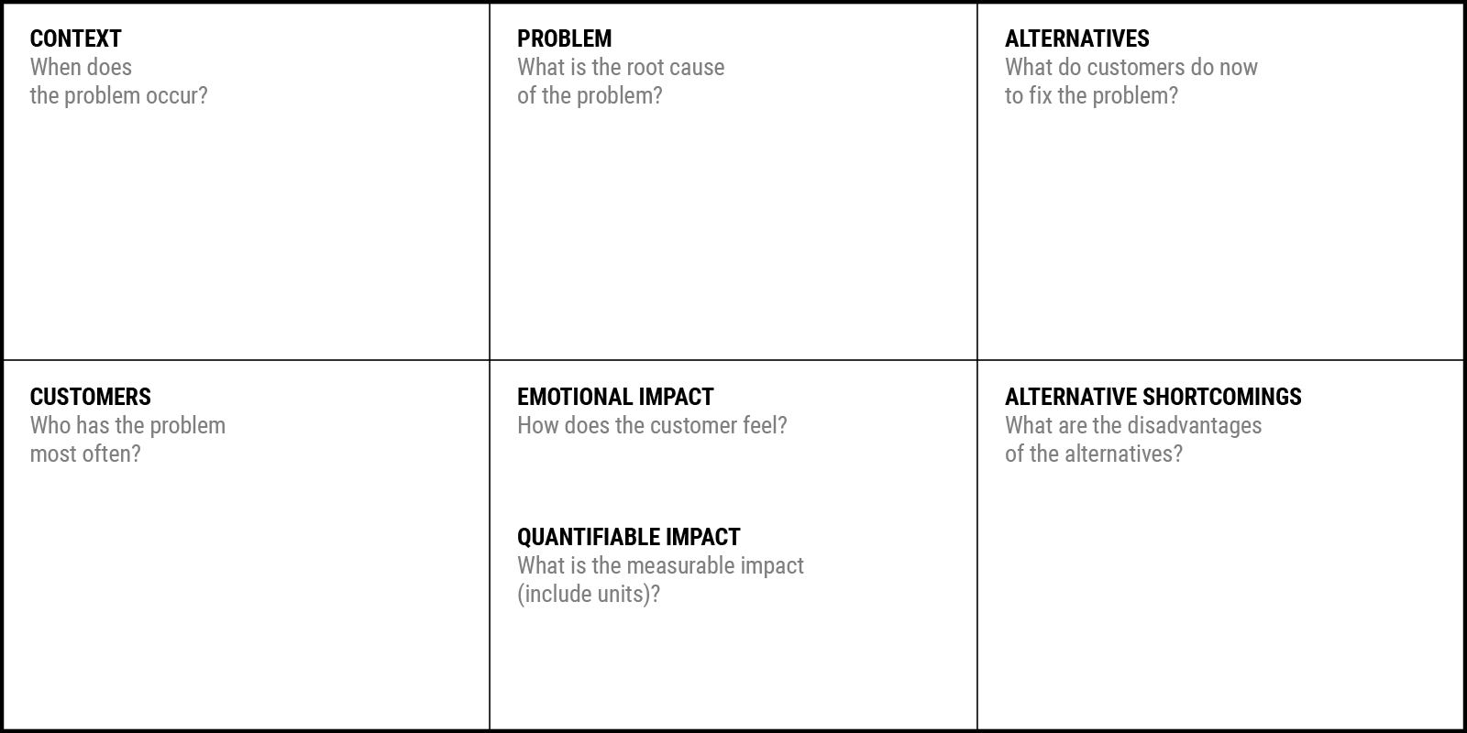
Indian weddings involve multiple ceremonies and vendors.
Planning requires coordination, scheduling, and budget control.
Professional planners largely serve high-budget weddings.
Many middle-income families plan weddings without professional support.
Wedding planners are financially inaccessible to many families.
Lack of affordable, structured execution support.
Heavy reliance on informal family coordination.
Self-coordination by family members.
Fragmented vendor management without central control.
Informal communication channels (calls, messaging apps).
Occasional reliance on local decorators or coordinators.
Persistent planning-related stress
Anxiety due to lack of control during execution.
Emotional burden of social expectations and responsibilities
Middle-income families organizing weddings on limited budgets.
Primary decision-makers (parents of bride and groom).
Families without access to professional wedding planners.
Informal coordination lacks accountability.
Family members are not trained for execution management.
No centralized control mechanism during events.
Event delays and schedule slippages
Cost escalations due to last-minute arrangements
High time and effort investment by family members

Slide 3
Problem Statement
How might we help middle-income families plan and execute weddings smoothly by providing affordable and structured coordination support, so they can reduce stress, improve execution, and enjoy the celebration

