Slide 1
Air Quality & Pollution Intelligence: An Integrated Data Mining and Business Intelligence Dashboard
Data Mining and Business Intelligence - project viva
<STUDENT NAME> | <ENROLMENT / ROLL NUMBER>
<INSTITUTION NAME> | <YYYY-YYYY>
17 slides - about 13 minutes - notebooks, code, dataset and dashboard all available for demonstration
Notes:
Suggested time: 0.5 minutes.
Greet the panel, name the project and say what you will show: a nine notebook mining pipeline, the processed datasets, and the Power BI design built on them. Do not read the title slide.

Slide 2
Introduction
What the data is, and why the analysis is not obvious
• An AQI table mixes three kinds of object
measured pollutant concentrations, one derived index (AQI), and one label derived from that index (AQI_Bucket)
• Answering ten practical questions needs an ordered pipeline
cities over time, pollutant-AQI association, natural groups, unusual days, predictable categories
• Data mining answers the questions once
clustering, outlier detection, classification, significance testing
• Business intelligence answers them for the next asker
star schema + DAX measures + a five-page Power BI dashboard
• The commitment behind every slide
numbers come from the artefacts; where evidence is weak, the deck says so
Air Quality & Pollution Intelligence | Data Mining + Power BI
2 / 17
Notes:
Suggested time: 0.8 minutes.
Frame the project as a journey: data -> knowledge -> mining -> BI -> insight. Emphasise the derived-column point early because it drives the leakage story in slide 12.

Slide 3
Problem Statement
As set in the project brief
Air-quality datasets contain multiple pollutants, locations, and time-based observations, making it difficult to identify pollution patterns, relationships, unusual observations, and city-level differences through raw data alone. This project aims to apply data-mining techniques and business-intelligence visualization to transform air-quality observations into structured analytical insights.
• Summarise five cities, ten years and nine pollutants without distorting them
• Measure pollutant-to-AQI association, with significance attached
• Define 'unusual' formally, without smuggling in the answer
• Quantify the leakage from the derived AQI column before trusting accuracy
• Publish the result as an interactive dashboard with documented KPIs
Air Quality & Pollution Intelligence | Data Mining + Power BI
3 / 17
Notes:
Suggested time: 0.8 minutes.
Read the italic statement in one breath, then list the five concrete gaps. Do not add claims the brief did not ask for.

Slide 4
Objectives
The ten questions the project must answer
• 1. Which cities have higher average AQI?
• 2. How does AQI change over time?
• 3. Which pollutants are most strongly associated with AQI?
• 4. How do pollutants correlate with each other?
• 5. Are cities and observations naturally grouped into pollution profiles?
• 6. Which observations represent unusual pollution patterns?
• 7. Can AQI categories be predicted using pollutant measurements?
• 8. Which months or seasons have higher pollution levels?
• 9. How do pollution profiles differ between cities?
• 10. What insights can be communicated through a BI dashboard?
Delivered through: cleaning and feature engineering, EDA, correlation, K-Means, Isolation Forest, four classifiers, and a Power BI design.
Each question is answered with a figure in the report (section 24) and on slides 8 to 14 here.
Air Quality & Pollution Intelligence | Data Mining + Power BI
4 / 17
Notes:
Suggested time: 0.7 minutes.
Say that the questions were kept fixed and the analysis was written to answer them, not the other way round.

Slide 5
Dataset
data/raw/Air_quality_data.csv
18,265
rows
13
columns
5
cities
2015-01 to 2024-12
date range
0
missing cells on load
• Pollutants present
PM2.5, PM10, NO, NO2, NOx, NH3, CO, SO2, O3
• Expected but absent
Benzene, Toluene, Xylene
• Derived columns
AQI (index) and AQI_Bucket (label from AQI)
• Exact duplicate rows on load: 0; rows after cleaning: 18,265
• Provenance not documented with the file
publisher, download date and collection method are unknown
Integrity finding: the measurement columns behave like uniform draws (independent of each other and of AQI, no city/month/year effect). Treat the results as properties of this file, not as findings about Indian air.
Air Quality & Pollution Intelligence | Data Mining + Power BI
5 / 17
Notes:
Suggested time: 1.0 minutes.
This is the honest slide. State the row/column counts from memory-free facts, then state the integrity finding plainly - the panel will ask about it anyway.

Slide 6
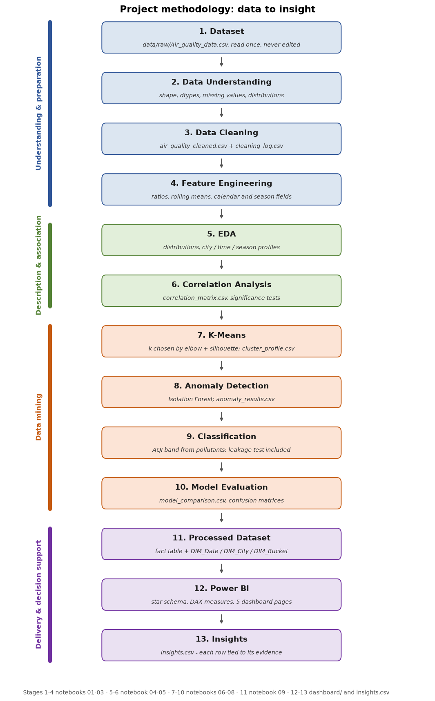
Methodology
Thirteen stages, each evidenced by an artefact
• Everything runs from reusable modules in src/
• Nine notebooks execute the same code end to end
• Notebook 09 re-runs the pipeline once and exports every artefact
• results.json is the single source of numbers for report and slides
• random_state = 42 everywhere; versions recorded
Air Quality & Pollution Intelligence | Data Mining + Power BI
6 / 17
Notes:
Suggested time: 0.7 minutes.
Walk the four phases in the diagram: preparation, description, mining, delivery. Mention that each stage names the file that proves it.

Slide 7
Data Preprocessing
Every decision logged with the values it touched
Cleaning action | Steps logged | Values affected
Categorical values | 2 | 0
Duplicate removal | 1 | 0
Extreme values (flagged, kept) | 9 | 0
Impossible values | 9 | 0
Missing values | 10 | 0
Numeric coercion check | 10 | 0
Ordinal encoding | 1 | 6
Uniqueness check | 1 | 0
• Raw file opened read-only; never overwritten
• Exact duplicate rows found on load: 0
• Date parsed to datetime; city names normalised
• Negative / impossible values checked per pollutant
• Extreme values flagged, not deleted
• No imputation was needed - nothing was silently filled
Air Quality & Pollution Intelligence | Data Mining + Power BI
7 / 17
Notes:
Suggested time: 0.8 minutes.
Point at the 'Values affected' column: the log is auditable, so a reviewer can re-check each step in notebook 02. The 43 individual log entries are collapsed into these groups on this slide.

Slide 8
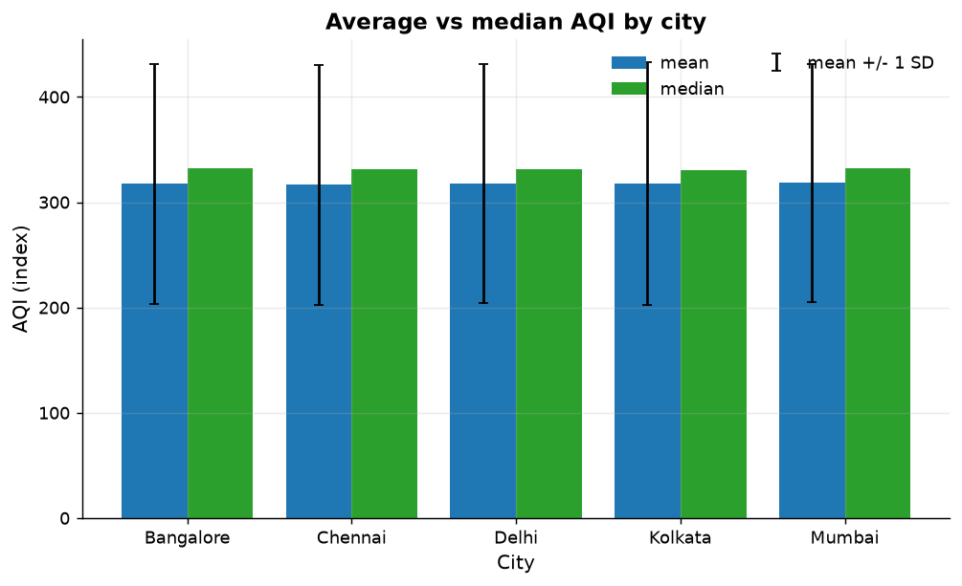
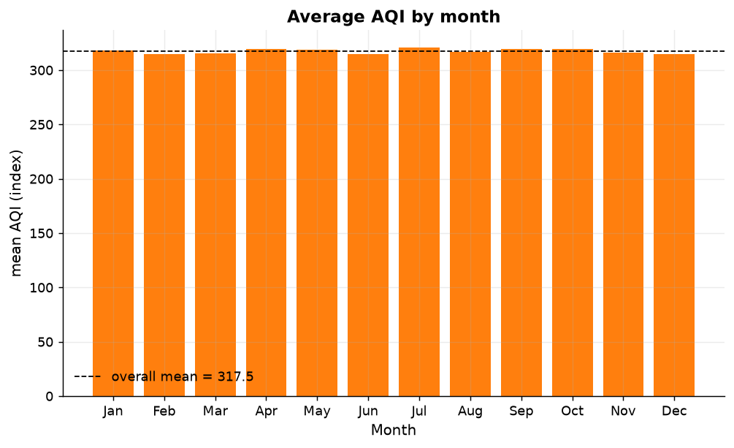
Exploratory Data Analysis
Distribution, trend, city and calendar profiles
• Average AQI by city ranges 316.62 (Chennai) to 318.19 (Mumbai)
a spread of 1.57 points on an index that runs to 500
• City effect is not statistically detectable (ANOVA p = 0.9830)
the ranking is descriptive only; it must not be quoted as 'X city is more polluted'
• Category shares follow the band widths, not the air
Very Poor and Severe together hold 58.91% of records; the rarest category, Good, holds 0.03%
• Distributions are flat, not environmental
Kolmogorov-Smirnov and skew/kurtosis tests reject the usual right-skewed pollutant shape
• No trend over ten years (slope 0.0366 AQI/year, p = 0.9001)
reported as 'no statistically detectable trend'
Air Quality & Pollution Intelligence | Data Mining + Power BI
8 / 17
Notes:
Suggested time: 1.0 minutes.
Two messages: what the descriptive statistics show, and why the significance tests stop you turning them into claims.

Slide 9
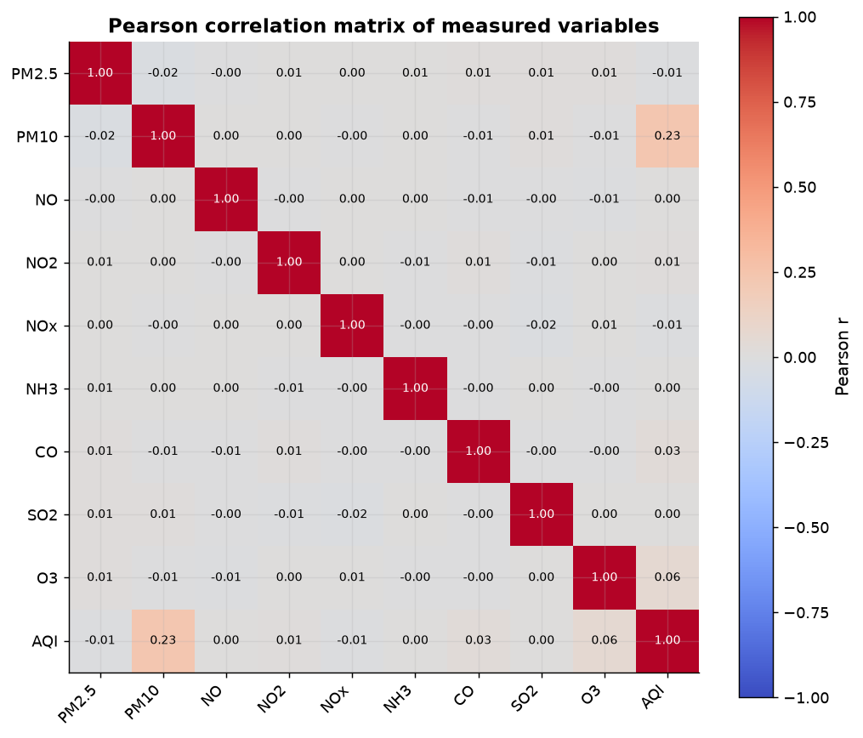
Correlation Analysis
Linear r, rank r, and a non-linear check
• Pollutant-pollutant correlation is near zero
the largest absolute Pearson r in the matrix is trivial; the columns behave independently
• Linear regression on AQI: R2 = 0.0579
Pearson r alone would say AQI is unexplained
• Tree ensemble on AQI: CV R2 = 0.9969
the relationship is non-linear, so a heat map understates it
• Forward selection: PM2.5 + PM10 reach CV R2 = 0.9588
AQI is rebuilt almost exactly from a pair of input columns - it is derived, not measured
Air Quality & Pollution Intelligence | Data Mining + Power BI
9 / 17
Notes:
Suggested time: 0.9 minutes.
The contrast between linear and tree R-squared is the analytical highlight of this slide; say why both were run.

Slide 10
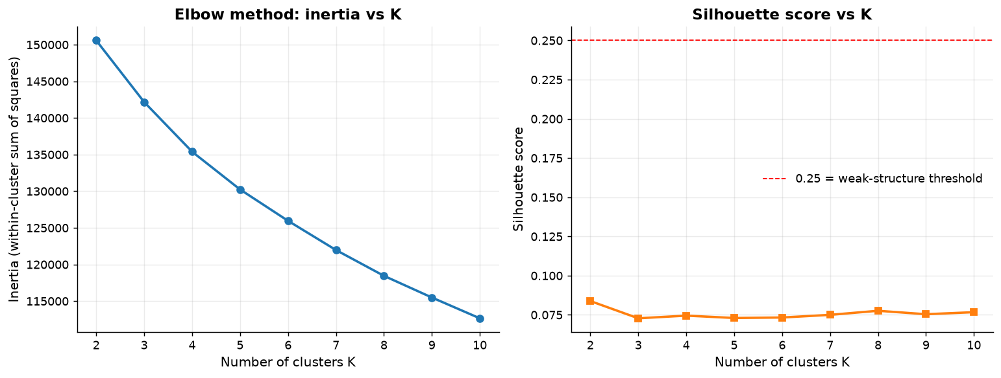
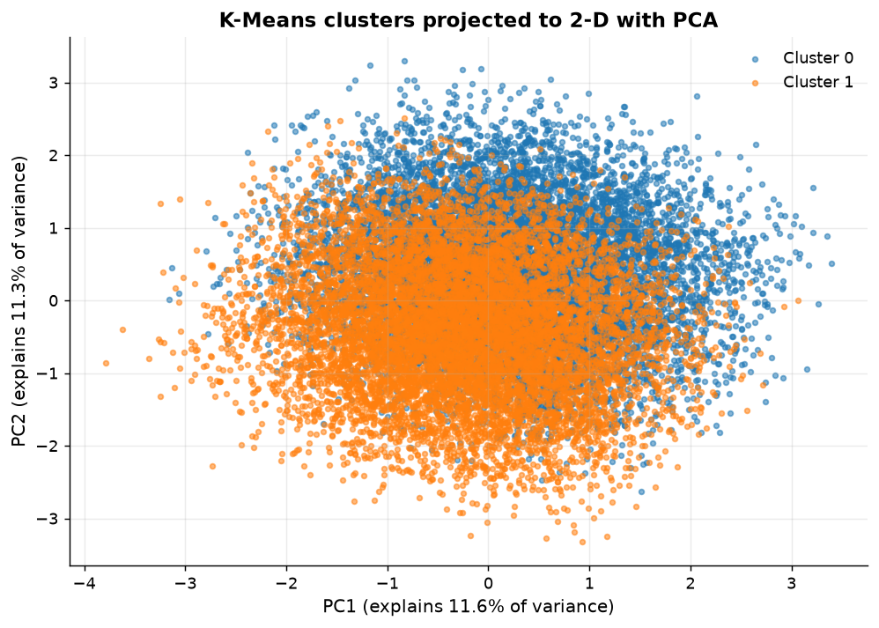
K-Means Clustering
k chosen from evidence, disagreement reported
• Features: nine pollutant concentrations, StandardScaler applied
scaling is mandatory - CO is of order 5 and PM10 of order 300
• Chosen k = 2 by silhouette (0.0838); the elbow rule suggested k = 4
the disagreement is reported, not hidden
• Silhouette near 0.08 means weak separation
the groups are a description of this file, not pollution 'regimes'
• PCA is used for the picture only
clustering runs on all nine scaled columns; the two plotted components carry just 22.9% of the variance, so the scatter is illustrative
Air Quality & Pollution Intelligence | Data Mining + Power BI
10 / 17
Notes:
Suggested time: 1.0 minutes.
Expect to be asked why you did not just take the elbow. Answer: the two criteria disagreed and the silhouette is weak, so the conservative k won.

Slide 11
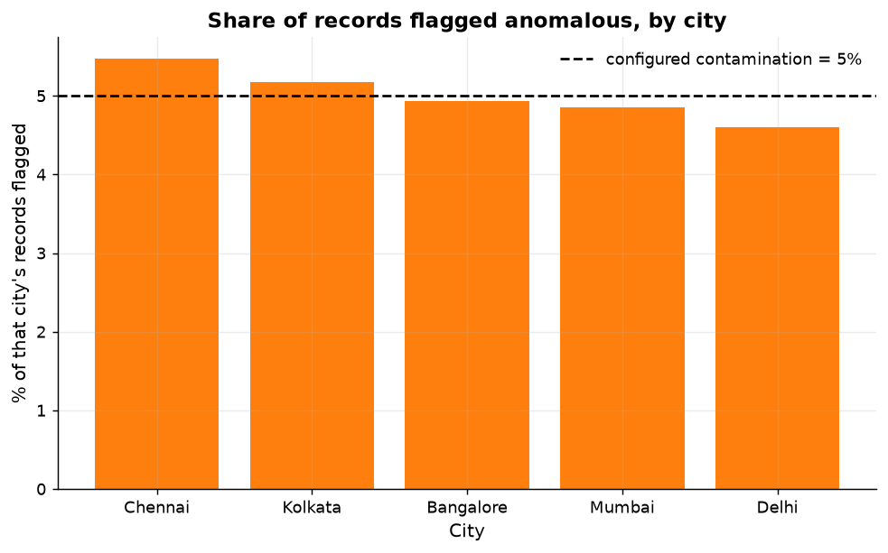
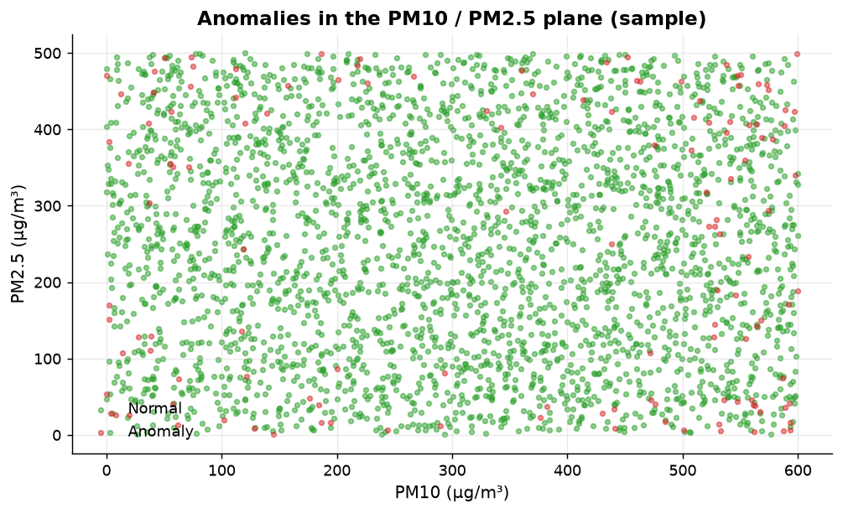
Anomaly Detection
Isolation Forest on nine pollutants
• 914 of 18,265 observations flagged (5.00%)
300 trees, random_state 42, contamination = 0.05
• The rate is an assumption, not a discovery
contamination fixes the share before the model sees the data
• Anomalous days are jointly unusual, not simply high
largest pollutant shift between normal and flagged rows is a few percent
• Spread evenly over cities and years
consistent with the uniform-distribution finding in slide 5
Air Quality & Pollution Intelligence | Data Mining + Power BI
11 / 17
Notes:
Suggested time: 0.9 minutes.
Say out loud that 5% is configured. If a marker asks 'how do you know there are 914 real anomalies?', the answer is that you do not.

Slide 12
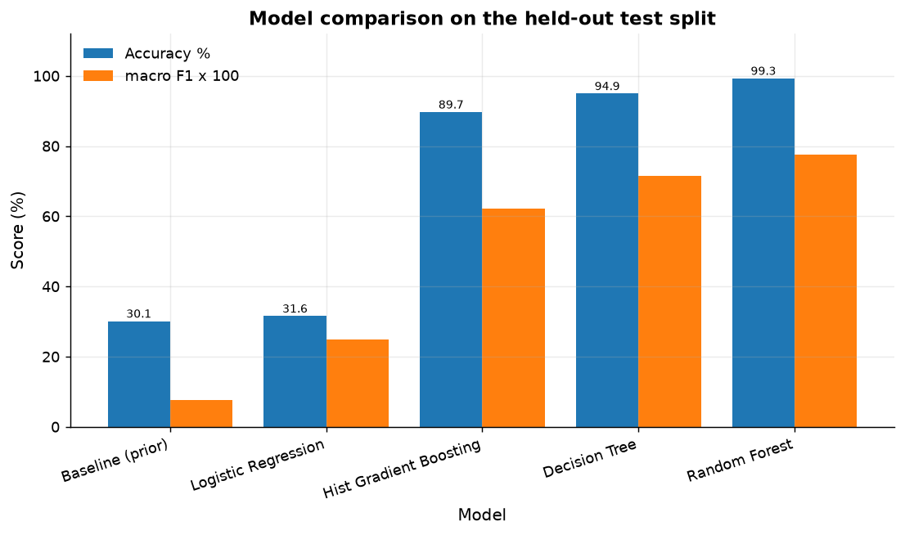
Classification
Predicting the AQI category from pollutants only
Model | Accuracy_% | F1_macro | Lift_over_Baseline_pp
Random Forest | 99.28 | 0.7765 | 69.17
Decision Tree | 94.94 | 0.7153 | 64.83
Hist Gradient Boosting | 89.69 | 0.6224 | 59.58
Logistic Regression | 31.55 | 0.2491 | 1.44
Baseline (prior) | 30.11 | 0.0771 | 0.0
• Best model: Random Forest - accuracy 99.28%, macro-F1 0.7765, lift 69.17 pp over the 30.11% prior baseline
stratified 75/25 split, AQI excluded from every feature set
• Including AQI inflates accuracy by 0.68 pp
the label is a band of AQI, so using AQI is predicting the target from itself
• Rare classes are where accuracy lies
Good (6 rows) and Satisfactory (113 rows) are why macro-F1 0.7765 sits far below 99.28% accuracy
Air Quality & Pollution Intelligence | Data Mining + Power BI
12 / 17
Notes:
Suggested time: 1.0 minutes.
This is the most likely question: 'why not report 99.96%?'. Answer: because that model saw AQI, and AQI determines the label.

Slide 13
Power BI Dashboard
Star schema, documented KPIs, five pages
Page | Purpose | Key visuals
Overview | One-glance status of the panel | 6 KPI cards, AQI by city, trend, category share
City Analysis | Compare cities in a filter context | radar/bar comparison, cluster mix, percentile table
Pollutant Analysis | Relation between pollutants and AQI | heat map, scatter vs AQI, ranking
Pattern Discovery | Mining results surfaced | cluster profiles, anomaly list, model comparison
Trends | Time intelligence | yearly/monthly/seasonal trend, YTD, year-over-year
• Fact: air_quality_cleaned.csv; dimensions: dim_date, dim_city, dim_bucket
• 67 DAX measures documented in dashboard/DAX_measures.dax and dashboard/KPI_DEFINITIONS.md
• Slicers (city, year, month, season, category) plus a what-if limit parameter
• Thresholds cite CPCB bands - verified to reproduce AQI_Bucket on 100% of rows
Air Quality & Pollution Intelligence | Data Mining + Power BI
13 / 17
Notes:
Suggested time: 1.0 minutes.
If the .pbix is available, switch to it here for two minutes: filter a city, watch the KPIs and titles recompute, then a cross-filter on a chart.

Slide 14
Results and Insights
Generated from computed artefacts only - never typed in
Insight (abridged) | Evidence
The dataset covers 18,265 daily observations across 5 cities from 2015-01-01 to 2024-12-31. | measured
Cleaning removed no rows: the supplied file contains no duplicate records and no missing values, so the analysis rests entirely on originally recorded... | measured
Mumbai has the highest average AQI (318.185) and Chennai the lowest (316.619), a gap of 1.6 index points. | measured
Although city averages differ slightly, the difference between cities is NOT statistically significant (ANOVA F=0.0985, p=0.983), so this dataset does... | measured
PM10 shows the strongest association with AQI (Pearson r=0.2296, weak, p=4.49e-217); 3 of 9 pollutants reach significance at 0.05. | measured
Measured linearly, PM10 explains only 5.3% of AQI variance, and correlation is not causation: this dataset contains no activity or meteorological data... | measured
20 insights are stored in data/processed/insights.csv, each with its quantitative evidence and the file it was derived from. Insights whose evidence is weak are labelled as weak.
Air Quality & Pollution Intelligence | Data Mining + Power BI
14 / 17
Notes:
Suggested time: 1.0 minutes.
Read out two or three insights and name the file behind each. Do not present a weak-evidence insight as a headline.

Slide 15
Limitations
What this project cannot claim
• Dataset availability is limited to the recorded cities and time period.
• Missing values may affect analysis.
• Correlation does not establish causation.
• K-Means results depend on feature selection and scaling.
• Anomaly detection identifies statistical unusualness rather than environmental causes.
• Classification performance depends on data quality and class distribution.
• The project does not replace official environmental monitoring or regulatory assessment.
Added by the analysis itself: the supplied file carries no provenance and its columns behave like independent uniform draws, so city, month and year differences are statistically indistinguishable. Findings are therefore descriptions of the file.
Air Quality & Pollution Intelligence | Data Mining + Power BI
15 / 17
Notes:
Suggested time: 0.8 minutes.
Owning limitations is what earns marks in a viva. Say which limitation changed the design: the derived target forced AQI out of the features.

Slide 16
Future Scope
Twelve directions, in three tiers
• Real-time air-quality APIs
• More cities and stations
• Satellite data
• Weather integration
• Forecasting
• Deep learning
• Geospatial analysis
• Real-time Power BI dashboards
• Mobile dashboard
• Automated alerts
• More advanced anomaly detection
• Explainable AI
Data first: real-time APIs, more cities, satellite and weather inputs.
Then modelling: forecasting, deep learning, stronger anomaly validation, explainability.
Then delivery: live and mobile dashboards, automated public alerts.
Air Quality & Pollution Intelligence | Data Mining + Power BI
16 / 17
Notes:
Suggested time: 0.7 minutes.
Keep this to 40 seconds - the value is in the tiering, not the list.

Slide 17
Conclusion
What was built, what was answered, what was not
• Pipeline delivered
13 source modules, 9 executed notebooks, 18,265 rows, processed datasets and a documented Power BI design
• Answered with evidence
city and calendar profiles, correlation structure (linear and non-linear), cluster solution, anomaly set, model comparison with a stated baseline
• Answered negatively, and reported that way
no detectable city, month or year effect; no detectable ten-year trend; clusters that do not separate strongly
• Leakage quantified, not assumed
AQI_Bucket is reproducible from AQI on 100% of rows; AQI excluded from all models; inflation measured at 0.68 pp
• Next step that matters most
replace this file with a documented monitoring record and re-run the same code - every artefact regenerates from it
Air Quality & Pollution Intelligence | Data Mining + Power BI
17 / 17
Notes:
Suggested time: 0.8 minutes.
Close on the reproducibility line: the same nine notebooks run against a real dataset unchanged. Then invite questions.

