Slide 1

PRIYANSHI JANI
Cricket Analytics Platform
From scattered data to trusted, decision-ready insight
✓
SQL Server · Alteryx · Tableau
Business Intelligence Practical Assignment
Notes:
Welcome. This is the Cricket Analytics Platform: a business-intelligence solution that takes cricket data from three separate places, checks it, organises it, and turns it into interactive dashboards. I will cover the problem, what we built and how, what it can do, and how it would run in production.

Slide 2
Agenda
Following the brief's demonstration checklist (section 15)
01
Business problem and approach
07
Tableau dashboards
Brief 1–2
Brief 8–9
02
Solution architecture
08
Data-quality handling
Brief 5
Brief 6–7
03
Data flow
09
Security considerations
Brief 5
Brief 11
04
SQL implementation
10
Performance considerations
Brief 4–5
Brief 10
05
Alteryx implementation
11
Deployment approach
Brief 4–5
Brief 12
06
Data processing
✓
Summary: design, scale and impact
Brief 5, 16
Brief 14, 17
Cricket Analytics Platform
2
Notes:
The presentation follows the demonstration checklist in section 15 of the brief, one topic at a time: the business problem and our approach, the architecture and data flow, the SQL, Alteryx and data processing, the Tableau dashboards, data quality, security, performance and deployment. Each slide carries the brief section it answers in its top corner.

Slide 3
01 · BUSINESS PROBLEM AND APPROACH Brief §1–2
The challenge
Cricket data lived in three places, in three formats, with no way to trust it
Master data
SQL Server
Teams, players, venues
?
Match files
Who is winning, and why?
JSON
120 matches, nested
Which players really perform?
Detail feeds
Can we trust these numbers?
CSV
Ball by ball, rankings
Cricket Analytics Platform
3
Notes:
The organisation already had cricket data, but in three unconnected places: a database of teams, players and venues; match files from an external provider; and detailed ball-by-ball and ranking files. Nobody could answer simple business questions without stitching these together by hand, and nobody could say whether the numbers could be trusted - the files contained missing, duplicated and invalid records.

Slide 4
01 · BUSINESS PROBLEM AND APPROACH Brief §1–2
The solution at a glance
Five steps from raw data to decisions
✓
ƒx
Collect
Check
Organise
Define
Visualise
All 3 sources,
every file tracked
43 quality rules,
nothing lost silently
One analytics
warehouse
Each measure
defined once
8 interactive
dashboards
Alteryx
Alteryx
SQL Server
SQL Server
Tableau
Cricket Analytics Platform
4
Notes:
Here is the whole solution in one line. We collect the data from all three sources; check every row against quality rules; organise it in a warehouse designed for analysis; define each business measure exactly once; and present it in Tableau dashboards that answer the business questions. Alteryx does the collecting and checking, SQL Server stores and defines, Tableau visualises.

Slide 5
01 · BUSINESS PROBLEM AND APPROACH Brief §1–2
How we built it
Nine milestones, each building on the last
Foundation
Ingestion
Warehouse
One-click run
Tested & shared
Databases created
by script
All sources in,
fully traceable
Built for fast
analysis
Whole pipeline
automated
108 checks, setup
on any PC
1
2
3
4
5
6
7
8
9
Realistic data
Quality gate
Business rules
Dashboards
3 formats, issues
planted on purpose
43 rules, every
problem logged
One definition
per measure
8 dashboards
and a story
Cricket Analytics Platform
5
Notes:
How we built it, in nine milestones. We started with a scripted database foundation, created realistic sample data with deliberate problems in it, brought every source in with full traceability, added the quality gate, built the warehouse, defined the business rules once, automated the whole run behind one click, built the dashboards, and finally tested and documented everything so another person can rebuild it on their own PC.

Slide 6
02 · SOLUTION ARCHITECTURE Brief §5
Architecture: medallion layers, metadata-driven
How data moves from source to dashboard on one PC
Orchestration 00_orchestrator · Control Containers · one LoadRunId · stops on first error
SOURCES
SQL SERVER · CricketDW
BRONZE
SILVER
GOLD
SEMANTIC
06 export
SQL Server
stg.*Raw
stg.*Valid
dw star schema
rpt · 22 views
.hyper extracts
04_Prepared
As received, with file,
hash and run ID
Passed the rules;
typed, standardised
Facts, dimensions,
Type-2 team history
Business rules
defined once
{ }
JSON
Alteryx 01–03
Alteryx 04 gate
Alteryx 05 publish
SQL views
Tableau
8 dashboards
CSV
Metadata &
control plane
config.DQRule
43 rules, 7 entities
config.Parameter
folders, thresholds
audit.FileControl
file hashes
audit.DQException
every violation
audit.ETLRunLog
every stage
audit.DQRunScore
quality scores
Cricket Analytics Platform
6
Notes:
This is the technical architecture. Data moves through medallion layers inside SQL Server. Bronze keeps every row exactly as received, with its source file, a content fingerprint and the run that loaded it. Silver holds only rows that passed the 43 quality rules. Gold is the star schema built for analysis. The semantic layer is a set of reporting views where every business measure is defined once. Alteryx moves data between layers and exports each view as a Tableau extract. Underneath, a metadata and control plane drives the pipeline: the quality rules, parameters and folder names are data, and every file, exception and run is logged. One orchestrator runs all of it under a single run ID.

Slide 7
03 · DATA FLOW Brief §5
From raw data to insight: the data journey
Seven processing steps between a raw file and a dashboard
SOURCES
BRONZE
SILVER
LOAD-READY
GOLD
SEMANTIC
EXTRACTS
DASHBOARDS
129
30,758
29,724
17
41,000+
22
18,557
8
files received
rows landed
rows passed
staged tables
warehouse rows
reporting views
rows exported
dashboards
1 live database,
JSON and CSV feeds
8 tables · as received,
file + hash + run ID
7 tables · 43 rules,
6 DQ dimensions
Keys, Type-2 history,
derived ball facts
16 tables · 36 FKs
facts, dims, bridge
10 rule functions,
each rule once
22 .hyper files,
counts reconciled
82 sheets
and a story
—
Alteryx 01–03
Alteryx 04
Alteryx 05
1 transaction
SQL views
Alteryx 06
Tableau
At every step every file fingerprinted · every violation logged to the row · every stage logged under one run ID · nothing dropped silently
Cricket Analytics Platform
7
Notes:
This is the journey every number on a dashboard takes. 129 files and the live source database land in Bronze exactly as received - 30,758 rows, each carrying its file, fingerprint and run ID. The quality gate checks every row against 43 rules; the rows that pass move to Silver. The transform builds keys, Type-2 team history and the ball-level facts into 17 load-ready tables, and one transaction publishes them to the Gold star schema - 16 tables holding over 41,000 rows. The semantic layer defines the business rules once in 22 reporting views, which are exported as 22 Tableau extracts and read by 8 dashboards. Seven processing steps sit between a raw file and an insight, and every one is logged.

Slide 8
04 · SQL IMPLEMENTATION Brief §4–5
SQL implementation
Two databases, five schemas, all created by script
Scripted, idempotent DDL
11 scripts, one batch file, re-runnable
Type-2 team history
Dim_Team versions; keys stay stable
CricketSource
CricketDW
source system
everything this project builds
One-transaction publish
dw.usp_PublishWarehouse: all or nothing
dbo.Teams
8
stg
32 tables
Bronze raw · Silver valid · load-ready
Rules stored as data
config.DQRule: 43 rules, set-based
dbo.Players
152
dw
16 tables
star schema: facts, dims, bridge
Business rules as functions
rpt.fn_StrikeRate, fn_Economy, fn_WinPct
dbo.Venues
8
rpt
22 views
+ 10 business-rule functions
audit
6 tables
files, exceptions, runs, scores
Integrity and speed
36 FKs · 50 indexes · over summary
config
3 tables
DQ rules, entities, parameters
Fail-safe orchestration
audit.vw_StuckRun blocks unsafe reruns
Cricket Analytics Platform
8
Notes:
SQL Server holds two databases. CricketSource stands in for the organisation's system of record: teams, players and venues. CricketDW is everything we built, organised by purpose into five schemas: staging, the warehouse, the reporting views, the audit trail and the configuration. Everything is created by eleven scripts run in order by one batch file, and every script can be re-run safely. The key SQL techniques are on the right: Type-2 history for teams, a single-transaction publish, quality rules stored as data, business rules as functions, and integrity and speed through foreign keys, indexes and a pre-aggregated over table.

Slide 9
04 · SQL IMPLEMENTATION Brief §5
SQL: the star schema
Facts at declared grains, conformed dimensions, 36 enforced foreign keys
Dim_Date
Fact_MatchResult
Dim_Team
day
one row per match
team version (Type-2)
Dim_Venue
Dim_Player
venue
Fact_Innings
player
team innings
Dim_MatchFormat
Bridge_PlayerTeamSeason
format
player × team × season
Fact_BallByBall
one row per delivery
+ Fact_PlayerRanking, Fact_PlayerSeasonStats
(player × date / season)
Fact_BattingPerformance
Fact_BowlingPerformance
Fact_Partnership
Fact_FallOfWicket
Agg_OverSummary
player × innings
player × innings
partnership
wicket
over (pre-aggregated)
Derived, not loaded twice the five tables in the bottom row are computed from 28,069 deliveries, so they always reconcile (tested)
Cricket Analytics Platform
9
Notes:
The warehouse is a Kimball star schema. The match result is the central fact, one row per match, linked to date, venue, format and team dimensions; each match has its innings, and every delivery is a row in the ball-by-ball fact. Batting, bowling, partnerships, falls of wicket and the over summary are derived from the ball-by-ball, so they always reconcile with it, which the tests prove. Teams keep their name history as Type-2 versions, and a bridge table tracks which player played for which team in each season.

Slide 10
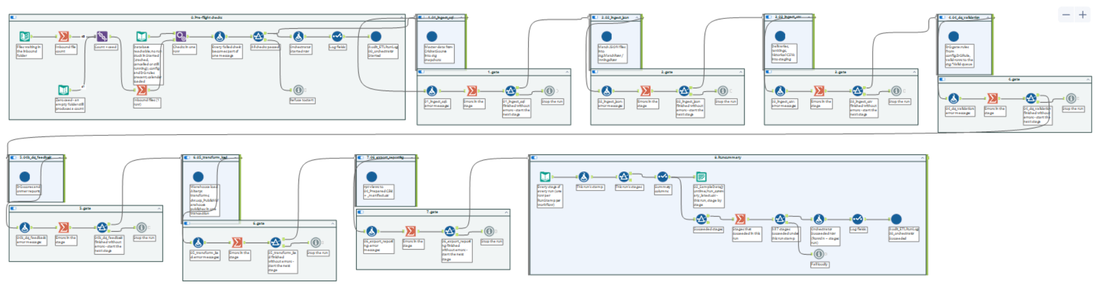
05 · ALTERYX IMPLEMENTATION Brief §4–5
Alteryx ETL pipeline
One orchestrator runs seven stages; each starts only if the last succeeded
01
SQL master
02
JSON
03
CSV
04
Quality gate
04b
DQ feedback
05
Load
06
Export
Live query of
CricketSource
MD5 fingerprint,
parse nested JSON
Route by name,
batch macro per file
43 SQL rules,
new files only
Scores and
owner reports
Type-2, derived
facts, one commit
.hyper per view,
counts reconciled
Cricket Analytics Platform
10
Notes:
The ETL is built in Alteryx. One orchestrator workflow, shown here, runs seven stage workflows in order. Each stage sits in its own control container with a gate after it: the next stage starts only if the previous one finished without errors, and a run summary is written at the end. Ingestion reads the SQL master data live, and reads every JSON and CSV file whole, fingerprinting it with an MD5 hash before parsing, so a re-sent file is recognised. The quality gate runs the 43 rules inside SQL Server, only on new or changed files. The load builds the warehouse and publishes it in one database transaction, so it is never half-written. The export writes one Tableau extract per reporting view and reconciles the row counts. Shared macros give every stage the same logging, rule engine and file readers.

Slide 11
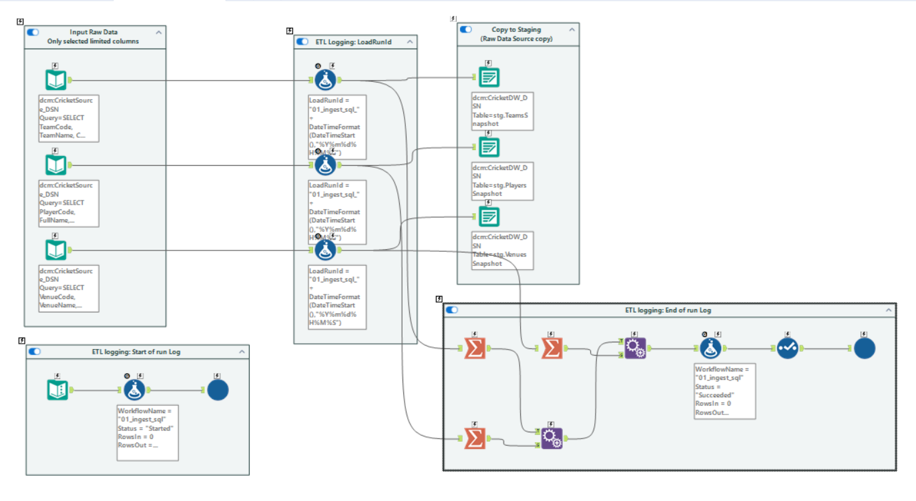
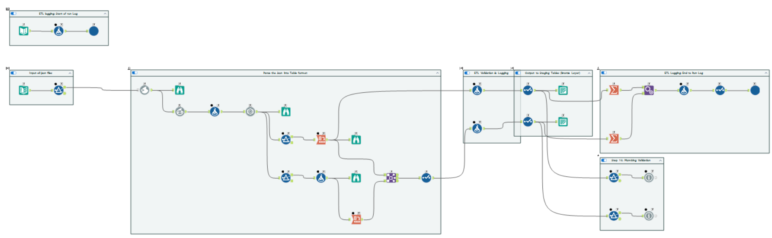
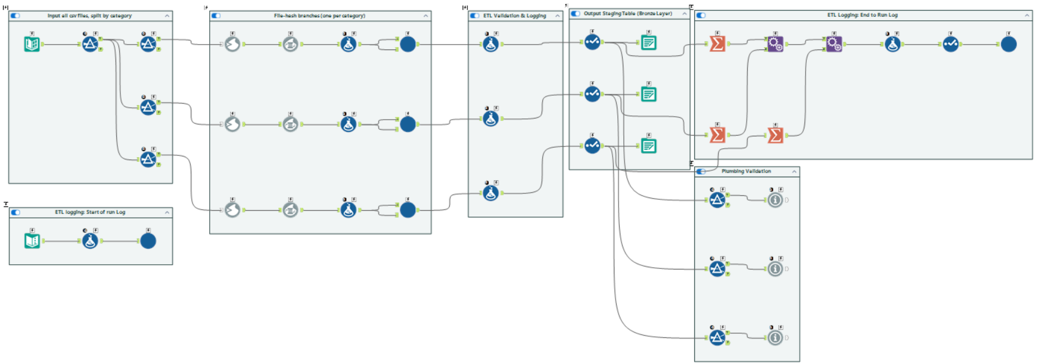
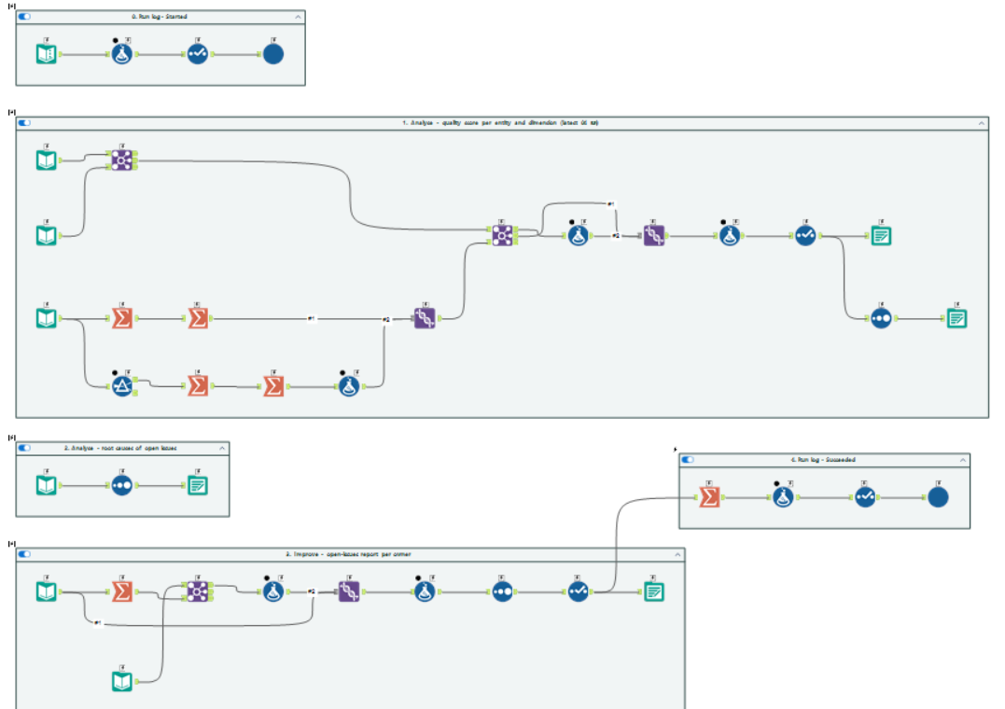
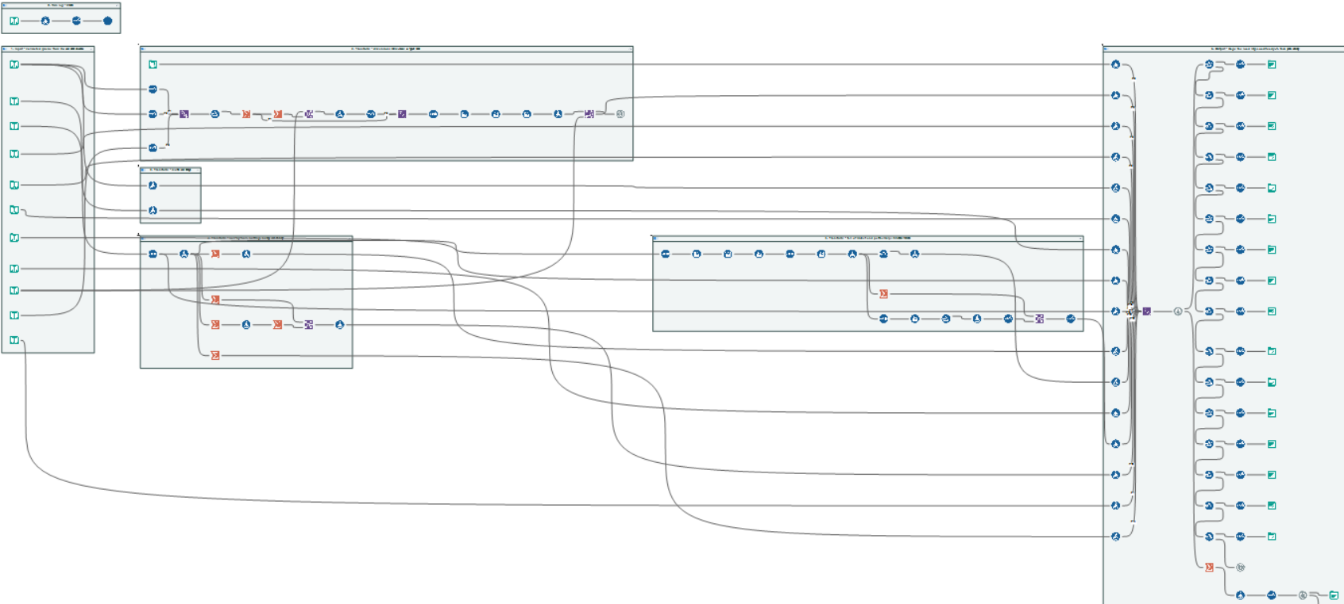
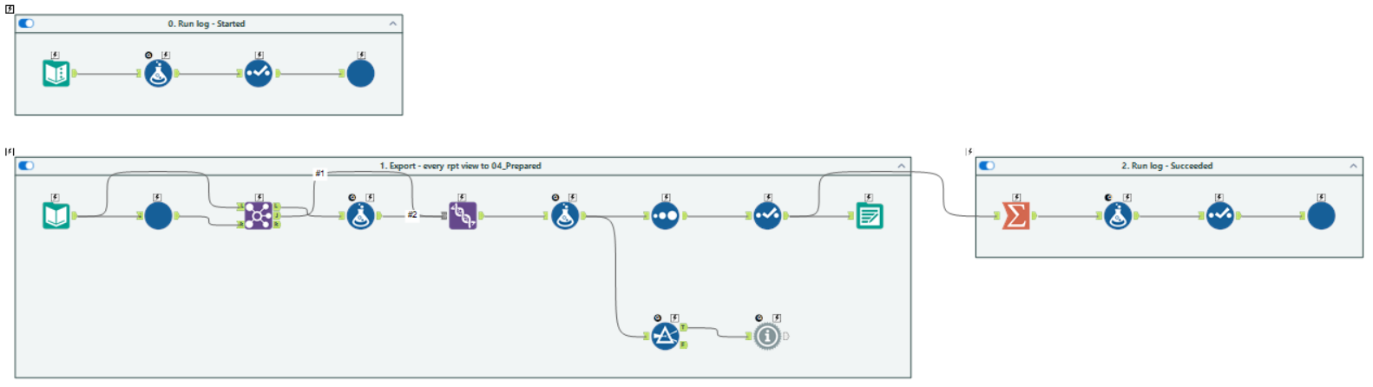
05 · ALTERYX IMPLEMENTATION Brief §4–5
Inside the Alteryx workflows
Each step in a labelled container; every run logged the same way
01 · SQL master data into Bronze
02 · JSON: fingerprint, parse, flatten
03 · CSV: route by name, batch-read
04b · Quality scores and owner reports
05 · Star schema, one-transaction publish
06 · Export every view to .hyper
Cricket Analytics Platform
11
Notes:
A closer look inside the workflows. Each canvas is organised into labelled containers, one per step, and every workflow starts and ends with the shared logging macro, so each run leaves a Started and a Succeeded or Failed row in the audit log. Paths are relative and connections are named, so the same files run on any machine.

Slide 12
06 · DATA PROCESSING Brief §5
Data processing
What happens to the data between a raw file and the warehouse
INPUT
PROCESSING (ALTERYX)
OUTPUT
Nested JSON match file
Parse and flatten
JSON Parse · Cross Tab
1 match row + its innings rows
28,069 deliveries
Derive facts
Summarize · Multi-Row Formula
batting 2,046 · bowling 1,246 · partnerships 1,839 · wickets 1,673
Team name in each match
Build history
Multi-Row (Type-2)
Dim_Team: 9 versions for 8 teams
Mixed date formats, name casing
Standardise
Formula · Select (typed)
Conformed, typed Silver rows
Re-sent or corrected file
Fingerprint (MD5)
vs Audit_FileControl
Copy skipped; correction replaces its match in one transaction
Cricket Analytics Platform
12
Notes:
Here is what processing actually does to the data. Nested match files are parsed and flattened into match and innings rows. Twenty-eight thousand deliveries are turned into batting and bowling figures, partnerships, falls of wicket and an over summary. A team's name as carried in each match file becomes Type-2 history. Mixed date formats and inconsistent names are standardised on the way into Silver. And every file is fingerprinted, so a re-sent copy is skipped while a corrected file replaces its match in one transaction.

Slide 13
06 · DATA PROCESSING Brief §16 · additional challenge
New data in, insight out
Four situations, all handled automatically, with no manual preparation
+
↻
✕
New match
Corrected file
Duplicate file
Broken file
119 → 120 matches
Result flips
Nothing changes
Rejected with a reason
Chennai Kings move to
the top of the 2025 table
Delhi won → Mumbai won;
old rows replaced
Recognised by its
fingerprint and skipped
The rest of the run
completes normally
Cricket Analytics Platform
13
Notes:
The real test of automation is new data. We prepared four situations. A new match: drop the file, one click, and it appears everywhere - match count goes from 119 to 120 and Chennai move to the top of the table. A corrected file: the result flips and the old rows are replaced, never duplicated. A duplicate: recognised and ignored. A broken file: rejected with its reason while everything else completes. Nobody prepares reporting data by hand.

Slide 14
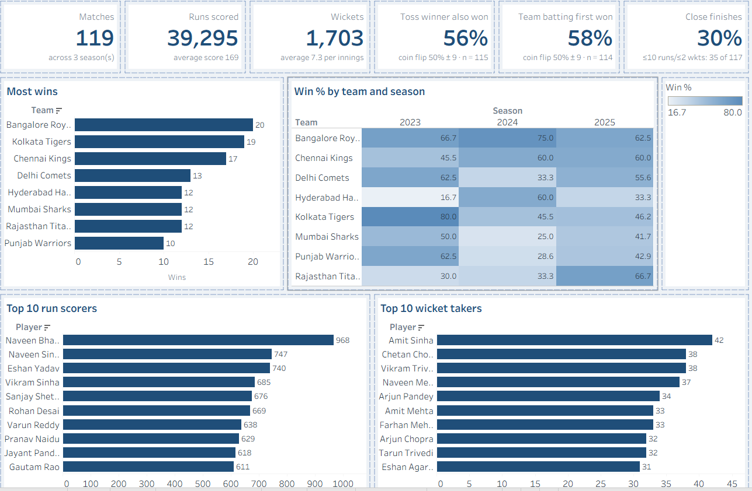
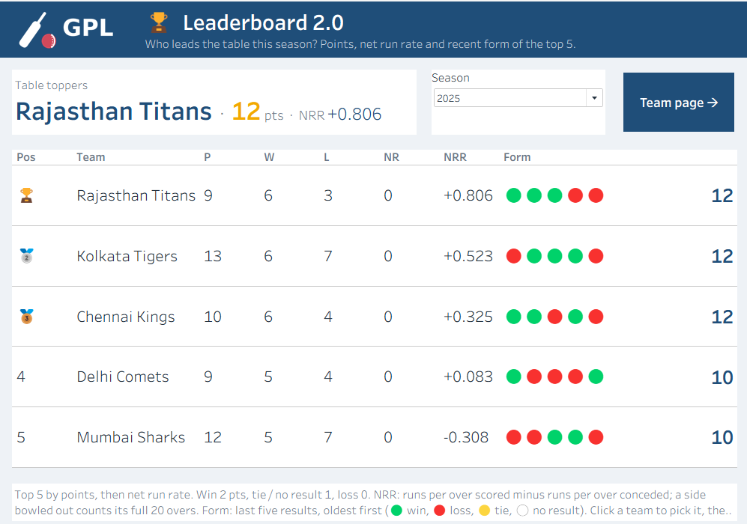
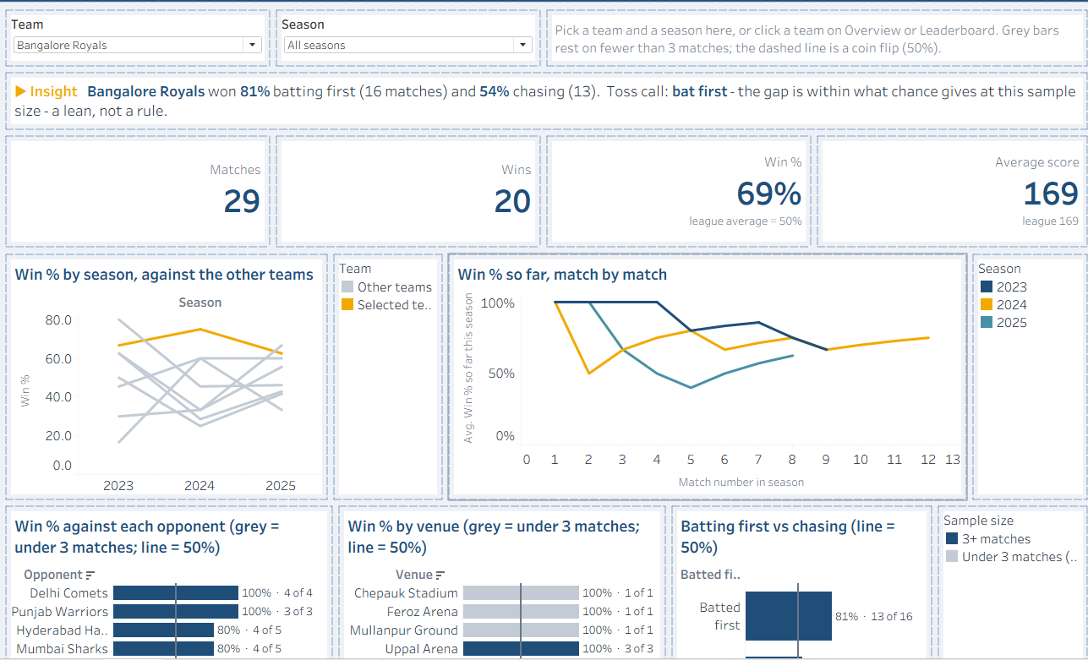
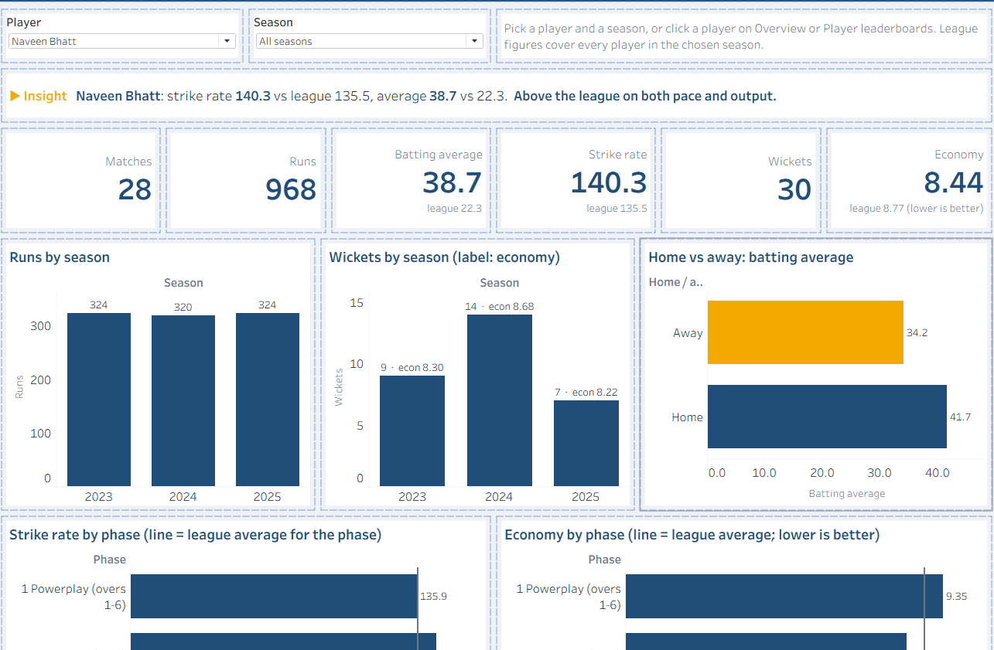
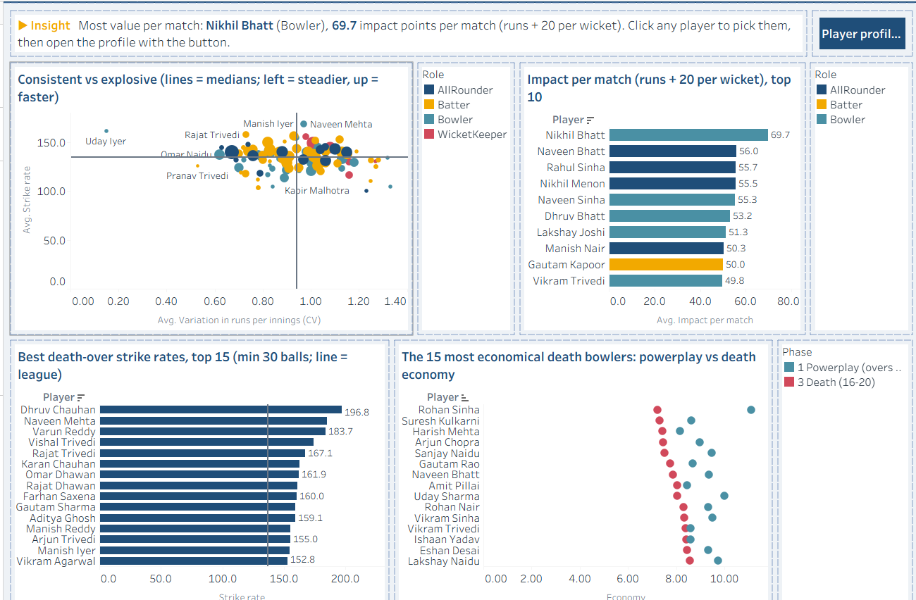
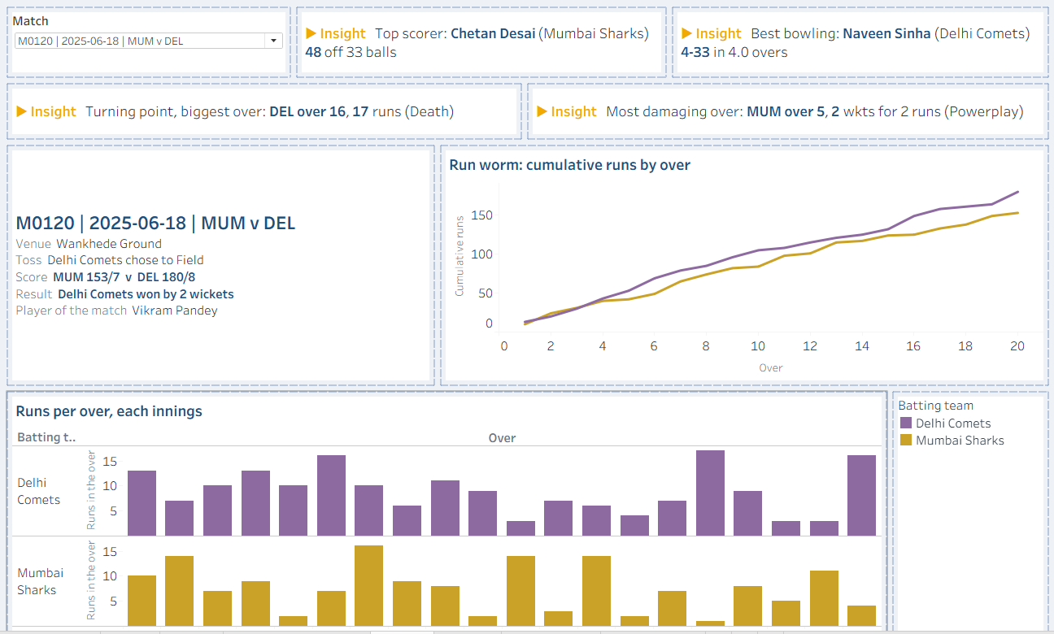
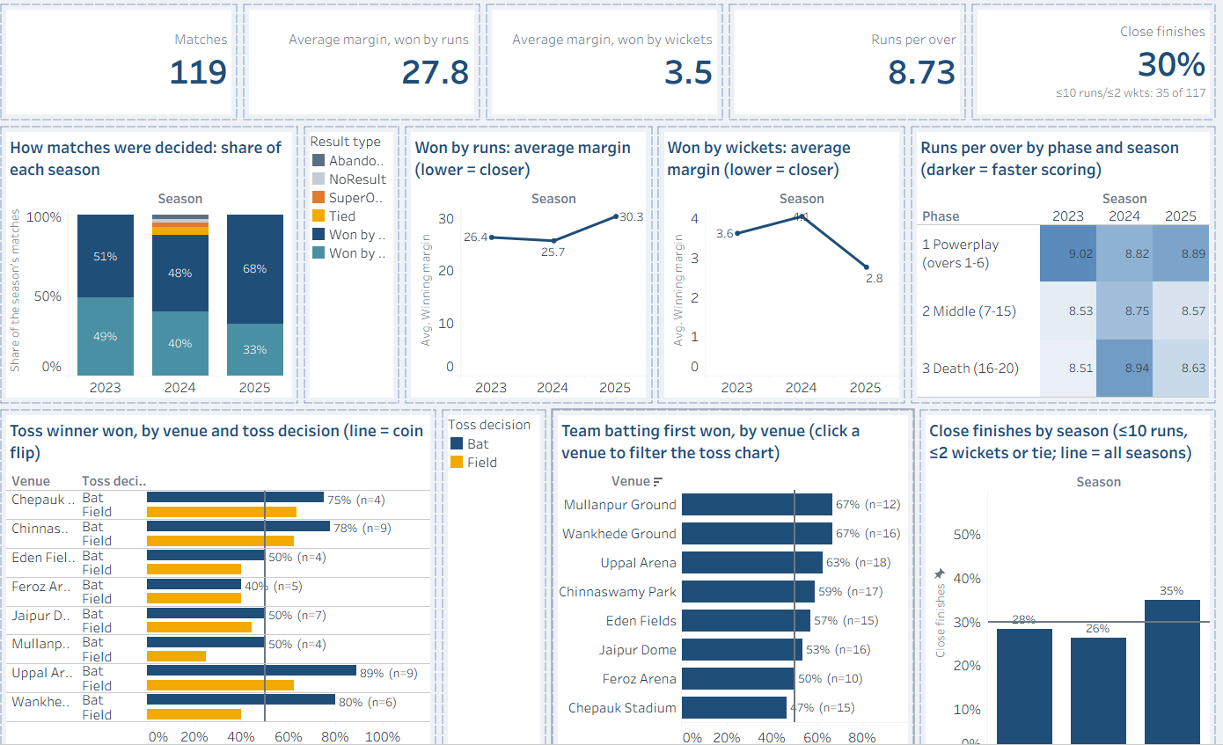
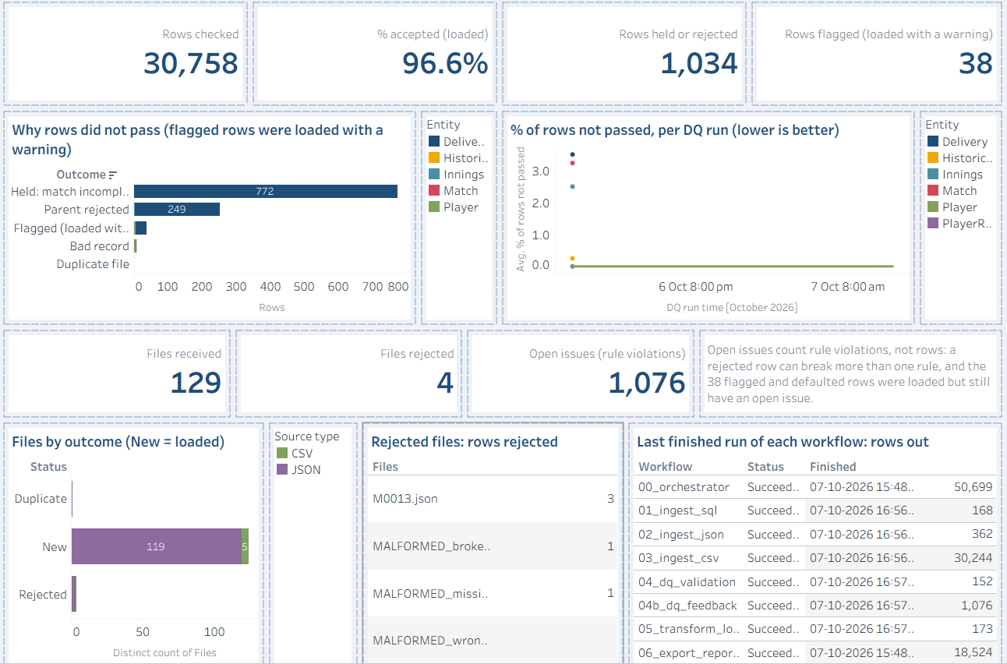
07 · TABLEAU DASHBOARDS Brief §8–9
Eight dashboards, one story
Each page opens with an insight sentence computed from the data
Overview
Leaderboard
Team
Player
Player leaderboards
Match centre
Trends
Data quality
Cricket Analytics Platform
14
Notes:
These are the eight dashboards. Overview gives the headline picture; Leaderboard is the points table; Team and Player let you pick any team or player; Player leaderboards rank who adds most value; Match centre replays any match; Trends shows how the game is changing; and Data quality shows how much of the data passed the checks. Every page opens with a one-line insight written by the data itself, so it stays true when new data arrives.

Slide 15
07 · TABLEAU DASHBOARDS Brief §8–9
What the data tells us
Dashboards separate real patterns from chance
Wins by team, all seasons
56%
Toss winners also won
Within chance: not a real edge
58%
Teams batting first won
A lean, not a rule
30%
Close finishes
A balanced competition
Cricket Analytics Platform
15
Notes:
What does the data tell us? Bangalore Royals have the most wins. More interesting are the myths the dashboards test: winning the toss looks like an advantage at 56%, but with 115 matches a coin flip lands that far from 50% by chance alone, so the dashboard says it is not a reliable edge. Batting first, 58%, is a lean, not a rule. And 30% of decided matches are close finishes - the competition is balanced. The dashboards make this distinction automatically, so nobody over-reads a lucky streak.

Slide 16
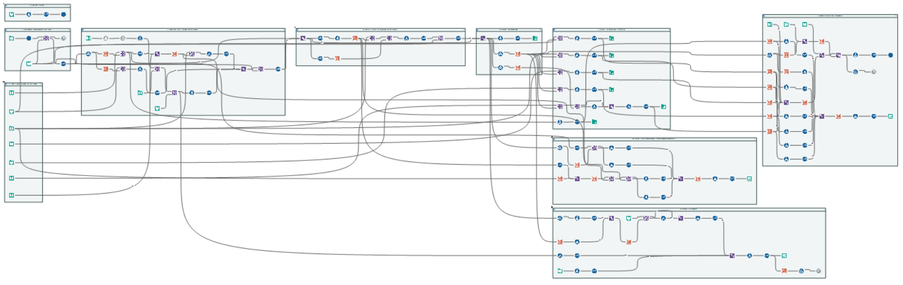
08 · DATA-QUALITY HANDLING Brief §6–7
Data-quality workflow
Rules are data: checked in-database, logged to the row, reported to owners
1
Scope
2
Rule engine
3
Outcome
4
Evidence
5
Feedback
Only new or changed
files (content hash)
43 rules read from
config.DQRule, run as SQL
Accepted → Silver
audit.DQException:
file, row, rule, value
Score per run; report
per data owner (04b)
Flagged · loaded
Rejected · held back
Rules by data-quality dimension
Cricket Analytics Platform
16
Notes:
This is the data-quality workflow in detail. Only files whose content has not been seen before are checked. The rule engine reads the 43 rules from a table - each rule is a row with its dimension, a SQL condition, an action, an owner, a root cause and a fix hint - and runs them inside SQL Server. Every row then gets one outcome: accepted into Silver, loaded with a warning, or held back. Every violation is logged with the file, the row, the rule and the raw value, so any number can be traced. Workflow 04b then scores each run and writes a report for each data owner. Adding a rule is a new row in the table, not a change to any workflow.

Slide 17
08 · DATA-QUALITY HANDLING Brief §6–7
Data you can trust
Every row is checked before it reaches a dashboard
43
quality rules
missing, duplicate, invalid,
unknown codes, broken files
96.6%
0
rows lost silently
of rows loaded
each rejected row keeps its
reason, rule and owner
129
files fingerprinted
re-sent copies are spotted
and never loaded twice
Accepted 29,686
Warning 38
Held / rejected 1,034
Cricket Analytics Platform
17
Notes:
Trust was the hardest part. Every one of the 30,758 rows is checked against 43 rules before it reaches a dashboard. 96.6% were loaded: 29,686 clean and 38 with a warning; 1,034 were held back or rejected - and each of those has a recorded reason and an owner who can fix it at the source. If one ball of a match is wrong, the whole match's ball-by-ball is held, so no dashboard ever shows a half-loaded match.

Slide 18
09 · SECURITY CONSIDERATIONS Brief §11
Security considerations
Least privilege: each identity can do one job, and nothing more
IDENTITY
CAN ACCESS
cricket_source_reader
SELECT only
CricketSource · dbo
Roles, not people
used by Alteryx 01
grants go to database roles
cricket_etl_writer
Read / write · rules read-only · no DDL
CricketDW · stg, dw, audit
No secrets in git
used by Alteryx 01–05
passwords only in local config
cricket_rpt_reader
SELECT + EXECUTE on rpt only
CricketDW · rpt views
Rules protected
used by Alteryx 06
pipeline cannot edit its own rules
Tableau
No database credentials at all
04_Prepared · .hyper files
Proven
used by dashboards
19 impersonation checks pass
In production AD-group roles · service accounts, no passwords · single sign-on · row-level security per user
Cricket Analytics Platform
18
Notes:
Security follows least privilege. Three SQL logins, each scoped to one database and one job, with permissions granted to roles rather than to people. The source reader can only read master data. The ETL writer can read and write staging, warehouse and audit, can read the rules but not change them, and cannot create objects. The reporting reader sees only the reporting views - not a single base table. Tableau holds no database credentials at all: it reads extracts. Passwords live only in a local file that is never committed, and the whole model is proven by impersonation tests. In production the same roles map to company groups, with single sign-on and row-level security.

Slide 19
10 · PERFORMANCE CONSIDERATIONS Brief §10
Performance considerations
Measured at each layer: what we changed, and the effect
Runs per over, per query (ms)
Pre-aggregated over table; indexes on fact keys and season
SQL
9x faster · all views in 176 ms
Only new or changed files validated (content hash)
Alteryx
a rerun skips 128 unchanged files
43 rules run set-based inside SQL Server
Alteryx
one query per rule, not row by row
One stream, one stored-procedure publish
Load
one transaction per run
9x faster
One extract per view, already at dashboard grain
Tableau
Match centre queries: 0.19 s
Cricket Analytics Platform
19
Notes:
Performance was considered at every layer. In SQL, run-rate charts read a pre-aggregated over table instead of summing every delivery: 3.6 milliseconds becomes 0.4, nine times faster, and all reporting views read in 176 milliseconds in total. In Alteryx, only new or changed files are validated, and the 43 rules run as set-based SQL inside the database instead of row by row. In Tableau, every view is an extract already at dashboard grain, so a whole dashboard's queries take about a fifth of a second.

Slide 20
11 · DEPLOYMENT APPROACH Brief §12
Deployment approach
Rebuilt on any Windows PC from the README, with one setting to enter
Install
Configure
Build
Connect
Run
Analyse
SQL Server Express,
Alteryx trial, Tableau
Public, Python
One file, one value:
SQL_INSTANCE
setup_database.bat
11 scripts, seeded
DSN script, 2 Alteryx
connections, relink
Stage files, then
one click in Alteryx
Open the workbook;
no setup needed
Repository, numbered in the order you use it
✓ No absolute paths
01_Setup
02_SampleData
03_Alteryx
04_Prepared
✓ No credentials in git
✓ Relative workbook paths
05_Tableau
06_Tests
07_Docs
config
✓ Re-runnable setup
Cricket Analytics Platform
20
Notes:
Deployment is designed so that another person can rebuild the whole solution on their own PC from the README. Install the four tools, enter the SQL Server instance once in a single config file, and run three scripts that check prerequisites, create both databases and create the ODBC data sources. Create the two Alteryx connections and run one relink script. From then on, a run is: stage the files, click run in the orchestrator, open the workbook. Nothing in the repository holds a server name, password or absolute path.

Slide 21
11 · DEPLOYMENT APPROACH Brief §12
Production architecture
The same medallion design, scheduled, secured and shared
ingest
load
read-only
HTTPS
Sources
Alteryx Server
SQL Server
Tableau Server
Business users
SQL Server (OLTP)
Scheduler + file watcher
Bronze · raw
Certified data source
Web and mobile
JSON via SFTP
Orchestrator in Gallery
Silver · validated
Extract, full refresh
SSO: SAML / AD
CSV landing share
Service-account DCM
Gold · star schema
Row-level security
Subscriptions, alerts
Run log → audit
Semantic · rpt views
Projects by AD group
Metadata & audit
Refresh only after a successful load (REST API)
Dev → Test → Prod from Git
Secrets in a vault
Alerts on failed or stuck runs
Cricket Analytics Platform
21
Notes:
Finally, the production architecture: the same medallion design, hosted for the organisation. Alteryx Server runs the orchestrator on a schedule or when new files land, with credentials held by a service account. A dedicated SQL Server holds the medallion layers and the metadata. Tableau Server publishes one certified data source; Alteryx triggers its refresh through the REST API only after a successful load, so dashboards never show a half-finished run. Users sign in with their company account, on the web or mobile, and row-level security shows each person only their data. Code is promoted from dev to test to production through Git.

Slide 22
✓ · SUMMARY Brief §17
Why this design works
Each requirement mapped to a design choice and its benefit
REQUIREMENT
DESIGN CHOICE
BENEFIT
Three source formats, new data arriving
Medallion layers: Bronze → Silver → Gold
Raw data replayable; one job per layer
Find bad data and trace its handling
Metadata-driven DQ: 43 rules as data
A new rule is a new row; every exception traced
Reliable runs, error handling and logging
Orchestrator, file fingerprints, run log
Safe failure, no duplicates, full audit
Business calculations consistent everywhere
Semantic layer: rules in rpt views
Dashboards match SQL by construction
Good performance at every layer
Star schema, pre-aggregates, extracts
Over-level queries 9x faster; fast dashboards
Secure, and deployable on another PC
Least privilege; config-driven scripted setup
No credentials in code; rebuilt from a guide
Cricket Analytics Platform
22
Notes:
To summarise the design: each requirement of the brief maps to a design choice, and each choice brings a concrete benefit. Medallion layers keep raw data replayable and give each layer one job. Metadata-driven quality rules make checks easy to extend and fully traceable. The orchestrator, file fingerprints and run log make runs reliable and auditable. A semantic layer keeps every calculation consistent. The star schema, pre-aggregation and extracts keep it fast. Least-privilege access and scripted setup keep it secure and reproducible.

Slide 23
✓ · SUMMARY Brief §14
The work behind the insights
A complete BI solution, by the numbers
8
648
6
43
Alteryx workflows
Alteryx tools
reusable macros
data-quality rules
1 orchestrator + 7 stages
in 52 labelled containers
logging, rules, readers, export
6 dimensions, stored as data
30,758
57 · 32
10
36 · 50
rows validated
SQL tables · views
business-rule functions
foreign keys · indexes
on every run
Bronze → Silver → Gold → rpt
every measure defined once
integrity and speed
108
22
8 · 82
1
automated SQL checks
reporting views
dashboards · sheets
click to rerun
plus 58 documented test cases
exported as 22 extracts
and a 5-point story
new data to dashboard
Cricket Analytics Platform
23
Notes:
To give a sense of the work behind the dashboards: eight Alteryx workflows - an orchestrator and seven stages - built from 648 tools in 52 labelled containers, sharing six reusable macros. 43 data-quality rules across six dimensions check over thirty thousand rows on every run. SQL Server holds 57 tables and 32 views, with ten business-rule functions, 36 foreign keys and 50 indexes, all created by script. Quality is proven by 108 automated SQL checks and 58 documented test cases, and the solution is documented end to end so anyone can rebuild it.

Slide 24
✓ · SUMMARY Brief §2
The impact
What changes for the business
Before
After
Hours of manual stitching
One click updates everything
Numbers you cannot check
Every number traced to its source
Problems hidden in the data
Every problem logged, with an owner
Static reports
Interactive answers, insight first
Works on one person's PC
Rebuilt anywhere from a guide
Cricket Analytics Platform
24
Notes:
So what changed? Before, answering a question meant stitching three sources together by hand, with no way to know whether a number was right. Now one click brings everything up to date, every number can be traced back to the row and file it came from, and business users explore the answers themselves in interactive dashboards. And because setup is scripted, the whole solution can be rebuilt on another PC from the instructions.

