Slide 1
MIS 6345.0W1 - High Performance Analytics - F18
Assignment 2
By – Priyanshi Khatri(pxk173330)

Slide 2

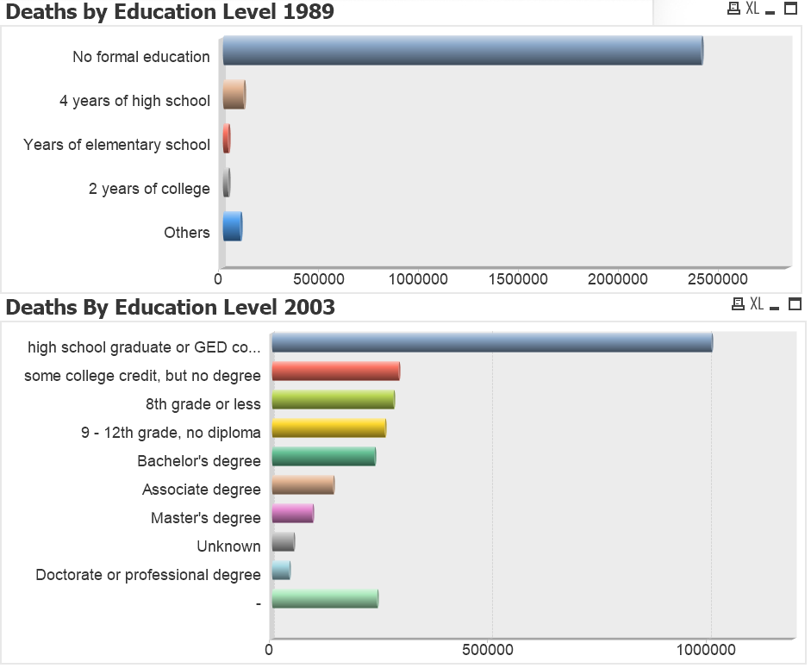
Findings
The percentage of death rate is quite high for high school graduates compared to all the other education levels for both years 1989 and 2003.
In 2003 it is observed that the people with highest level of education which is doctorate or professional degree have the lowest death rate.
Also education levels of some individuals in unknown.

Slide 3
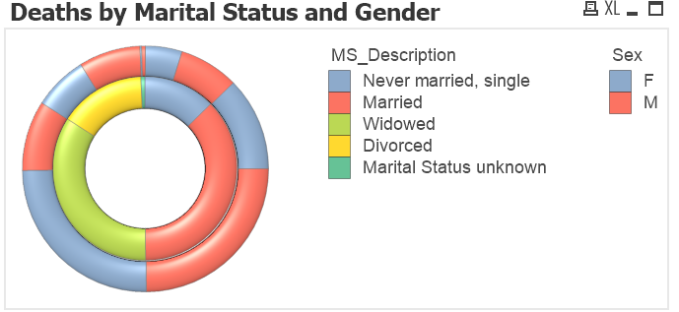
Findings - Continued
In death analysis by demographics - Most of the registered death cases are either for married or widowed (Marital Status)
For Married - Male Deaths >> Female Deaths For Widowed - Male Deaths << Female Deaths
It is quite a distinctive observation that getting widowed has a negative impact on females life whereas married male die more compare to females.
In terms of Resident status, maximum death rate is for Residents and minimum death rate is for Foreign Residents

Slide 4
Findings - Continued
Age range of 75-95 years have high death rates for both males and females.
Whites have high number of death records where as Samoan has the least number of death records.
One of the major causes of death is Heart Diseases as they have the maximum number of death records.
Also, for a lot of individuals the cause of death is mentioned as ‘Other’ in the data.

Slide 5
Findings - Continued
Following places have been shown as ‘Places of Injury’ with maximum death records (other than unknown places)-
Home
Street and Highway
Residential Institution
Following places have been shown as ‘Places of Injury’ with maximum death records –
Hospital, Clinic or Medical Center
Decedent's Home
Nursing Homes

Slide 6
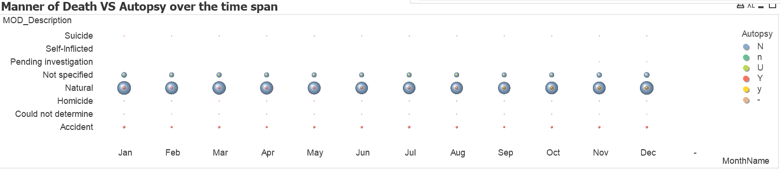
Findings - Continued
For cases still ‘Pending Investigation’ and ‘Could Not Determine’ (Manner of death), it is observed that Autopsy was performed on majority of the cases. Even then the cases has not yet been resolved. Thus, the information gained through autopsies might not have a significant contribution to complete the pending investigations.
Majority of the death records has Natural Death as the Manner of Death and no data is available for Self – Inflicted.

Slide 7
Problems Faced
More information is required to understand the context of the database theme, attributes were difficult to understand without metadata.
It was difficult to understand the role of few data fields and the relationship between data tables without the field descriptions.
Faced difficulty in writing expressions as some of the keys did not have unique values.
Faced difficulty in utilizing the front end features of QlikView such as modifying the existing field names as some of them were too long and reassigning the new values for a particular field.
The data was huge, and so reloading the script took a lot of time. Thus, I had to check the whole script and make as many corrections as possible at once so that I don’t have to reload it again and again.

Slide 8
Recommendations
The data provided is only for a year, analysis would have been better if the same data was for minimum 3 to 4 years. The trend of death rate over the years would have been a very useful insight.
Death rate at Nursing homes and hospitals can be reduced by implementing safety measures.
As adults are more vulnerable to deaths, it requires further study to find the leading causes of deaths. In the data the cause of death for a major portion of individuals is just mentioned as ‘other’.
Research needs to be done regarding the low mortality of blacks citizens in comparison to white citizens.
Better mental heath services for prevention of suicide/homicide and also only 50% of the cases were examined.

