Slide 1

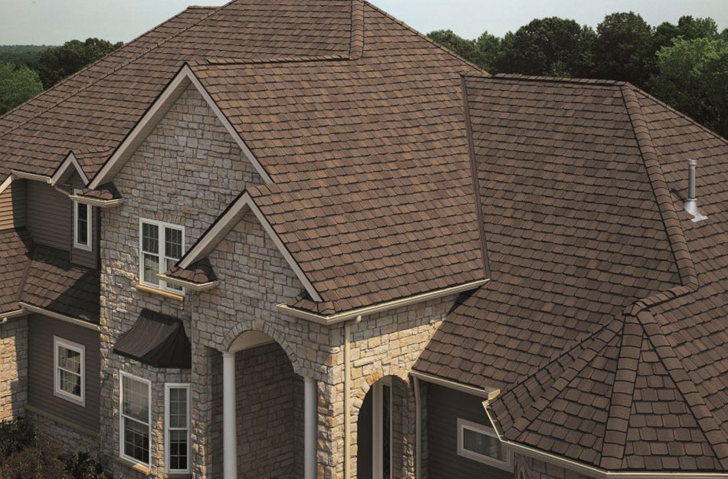
Saint-gobain india
WEB ANALYTICS PROJECT
Group - 1
Dolly Kumari
Noopur Dulet
Parul Hatwar
Priyanshi Khatri
Sai Ram Bharadwaj Godasi
Sonali Gupta

Slide 2
CAMPAIGN OVERVIEW
Business – Saint-Gobain India
Target Location – Kerala
Goal – To generate sales leads
Campaigns – 1) Branded
2) Non-Branded
3) Shingles Awareness
Run Time – 25th March – 15th April
Total Budget - $248
Distribution – Effective - $210 Tax (GST) - $38
First Week - $55
Second Week - $85
Third Week - $108

Slide 3
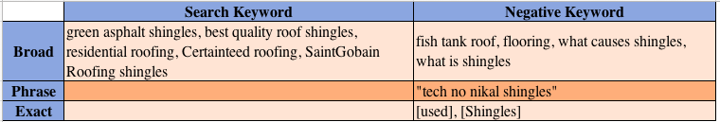
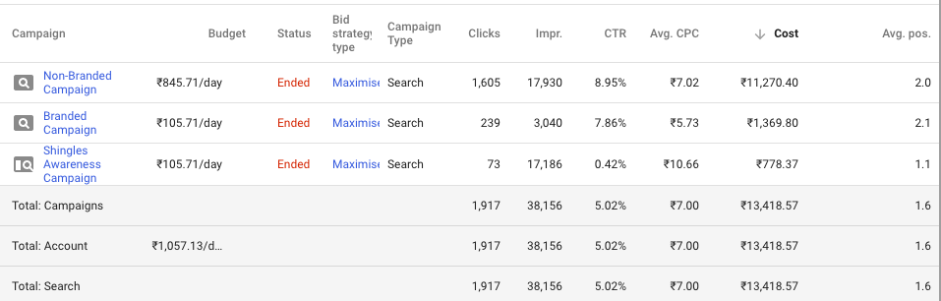
EVOLUTION OF CAMPAIGN STRATEGY
Total Search Keywords – 283 Negative Keywords – 10
Keyword Strategy
During the campaign, keyword optimization was done by adding negative keywords, matching keywords better with ad copies, and developing match types from broad to phrase and exact match. The less relevant keywords were paused, as they didn't generate clicks.
Keyword Strategy
Campaign’s Performance
Budget Allocation
Overall Campaign’s Performance

Slide 4
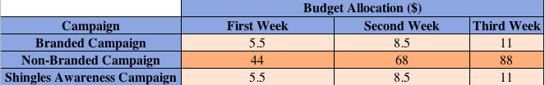
EVOLUTION OF CAMPAIGN STRATEGY
The Non-Branded campaign was the most cost-effective one due to the use of specific keywords. The Branded campaign was intended to create awareness, which it achieved with 239 clicks.
Budget Allocation
Keyword Strategy
Campaign’s Performance
Budget Allocation
Originally, we started the campaign with lowest of all the 3 weeks. After first week, we were able to develop insight on how to reassign our budget as per our campaign structure. We increased the budget for following weeks and reassigned the budget as well, depending on ad’s performance.

Slide 5
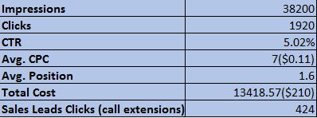
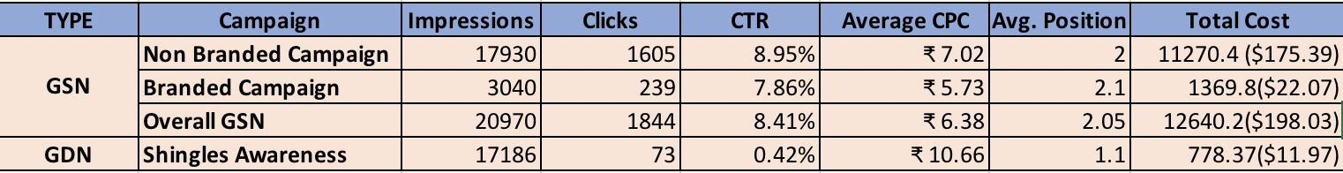
KEY RESULTS AND SUMMARY
Overall Account Statistics
This strong CTR across all the campaigns was achieved using highly specific targeting options based on Demographics like age, income, and location-based targeting.
Overall Account Statistics
Campaign’s Performance
Ad Group Level Performance
Overall Campaign Level Statistics

Slide 6
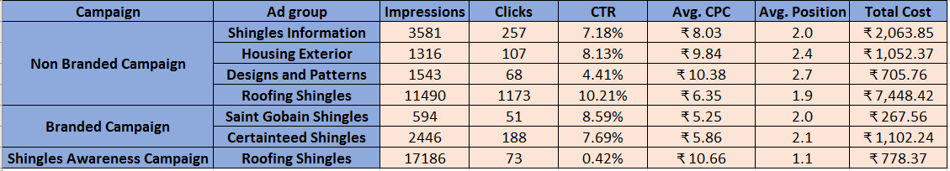
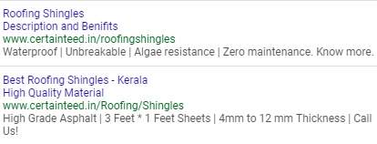
KEY RESULTS AND SUMMARY
Performance Statistics at Ad Group Level
The three top Ad Groups were Roofing Shingles with 1173 clicks and 10.21% CTR, Shingles Information with 257 clicks and 7.18% CTR, and CertainTeed Shingles with 188 clicks and a CTR of 7.69%.
Overall Account Statistics
Campaign’s Performance
Ad Group Level Performance
Top Performing Ads
Top Performing Ads

Slide 7
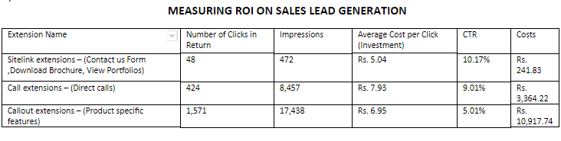
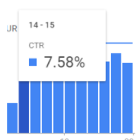
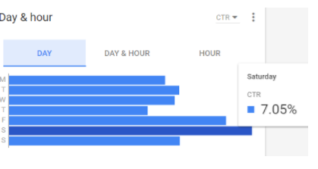
FUTURE RECOMMENDA-TIONS & Learnings
Timely group meetings
Tracking campaign changes
Communication plays a
vital role
Contact AdWords support immediately
Maximum CTR on Friday and Saturday between 2PM and 12 AM
THANK YOU!

