Slide 1

SRM Institute of Science and Technology
College of Engineering & Technology | School of Computing Department of Computing Technologies
18CSC305J Artificial Intelligence – Mini Project
Navigating Stock Markets with LSTM Insights
Team Members
RA2111026010396 – Prasham Jain
RA2111026010409 – Priyanshi Maheshwari

Slide 2
Abstract
Stock market prediction using artificial intelligence (AI) has gained significant attention due to its potential to provide valuable insights for investors and traders. This project aims to develop a predictive model leveraging AI techniques to forecast stock price movements accurately.
The methodology involves collecting and preprocessing historical stock data, including prices, volumes, financial statements, and external factors such as economic indicators and news sentiment. Feature selection techniques are employed to identify relevant predictors influencing stock prices.
Various machine learning algorithms, including regression models, support vector machines, decision trees, random forests, and neural networks, are evaluated and compared for their predictive performance.

Slide 3
Introduction
Problem Statement: To develop a Stock market predictor using artificial intelligence
(AI) which involves utilizing machine learning algorithms and other AI techniques to
analyze historical stock data, market trends, and various factors influencing stock
prices to forecast future movements in the market. Here's a synopsis of the process:
Data Collection: AI-based stock market prediction begins with collecting a vast
amount of data, including historical stock prices, trading volumes, financial statements, economic indicators, news articles, and social media sentiment.
Data Preprocessing: The collected data undergoes preprocessing to clean and
normalize it, removing outliers and handling missing values. This ensures that the data is suitable for analysis by AI algorithms.
Feature Selection: Relevant features that may impact stock prices are identified
and selected from the preprocessed data. These features could include factors
such as company financials, market indices, macroeconomic indicators, and sentiment analysis of news and social media.

Slide 4
Introduction
Model Selection: Various machine learning algorithms are evaluated and selected based on their performance for the specific prediction task. Commonly used algorithms include regression models, support vector machines, decision trees, random forests, and neural networks.
Training the Model: The selected model is trained using historical data, where it learns the underlying patterns and relationships between the selected features and stock price movements. The training process involves adjusting the model's parameters to minimize prediction errors.
Evaluation: The trained model is evaluated using a separate dataset to assess its performance and generalization capabilities. Evaluation metrics such as mean squared error, accuracy, precision, recall, and F1-score are used to measure the model's predictive accuracy.
Prediction: Once the model is trained and evaluated, it is deployed to make predictions on future stock price movements based on new incoming data. Predictions may include short-term price fluctuations, long-term trends, buy/sell recommendations, or risk assessments.
Monitoring and Refinement: The performance of the prediction model is continuously monitored, and the model may be refined or updated periodically to adapt to changing market conditions and improve prediction accuracy.

Slide 5
Challenges / Motivation
In a particular application of stock market prediction using AI, several challenges and issues may arise, including:
Data Quality: One of the most significant challenges is ensuring the quality and reliability of the
data used for training the predictive models. Data may contain errors, inconsistencies, or missing values, which can adversely affect the performance of the AI algorithms.
Overfitting: Overfitting occurs when a model learns noise or random fluctuations in the training
data, leading to poor generalization to new, unseen data. Balancing model complexity and generalization is crucial to avoid overfitting and ensure robust performance.
Feature Selection: Identifying relevant features or predictors that impact stock prices can be
challenging, especially in highly dynamic and complex financial markets. Choosing the right set of
features while avoiding irrelevant or redundant ones is essential for building accurate predictive models.
Market Dynamics: Financial markets are influenced by a myriad of factors, including economic
indicators, geopolitical events, investor sentiment, and market psychology. Capturing the complex
interactions between these factors and stock price movements presents a significant challenge for AI-based prediction models.

Slide 6
Problem Statement
Statement : Develop an AI model to predict the future price movements of stocks in the financial markets. The aim is to provide investors with actionable insights to make informed decisions regarding buying, selling, or holding stocks.
Description: Stock market prediction involves forecasting the future price movements of individual stocks or broader market indices. It is a complex task influenced by various factors such as company performance, economic indicators, market sentiment, and geopolitical events. The goal of this project is to leverage machine learning and statistical techniques to analyze historical stock data and identify patterns that can be used to predict future price movements.

Slide 7
Literature Survey
Author | Title | Methods
Troy J. Strader, Drake University, John J. Rozycki, Drake Univ, | Machine Learning Stock Market Prediction Studies: Review and Research Directions | A systematic literature review methodology is used to identify relevant peer-reviewed journal articles from the past twenty years and categorize studies that have similar methods and contexts
Yixin Guo, Södertörn University | Stock Price Prediction Using Machine Learning | This article introduces the theoretical knowledgeof time series model and LSTM neural network,, and then use the root mean square error to compare the prediction results of several models

Slide 8
Existing System / Work
Existing Dataset:
Historical Stock Price Data: Utilize datasets containing historical stock price information, including daily open, high, low, and close prices, as well as trading volumes. These datasets may cover various stocks across different time periods, providing a rich source of information for training and testing predictive models.
Additional Features: Some datasets may also include additional features such as company financials, news sentiment, analyst ratings, and macroeconomic indicators. These features can help enrich the dataset and capture the broader market context influencing stock price movements.

Slide 9
Existing System
Existing Methodology:
Time Series Analysis: Many existing methodologies for stock prediction leverage techniques from time series analysis. These include moving averages, exponential smoothing, autoregressive integrated moving average (ARIMA) models, and seasonal decomposition methods.
Machine Learning Approaches: Some methodologies employ machine learning algorithms such as linear regression, decision trees, random forests, support vector machines (SVM), and artificial neural networks (ANNs). Ensemble methods like gradient boosting and deep learning architectures like recurrent neural networks (RNNs) and long short-term memory (LSTM) networks are also commonly used.
Feature Engineering: Feature engineering techniques are employed to extract meaningful information from raw data. This may include calculating technical indicators (e.g., moving averages, RSI), sentiment analysis of news articles, or deriving features from company financial statements.

Slide 10
Existing Parameters
Performance & Evaluation Metrics of Existing Methodology:
Mean Absolute Error (MAE): MAE measures the average absolute errors between predicted and actual stock prices. It provides a straightforward indication of prediction accuracy.
Mean Squared Error (MSE): MSE calculates the average of the squares of the errors between predicted and actual values. It penalizes larger errors more heavily than MAE.
Root Mean Squared Error (RMSE): RMSE is the square root of the MSE and provides an interpretable measure in the same unit as the target variable.

Slide 11
Proposed System / Work
To overcome limitations of existing methodologies in stock prediction, researchers can explore several strategies:
Incorporating Alternative Data Sources: Beyond traditional stock price and financial data, integrating alternative data sources such as social media sentiment, satellite imagery, or consumer behavior data can provide additional insights into market trends and investor sentiment.
Enhanced Feature Engineering: Experiment with advanced feature engineering techniques to extract more relevant information from the data. This may involve incorporating domain-specific knowledge or generating new features that capture complex relationships between variables.
Ensemble Modeling: Combine multiple models using ensemble techniques such as bagging, boosting, or stacking. Ensemble methods can help improve prediction accuracy by leveraging the diversity of different models and reducing the risk of overfitting.

Slide 12
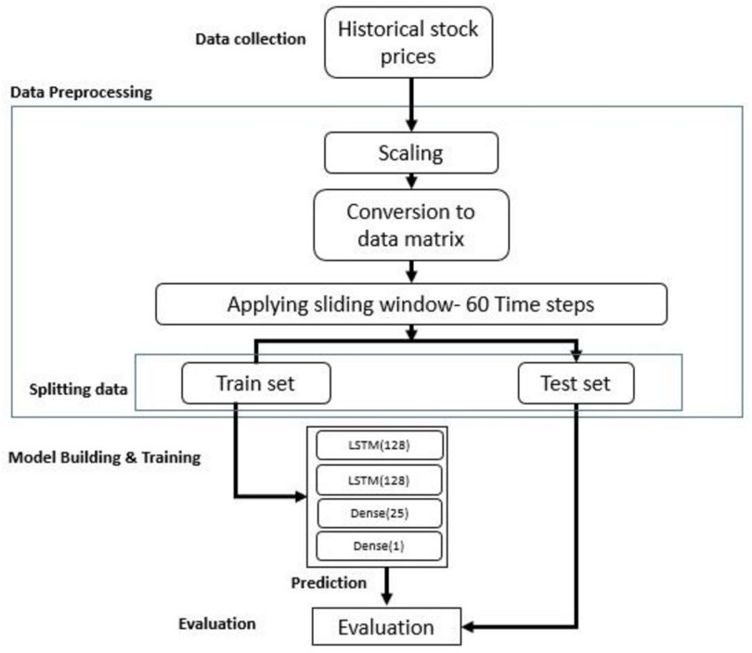
Architecture / Data Flow Diagram

Slide 13
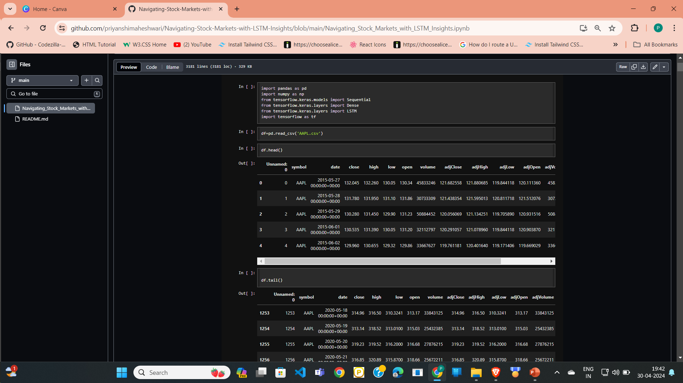
Prototype / Application Developed
1. Import all the libraries and data file

Slide 14
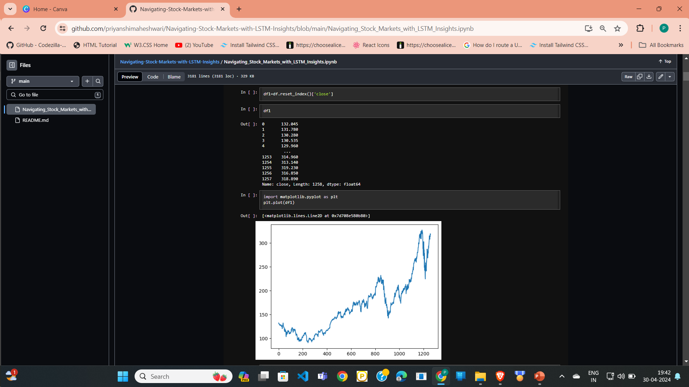
Using closing values for our experimentation of time series with LSTM and plotting the graph for it

Slide 15
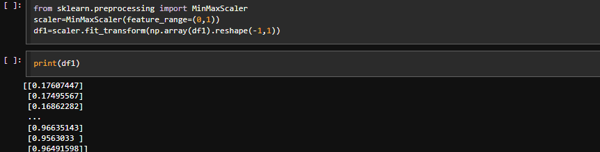
6. Normalizing the Data

Slide 16
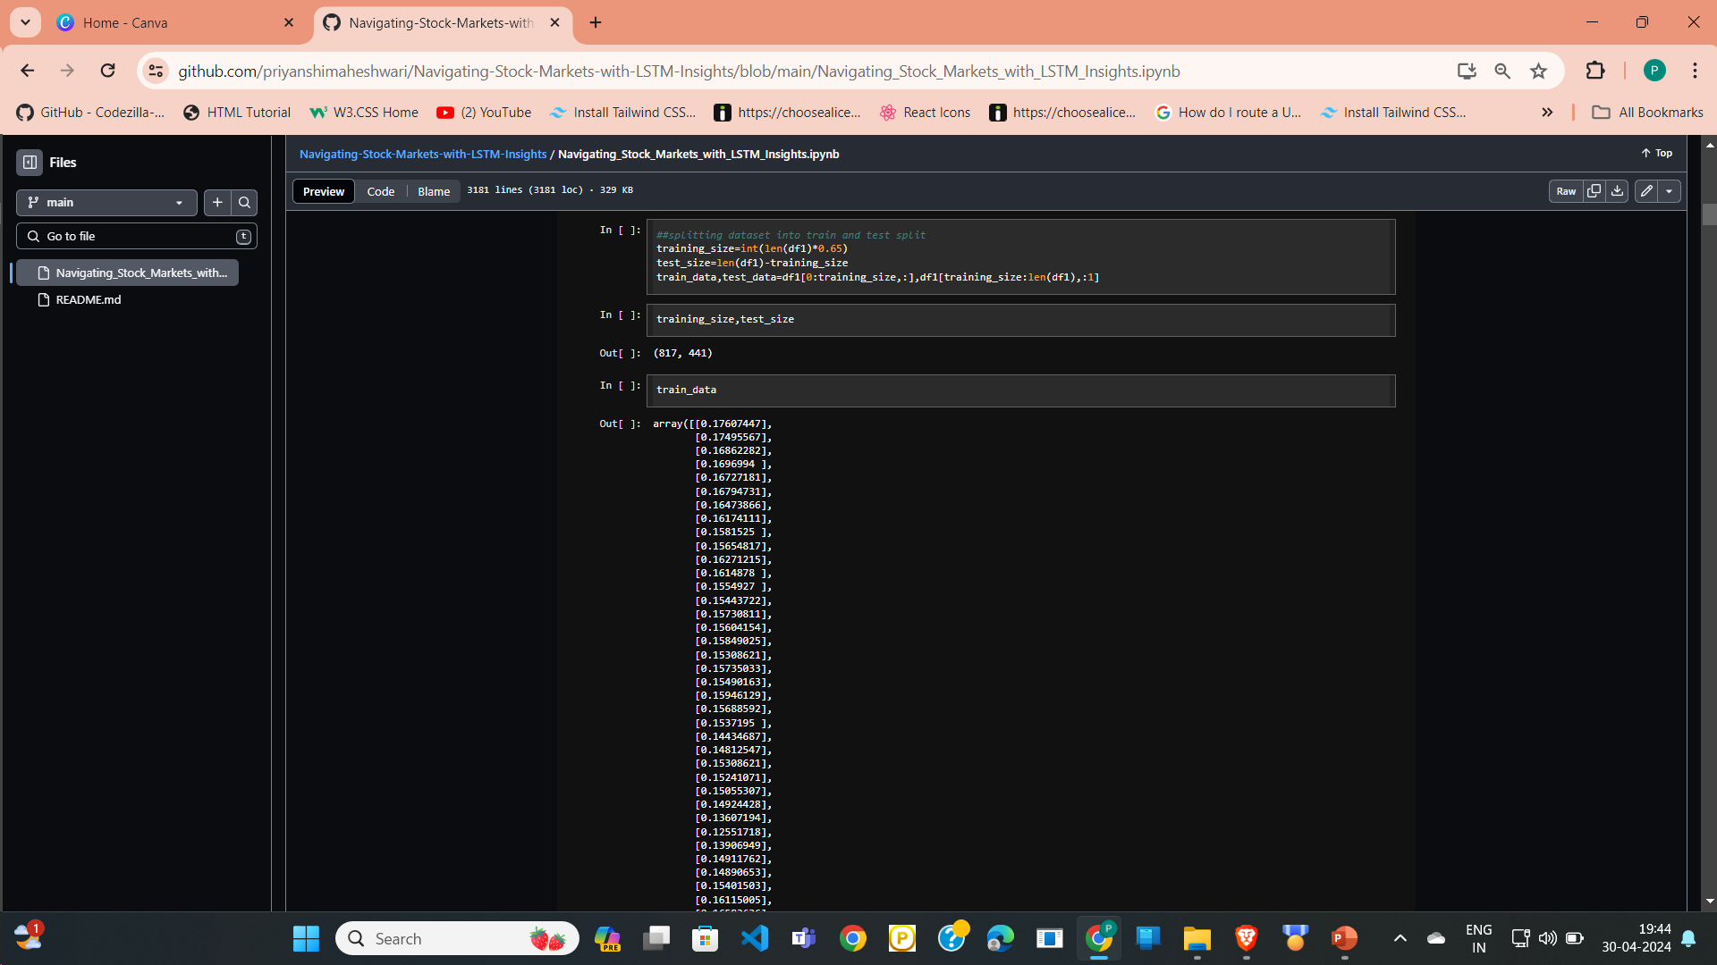
7. Creating X_TRAIN AND Y_TRAIN DATA STRUCTURES

Slide 17

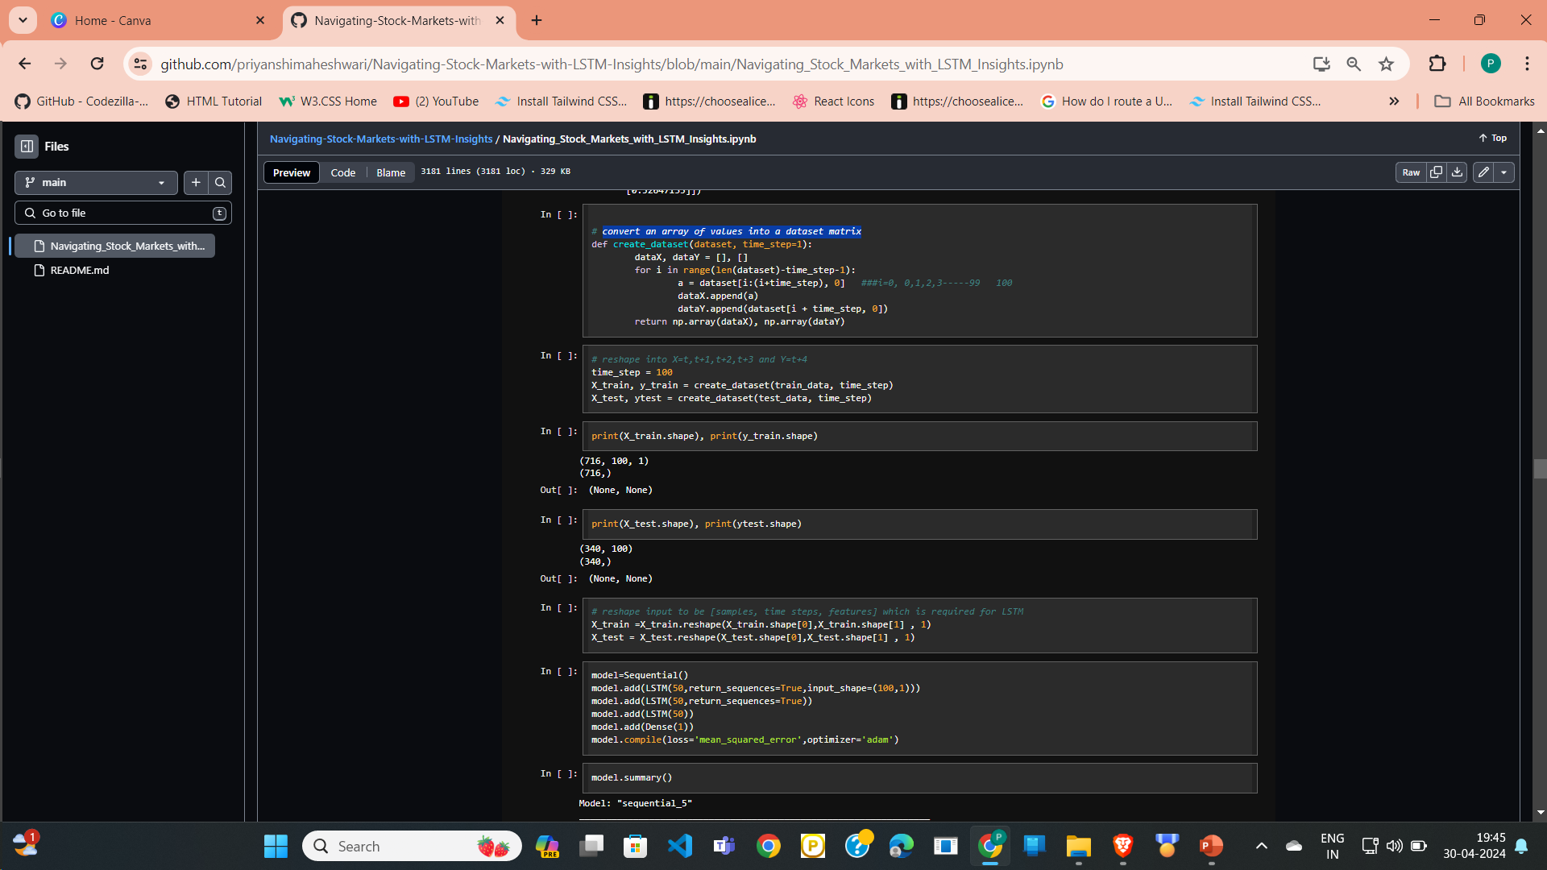
convert an array of values into a dataset matrix and reshaping it

Slide 18
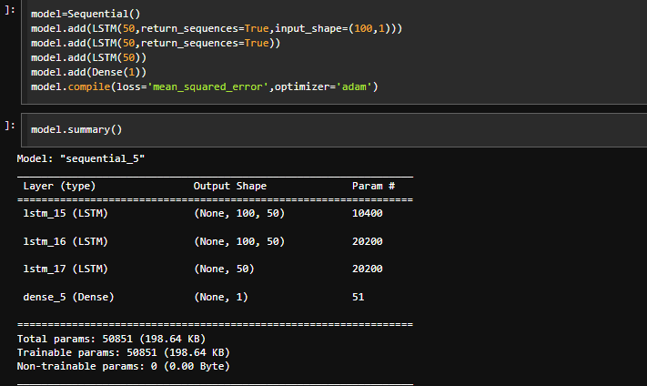
Building the lstm models with lstm and dense layer

Slide 19
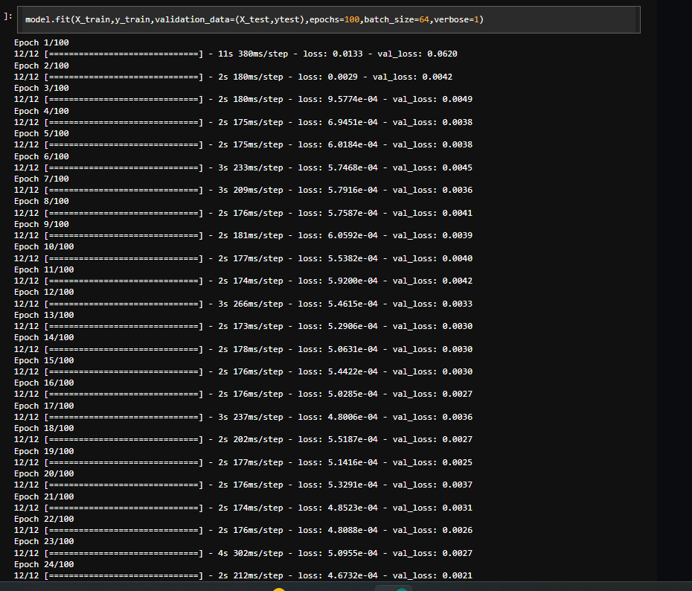
Fit the model

Slide 20
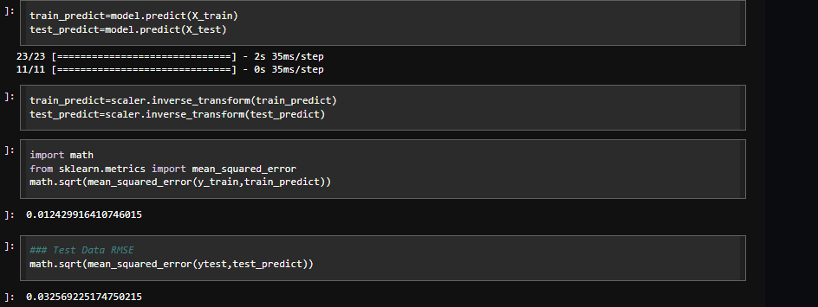
Making prediction on both train and test data and Invert the scaling and calculate mse for both train and test data

Slide 21
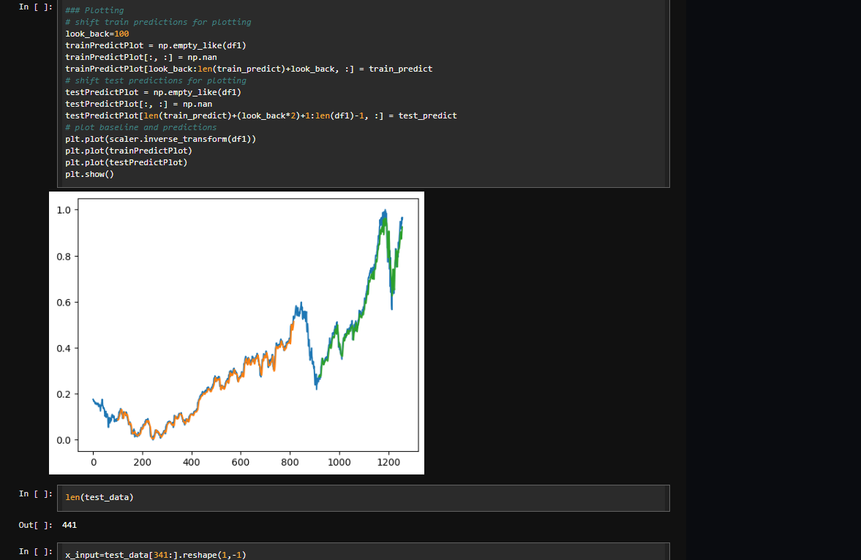
Plotting the graph

Slide 22
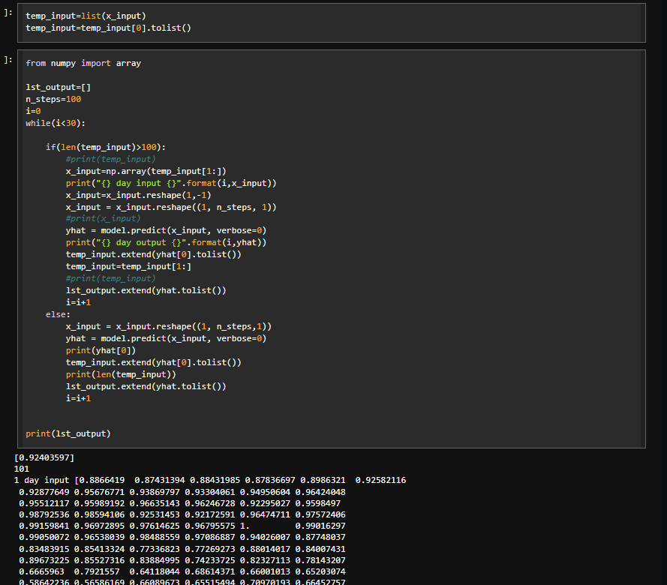
Prepare input and generate prediction for next 30 days

Slide 23
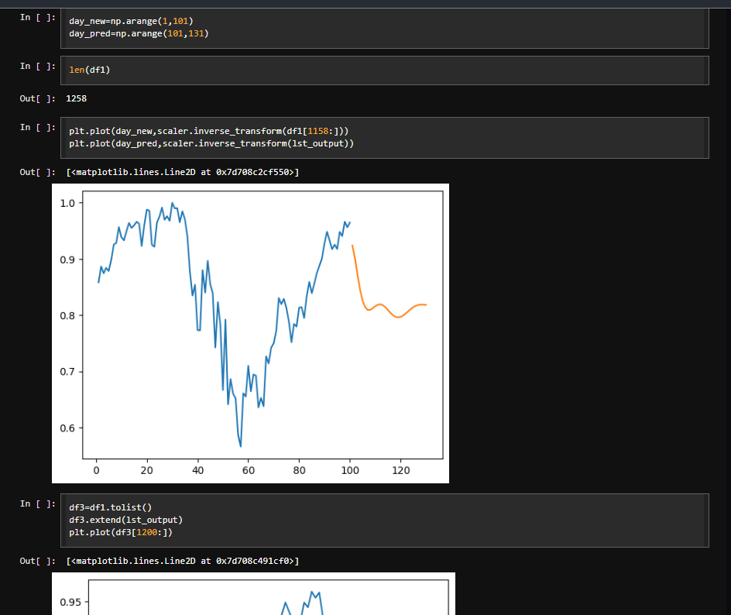
Plotting graph for last 100 days and next 30 days and concating it concat

Slide 24
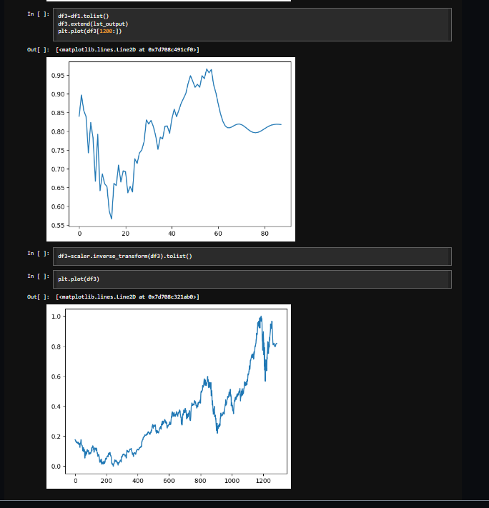
Plotting graph for last 100 days and next 30 days

Slide 25
Conclusion
In conclusion, overcoming the limitations of existing methodologies in stock prediction requires a multifaceted approach that leverages alternative data sources, advanced modeling techniques, and rigorous evaluation methods. By incorporating diverse data streams, such as social media sentiment and consumer behavior, researchers can gain deeper insights into market dynamics and investor sentiment. Enhanced feature engineering, ensemble modeling, and deep learning architectures enable the extraction of complex patterns from financial data, leading to more accurate predictions.

Slide 26
References
https://colah.github.io/posts/2015-08-Understanding-LSTMs/
https://www.sas.com/en_us/insights/analytics/machine- learning.html
https://groww.in/us-stocks/googl
https://www.investopedia.com/terms/d/deep-learning.asp
https://www.nasdaq.com/market-activity/stocks/goog

