Slide 1
Hacker Camp 2018
Priyansh Jain
The LNM Institute of Information Technology
Contact: +91-8290925378 | 15uec044@lnmiit.ac.in

Slide 2
Problem Statement
Train a model to identify unique patients in the sample dataset attached here. You are free to add more training data to make the model more accurate.
Variation in names leads to difficulty in identifying a unique person and hence deduplication of records is an unsolved challenge. The problem becomes more complicated in cases where data is coming from multiple sources. Following variations are same as Vladimir Frometa:
Vladimir A Frometa Garo Vladimir Frometa Vladimir Frometa G Vladimir A Frometa Vladimir A Frometa G

Slide 3
Approach To Problem
For approaching this problem, I used python and its “Dedupe” library along with the help of “pandas”, “numpy” and “os” library.
In this model, I used “Active Labelling” method to solve this problem. Then I created list of tuples of duplicate data values and then took one value from each of them.
After that I appended them on remaining single names to create a new csv file.

Slide 4
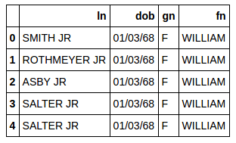
Initial Datasets
Duplicate values, we need to remove one of them

Slide 5
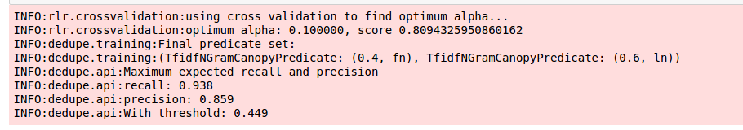
Results Obtained

Slide 6
Final Results and Scope of Improvement
We can improve results by taking more iterations for “Active Labelling”.
However, it takes more time to training due to more number of data values and their repetition.
For final results I got 62 names from list of 103 as non duplicate.

