Slide 1
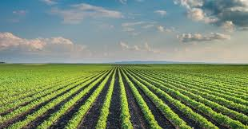


Slide 2

About:- At Hosachiguru, we combine passion for agriculture with social responsibility and economic returns. As much as we’re focused on soil health, water conservation and the impact we have on the environment, we don’t shy away from higher yields. This dual approach allows us to take on the traditional without disregarding the modern. Meticulous planning and continual innovation keeps us on the path to a sustainable greener future. Hosachiguru is a word derived from Kannada language where “Hosa” means “New” and “Chiguru” means “Shoot”.

Slide 3
Services
Managed farm lands
Hosachiguru offers you a well curated farmland that has good water, soil, access to labor and situated in a high growth area.
Plan & Design
Designing and Turnkey execution of Modern Irrigation systems, Rain Water Harvesting systems, Access paths to every farm plot, Precision Planting and establish necessary farm infrastructure.
Mobilize Resources
Mobilize state of the art farm equipment’s from hand tools to power tools and qualified human resources to manage the farm land effectively and professionally.
Execute Farm Operations
Smart Water management, Plant nutrition, Plant protection using IPM and all agricultural extension services to manage the crop and the farm land in the most optimal way.
Hospitality Services
Hosachiguru farm lands are a perfect weekend getaway destination. We take care of your stay at the farm.
Harvest & Market Produce
Harvesting at the right time using the best equipment’s with end to end responsibility of marketing of the produce.

Slide 4


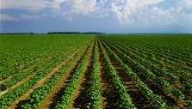


OUR 5 STEP PROCESS FOR DEVELOPING A SCIENTIFIC, SUSTAINABLE & BOTTOMLINE DRIVEN FARM
1
Right Crop
2
Right Source
3
Right Technique
₄ Minimize
Uncertainty
₅ Maximize
Potential
Identify commercially attractive crops that are less dependent on labor and are environmentally friendly (eg. Improve soil richness, water table)
Source saplings for the identified crops from the best possible mother tree, ensuring best chance of survival and high yields
Adopt cutting-edge and scientific farming techniques for each type of crop that maximizes productivity and benefits the local environment
Drive usage of technology and equipment to minimize labor dependency and ensure continuous monitoring of site
Implement a trial- and-error approach that translates the techniques to optimize crop outcomes in local land conditions

Slide 5
WHAT MAKES HOSACHIGURU A SUCCESS….

Slide 6
1
TEAM
2
ADVISORY AND MANAGERIAL EXPERTISE
3
FARMING PROCESS AND TECHNOLOGY
4
FERTIGATION & WATER MANAGEMENT
5
MARKETING TIE- UPS

Slide 7
HOASCHIGURU PARENT COMPANY
ORGANIZATION STRUCTURE
1
DIRECTORS
ADVISORY
Dr.Ananth Padmanabha Mr. Bhimsen
Dr. Venugopal
Reddy
Srinath S
Sriram C
Ashok J
Ayappa Masagi
Sales and CRM
Pricing
Trading/ sale of produce
Audit and tax
compliance
Farmer and local stakeholder management
Ground level regulatory management
Agri scientist
-manages advisory board
Liaison with govt & pvt. experts
AM and Dr. VR nominated to board members
2 Farm Managers
Horticulture Manager–
N.Sanjeev Reddy
Ginger – Dr.
Bale
100 Farmers

Slide 8
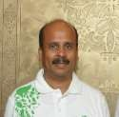
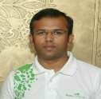
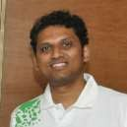
DIRECTORS – CREDENTIALS & EXPERIENCE
1
Ashok J, Chairman, Agriculture Ops and Strategy
Education: B.E. (BMS), Agricultural expert and guest lecturer (IWST)
Institutional experience: Expert in scientific and technology driven agriculture with over 30 years of experience including hydroponics, timber farms, horticulture and floriculture. Incorporated latest techniques in extracting soil productivity, nutrients, rain water harvesting and drip irrigation. Developed a proprietary technique called ‘Power Grow’ for high growth & productivity
Srinath Setty, Director, Sales & Marketing
Education: B.E. (BMS), MBA (Xavier Institute of Management and Entrepreneurship)
Institutional experience : A serial entrepreneur for over a decade running family businesses in agriculture, horticulture, real estate and land development. Agriculture in particular has been Srinath’s passion, and over the years he has developed deep expertise in farm land procurement ,marketing & trading of farm produce. Most recently involved in the distribution of a high performance nutrient called ‘Procam’
Sriram Chitlur, Director, Farming Operations, labor Management
Education: B.E. (BMS), Agricultural expert and guest lecturer (IWST)
Institutional experience: Trained at the prestigious Institute for Wood Science and Technology, Sriram has more than 7 years of experience in agricultural operations – equipment and labor sourcing and
management and, supply chain management from ‘seed to soil’ . With a deep interest to developing sustainable yet economically viable farming, he cofounded Hosachiguru

Slide 9
2 ADVISORY AND MANAGERIAL EXPERTISE
Mr. Ayyappa Masagi, Nominated Director, Rain Water Harvesting
Recognized by Oxfam and Ashoka Innovators, developed innovative technologies for irrigation , urban and rural rainwater harvesting; bore-well recharging; subsoil recharging; stream-water harvesting; groundwater recharging; non-irrigational agriculture; and the recycling of used water.
Founded an NGO, Water Literacy Foundation in 2005. Mr. Masagi is also a frequent guest speaker in all varieties of public settings. He also published a book on rainwater harvesting technology, Nela-Jala-Jana.
Dr.Venugopal Reddy, Nominated Director and Advisor, Pomegranate
Expert in horticulture with deep expertise with fruit bearing plants such as pomegranate, grapes and papaya. A scientist of 15 years experience in horticulture in India, he hails from a family that has been into farming for generations.
A highly sought after scientific agricultural advisor to several state govts., forest depts, farmers as well as corporates in India. He is also assisting and providing guidance on high productivity horticulture in African countries
Dr. H.S. Anantha Padmanabha, Advisor Sandalwood
A scientist of 40 years experience in forestry in India, he worked at the IWST (India) where he was responsible for guiding research projects on sandalwood and other forestry species
Consultant to Tropical Forestry Services Western Australia, Forest Rewards, Western Australia, Department of Conservation and
Land Development and Forest Product Commission, Western Australia .
Co-authored books on sandalwood and have published over 150 publications in both Indian and International journals. He was designated as chief Technical Advisor for sandalwood projects with the World Bank FREE project

Slide 10
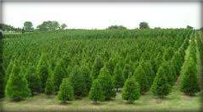




3 FARMING TECHNOLOGY AND PROCESS
All Orchards designed for higher yield per plant, better longevity of the plant, ease of farm mechanization (pesticide spraying, de-weeding, harvesting) and reduced dependency on labor
Exploring technology partnerships with top notch players such as Pomeg- Tech and Agriquality
In discussions with an Israeli Research Institute for growth/ disease management
Use Israeli technology for fertilizer and water management, right from inline drip irrigation to mulching sheets
Developed a proprietary plant growing technique
called power grow for fast growth and high yield

Slide 11
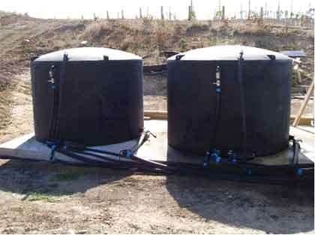
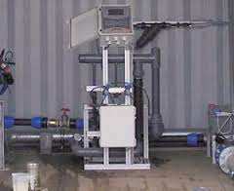
4 FERTIGAON
+
Fertilizer storage tanks connected to irrigation grid with sufficient capacity to ensure that fertilizer is available when required
Automated system that helps in spoon- feeding additional nutrients or correct nutrient deficiencies besides irrigation.
Comes with diverse dosing channels, dosing boosters, controllers, peripherals and accessories addressing a wide range of applications and overcoming myriad infrastructure constraints
HCF deploys fertigation systems that are on par with global standards

Slide 12
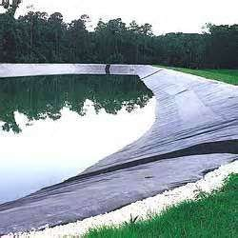
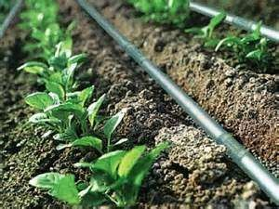
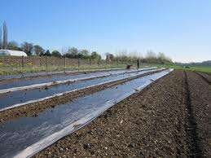
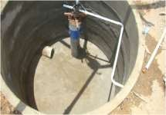
4 WATER MANAGEMENT
Inline Drip irrigation that gives water without any pressure loss with change in land gradient
Self cleaning system that ensures water reaches every plant at all times
Storage pond with 24 Lakh
liter storage capacity
Suffices irrigation requirements of 15 days
Mulching sheet preventing water evaporation and increase water availability
Minimizes weeds and hence labor for de- weeding
Rainwater harvesting to recharge the borewells
Hosachiguru employs comprehensive water management that allows us to withstand 2 consecutive bad monsoons

Slide 13


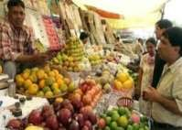



5 MARKETING TIE- UPS
We are already in discussions with several organizations to buy our produce…
MoU already signed with KSDL for offtake of approx. Rs. 92 cr of Sandalwood from an earlier project
In discussions with Mahindra Shubhlabh on a forward contract for offtake of Hosachiguru’s pom produce
Open Markets of
Delhi & Mumbai
In discussions with Sam Agritech on a forward contract for offtake of Hosachiguru’s pom produce

Slide 14
Impact At Hosachiguru, we are a mindful bunch of agri-enthusiasts who never lose touch with the impact our business creates as we walk our journey. From the soil we work on to the people we work with, we account for every detail we encounter and create.

Slide 15
ENVIRONMENTAL IMPACT
Hosachiguru effectively contributes in removing atmospheric carbon
We help improve flora and fauna around our farm lands
We have converted dry land to arable sustainable land
We help improve soil health by organic practices
We contribute to ground water recharging
SOCIAL IMPACT
Hosachiguru has created jobs to the local farmers
More than 500 family members of these farmers have been impacted positively
We help mitigate migration of rural folks

Slide 16
ECONOMICAL IMPACT
Timber cultivation makes a great long-term wealth creation
Short supply and high demand has led to steep rise in the prices of timber supplies
The value of the land appreciates over time
You can make long term wealth with a blend of social responsibility and environmental concerns
We contribute to the production and security of nation

Slide 17
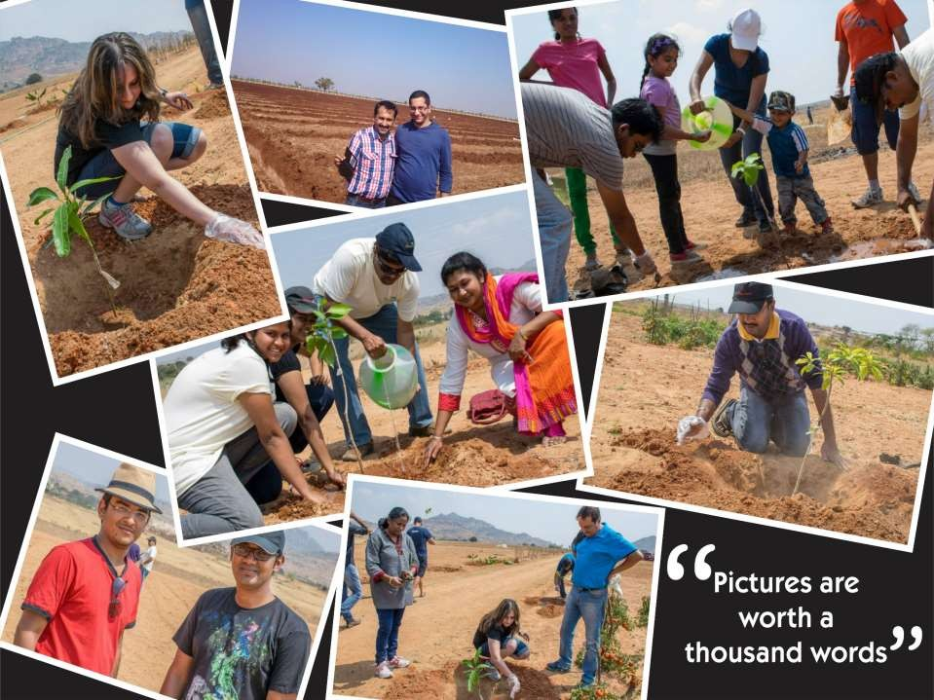

Slide 18
CONTACT US
Address:-
#1, 1st Floor, Hara House, Gutte Anjaneya Temple Street, Hosur Main Road, Wilson Garden, Opposite to IMBR, Bengaluru – 560 027, Karnataka
Mail:- info@hosachiguru.com
Phone number:- +91 7829555550 +91 7022289533

Slide 19


