Slide 1

Assessment of Extractive Text Summarization Scoring Techniques
Subject: Capstone Project - III
Prepared By:
Nishith Patel (19012011050)
Priyansh Patel (19012011051)
Guided By:
Prof. PRAVESH PATEL

Slide 2
Outline
Introduction
Types of Text Summarization
Abstractive Text Summarization
1
3
5
2
4
6
Objective
Extractive Text Summarization
Process of Text Summarization

Slide 3
Introduction
Text Summarization is the process of summarizing long text into a short piece of text. Its main focus is to only add necessary and important sentences and text into the final summary. The goal of Text Summarization is to provide a shorter version of the source text containing only important aspects of the source text. It can be used if we want to get only important information from a very long source text.

Slide 4
In the text summarization process, several scoring techniques are used to give a score to a sentence. Sentence score is also known as sentence weight. In the real world as human beings, we generate a summary of any text by finding some important keywords, important sentences, positive-negative sentences, cue phrases, some important numerical values, etc.

Slide 5
Objective
Text Summarization provides us with a shorter version of long text containing only the important and necessary points and aspects of the source file. It helps in ignoring irrelevant information from the source text. It saves the reader time by reducing the text size. It is mainly used to make concise summary of long publications.

Slide 6
Classification of Text Summarization
Single Document
Abstractive
Based on Input Type
Text Summarization
Based on Output Type
Multi Document
Extractive
Based on the Purpose
Generic
Query-based
Domain Specific

Slide 7
Based on Input Type
Single Document : The process of summarizing only single document then it is known single document text summarization.
Multi Document : The process of summarizing multiple document is known as Multi Document Text Summarization.

Slide 8
Based on The Purpose
Generic text summarization: It’s a methods that create text summaries by ranking and extracting sentences from the original documents.
Query-based: Query-based text summarization is aimed at extracting essential information that answers the query from original text.
Domain Specific: It aims at distilling the essential information from a text to produce a shorter version, such as generating headlines for news and subject lines for emails.

Slide 9
Based on Output Type
Based on Output Type
Abstractive Text
Summarization
Extractive Text
Summarization

Slide 10
Abstractive Text Summarization
This is a very interesting approach. Here, we generate new sentences from the original text. This is in contrast to the extractive approach we saw earlier where we used only the sentences that were present. The sentences generated through abstractive summarization might not be present in the original text.
Text
Sentence 1
Sentence 2
Sentence 3
Sentence 4
Abstractive Summarizer
Summary
New Sentence

Slide 11
Extractive Text Summarization
The name gives away what this approach does. We identify the important sentences or phrases from the original text and extract only those from the text. Those extracted sentences would be our summary. The below diagram illustrates extractive summarization.
Text
Sentence 1
Sentence 2
Sentence 3
Sentence 4
Extractive Summarizer
Summary
Sentence 2
Sentence 4

Slide 12
Process of Text Summarization
Firstly it separates the document sentence-wise. Then it uses various word scoring and sentence scoring techniques to decide the score of individual sentences. Sentence scoring is the process of evaluating sentence importance by using several scoring algorithms. Sometimes more than one sentence scoring technique is used simultaneously to find the more accurate score of the sentence. Then sentences having high scores are taken to include in the final summary.
The system-generated summary is then compared with the golden summary(summary having the highest matching score with the original document) to find the precision and f-score. Then the sentence scoring technique which gives the highest precision score is used for converting long documents into short documents.

Slide 13
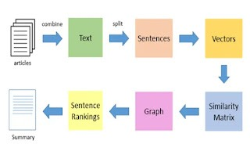
Flow of Text Summarization

Slide 14
Dataset Description
To further progress in summarization and enable researchers to participate in large-scale experiments, the National Institute of Standards and Technology (NIST) continued an evaluation in the area of text summarization called the Document Understanding Conference (DUC).
DUC is part of a Defense Advanced Research Projects Agency (DARPA) program, Translingual Information Detection, Extraction, and Summarization (TIDES), which specifically calls for major advances in summarization technology, both in English and from other languages to English (cross-language summarization).
The basic design for the evaluation follows ideas in a summarization road map that was created by a committee of researchers in summarization, headed by Daniel Marcu. It also profited from the experiences of DUC 2001.

Slide 15
Rouge Score
The Recall-Oriented Understudy for Gisting Evaluation (ROUGE) scoring algorithm evaluates the similarity between a candidate document and a collection of reference documents. Use the ROUGE score to evaluate the quality of document translation and summarization models.
It is a set of metrics and a software package used for evaluating automatic summarization and machine translation software in natural language processing. The metrics compare an automatically produced summary or translation against a reference or a set of references (human-produced) summary or translation.

Slide 16
Blue Score
Bleu is a measurement of the difference between an automatic translation and human-created reference translations of the same source sentence. The BLEU algorithm compares consecutive phrases of the automatic translation with the consecutive phrases it finds in the reference translation, and counts the number of matches, in a weighted fashion. These matches are position independent. A higher match degree indicates a higher degree of similarity with the reference translation, and higher score. Intelligibility and grammatical correctness aren't taken into account.

Slide 17
Cuckoo Algorithm
Sentence scoring methods are used to represent sentences into numerical forms and then CS algorithm is used to select the best suitable sentences that can be used to give the extractive summary. Sentiment analysis is used to select most significant sentences to represent the summary.
Experimental result shows that proposed method produces notable improvement in terms of precision, recall and F1-score to existing three methods namely CSSA, summary using key concepts and sentence importance and DUC baseline.

Slide 18
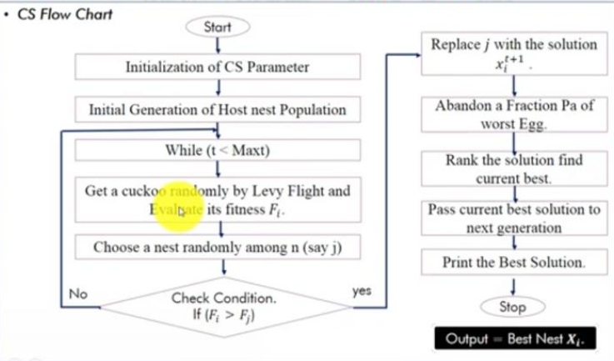
Cuckoo Search Algorithm Flow

Slide 19
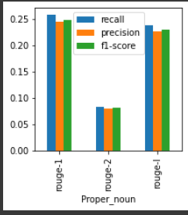
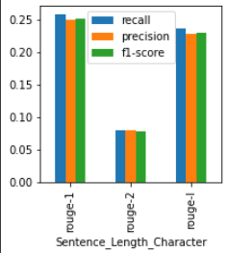
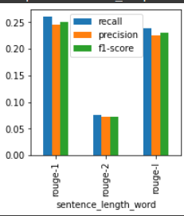
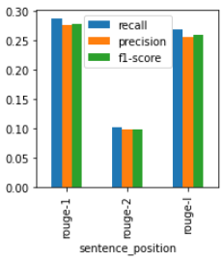
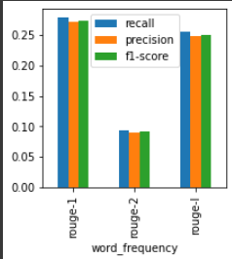
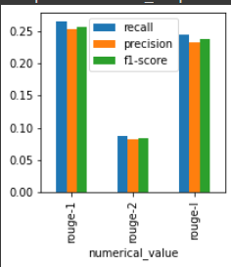
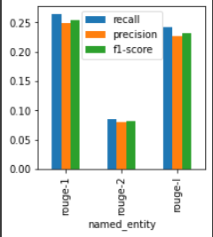
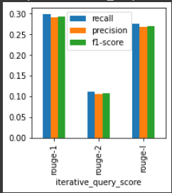
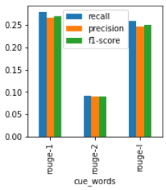
Result of Scoring Techniques

Slide 20
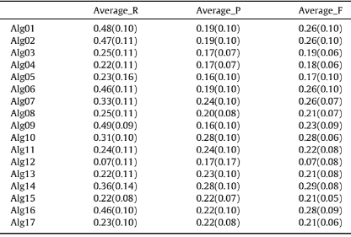
Score in "Assessing sentence scoring techniques" Research Paper

Slide 21
Thank You!

