Slide 1
Servlet

Slide 2
Introduction
It is used for developing dynamic web applications.
What is dynamic web page:-
A dynamic page displays different content for different users while retaining the same layout and design.
Servlet is a java program that runs inside JVM on the web server
Servlets are nothing but the Java programs which reside on the server side and their main purpose is to serve the client request.
Servlets are fully compatible with Java. You can use any of the available Java APIs like JDBC inside the servlets.
Servlets are protocol independent. i.e. they support FTP, SMTP, HTTP etc. protocols.
In Servlets, a thread is created for each request unlike in CGI where a process is created for each request. Hence, servlets give better performance than CGI.

Slide 3
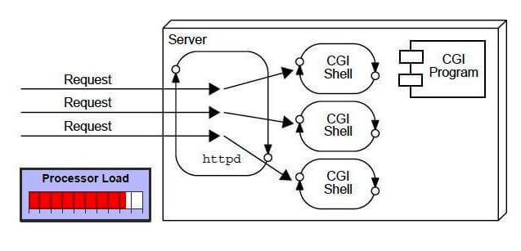
What is CGI(Common Gateway Process)
CGI technology enables the web server to call an external program and pass HTTP request information to the external program to process the request. For each request, it starts a new process.
The web container creates threads for handling the multiple requests to the Servlet. Threads have many benefits over the Processes such as they share a common memory area, lightweight, cost of communication between the threads are low.

Slide 4
Why Servlet???
There are other server-side scripting technologies exist Say CGI(Common Gateway Interface)
In CGI scripts, Server has to create a new CGI process for every client request.
CGI programs are handled by a new process every time a new request has been made.
CGI program can be written in any programming language that makes it mostly platform dependent as not all programming languages are platform independent
But Servlet is more advantageous than them as:
Servlet programs are handled by separate threads that can run concurrently more efficiently.
Servlet only uses Java as programming language that makes it platform independent and portable

Slide 5
Characteristics of Servlets
Servlet are efficient:
Initialization code for a servlet is executed only when the servlet is executed for first time
Servlet are robust:
As servlet are based on Java, they provide all powerful features of Java such as exception handling ,garbage collection which makes them robust.
Servlet are portable:
Servlets are also portable because they are developed in Java. This enables easy portability across web servers.
Servlet are persistent:
Servlet helps to increase the performance of the system by preventing frequent disk access

Slide 6
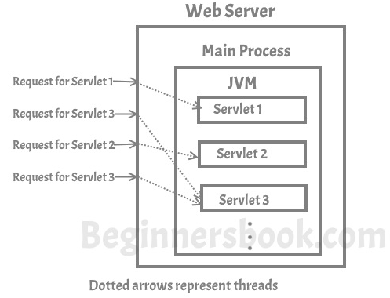
How Servlet Works
As servlet handles concurrent requests to the server are handled by threads, here is the graphical representation of the same –

Slide 7
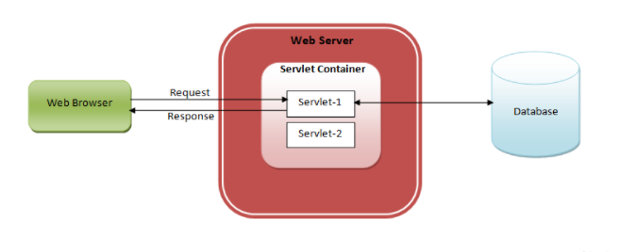
Java Servlets Architecture :
Step1 :Client i.e. web browser sends the request to the web server.
Step 2 : Web server receives the request and sends it to the servlet container. Servlet container is also called web container or servlet engine. It is responsible for handling the life of a servlet.
Step 3 : Servlet container understands the request’s URL and calls the particular servlet. Actually, it creates a thread for execution of that servlet. If there are multiple requests for the same servlet, then for each request, one thread will be created.
Step 4: Servlet processes the request object and prepares response object after interacting with the database or performing any other operations and sends the response object back to the web server.
Step 5 : Then web server sends the response back to the client.

Slide 8
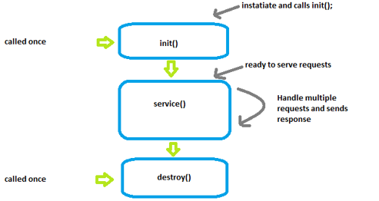
Servlet life cycle

Slide 9
Web Container or Servlet Container
Web Container: it maintains the life cycle for Servlet Object. Calls the service method for that servlet object. pass the HttpServletRequest and HttpServletResponse Object.
Web container also known as a Servlet container is the component of a web server that interacts with Java servlets.
Responsibility of web Container:
A web container is responsible for
For managing the lifecycle of servlets,
Mapping a URL to a particular servlet and ensuring that the ,
URL requester has the correct access rights.
Get the session information from cookie and use it

Slide 10
Servlet API
Java supports implementation of servlets using following packages:
1) The javax.servlet and
2) javax.servlet. Http
These packages represent interfaces and classes for servlet API.
Servlet can be implemented in 3 ways
Implement the interface
javax.servlet.Servlet
Extending subclass from javax.servlet.GenericServlet
Extending subclass from javax.servlet.http.HttpServlet

Slide 11
GenericServlet and HttpServlet
GenericServlet class is used to create servlets that can work with any protocol.
Whereas
HttpServlet is used to create HTTP servlets that provide output in the form of HTML pages.
Class.java.lang.Object
Interface
javax.servlet.Servlet
Class javax.servlet.GenericServlet
Interface
javax.servlet.
ServletConfig
Interface
javax.io.serializable
Class javax.servlet.HttpServlet

Slide 12
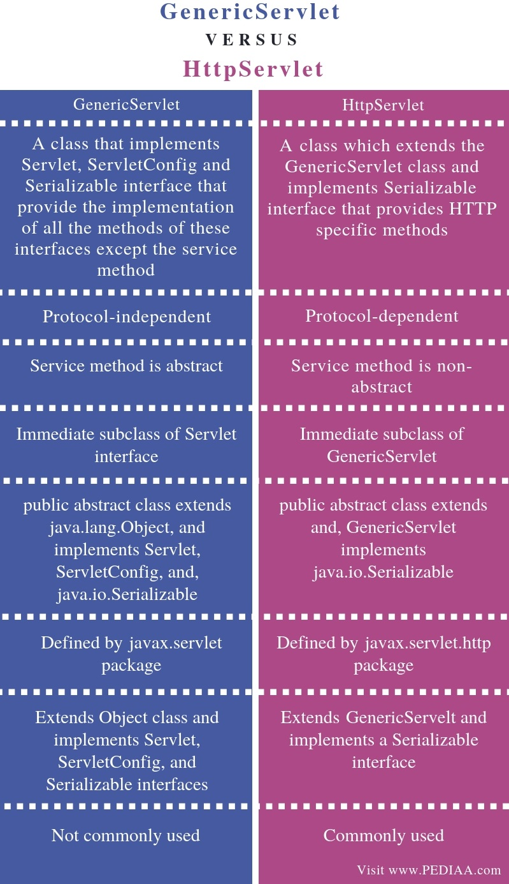

Slide 13
GenericServlet
GenericServlet is the immediate subclass of Servlet interface.
That means a method inherited from the Servlet interface called the service () is an abstract method in GenericServlet.
To write a program who extends the GenericServlet class should override the service () method and write the implementation for it.
HTTPServlet
HttpServlet is designed to support HTTP protocol.
It is also an abstract class. Furthermore, the immediate superclass of HttpServlet is GenericServlet.
HttpServlet overrides the service method in GenericServlet.
It is possible to replace the service (method using doGet () or doPost () with the same parameters of the service method.

Slide 14
Files required for servlet:
The web application structure involving the WEB-INF subdirectory is standard to all Java web applications and specified by the servlet API specification.
What is WEB-INF subdirectory:-
1) This directory, which is contained within the Document Root, is invisible from the web container.
2) It contains all resources needed to run the application, from Java classes, to JAR files and libraries, to other supporting files that the developer does not want a web user to access.
Here is how this directory structure looks like:
/webapps → is a subdirectory of tomcat web server
/myapp → is a name of application
/WEB-INF → Subdirectory for deployment descriptor
/classes → This will hold .java and .class file of servlet
/lib

Slide 15
Deployment descriptor(Web.xml file)
The deployment descriptor is an .xml file, from which Web Container gets the information about the servlet to be invoked.
web. xml defines mappings between URL paths and the servlets that handle requests with those paths.
The web server uses this configuration to identify the servlet to handle a given request and call the class method that corresponds to the request method.
The web container uses the Parser to get the information from the web.xml file. There are many xml parsers such as SAX, DOM and Pull.
There are many elements in the web.xml file. Here is given some necessary elements to run the simple servlet program.

Slide 16
Deployment descriptor-Web.xml
Sr.No | Element name | Description
1. | <web-app> | represents the whole application.
2. | <servlet> | is sub element of <web-app> and represents the servlet
3. | <servlet-name> | is sub element of <servlet> represents the name of the servlet.
4. | <servlet-class> | is sub element of <servlet> represents the class of the servlet.
5. | <servlet-mapping> | is sub element of <web-app>. It is used to map the servlet.
6. | <url-pattern> | is sub element of <servlet-mapping>. This pattern is used at client side to invoke the servlet.

Slide 17
Steps to create Servlet:
Create a directory structure
Create a Servlet
Compile the Servlet
Create a deployment descriptor
Start the server and deploy the project
Access the servlet

Slide 18
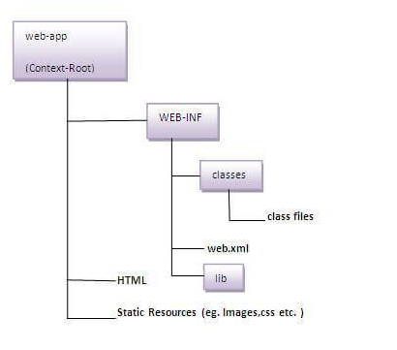
Step1- Create a directory structure
The Sun Microsystem defines a unique standard to be followed by all the server vendors.
Let's see the directory structure that must be followed to create the servlet.

Slide 19
Step 2- Create a Servlet
For creating servlet HTTPservlet class and 3 methods are used:
doGet() or doPost()
setContentType()
getWriter()
To create a servlet that extends the HttpServlet class:
public class DemoServlet extends HttpServlet
Inside the above class, provide implementation of doGet() method:
public void doGet(HttpServletRequest req, HttpServletResponse res)
throws ServletException,IOException
NOTE:
get request is the default request.

Slide 20
Step 2- Create a Servlet
doGet(HttpServletRequest req, HttpServletResponse res)
The doGet() method is used for getting the information from server
Override the doGet() method 4 main things are required
Read request data--
write the response headers, --
get the response's writer and --
finally, write the response data
String name=req.getParameter("name");
res.setContentType("text/html");
PrintWriter pw=res.getWriter();
pw.println("<html><body>");
pw.println("Welcome to servlet"); pw.println("</body></html>");
NOTE:
get request is the default request.

Slide 21
Step 3- Compile the Servlet
Put the java file in
C:\ProgramFiles\ApacheSoftwareFoundation\Tomcat8.5\webapps\login\WEB-INF\classes
To compile a Servlet a JAR file is required. Different servers require different JAR files. In Apache Tomcat server servlet-api.jar file is required to compile a servlet class.
Check Servlet-api.jar file is present in lib folder (C:\Program Files\Apache Software Foundation\Tomcat 8.5\lib

Slide 22
Step 3- Compile the Servlet
Set the Class Path as:
C:\Program Files\Apache Software Foundation\Tomcat 8.5\webapps\login\WEB-INF\classes>set path = "C:\Program Files\Java\jdk1.8.0_241\bin";
Compile the java files as :C:\Program Files\Apache Software Foundation\Tomcat 8.5\webapps\login\WEB-INF\classes> javac DemoServ.java

Slide 23
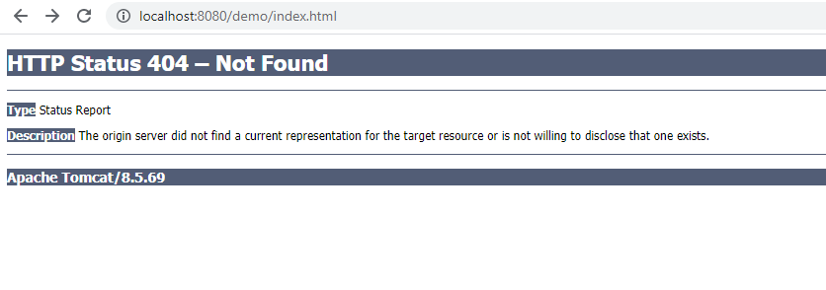
Step 4:Create a deployment descriptor
<web-app>
<servlet>
<servlet-name>Servlet1</servlet-name>
<servlet-class>DemoServlet</servlet-class>
</servlet>
<servlet-mapping>
<servlet-name> Servlet1 </servlet-name>
<url-pattern>/welcome</url-pattern>
</servlet-mapping>
</web-app>
If <url-pattern> tag is not written then it will show this error.

Slide 24
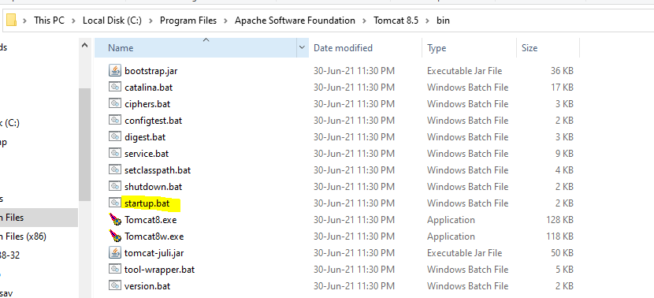
Step 5: Start the Server and deploy the project
To start Apache Tomcat server, double click on the startup.bat file under Apache-tomcat/bin directory.

Slide 25
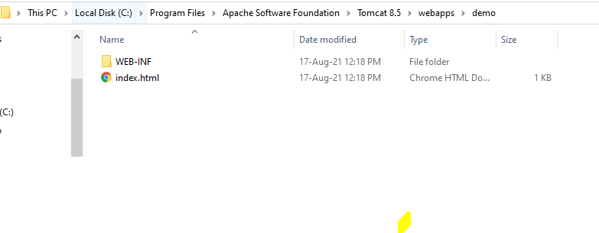
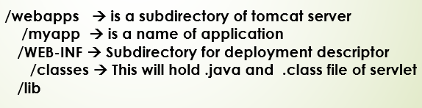
Step 5: Start the Server and deploy the project
To deploy the project:
Copy the project and paste it in the webapps folder under Apache tomcat.

Slide 26
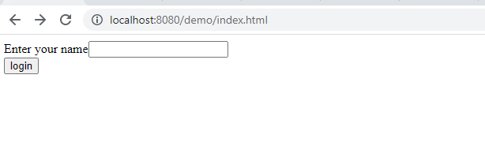
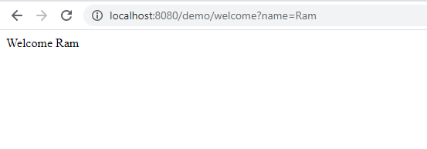
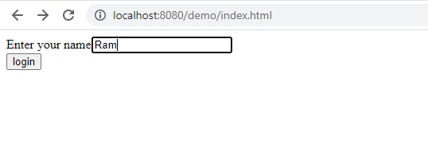
Step 6:Access the servlet
Open browser and write
http://hostname:portno/contextroot/urlpatternofservlet.
For example:
http://localhost:8080/demo/welcome

Slide 27
Step 6:Access the servlet(Changing the Port number
NOTE:
While In step 5 ,after the Tomcat server is started there is one optional step is of changing the port number It is required if another server(Say) Oracle is running on same port (8080).
This is done as follows:
Open server.xml file in notepad.
It is located inside the apache-tomcat/conf directory .
Change the Connector port = 8080 and replace 8080 by any four digit number instead of 8080.
Let us replace it by 9999 and save this file.
In that case we will access the servlet:
http://localhost:9999/demo/welcome

Slide 28
Session Handling in Servlet

Slide 29
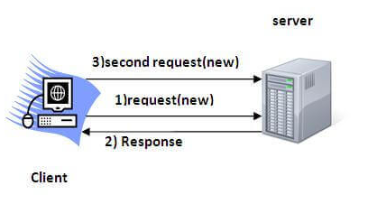
Session Handling or Tracking
Session simply means a particular interval of time.
Session Tracking/Handling is a way to maintain state (data) of an user. It is also known as session management in servlet.
HTTP is stateless that means each request is considered as the new request. It is shown in the figure given below:

Slide 30
Why to use Session Tracking
HTTP for completing request response cycle.
HTTP is a stateless protocol which means when a new request comes it can’t keep any record or state of previous request of the user.
That’s why we need session tracking for maintaining the state of the user.

Slide 31
Understanding Cookies

Slide 32
Cookies In Servlet
A cookie is a small piece of information as a text file stored on client’s machine by a web application.
How cookie works?
In case of cookie a text file with small piece of information is added to the response of first request.
They are stored on client’s machine.
Now when a new request comes cookie is by default added with the request.
With this information we can identify that it is a new user or a previous user.

Slide 33
Types of cookies:
Session cookies/Non-persistent cookies:
These types of cookies are session dependent
i.e., they are accessible as long as session is open and
they are lost when session is closed by exiting from the web application.
Permanent cookies/Persistent cookies:
These types of cookies are session independent.
i.e., they are not lost when session is closed by exiting from the web application.
They are lost when they expire.

Slide 34
How to send Cookies to the Client
Steps for sending cookie to the client:
Create a Cookie object.
Set the maximum Age.
Place the Cookie in HTTP response header.
1. Create a Cookie object:
Cookie c = new Cookie(“username”,”Ram”);
2. Set the maximum Age.
By using setMaxAge() method we can set the maximum age for the particular cookie in seconds.
c.setMaxAge(1800);
3. Place the Cookie in HTTP response header:
We can send the cookie to the client browser through response.addCookie() method.
response.addCookie(c);

Slide 35
How to read cookies
To read cookie information as name and it’s value ,two methods are there:
public String getName(): Returns the name of the cookie. The name cannot be changed after creation.
public String getValue(): Gets the current value of this Cookie.

Slide 36
How to delete Cookie?
Let's see the simple code to delete cookie. It is mainly used to logout or sign-out the user.
Cookie ck=new Cookie("user","");//deleting value of cookie
ck.setMaxAge(0);//changing the maximum age to 0 seconds
response.addCookie(ck);//adding cookie in the response

Slide 37
Example of Cookies in java servlet
login.html
<html>
<body>
<h2>Demo for Servlet</h2>
<form action="login" method="post">
User Name:<input type="text" name="userName"/><br/>
Password:<input type="password" name="userPassword"/><br/><br/>
<input type="submit" value="submit"/>
</form>
</body>
</html>

Slide 38
Example of Cookies in java servlet

Slide 39
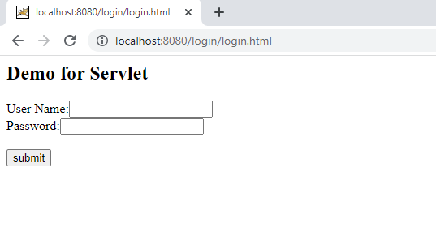
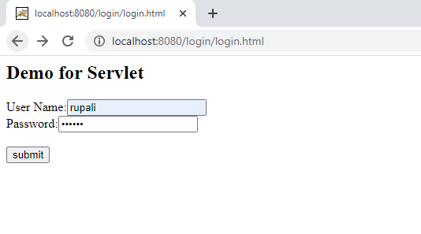
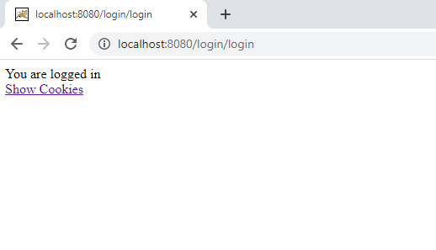
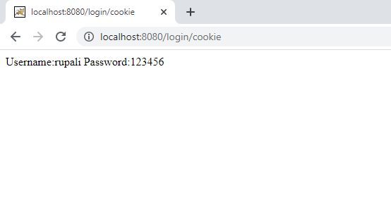
Ex: To maintain username and password in cookie.

Slide 40
Installation and Configuration Of Tomcat Web Server
Link for installation are:(29th Sept 21)
https://youtu.be/grW6afp8yE4
Refer the above link for installation of Tomcat version 8.5.23

