Slide 1
Web Server

Slide 2
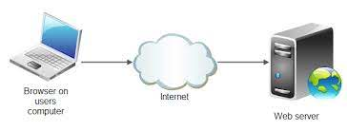
What is web server
A web server is software and hardware that uses HTTP (Hypertext Transfer Protocol) and other protocols to respond to client requests made over the World Wide Web
The main job of a web server is to display website content through storing, processing and delivering webpages to users.

Slide 3


What is LAMP/WAMP / MAMP/ XAMPP

Slide 4
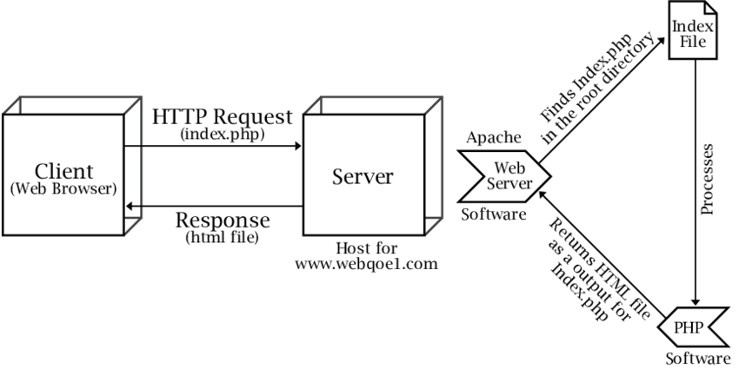
What is Apache Web Server
Apache is a cross-platform software, therefore it works on both Unix and Windows servers.
Its job is to establish a connection between a server and the browsers of website visitors (Firefox, Google Chrome, Safari, etc.) while delivering files back and forth between them (client-server structure).

Slide 5
What is MYSQL
MySQL is a freely available open source Relational Database Management System (RDBMS) that uses Structured Query Language (SQL).
SQL is the most popular language for adding, accessing and managing content in a database

Slide 6
What is PHP
PHP is a general-purpose scripting language that is especially suited to server-side web development, in which case PHP generally runs on a web server.
Any PHP code in a requested file is executed by the PHP runtime, usually to create dynamic web page content or dynamic images used on websites or elsewhere.

Slide 7
What is Local Host
The localhost is the default name describing the local computer address also known as the loopback address.
For example, typing: ping localhost would ping the local IP address of 127.0. 0.1 (the loopback address)

Slide 8
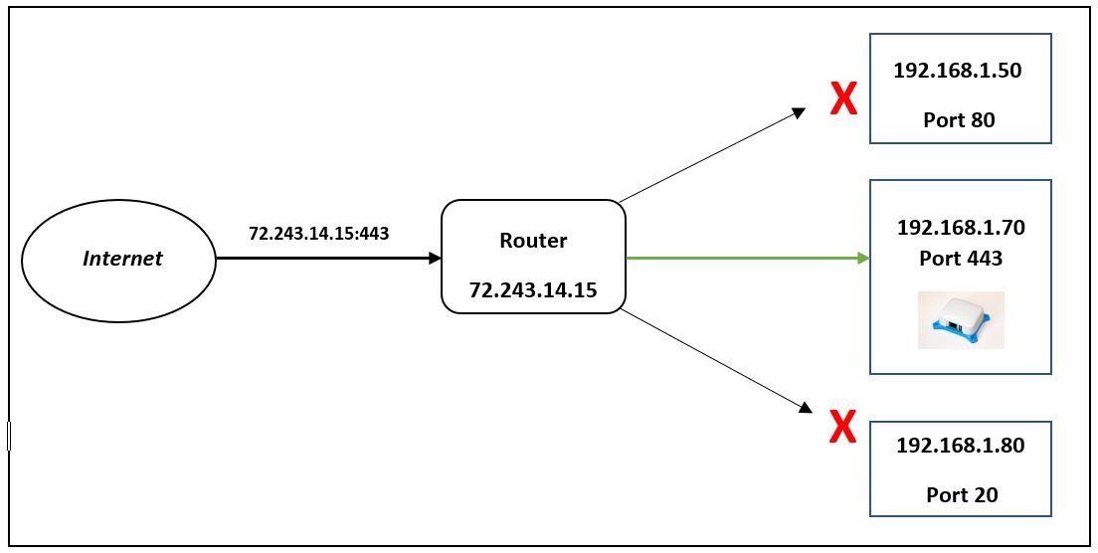
What is port number
A port number is always associated with an IP address of a host and the type of transport protocol used for communication.

Slide 9
What is port number
On which port MySQL and Apache Web Server works?
Every service has a default port: The Apache web server typically uses port 80,
The MySQL database server utilizes port 3306. These ports are configurable.
We can change the port numbers ,steps to change the port number per OS are different.
Refer this site:
https://www.papercut.com/support/resources/manuals/ng-mf/common/topics/customize-enable-additional-ports.html

Slide 10
Installation of wamp
Download wampserver from site: https://sourceforge.net/projects/wampserver/files/
Click on Wampserver 3 and select wampserver 3.0.0
Select wampserver3.2.3_x86.exe (based on your windows version) to download wampserver3.2.3_x64.exe.
Once it get downloaded in Downloads folder and then start installation

Slide 11
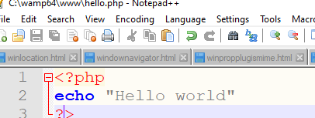
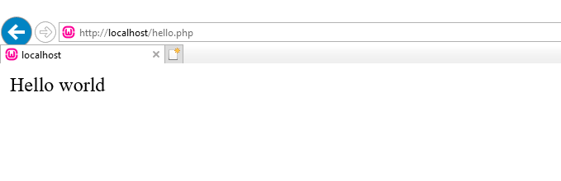
Installation of wamp
Once it get installed test Hello world program using php or html file you must get output as follows:

