Slide 1
XML

Slide 2
What is XML?
XML is a software- and hardware-independent tool for storing and transporting data.
Stands for eXtensible Markup Language
It is a markup language much like HTML
Designed to store and transport data
Designed to be self-descriptive
XML is a W3C Recommendation

Slide 3
XML Example
XML does not DO anything.
This note is a note to Tove from Jani, stored as XML
The XML above is quite self-descriptive:
It has sender information.
It has receiver information
It has a heading
It has a message body.
But still, the XML above does not DO anything.
XML is just information wrapped in tags.
Someone must write a piece of software to send, receive, store, or display it
<note>
<to>Tove</to>
<from>Jani</from>
<heading>Reminder</heading>
<body>Don't forget me this weekend!</body>
</note>

Slide 4
XML and HTML were designed with different goals:
XML was designed to carry data - with focus on what data is
HTML was designed to display data - with focus on how data looks
XML tags are not predefined like HTML tags are
The tags in the example above (like <to> and <from>) are not defined in any XML standard.
These tags are "invented" by the author of the XML document.
HTML works with predefined tags like <p>, <h1>, <table>, etc.
With XML, the author must define both the tags and the document structure.
XML Example
<note>
<to>Tove</to>
<from>Jani</from>
<heading>Reminder</heading>
<body>Don't forget me this weekend!</body>
</note>

Slide 5
Most XML applications will work as expected even if new data is added (or removed).
Imagine an application designed to display the original version of note.xml (<to> <from> <heading> <body>).
Then imagine a newer version of note.xml with added <date> and <hour> elements, and a removed <heading>.
The way XML is constructed, older version of the application can still work
XML is Extensible
<note>
<to>Tove</to>
<from>Jani</from>
<heading>Reminder</heading>
<body>Don't forget me this weekend!</body>
</note>
<note>
<date>2015-09-01</date>
<hour>08:30</hour>
<to>Tove</to>
<from>Jani</from>
<body>Don't forget me this weekend!</body>
</note>

Slide 6
XML Simplifies Things
Data Sharing
Many computer systems contain data in incompatible formats.
Exchanging data between incompatible systems (or upgraded systems) is a time-consuming task for web developers.
Large amounts of data must be converted, and incompatible data is often lost.
Data Transport
XML stores data in plain text format.
This provides a software- and hardware-independent way of storing, transporting, and sharing data.

Slide 7
XML Simplifies Things
Platform sharing
XML makes it easier to expand or upgrade without losing data to
new operating systems
new applications
new browsers
Data Availability
data can be available to all kinds of "reading machines" like people, computers, voice machines, news feeds, etc.

Slide 8
How to use XML?
XML Separates Data from Presentation
XML does not carry any information about how to be displayed.
The same XML data can be used in many different presentation scenarios.
Because of this, with XML, there is a full separation between data and presentation.
XML is Often a Complement to HTML
In many HTML applications, XML is used to store or transport data, while HTML is used to format and display the same data.

Slide 9
How to use XML?
XML Separates Data from HTML
When displaying data in HTML, you should not have to edit the HTML file when the data changes.
With XML, the data can be stored in separate XML files.
With a few lines of JavaScript code, you can read an XML file and update the data content of any HTML page.

Slide 10
<?xml version="1.0" encoding="UTF-8"?> <bookstore> <book category="cooking"> <title lang="en">Everyday Italian</title> <author>Giada De Laurentiis</author> <year>2005</year> <price>30.00</price> </book> <book category="children"> <title lang="en">Harry Potter</title> <author>J K. Rowling</author> <year>2005</year> <price>29.99</price> </book> <book category="web"> <title lang="en">XQuery Kick Start</title> <author>James McGovern</author> <author>Per Bothner</author> <author>Kurt Cagle</author> <author>James Linn</author> <author>Vaidyanathan Nagarajan</author> <year>2003</year> <price>49.99</price> </book> <book category="web" cover="paperback"> <title lang="en">Learning XML</title> <author>Erik T. Ray</author> <year>2003</year> <price>39.95</price> </book> </bookstore>
Books.xml
Title Author
Everyday Italian Giada De Laurentiis
Harry Potter J K. Rowling
XQuery Kick Start James McGovern
Learning XML Erik T. Ray

Slide 11
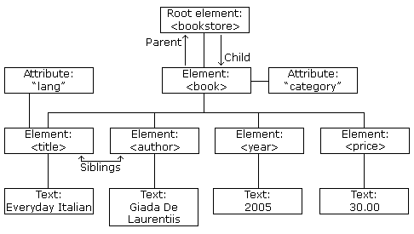
XML Tree
<?xml version="1.0" encoding="UTF-8"?> <bookstore> <book category="cooking"> <title lang="en">Everyday Italian</title> <author>Giada De Laurentiis</author> <year>2005</year> <price>30.00</price> </book> <book category="children"> <title lang="en">Harry Potter</title> <author>J K. Rowling</author> <year>2005</year> <price>29.99</price> </book> <book category="web"> <title lang="en">Learning XML</title> <author>Erik T. Ray</author> <year>2003</year> <price>39.95</price> </book> </bookstore>

Slide 12
XML documents are formed as element trees.
An XML tree starts at a root element and branches from the root to child elements.
All elements can have sub elements (child elements):
<root>
<child>
<subchild>.....</subchild>
</child>
</root>
The terms parent, child, and sibling are used to describe the relationships between elements.
Parents have children. Children have parents. Siblings are children on the same level (brothers and sisters).
All elements can have text content (Harry Potter) and attributes (category="cooking").
XML Tree
<?xml version="1.0" encoding="UTF-8"?> <bookstore> <book category="cooking"> <title lang="en">Everyday Italian</title> <author>Giada De Laurentiis</author> <year>2005</year> <price>30.00</price> </book> <book category="children"> <title lang="en">Harry Potter</title> <author>J K. Rowling</author> <year>2005</year> <price>29.99</price> </book> <book category="web"> <title lang="en">Learning XML</title> <author>Erik T. Ray</author> <year>2003</year> <price>39.95</price> </book> </bookstore>

Slide 13
XML document must have ROOT element
XML Prolog: Optional, if exist then first statement
All XML elements must have closing tag
XML tags are case sensitive
XML elements must be properly nested
XML Attribute Values Must Always be Quoted
White space is preserved in XML
Entity Reference
&lt; < less than
&gt; > greater than
&amp; & ampersand
&apos; ' apostrophe
&quot; " quotation mark
XML Syntax Rule
<?xml version="1.0" encoding="UTF-8"?> <bookstore> <book category="cooking"> <title lang="en">Everyday Italian</title> <author>Giada De Laurentiis</author> <year>2005</year> <price>30.00</price> </book> <book category="children"> <title lang="en">Harry Potter</title> <author>J K. Rowling</author> <year>2005</year> <price>29.99</price> </book> <book category="web"> <title lang="en">Learning XML</title> <author>Erik T. Ray</author> <year>2003</year> <price>39.95</price> </book> </bookstore>

Slide 14
XML HTTPRequest
All modern browsers have a built-in XMLHttpRequest object to request data from a server.
The XMLHttpRequest object can be used to request data from a web server.
The XMLHttpRequest object is a developers dream, because you can:
Update a web page without reloading the page
Request data from a server - after the page has loaded
Receive data from a server - after the page has loaded
Send data to a server - in the background

Slide 15
Sending an XMLHTTPRequest
The first line in the example above creates an XMLHttpRequest object
The onreadystatechange property specifies a function to be executed every time the status of the XMLHttpRequest object changes
When readyState property is 4 and the status property is 200, the response is ready
The responseText property returns the server response as a text string.
The text string can be used to update a web page
var xhttp = new XMLHttpRequest(); xhttp.onreadystatechange = function() { if (this.readyState == 4 && this.status == 200) { // Typical action to be performed when the document is ready: document.getElementById("demo").innerHTML = xhttp.responseText; } }; xhttp.open("GET", "filename", true); xhttp.send();

Slide 16
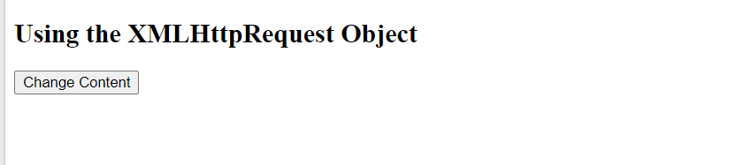
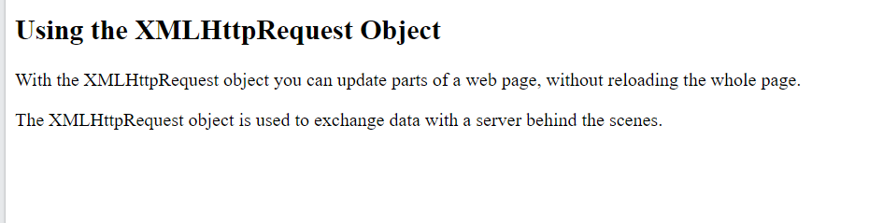
<!DOCTYPE html>
<html>
<body>
<h2>Using the XMLHttpRequest Object</h2>
<div id="demo">
<button type="button" onclick="loadXMLDoc()">Change Content</button>
</div>
<script>
function loadXMLDoc() {
var xmlhttp;
if (window.XMLHttpRequest) {
xmlhttp = new XMLHttpRequest();
} else {
// code for older browsers
xmlhttp = new ActiveXObject("Microsoft.XMLHTTP");
}
xmlhttp.onreadystatechange = function() {
if (this.readyState == 4 && this.status == 200) {
document.getElementById("demo").innerHTML =
this.responseText;
}
};
xmlhttp.open("GET", "xmlhttp_info.txt", true);
xmlhttp.send();
}
</script>
</body>
</html>
Sending an XMLHTTPRequest

Slide 17
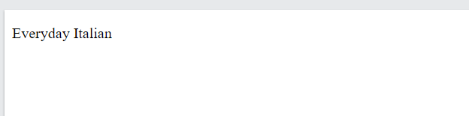
XML Parser
<html> <body> <p id="demo"></p> <script> var text, parser, xmlDoc;
// text string is defined text = "<bookstore><book>" + "<title>Everyday Italian</title>" + "<author>Giada De Laurentiis</author>" + "<year>2005</year>" + "</book></bookstore>";
parser = new DOMParser(); xmlDoc = parser.parseFromString(text,"text/xml"); document.getElementById("demo").innerHTML = xmlDoc.getElementsByTagName("title")[0].childNodes[0].nodeValue; </script> </body> </html>
The XML DOM (Document Object Model) defines the properties and methods for accessing and editing XML.
However, before an XML document can be accessed, it must be loaded into an XML DOM object.
All modern browsers have a built-in XML parser that can convert text into an XML DOM object.

Slide 18
XML Parser
<html> <body> <p id="demo"></p> <script> var text, parser, xmlDoc;
// text string is defined text = "<bookstore><book>" + "<title>Everyday Italian</title>" + "<author>Giada De Laurentiis</author>" + "<year>2005</year>" + "</book></bookstore>";
parser = new DOMParser(); xmlDoc = parser.parseFromString(text,"text/xml"); document.getElementById("demo").innerHTML = xmlDoc.getElementsByTagName("title")[0].childNodes[0].nodeValue; </script> </body> </html>
All XML elements can be accessed through the XML DOM.
This code retrieves the text value of the first <title> element in an XML document:
Example
txt = xmlDoc.getElementsByTagName("title")[0].childNodes[0].nodeValue;
The XML DOM is a standard for how to get, change, add, and delete XML elements.
This example loads a text string into an XML DOM object, and extracts the info from it with JavaScript:

Slide 19
XPath
is a major element in the XSLT standard.
can be used to navigate through elements and attributes in an XML document.
is a syntax for defining parts of an XML document
uses path expressions to navigate in XML documents
contains a library of standard functions
is a major element in XSLT and in XQuery
is a W3C recommendation

Slide 20
Xpath Path Expression
XPath uses path expressions to select nodes or node-sets in an XML document.
These path expressions look very much like the expressions you see when you work with a traditional computer file system.
XPath expressions can be used in JavaScript, Java, XML Schema, PHP, Python, C and C++, and lots of other languages.

Slide 21
Xpath Path Expression
XPath Expression Result
/bookstore/book[1] Selects the first book element that is the child of the bookstore element
/bookstore/book[last()] Selects the last book element that is the child of the bookstore element
/bookstore/book[last()-1] Selects the last but one book element that is the child of the bookstore element
/bookstore/book[position()<3] Selects the first two book elements that are children of the bookstore element
//title[@lang] Selects all the title elements that have an attribute named lang
//title[@lang='en’] Selects all the title elements that have a "lang" attribute with a value of "en"
/bookstore/book[price>35.00] Selects all the book elements of the bookstore element that have a price element with a value greater than 35.00
/bookstore/book[price>35.00]/title Selects all the title elements of the book elements of the bookstore element that have a price element with a value greater than 35.00

