Slide 1
Module-4
Loaders and Linkers

Slide 2
Types of Loader/Loader Schemes
General Loader Scheme
Relocating Loaders
Compile and Go Loaders
Absolute Loaders
Subroutine Linkages
Direct Linking Loaders
Other Loader Schemes:
Dynamic Loading
Dynamic Linking

Slide 3
3. Assemble (or Compile) and Go Loader
In this type of loader, the instruction is read line by line, its machine code is obtained and it is directly put in the main memory at some known address.
That means the assembler runs in one part of memory and the assembled machine instructions and data is directly put into their assigned memory locations.
After completion of assembly process, assign starting address of the program to the location counter.
This loading scheme is also called as “assemble and go”.

Slide 4
3. Assemble (or Compile) and Go Loader
Advantage:
Easy to implement
Assembler runs in one part of memory and assembled instructions are directly loaded into core
No extra procedures are involved

Slide 5
3. Assemble (or Compile) and Go Loader
Disadvantage:
Wastage of memory as assembler and loader both occupies memory space
Time consuming process as no production of object file
It can’t handle multiple source languages and multiple source programs
For a programmer it is very difficult to make an orderly modulator program and also it becomes difficult to maintain such program, and the “compile and go” loader cannot handle such programs.
Execution time is more

Slide 6
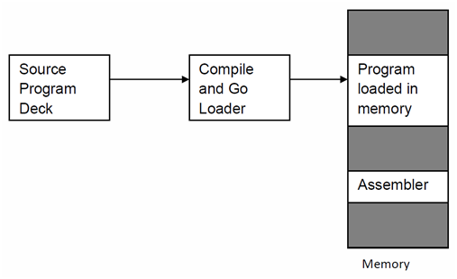
3. Assemble (or Compile) and Go Loader

Slide 7
4. Absolute Loader
Absolute loader is a kind of loader in which relocated object files are created.
Loader accepts these files and places them at specified locations in the memory.
This type of loader is called absolute because no relocation information is needed
This relocation information is obtained from the programmer or assembler.

Slide 8
4. Absolute Loader
The starting address of every module is known to the programmer, and this corresponding starting address is stored in the object file
Then task of loader becomes very simple and that is to simply place the executable form of the machine instructions at the locations mentioned in the object file.
In this scheme, the programmer or assembler should have knowledge of memory management.
The resolution of external references or linking of different subroutines is the issues which need to be handled by the programmer.

Slide 9
4. Absolute Loader
Advantages:
Simple to implement
Process of Execution is efficient
Multiple Programs are allowed
Multiple source languages can be used
Common object file will be prepared for multiple languages or multiple programs
Task of Loader is to load the object code in main memory at given address

Slide 10
4. Absolute Loader
Disadvantages:
Programmer’s duty is to perform all linking activity and inter-segment addresses
Programmer must know memory management
Programmer need to update changes in starting address of modules if any modification is in source program

Slide 11
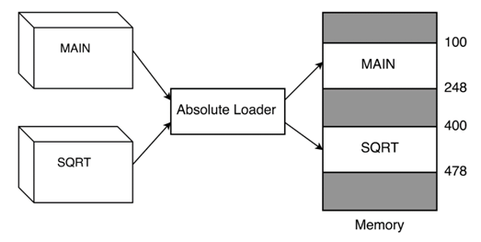
4. Absolute Loader

Slide 12
Design of an Absolute Loader
With an absolute loading scheme, the programmer and the assembler perform the tasks of allocation, relocation, and linking.
Therefore, it is only necessary for the loader to read cards of the object deck and move the text on the cards into the absolute locations specified by the assembler.
There are two types of information that the object deck must communicate from the assembler to the loader.:
First, it must convey the machine instructions that the assembler has created along with the assigned core locations.
Second, it must convey the entry point of the program, which is where the loader is to transfer control when all instructions arc loaded.

Slide 13
Design of an Absolute Loader
Card Formats for an Absolute Loader:
Text Cards
(for instructions and data)
Transfer Cards
(to hold entry point to program)
Card Column | Contents
1 | Card type = 0 (for text card identifier)
2 | Count of number of bytes (1 byte per column) of information on card
3-5 | Addresses at which data on card is to be put
6-7 | Empty (could be used for validity checking)
8-72 | Instructions and data to be loaded
73-80 | Card sequence number
Card Column | Contents
1 | Card type = 1 (transfer card identifier)
2 | Count = 0
3-5 | Addresses of entry point
6-72 | Empty
73-80 | Card sequence number

Slide 14
Design of an Absolute Loader
In the card format, the instructions are stored on the card as one core byte per column.
For each of the 256 possible contents of an eight-bit byte there is a corresponding punched card code (e.g., hexadecimal 00 is a column punched with five holes, 12-0-1-8-9, whereas a hexadecimal F1 is a column with a single punch in row 1).
Thus, when a card is read, it is stored in core as 80 contiguous bytes.

Slide 15
Design of an Absolute Loader
Algorithm
The object deck for this loader consists of a series of text cards terminated by a transfer card.
Therefore, the loader should read one card at a time, moving the text to the location specified on the card, until the transfer card is reached.
At this point, the assembled instructions are in core, and it is only necessary to transfer to the entry point specified on the transfer card.

Slide 16
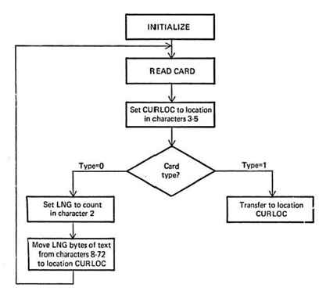
Design of an Absolute Loader
Flowchart

Slide 17
5. Sub routine Linkages
It deals with the special mechanism for calling another subroutine in an assembly language program.
The problem of subroutine linkage:
Let “A” be the main program
A wishes to transfer to subprogram B.
The programmer, in program A, could write a transfer instruction (e.g., BAL 14, B) (Branch and Link) to subprogram B.
However, the assembler does not know the value of this Symbol reference and will declare it as an error (undefined Symbol) unless a special mechanism has been provided.

Slide 18
5. Sub routine Linkages
There are two assembler pseudo-ops which are used for subroutine linkages :
EXTRN: It is followed by a list of Symbols which indicates that these Symbols are defined in other programs but referenced in the present program.
ENTRY: It is followed by a list of Symbols which indicates that these Symbols are defined in same programs but referenced in the other program.
In turn, the assembler will inform the loader that these Symbols may be referenced by other programs.

Slide 19
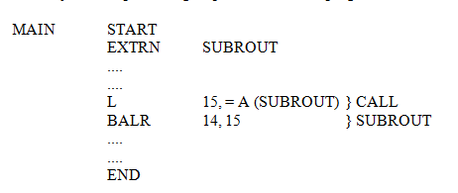
5. Sub routine Linkages
Example:
The following sequence of instructions may be a simple calling sequence to another program:

Slide 20
5. Sub routine Linkages
The above sequence of instructions first declares SUBROUT as an external variable, that is, a variable reference but not defined in this program.
The load instruction loads the address of that variable into register 15.
The BALR instruction branches to the contents of register 15, which is the address of SUBROUT, and leaves the value of the next Instruction in register 14.
In most assemblies, we may simply use a CALL SUBROUT macro, which is translated by the assembler into a calling sequence

Slide 21
6. Direct linking loader
A direct-linking loader is a general relocatable loader, and is perhaps the most popular loading scheme presently used
The direct-linking loader has the advantage of allowing the programmer multiple procedure segments and multiple data segments and of giving him complete freedom in referencing data or instructions contained in other segments.

Slide 22
6. Direct linking loader
Disadvantage:
It is necessary to allocate, relocate, link, and load all of the subroutines each time in order to execute a program
Since there may be tens and often hundreds of subroutines involved, this loading process can be extremely time-consuming.
Furthermore, even though the loader program may be smaller than the assembler, it does absorb a considerable amount of space

Slide 23
7. Other Loading Schemes: a) Dynamic loading
In each of the previous loader schemes we have assumed that all of the subroutines needed are loaded into core at the same time.
If the total amount of core required by all these subroutines exceeds the amount available, then it is a problem
There are several hardware techniques, such as paging and segmentation, that attempt to solve this problem
A dynamic loading schemes based upon the concept of a binder prior to loading can solve this problem

Slide 24
Loading process
The Loading Process can be divided into two separate programs:
Binder
Module Loader

Slide 25
Loading process
A binder is a program that performs the same functions as the direct-linking loader in "binding" subroutines together, but rather than placing the relocated and linked text directly into memory, it outputs the text as a file or card deck.
This output file is in a format ready to be loaded and is typically called a load module.
Binder: Performs following functions-Allocation, Relocation, Linking
The module loader has to physically load the module into core.
Module Loader: Task of Loading

Slide 26
7. a) Dynamic loading
Usually the subroutines of a program are needed at different times
By explicitly recognizing which subroutines call other subroutines it is possible to produce an overlay structure that identifies mutually exclusive subroutines.

Slide 27
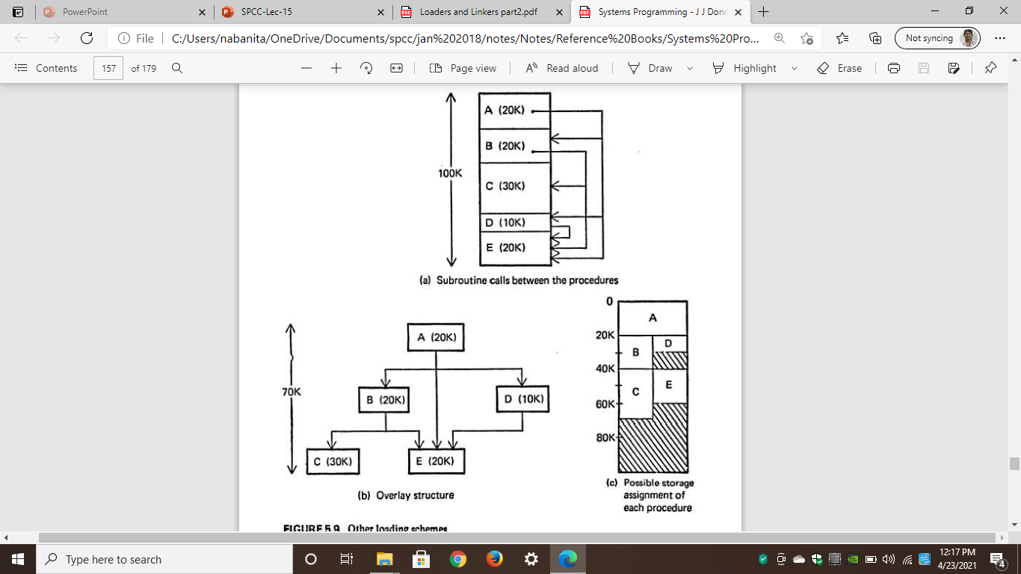
7. a) Dynamic loading

Slide 28
7. a) Dynamic loading
In the figure(a): A program consisting of five subprograms (A,B,C,D and E) that require lOOK bytes of core.
The arrows indicate that subprogram A only calls B, D and E
Subprogram B only calls C and E; subprogram D only calls E;
Subprograms C and E do not call any other routines.

Slide 29
7. a) Dynamic loading
In Figure 5 .9b the inter dependencies between the procedures are highlighted
Procedures B and D arc never in use at the same time; neither are C and E.
If we load only those procedures that are actually to be used at any particular time, the amount of core needed is equal to the longest path of the overlay structure.

Slide 30
7. a) Dynamic loading
This happens to be 70K for the example in Figure 5.9b - procedures A, B, and C.
Figure 5.9c illustrates a storage assignment for each procedure consistent with the overlay structure.

Slide 31
Overlay structure
In order for the overlay structure to work it is necessary for the module loader to load the various procedures as they are needed.
There are many binders capable of processing and allocating an overlay structure.
The portion of the loader that actually intercepts the "calls" and loads the necessary procedure is called the overlay supervisor or simply the flipper.
This overall scheme is called dynamic loading or load-on-call (LOCAL).

Slide 32
Disadvantage
Overlay structure
Disadvantage
If a subroutine is referenced but never executed, the loader would still incur the overhead of linking the subroutine.
Furthermore, all of these schemes require the programmer to explicitly name all procedures that might be called.

Slide 33
7. b) Dynamic linking
This is a mechanism by which loading and linking of external references are postponed until execution time.
The assembler produces text, binding, and relocation information from a source language deck.
The loader loads only the main program.
If the main program should execute a transfer instruction to an external address, or should reference an external variable, then the loader is called.
Only then is the segment containing the external reference is loaded.

Slide 34
advantage
7. b) Dynamic linking
Advantage
No overhead is incurred unless the procedure to be called or referenced is actually used.
The system can be dynamically reconfigured.

Slide 35
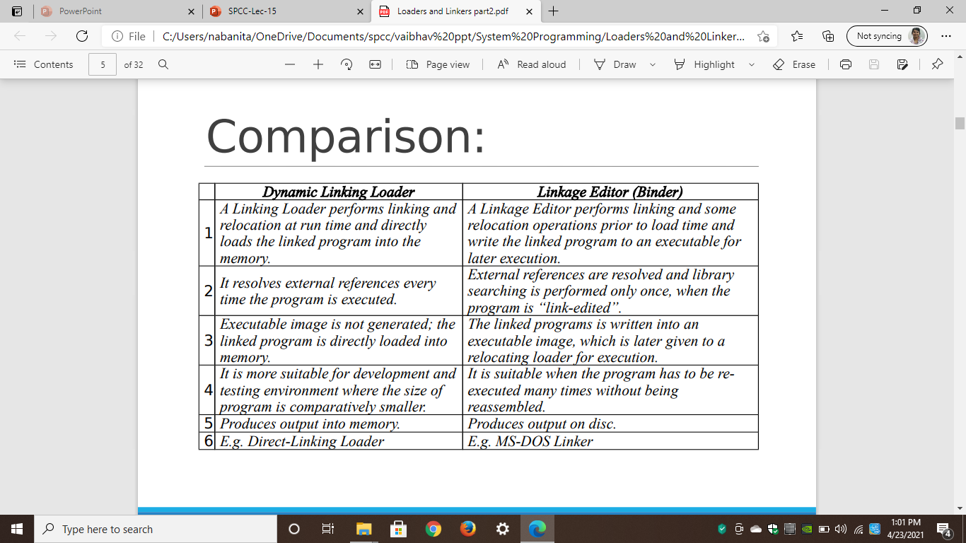
Dynamic linking vs binders

