Slide 1
Cryptography and System Security (CSS)
T.E – Sem.-VI
-Ms. Nabanita Mandal

Slide 2
Information Security
Information security ensures that both physical and digital data is protected from unauthorized access, use, disclosure, disruption, modification, inspection, recording or destruction.

Slide 3
Cybersecurity
Cybersecurity protects only digital data.
Cybersecurity, a subset of information security, which is the practice of defending your organization’s networks, computers and data from unauthorized digital access, attack or damage by implementing various processes, technologies and practices.

Slide 4
Network Security
Network security, a subset of cyber security, aims to protect any data that is being sent through devices in your network to ensure that the information is not changed or intercepted.
Network security consists of the policies and practices adopted to prevent and monitor unauthorized access, misuse, modification, or denial of a computer network.

Slide 5
Cryptography
Cryptography, which translates as "secret writing," refers to the science of concealing the meaning of data so only specified parties understand a transmission's contents.

Slide 6
System Security
The objective of system security is the protection of information and property from theft, corruption and other types of damage, while allowing the information and property to remain accessible and productive.
System security includes the development and implementation of security countermeasures.
.

Slide 7
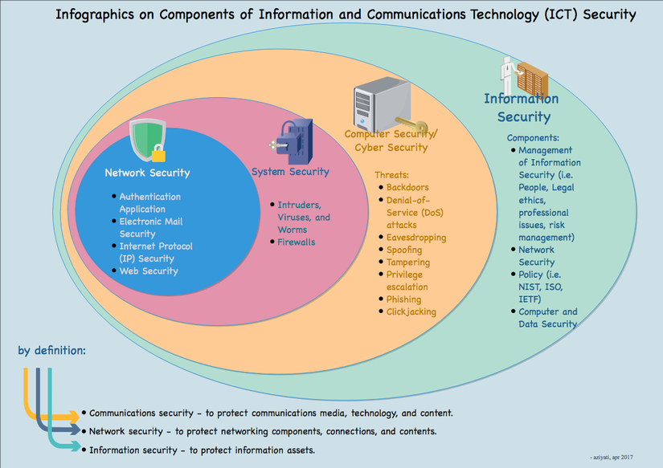
ICT Security
.

Slide 8
Computer Security
The NIST Computer Security Handbook [NIST95] defines the term computer security as follows:
The protection afforded to an automated information system in order to attain the applicable objectives of preserving the integrity, availability and confidentiality of information system resources (includes hardware, software, firmware, information/data, and telecommunications
This definition introduces three key objectives that are at the heart of computer security
.

Slide 9

Key Security Concepts
Security Objectives

Slide 10
Key Security Concepts
Confidentiality (covers both data confidentiality and privacy): preserving authorized restrictions on information access and disclosure, including means for protecting personal privacy and proprietary information. A loss of confidentiality is the unauthorized disclosure of information.
Integrity (covers both data and system integrity): Guarding against improper information modification or destruction, and includes ensuring information non-repudiation and authenticity. A loss of integrity is the unauthorized modification or destruction of information.
Availability: Ensuring timely and reliable access to and use of information. A loss of availability is the disruption of access to or use of information or an information system.

Slide 11
Key Security Concepts
Although the use of the CIA triad to define security objectives is well established, some in the security field feel that additional concepts are needed to present a complete picture.
Two of the most commonly mentioned are:
• Authenticity: The property of being genuine and being able to be verified and trusted; confidence in the validity of a transmission, a message, or message originator.
• Accountability: The security goal that generates the requirement for actions of an entity to be traced uniquely to that entity.

Slide 12
Levels of Impact
3 levels of impact from a security breach can be defined
  Low
  Moderate
  High

Slide 13
Low Impact
The loss could be expected to have a limited adverse effect on organizational operations, organizational assets, or individuals.
Example, the loss of confidentiality, integrity, or availability might
  (i) cause a degradation in mission capability to an extent and duration that the organization is able to perform its primary functions, but the effectiveness of the functions is noticeably reduced;
  (ii) result in minor damage to organizational assets;
  (iii) result in minor financial loss; or
  (iv) result in minor harm to individuals

Slide 14
Moderate Impact
The loss could be expected to have a serious adverse effect on organizational operations, organizational assets, or individuals.
Example, the loss might
  (i) cause a significant degradation in mission capability to an extent and duration that the organization is able to perform its primary functions, but the effectiveness of the functions is significantly reduced;
  (ii) result in significant damage to organizational assets;
  (iii) result in significant financial loss; or
  (iv) result in significant harm to individuals that does not involve loss of life or serious, life-threatening injuries.

Slide 15
High Impact
The loss could be expected to have a severe or catastrophic adverse effect on organizational operations, organizational assets, or individuals.
Example, the loss might
  (i) cause a severe degradation in or loss of mission capability to an extent and duration that the organization is not able to perform one or more of its primary functions;
  (ii) result in major damage to organizational assets;
  (iii) result in major financial loss; or
  (iv) result in severe or catastrophic harm to individuals involving loss of life or serious life threatening injuries.

Slide 16
Aspects of Security
  Security attack
  Security mechanism (control)
  Security service

Slide 17
Important Terms
  Threat – a potential for violation of security
  Vulnerability – a way by which loss can happen
  Attack – an assault on system security, a deliberate attempt to evade security services

Slide 18
Basic Terminology
plaintext - the original message
ciphertext - the coded message
cipher - algorithm for transforming plaintext/ciphertext
key - info used in cipher known only to sender/receiver
encipher (encrypt) - converting plaintext to ciphertext
decipher (decrypt) - recovering ciphertext from plaintext
cryptography - study of encryption principles/methods
cryptanalysis (codebreaking) - the study of principles/ methods of deciphering ciphertext without knowing key
cryptology - the field of both cryptography and cryptanalysis

Slide 19
Two kinds of Ciphers
State-of-the-art: two kinds of most popular encryption algorithms
Symmetric ciphers
  Sender and receiver share a common key
Public key ciphers
  Sender and receiver have asymmetric information of the key(s)

Slide 20
Symmetric Encryption
Conventional / private-key / single-key
It was the only type prior to invention of public-key in 1970’s
It remains very widely used
In this, sender and recipient share a common key
  Both parties have full information of the key
All classical encryption algorithms are common key (private-key) algorithms
  Characteristic of conventional algorithms
Notes:
All traditional schemes are symmetric / single key / private-key encryption algorithms, with a single key, used for both encryption and decryption, since both sender and receiver are equivalent, either can encrypt or decrypt messages using that common key.

Slide 21
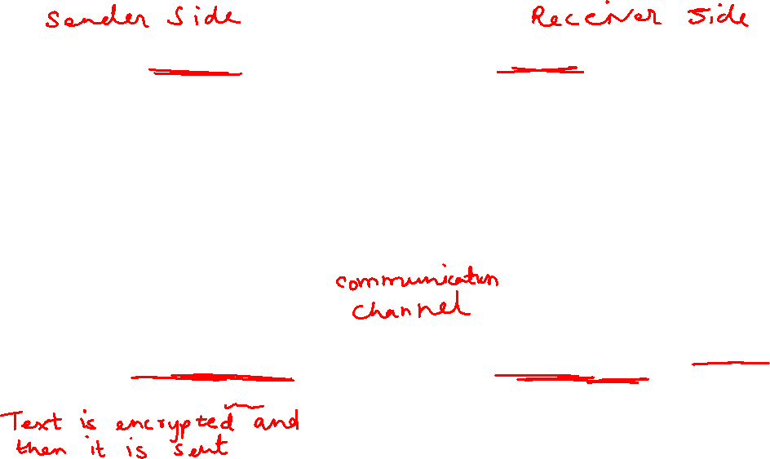

Symmetric Cipher Model
Notes:
Stallings Fig 2-1 details 5 ingredients of the symmetric cipher model:
plaintext
encryption algorithm – performs substitutions/transformations on plaintext
secret key – control exact substitutions/transformations used in encryption algorithm
ciphertext
decryption algorithm – inverse of encryption algorithm

Slide 22
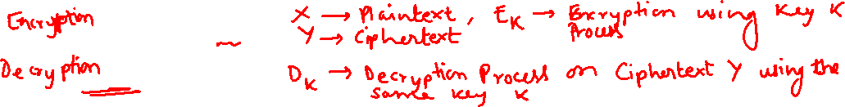
Requirements
two requirements for secure use of symmetric encryption:
  a strong encryption algorithm (keeping key secret is sufficient for security)
  a secret key known only to sender / receiver
  Y = E_{K}(X)
  X = D_{K}(Y)
assume encryption algorithm is known
implies a secure channel to distribute key
Notes:
Generally assume that the algorithm is known.
This allows easy distribution of s/w and h/w implementations.
Hence assume just keeping key secret is sufficient to secure encrypted messages.
Have plaintext X, ciphertext Y, key K, encryption algorithm Ek, decryption algorithm Dk.

Slide 23
Cryptography
can characterize by:
  type of encryption operations used
    substitution / transposition / product systems
  number of keys used
    single-key or private / two-key or public
  way in which plaintext is processed
    Block: process one block of elements a time
    Stream: continuous input, output one element a time

