Slide 1
Module-4
Authentication Protocols
&
Digital Signature Schemes

Slide 2
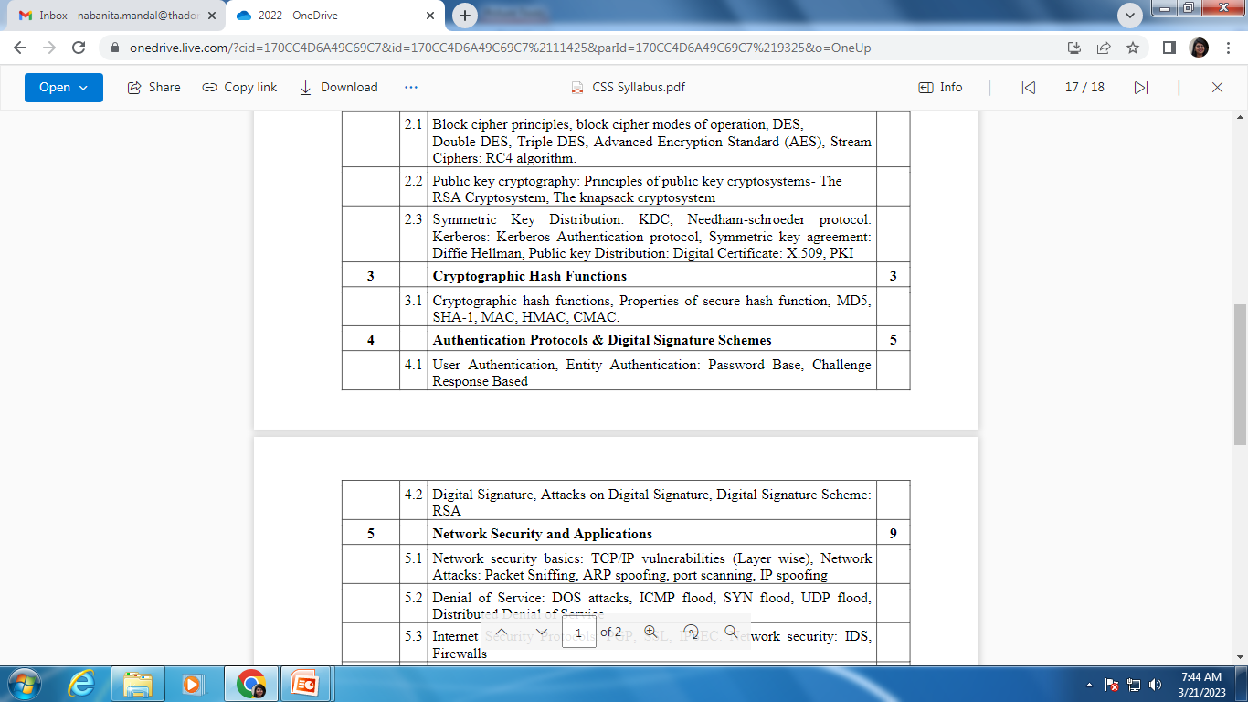
Syllabus

Slide 3
User and Entity Authentication
User (Entity) authentication is a technique designed to let one party prove the identity of another party
An entity can be a client, a server , a person or a process
The entity whose identity needs to be proved is called the claimant
The party that tries to verify the identity of the claimant is called the verifier
When Bob tries to prove the identity of Alice then Alice is the Claimant and Bob is the verifier
3
Notes:
3

Slide 4
Message Vs Entity Authentication
Message authentication authenticates one message at a time. The process needs to be repeated for each new message.
But Entity authentication authenticates the claimant for the entire duration of a session
For message authentication, it is not necessary for the client to be present online always. The sender can go offline after the message is sent and still that message will be authenticated.
But in case of Entity Authentication, the other party needs to be online
4
Notes:
4

Slide 5
Password based Entity Authentication
Authentication
Fixed Password: Used over and over again for every access
Example: e-mail
2. One-time-Password: This type of password is used only once
Example: Banking transactions
5
Notes:
5

Slide 6
1. Fixed Password based Entity Authentication
Method 1: Storing the password in a file
Possible Attacks: Eavesdropping, Stealing the password, Accessing the password file, Guessing
Method 2: Storing Hash of the Password in a file
Possible Attacks on Hashed Password: Dictionary Attack
Method 3: Salting the password
Method 4: Something possessed, something known(e.g- ATM card and ATM PIN)
6
Notes:
6

Slide 7
2. One time Password based Entity Authentication
Method 1: User and the system agree upon a list of passwords
Method 2: User and the system agree to sequentially update the password
Method 3: User and the system create a sequentially updated password using a Hash Function
7
Notes:
7

Slide 8
Challenge Response based Protocol
In password based authentication, the claimant proves her identity by demonstrating that she knows the password
But in challenge response based authentication, the claimant proves that she knows the password but does not send it. The verifier either has it or finds it
8
Notes:
8

Slide 9
Challenge Response based Protocol
Using symmetric key cipher
Using keyed hashed function
Using asymmetric key cipher
Using digital signature
9
Notes:
9

Slide 10
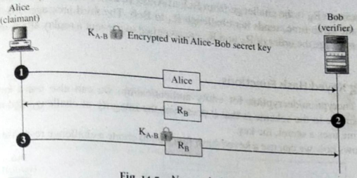
1. Using symmetric key cipher
i) First Approach: (Nonce Challenge)
The verifier sends a nonce (random number used only once ) to challenge the claimant
The claimant responds to the challenge using the shared secret key between herself and the verifier
10
Notes:
10

Slide 11
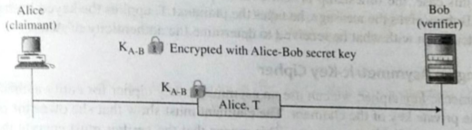
1. Using symmetric key cipher
ii) Second Approach: (Timestamp)
The challenge message is the current time (timestamp) sent from the verifier to the claimant
11
Notes:
11

Slide 12
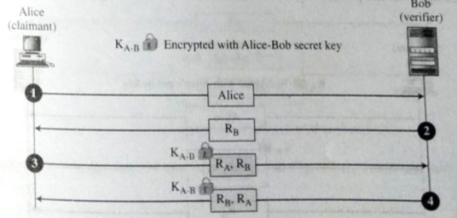
1. Using symmetric key cipher
iii) Third Approach: (Bidirectional authentication)
Both client and server sends challenge to each other
12
Notes:
12

Slide 13
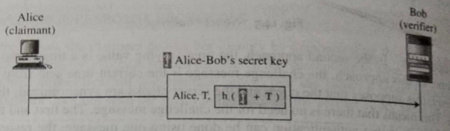
2. Using keyed hash function
In this approach, instead of using encryption/decryption, a keyed hash function is used for authentication (MAC)
It preserves the integrity of the challenge and response messages as well as uses the key.
13
Notes:
13

Slide 14
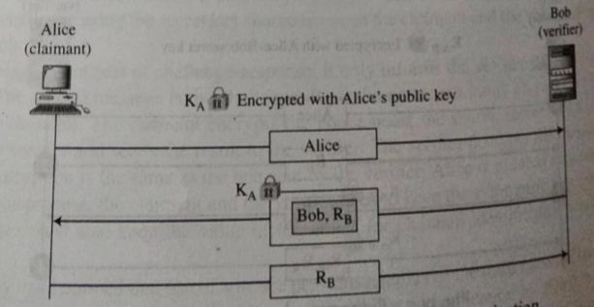
3. Using asymmetric key cipher
i) First Approach (Unidirectional)
Verifier encrypts the challenge using claimant’s public key
Claimant decrypts the message with her private key and sends the nonce to the verifier
14
Notes:
14

Slide 15
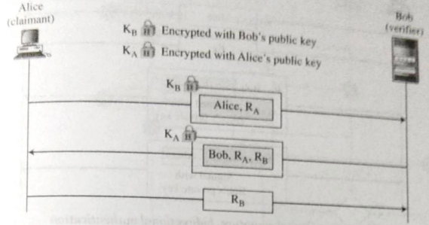
3. Using asymmetric key cipher
ii) Second Approach (Bidirectional)
Claimant sends her identity and nonce encrypted with verifier’s public key
Verifier responds with his nonce encrypted with claimant’s public key
Claimant responds with verifier’s decrypted nonce
15
Notes:
15

Slide 16
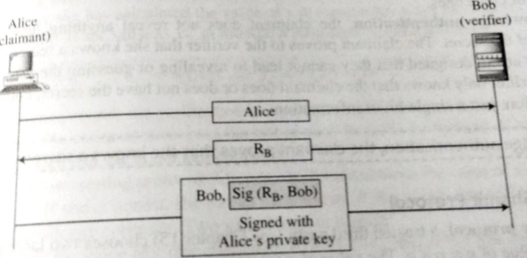
4. Using digital signature
i) First Approach: (Unidirectional)
Verifier uses a plaintext challenge and claimant signs the responses
16
Notes:
16

Slide 17
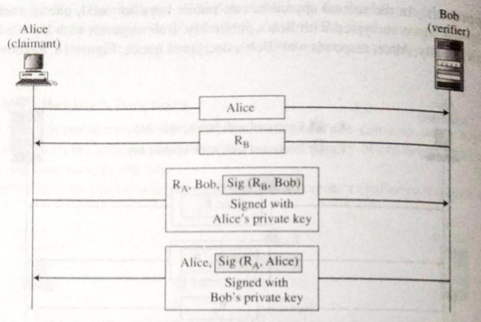
4. Using digital signature
ii) Second Approach: (Bidirectional)
Verifier and claimant authenticate each other
17
Notes:
17

