Slide 1
Cryptography and System Security (CSS)
T.E – Sem.-VI
-Ms. Nabanita Mandal

Slide 2
Transposition Cipher
It hides the message by rearranging the letter order without altering the actual letters used
A transposition cipher does not substitute one symbol for another, instead it changes the location of the symbols
It can be categorized as:
Keyless Transposition
Keyed Transposition

Slide 3
Keyless Transposition Cipher
Simple transposition ciphers, which were used in the past, are keyless.
Example: rail fence cipher.
The ciphertext is created reading the pattern row by row.

Slide 4
Rail Fence
For example, to send the message “Meet me at the park” to Bob, Alice writes
She then creates the ciphertext “MEMATEAKETETHPR”.

Slide 5
Row Transposition Cipher
A more complex scheme
Write letters of message in rows over a specified number of columns
Then reorder the columns according to some key before reading the rows

Slide 6

Columnar Transposition Cipher
Alice and Bob can agree on the number of columns
Alice writes the same plaintext, row by row, in a table of four columns.
Plaintext: “Meet me at the park”
She then creates the ciphertext “MMTAEEHREAEKTTP”.

Slide 7
Keyed Transposition Cipher
The keyless ciphers permute the characters by using writing plaintext in one way and reading it in another way
The permutation is done on the whole plaintext to create the whole ciphertext.
Another method is to divide the plaintext into groups of predetermined size, called blocks, and then use a key to permute the characters in each block separately.

Slide 8

Keyed Transposition Cipher
Alice needs to send the message “Enemy attacks tonight” to Bob.
The key used for encryption and decryption is a permutation key, which shows how the character are permuted.

Slide 9
Keyed Transposition Cipher
The permutation yields

Slide 10
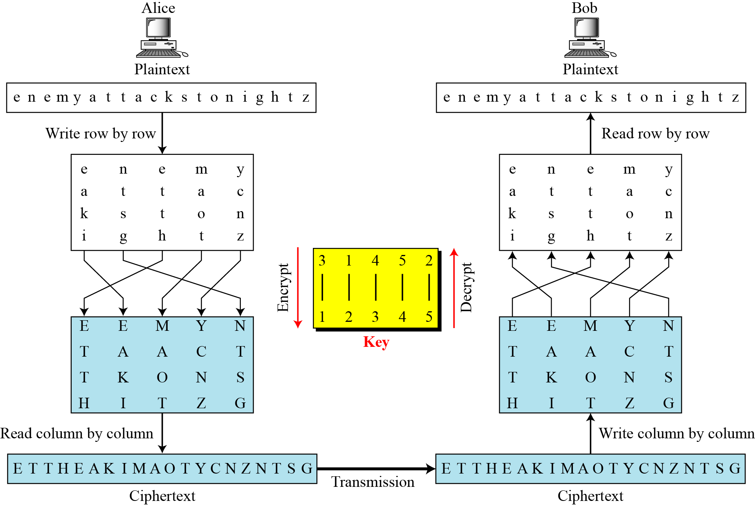
Keyed and Keyless (Combination)

Slide 11
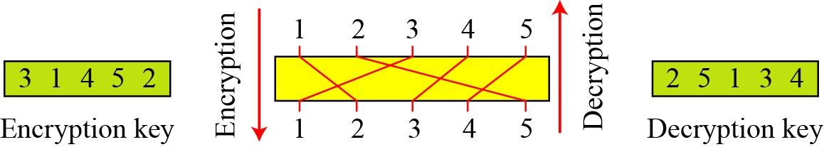
Keyed and Keyless (Combination)
A single key was used in two directions for the column exchange:
downward for encryption and upward for decryption.
It is customary to create two keys.

Slide 12
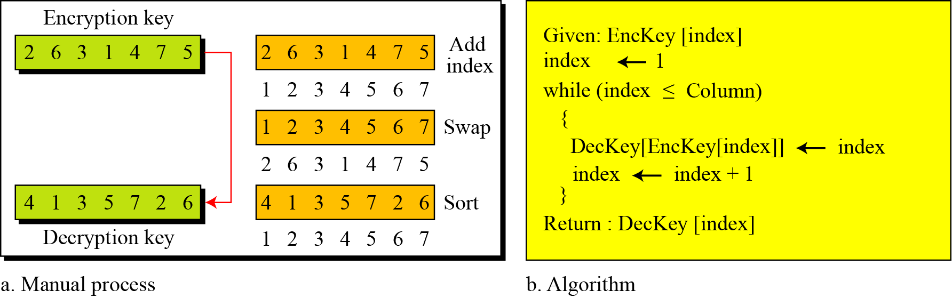
Keyed and Keyless (Combination)
Key Inversion

Slide 13
Stream and Block Ciphers

Slide 14
Stream and Block Ciphers

Slide 15
Stream and Block Ciphers

Slide 16
Stream and Block Ciphers

Slide 17
Theorems
Fermat’s Theorem
Euler’s Theorem
Euclidean Algorithm

Slide 18
Prime number:
A prime number is divisible only by 1 and itself
For example: {2, 3, 5, 7, 11, 13, 17, …}
1 could also be considered prime, but it’s not very useful.

Slide 19
Prime Factorization:
To factor a number n is to write it as a product of other numbers.
n = a * b * c
Example: 100 = 5 * 5 * 2 * 2
Prime factorization of a number n is writing it as a product of prime numbers.
143 = 11 * 13

Slide 20
Relatively Prime Numbers
Relatively Prime Numbers
Two numbers are relatively prime if they have no common divisors other than 1.
Example: 10 and 21 are relatively prime, in respect to each other, as 10 has factors of 1, 2, 5, 10 and 21 has factors of 1, 3, 7, 21.
The Greatest Common Divisor (GCD) of two relatively prime numbers can be determined by comparing their prime factorizations and selecting the least powers.

Slide 21
Relatively Prime Numbers
For example, 125 = 5³ and 200 = 2³ * 5²
GCD(125, 200) = 2⁰ * 5² = 25
If the two numbers are relatively prime the GCD will be 1.
Consider the following: 10(1, 2, 5, 10) and 21(1, 3, 7, 21)
GCD(10, 21) = 1
It then follows, that a prime number is also relatively prime to any other number other than itself and 1.

Slide 22
Euler Totient Function Or Euler’s Phi Function
The Euler's totient function, or phi (φ) function is a very important number theoretic function having a deep relationship to prime numbers and the so-called order of integers.
The totient φ(n) of a positive integer n greater than 1 is defined to be the number of positive integers less than n that are coprime to n.

Slide 23
Euler Totient Function Or Euler’s Phi Function
The following table shows the function values for the first several natural numbers:
n | φ(n) | numbers coprime to n
1 | 1 | 1
2 | 1 | 1
3 | 2 | 1, 2
4 | 2 | 1,3
5 | 4 | 1,2,3,4
6 | 2 | 1,5
7 | 6 | 1,2,3,4,5,6
8 | 4 | 1,3,5,7
9 | 6 | 1,2,4,5,7,8
10 | 4 | 1,3,7,9
11 | 10 | 1,2,3,4,5,6,7,8,9,10
12 | 4 | 1,5,7,11
13 | 12 | 1,2,3,4,5,6,7,8,9,10,11,12
14 | 6 | 1,3,5,9,11,13
15 | 8 | 1,2,4,7,8,11,13,14

Slide 24
Can you find some relationships between n and φ(n)?
φ(1) is defined to be 1
φ(1) = 1
2. when n is a prime number (e.g. 2, 3, 5, 7, 11, 13),
φ(n) = n-1
3. when m and n are coprime or relatively prime,
φ(m*n) = φ(m)*φ(n)
If P is a prime,
φ(P^{e}) = P^{e} - P^{e - 1}

Slide 25
By combining all 4 rules,
The general formula to compute φ(n) is the following:
If the prime factorization of n is given by
n =p₁^{e1}* p₂^{e2}...........*p_{k}^{ek}
then
φ(n) = (p₁^{e1} - p₁^{e1 - 1} ) x (p₂^{e2} - p₂^{e2 - 1} ) x…x (p_{k}^{ek} - p_{k}^{ek - 1} )

Slide 26
Examples :
φ(13) = (13-1) = 12 ( use rule 2)
2. φ(10) (use rule 3)
φ(10) = φ(2) x φ(5) = (2-1) x (5-1) = 1 x 4 = 4
….as 2 and 5 are prime
3. φ(240) = 2⁴ x 3¹ x 5¹ ……(use rule 4)
= (2⁴ - 2³ ) x (3^{1 _} 3⁰ ) x (5^{1 _} 5⁰ ) = 64

Slide 27
4. φ(49) = φ( 7²) = 7² – 7¹ = 42
….use rule 3 not 2 as m and n are relatively prime.
5. φ(14) = φ(7) x φ(2) = 6 x 1 = 6
( 1,3,5,9,11,13)

Slide 28


Fermat’s Little Theorem
If p is prime and a is an integer not divisible by p, then
a^{p-1} 1 (mod p).
And for every integer a and p is prime
a^{p} a (mod p).
This theorem is useful in public key (RSA) and primality testing.

Slide 29
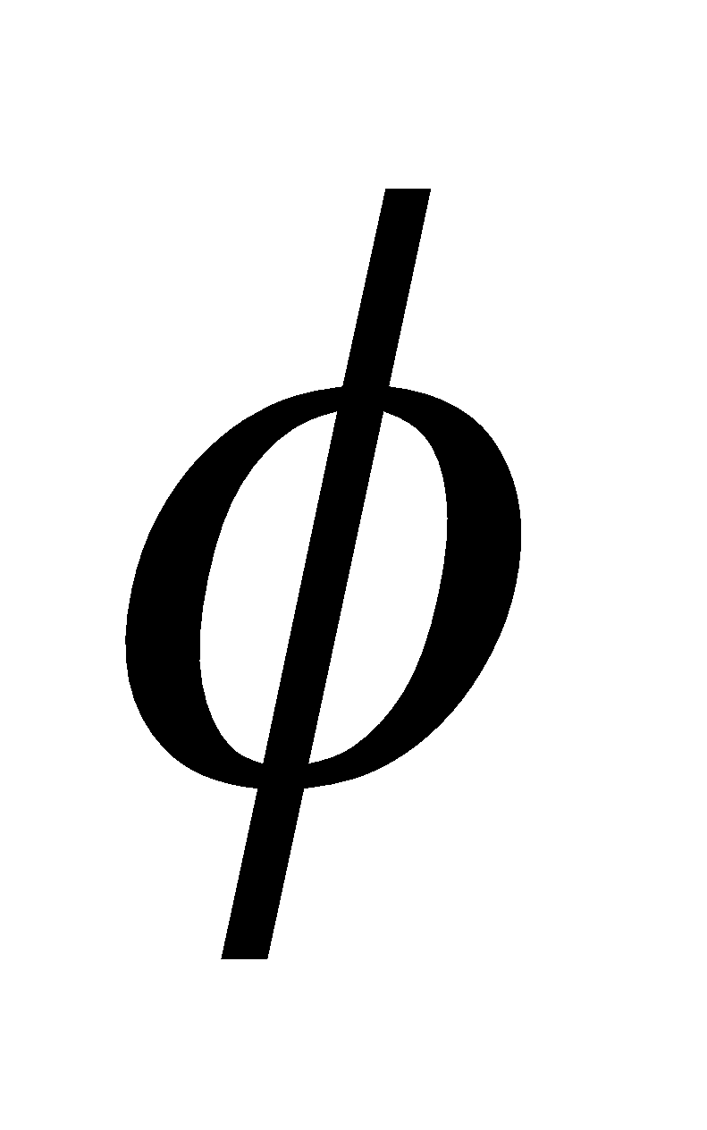
Euler’s theorem
Euler’s theorem uses modulus arithmetic which helps to lay the foundation for RSA encryption.
To construct a personal cipher key we need an appropriate value we will call variable R.
So, we select two very large prime numbers U and V and multiply them.
(R) = (U-1)*(V-1).
This makes R difficult to factor, since the fewer factors a number has, the longer it takes to find them.

Slide 30
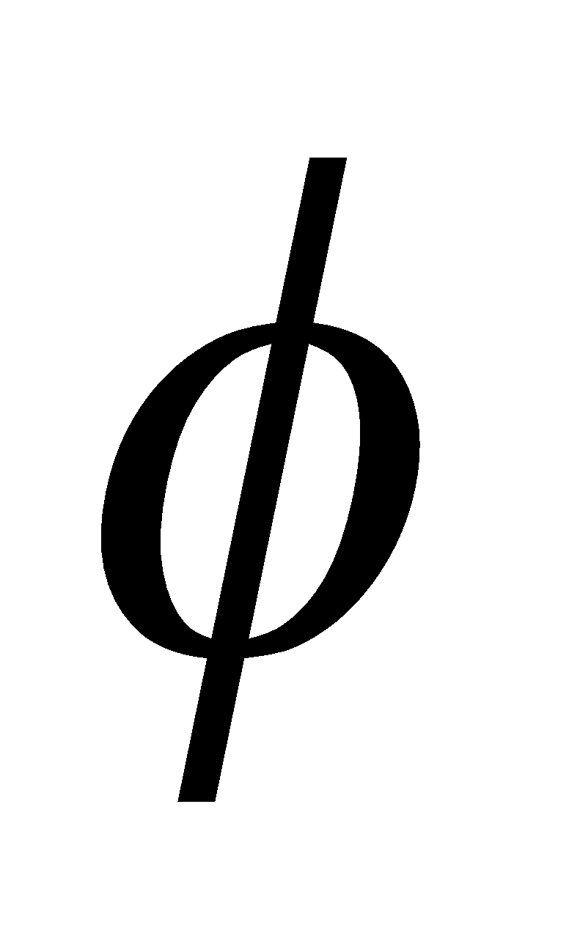

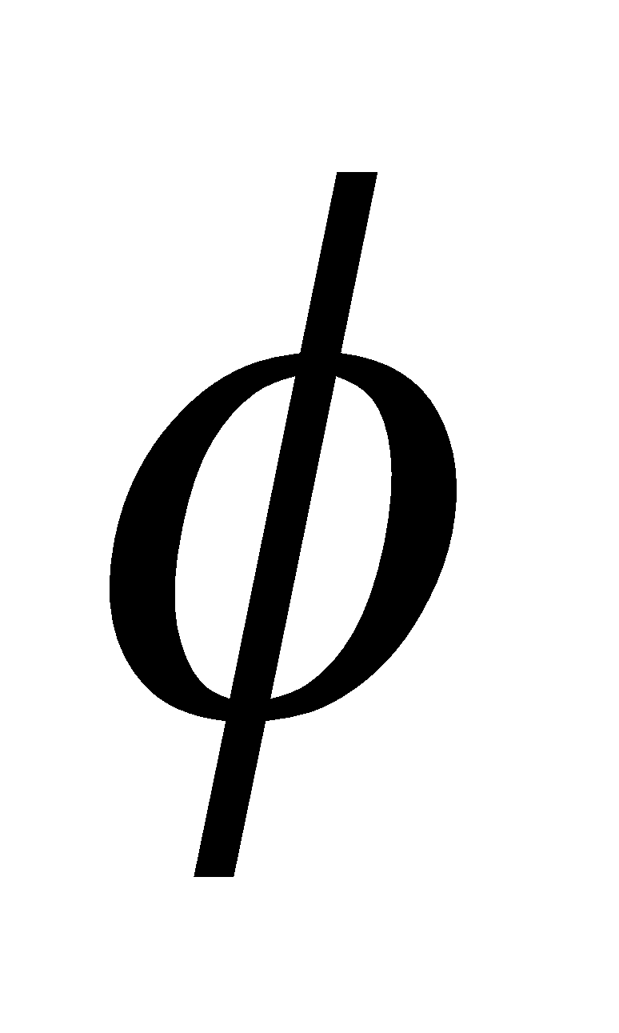
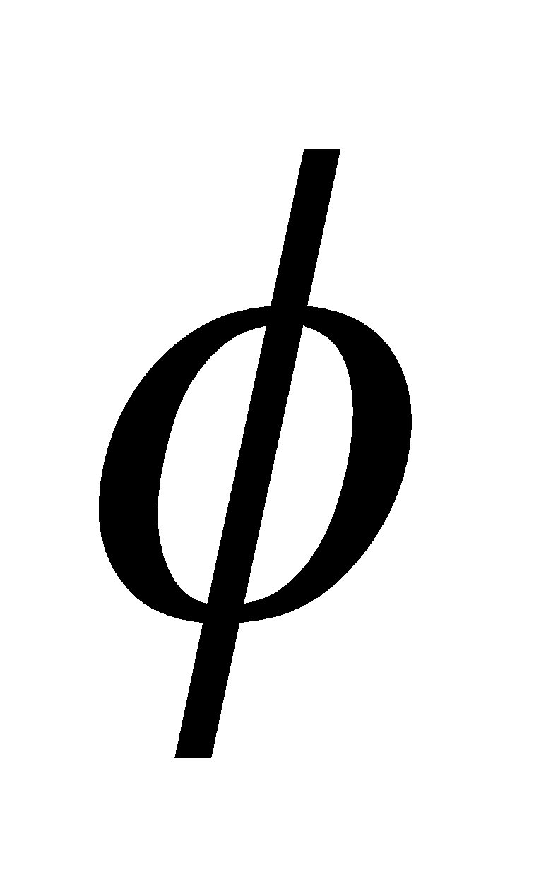
Euler’s theorem
We also define the variables P and Q. P is an arbitrary number that is relatively prime to (R). Q is the calculated inverse of P in (mod (R)).
We use P and R to create a public key, and Q and R to create a private key.
This yields P*Q 1(mod (R) ).
Information in these slides compiled by Christopher Simons

