Slide 1
CRYPTOGRAPHIC HASH FUNCTIONS
Module-3

Slide 2
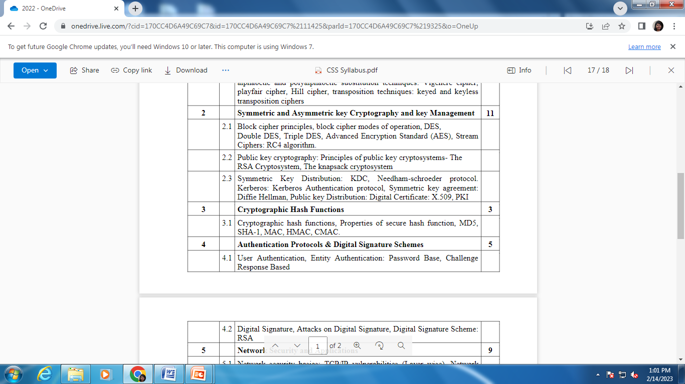
Syllabus

Slide 3
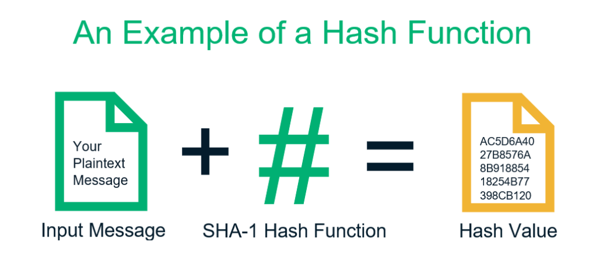
Cryptographic Hash function
Hashing, or a hashing algorithm, is a one-way process that converts your input data of any size into fixed-length enciphered data
For every input, you get a unique hash output.

Slide 4
Cryptographic Hash function
It condenses arbitrary message to fixed size
h = H(M)
usually assume hash function is public
hash used to detect changes to message
We want a cryptographic hash function computationally infeasible to find data mapping to specific hash (one-way property)
It is computationally infeasible to find two data to same hash (collision-free property)

Slide 5
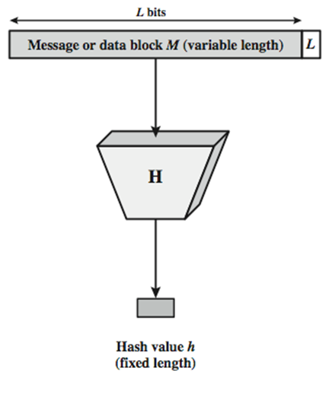
Cryptographic Hash function

Slide 6
Cryptographic Hash function-Uses
Message Integrity Check (MIC)
send hash of message (digest)
MIC always encrypted, message optionally
Message Authentication Code (MAC)
send keyed hash of message
MAC, message optionally encrypted
Digital Signature (non-repudiation)
Encrypt hash with private (signing) key
Verify with public (verification) key

Slide 7
Properties of Cryptographic Hash Function
Preimage Resistance
Second Preimage Resistance
Collision Resistance

Slide 8
Cryptographic Hash function
Hash functions are used in several different ways:
Ensuring data integrity,
Creating and verify digital signatures (which are encrypted hashes),
Facilitating secure password storage.

Slide 9
Characteristics of Cryptographic Hash Function
A Hash Function Is Practically Irreversible
Hash Values Are Unique

Slide 10
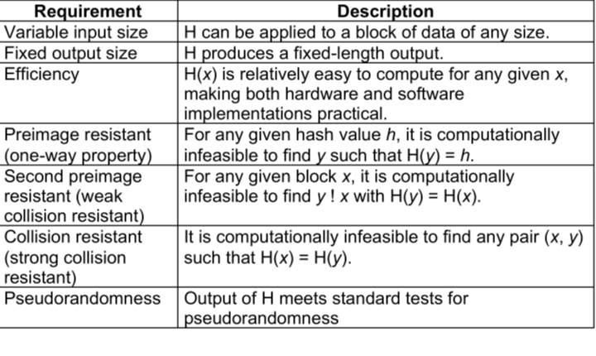
Cryptographic Hash Function-Requirements

Slide 11
Applications
Digital signatures,
Biometrics,
Password storage,
SSL/TLS certificates,
Code signing certificates,
Document signing certificates, and
Email signing certificates.

Slide 12
Iterated hash functions
All cryptographic hash functions need to create a fixed size digest from a variable size message
Creation of such a function is done using Iteration
A function with fixed size input is created and is used necessary number of times for a variable length input
This fixed size input is referred to as a compression function
It compresses an n-bit string to create m-bit string where n > m

Slide 13
Hashing Algorithms
A set of cryptographic hash functions uses compression methods that are made from scratch
Message Digest (MD) - MD2, MD4, MD5
MD5 is the strengthened version of MD4
It divides the message into blocks of 512 bits and creates a 128 bit digest

Slide 14
Hashing Algorithms
Secure hash algorithm (SHA)
It is a standard based on MD5
It has many versions SHA-224, SHA-256, SHA-384, SHA-512

Slide 15
Iterated hash functions
The size of the data block(s) differs from one algorithm to another.
But for a particular algorithm, it remains the same. For example, SHA-1 takes in the message/data in blocks of 512-bit only.
So, if the message is exactly of 512-bit length, the hash function runs only once (80 rounds in case of SHA-1).

Slide 16
Iterated hash functions
Similarly, if the message is 1024-bit, it’s divided into two blocks of 512-bit and the hash function is run twice.
However, most of the time, the message won’t be in the multiples of 512-bit. For such cases, a technique called Padding is used.

Slide 17
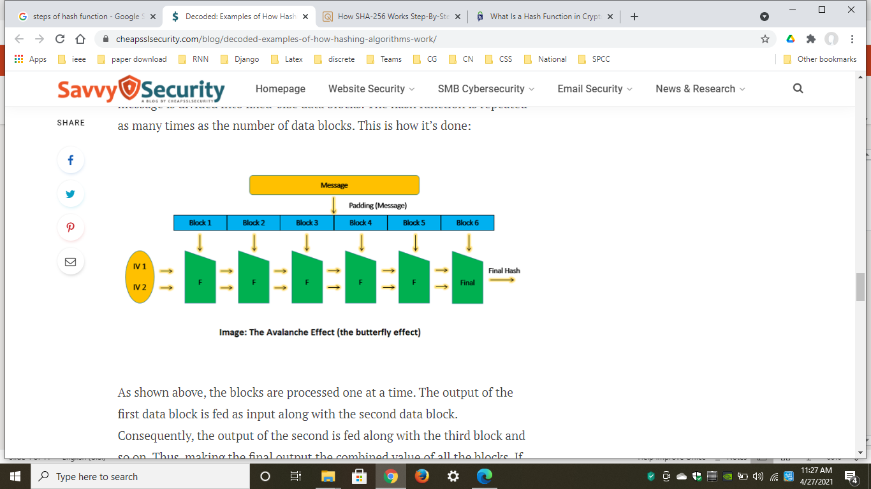
Iterated hash functions
Using a padding technique, the entire message is divided into fixed-size data blocks.
The hash function is repeated as many times as the number of data blocks.

Slide 18
Iterated hash functions
The blocks are processed one at a time.
The output of the first data block is fed as input along with the second data block.
Consequently, the output of the second is fed along with the third block and so on.
Thus, making the final output the combined value of all the blocks.
If you change one bit anywhere in the message, the entire hash value changes. This is called ‘the avalanche effect’.

Slide 19
Hash functions
A one-way hash function, H(M), operates on an arbitrary-length pre-image message, M.
It returns a fixed-length hash value, h.
h = H(M), where h is of length m

Slide 20
Hash functions
Many functions can take an arbitrary-length input and return an output of fixed length, but one-way hash functions have additional characteristics that make them one-way:
Given M, it is easy to compute h.
Given h, it is hard to compute M such that H(M)= h.
Given M, it is hard to find another message, M’, such that H(M) = H(M’).

Slide 21
hash functions
The whole point of the one-way hash function is to provide a “fingerprint” of M that is unique.
Example:
If Alice signed M by using a digital signature algorithm on H(M), and Bob could produce M’, another message different from M where H(M) = H(M’), then Bob could claim that Alice signed M’

Slide 22
hash functions
In some applications, one-wayness is insufficient; we need an additional requirement called collision-resistance.
It is hard to find two random messages, M and M’, such that H(M) = H(M’).
Collision attack: In this attack, Eve tries to compute two distinct messages, M and M' which hash to the same value

Slide 23
hash functions
Hashing functions are:
Deterministic (it always produces the same output given the same input), and
Irreversible (it’s impossible to convert hash values back to plaintext)
However, that poses a problem. How can we guarantee that each output will be unique so that two different passwords don’t map to the same output?
There is no gurantee to it because hash functions will output a fixed-length hash.

Slide 24
hash functions
The number of possible hash values will depend on the function used:
MD5 can output 2^128 different hash values,
SHA-1 can output 2^160 different hash values,
Since inputs are infinite, some of them will invariably be mapped to the same hash output.

Slide 25
Birthday attack-Problem
The Pigeonhole principle states that if n items are put into m containers, with n > m, then at least one container must contain more than one item.
For example, we have around 7.5 billion people on the planet (“n items”), but we can only be born in 365 days of the year (“m containers”).
There is a famous application of the Pigeonhole Principle in mathematics related to this problem known as the Birthday Problem. It can be stated as such:
How many people must be in a room such that the chance of two people sharing a birthday is 50%? We’ll exclude leap years for simplicity. We’ll also assume that the likelihood of a person being born in each of the 365 days is equal.
The answer is only 23 people.

Slide 26
Birthday attack-Problem
That means that you stand a 50% chance of finding an MD5 collision (sample space of 2^128 possibilities) after around 2^64 operations and a 50% chance of finding an SHA-1 collision (sample space of 2^160 possibilities) after around 2^80 operations.

Slide 27
Birthday attack-Solution
Hash functions of 64 bits are just too small to survive a birthday attack.
Most practical one-way hash functions produce 128-bit hashes.
This forces anyone attempting the birthday attack to hash 2^64 random documents to find two that hash to the same value, not enough for lasting security.
NIST, in its Secure Hash Standard (SHS), uses a 160-bit hash value. This makes the birthday attack even harder, requiring 2^80 random hashes

Slide 28
MD5
Input: MD5 processes the input text in 512-bit blocks, divided into 16 32-bit sub-blocks.
Output: The output of the algorithm is a set of four 32-bit blocks, which concatenate to form a single 128-bit hash value.

Slide 29
MD5
Steps
First, the message is padded so that its length is just 64 bits short of being a multiple of 512.
This padding is a single 1-bit added to the end of the message, followed by as many zeros as are required.
Then, a 64-bit representation of the message’s length (before padding bits were added) is appended to the result.
These two steps serve to make the message length an exact multiple of 512 bits in length (required for the rest of the algorithm), while ensuring that different messages will not look the same after padding

Slide 30
MD5
Steps
Four 32-bit variables are initialized:
A = 0x01234567
B = 0x89abcdef
C = 0xfedcba98
D = 0x76543210
These are called chaining variable
Now, the main loop of the algorithm begins. This loop continues for as many 512-bit blocks as are in the message.

Slide 31
MD5
Steps
The four variables are copied into different variables: a gets A, b gets B, c gets C, and d gets D
The main loop has four rounds (MD4 had only three rounds), all very similar.
Each round uses a different operation 16 times.
Each operation performs a nonlinear function on three variables a, b, c, and d.
Then it adds that result to the fourth variable, a sub-block of the text and a constant.
Then it rotates that result to the right a variable number of bits and adds the result to one of a, b, c, or d

Slide 32
MD5
Steps
There are four nonlinear functions, one used in each operation (a different one for each round).
F(X,Y,Z) = (X ¥ Y) ¦ ((¬ X) ¥ Z)
G(X,Y,Z) = (X ¥ Z) ¬ (Y (¬ Z))
H(X,Y,Z) = X • Y • Z
I(X,Y,Z) = Y • (X ¦ (¬ Z))
(• is XOR, ¥ is AND, ¦ is OR, and ¬ is NOT)

Slide 33
MD5
Steps
These functions are designed so that if the corresponding bits of X, Y, and Z are independent and unbiased, then each bit of the result will also be independent and unbiased.
The function F is the bit-wise conditional: If X then Y else Z.
The function H is the bit-wise parity operator

Slide 34
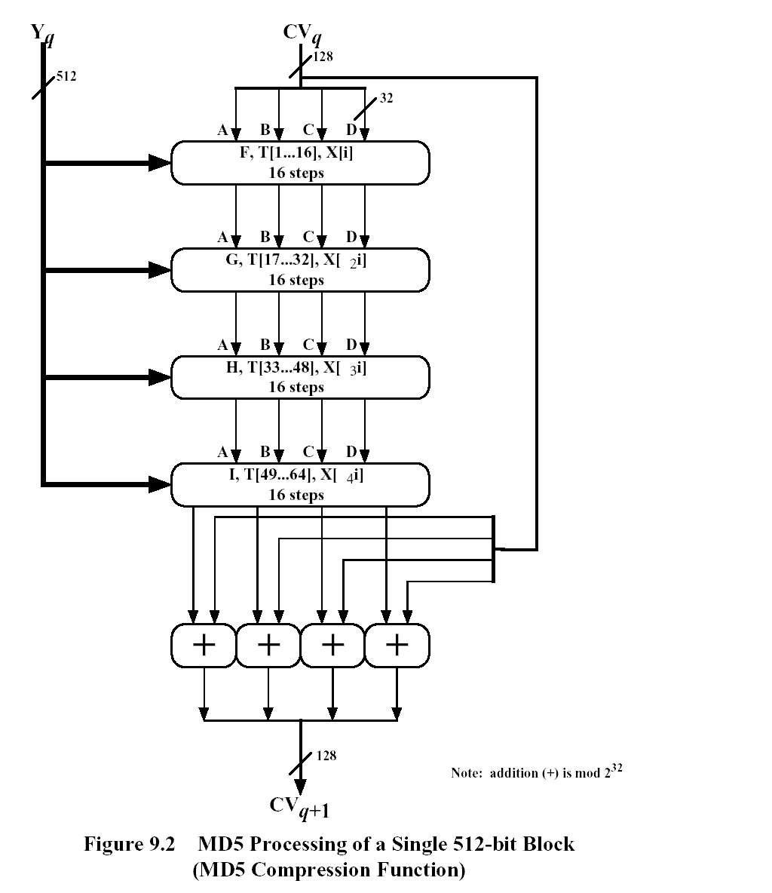
MD5

Slide 35
SHA
SHA produces a 160-bit hash, longer than MD5
First, the message is padded to make it a multiple of 512 bits long. Padding is exactly the same as in MD5:
First append a one, then as many zeros as necessary to make it 64 bits short of a multiple of 512, and finally a 64-bit representation of the length of the message before padding

Slide 36
SHA
Five 32-bit variables (MD5 has four variables, but this algorithm needs to produce a 160-bit hash) are initialized as follows:
A = 0x67452301
B = 0xefcdab89
C = 0x98badcfe
D = 0x10325476
E = 0xc3d2e1f

Slide 37
SHA
The main loop of the algorithm then begins. It processes the message 512 bits at a time and continues for as many 512-bit blocks as are in the message.
First the five variables are copied into different variables: a gets A, b gets B, c gets C, d gets D, and e gets E
The main loop has four rounds of 20 operations each (MD5 has four rounds of 16 operations each).
Each operation performs a nonlinear function on three of a, b, c, d, and e, and then does shifting and adding similar to MD5

Slide 38
SHA
SHA’s set of nonlinear functions is:
f_{t} (X,Y,Z ) = (X¥ Y) ¦ ((¬ X )¥ Z), for t = 0 to 19.
f_{t} (X,Y,Z ) = X • Y • Z, for t = 20 to 39.
f_{t} (X,Y,Z ) = (X¥ Y ) ¦ (X¥ Z) ¦ (Y¥ Z), for t = 40 to 59.
f_{t} (X,Y,Z ) = X • Y • Z, for t = 60 to 79

Slide 39
SHA
Four constants are used in the algorithm:
K_{t} = 0x5a827999, for t = 0 to 19.
K_{t} = 0x6ed9eba1, for t = 20 to 39.
K_{t} = 0x8f1bbcdc, for t = 40 to 59.
K_{t} = 0xca62c1d6, for t = 60 to 79
These numbers are obtained as follows:
0x5a827999 = 2^{1/2} /4, 0x6ed9eba1 = 3^{1/2} /4, 0x8f1bbcdc = 5^{1/2} /4, and 0xca62c1d6 = 10^{1/2} /4; all times 2³².

Slide 40
SHA
The message block is transformed from 16 32-bit words (M0 to M15 ) to 80 32-bit words (W0 to W79) using the following algorithm:
W_{t} = M_{t} , for t = 0 to 15
W_{t} = (W_{t- 3} • W_{t - 8} • W_{t - 14} • W_{t - 16} ) <<< 1, for t = 16 to 79
If t is the operation number (from 0 to 79), W_{t} represents the t^{th} sub-block of the expanded message, and <<< s represents a left circular shift of s bits

Slide 41
SHA
After all of this, a, b, c, d, and e are added to A, B, C, D, and E respectively, and the algorithm continues with the next block of data.
The final output is the concatenation of A, B, C, D, and E

Slide 42
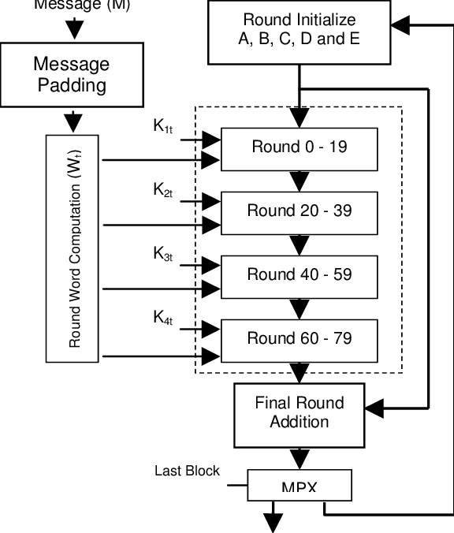
SHA

