Slide 1
Module-6 System Security

Slide 2
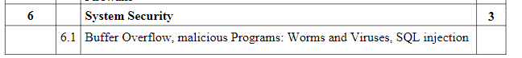
Syllabus

Slide 3
Secure Programs
What is a secure program?
Everyone has there own requirement of secure.
Part of assessing software quality
Does it meet security requirements in specification? (is requirements complete?)
In general, we often look at quantity and types of faults for evidence of security (or lack of it). We track these things.

Slide 4
Who’s Fault is it?
Finding lots of faults in software early.
NOT GOOD.
Early approaches were “Penetrate” and then “Patch”
NOT GOOD.
Repairing with a patch is a narrow focus and not the more important requirements.
Patches can cause other problems.
Non obvious side effects
Fix one places – fails another
Performance or function suffers

Slide 5
Types of Flaws
Validation error (incomplete or inconsistent): permissions checks
Domain error: controlled access to data
Serialization and aliasing: program flow order
Inadequate identification and authentication: basis for authorization
Boundary condition violation: failure on first or last case
Other exploitable logic errors

Slide 6
Unexpected Behavior
Unexpected behavior is a program security flaw.
Does the program behave as it was designed?
Behavior can be:
Vulnerability (class of fault)
Flaw (fault or failure)
Flaw (human)
Inadvertent
Intentional

Slide 7
Nonmalicious Program Errors
Buffer Overflows
Excess information provided – overfilling the bucket
Buffer – space in which data is held (array or string)
char sample[10] or char sample[i]
For (i=0; I<=9; i++) sample[i] = ‘A’;
sample[10] = ‘B’;

Slide 8
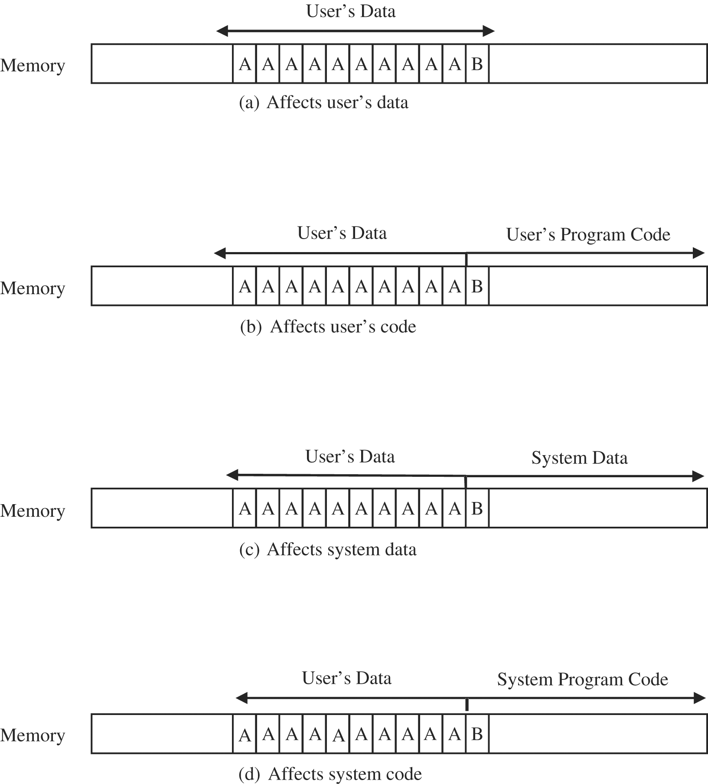
Figure 3-1 Places Where a Buffer Can Overflow.

Slide 9
Buffer overflows
One of the most common vulnerabilities in software
Particularly problematic when present in system libraries and other code that runs with high execution privileges.

Slide 10
How it works
Application reserves adjacent memory locations (buffer) to store arguments to a function, or variable values.
Attacker gives an argument too long to fit in the buffer.
The application copies the whole argument, overflowing the buffer and overwriting memory space.
If the conditions are “just right” this will enable to attacker to gain control over the program flow and execute arbitrary code, with the same privileges of the original application.

Slide 11
Buffer Overflows
void function(char *str) {
char buffer[8];
strcpy(buffer,str); }
void main() {
char large_string[256];
int i;
for( i = 0; i < 255; i++)
large_string[i] = 'A'; function(large_string); }

Slide 12
Buffer Overflows

Slide 13
Buffer Overflows

Slide 14
Buffer Overflows

Slide 15
Buffer Overflows

Slide 16
Buffer Overflows

Slide 17
Buffer Overflows

Slide 18
Buffer Overflows

Slide 19
Buffer Overflows

Slide 20
What's the problem?
The gets and strcpy functions don't check that the string they're copying into the buffer will fit in the buffer!
Some languages would give you some kind of exception here, and crash the program.
Not C (the most commonly used language for systems programming). C doesn't even notice something bad happened, and continues on its way.
Notes:
20

Slide 21
Buffer overflow
If the attacker can write data past the end of an array on the stack, she can usually overwrite things like the saved return address. When the function returns, it will jump to any address of her choosing.
Targets: programs on a local machine that run with setuid (superuser) privileges, or network daemons on a remote machine
Notes:
21

Slide 22
Kinds of Defenses
Better software engineering practices
Find-and-patch methods
Language tools
Analysis tools
Compiler tools
Operating system tools

Slide 23
Types of security flaws
One way to divide up security flaws is by genesis (where they came from)‏
Some flaws are intentional
Malicious flaws are intentionally inserted to attack systems, either in general, or certain systems in particular
If it's meant to attack some particular system, we call it a targeted malicious flaw
Nonmalicious (but intentional) flaws are often features that are meant to be in the system, and are correctly implemented, but nonetheless can cause a failure when used by an attacker
Notes:
23

Slide 24
Unintentional program errors
Most security flaws are caused by unintentional program errors
the most common sources of unintentional security flaws
Buffer overflows
Notes:
24

Slide 25
Viruses and Other Malicious Code
Mistakes are not malicious (human error)
Virus – program that replicates itself to other programs by altering the program code.
Transient virus – runs when host runs
Resident virus – resides in memory (active as a stand alone)

