Slide 1
Module-6 System Security

Slide 2
Types of Malicious Code
Virus - program that attaches itself to non-malicious programs and propagates itself to other programs
Trojan Horse – Malicious code that in addition to its primary non-malicious effect, has a non-obvious malicious effect
Logic Bomb – only on a condition
Time bomb – only at certain time
Trapdoor (backdoor) – other means of privileged access; intentional and non-intentional . i.e. unauthorized access to functionality

Slide 3
Types of Malicious Code
Worm – spreads virus via network
Rabbit – replicates to exhaust recourses
Rootkits - Tools to misrepresent what is on the system
Keylogger/spyware - Code that observers and reports actions on the computer

Slide 4
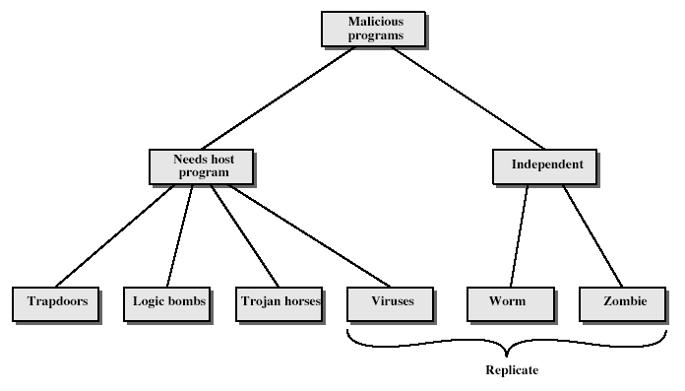
Malicious Software
Notes:
Stallings Fig 19-1.
Taxonomy can be divided into two categories: those that need a host program, and those that are independent;
can also differentiate between those software threats that do not replicate and those that do.

Slide 5
1. Trojan Horse
Programs that appear to have one function but actually perform another.
Modern Trojan Horse: resemble a program that the user wishes to run - usually superficially attractive
eg game, s/w upgrade etc
3. When run it performs some additional tasks
allows attacker to indirectly gain access they do not have directly
4. Often used to propagate a virus/worm or install a backdoor
Or simply to destroy data

Slide 6
2. Trapdoors (Back doors)
Secret entry point into a program
Allows those who know access bypassing usual security procedures
Have been commonly used by developers
A threat when left in production programs allowing exploited by attackers
Very hard to block in O/S
Requires good s/w development & update

Slide 7
3. Logic Bomb
one of oldest types of malicious software
code embedded in legitimate program
activated when specified conditions met
eg presence/absence of some file
particular date/time
particular user
particular series of keystrokes
when triggered typically damage system
modify/delete files/disks

Slide 8
4. Zombie
program which secretly takes over another networked computer
then uses it to indirectly launch attacks
often used to launch distributed denial of service (DDoS) attacks
exploits known flaws in network systems

Slide 9
5.Key Loggers and Spyware
Gather information from computer
Send back to the central office
From key loggers can gather
Passwords
Confidential communication
Keep track of your kids/employees
From spyware can gather
Web browsing habits
Gather marketing information

Slide 10
6. Rootkits
Insert file filters to cause files or directories disappear from normal listings
Can replace Windows API pointers (user mode)
Can also replace syscall table pointers
Both require privilege, but with Windows most installs require privilege anyway
The power of extensibility used for the dark side
Techniques apply equally well to Linux and Mac

Slide 11
Virus Operation
Virus Phases:
Dormant: Waiting on trigger event
Propagation: Replicating to programs/disks
Triggering: By event to execute payload
Execution: Executing payload
Details usually Machine/OS specific
Exploits different features or weaknesses

Slide 12
Virus Pseudocode
beginvirus:
If spread-condition then begin
For some set of target files do begin
If target is not infected then begin
Determine where to place virus instructions
Copy instructions from beginvirus to endvirus into target
Alter target to execute new instructions
Perform some actions
Goto beginning of infected program
endvirus:

Slide 13
Structure of A Virus
Virus() {
infectExecutable();
if (triggered()) {
doDamage();
}
jump to main of infected program;
}
void infectExecutable() {
file = choose an uninfected executable file;
prepend V to file;
}
void doDamage() { ... }
int triggered() { return (some test? 1 : 0); }

Slide 14
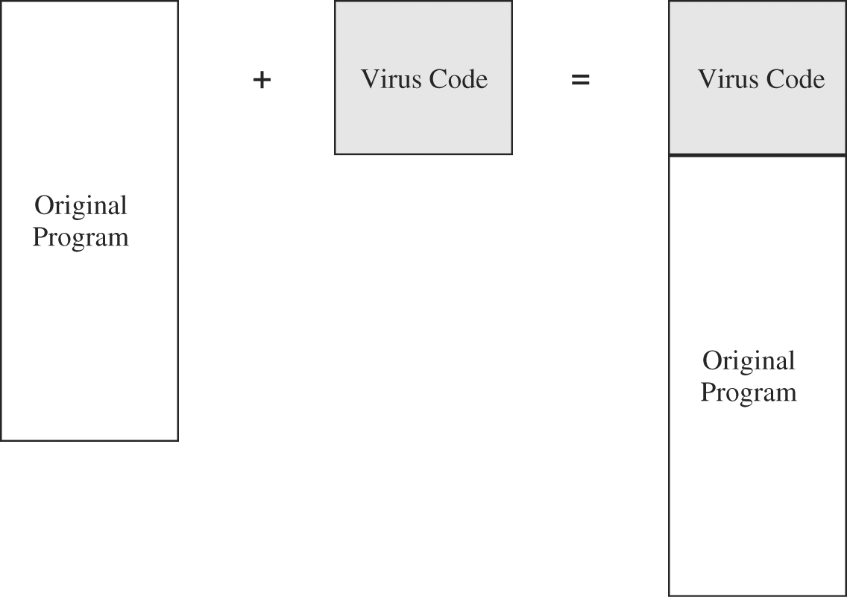
How Viruses Work
Attach
Append to program or e-mail
Executes with program
Surrounds program
Executes before and after program
Erases its tracks
Integrates or replaces program code
Gain control
Virus replaces target
Reside
In boot sector
Memory
Application program
Libraries

Slide 15
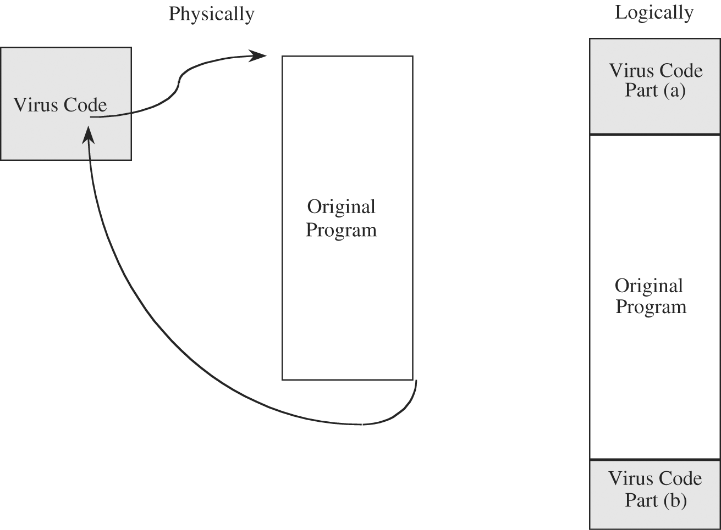
Figure 3-5 Virus Surrounding a Program.

Slide 16
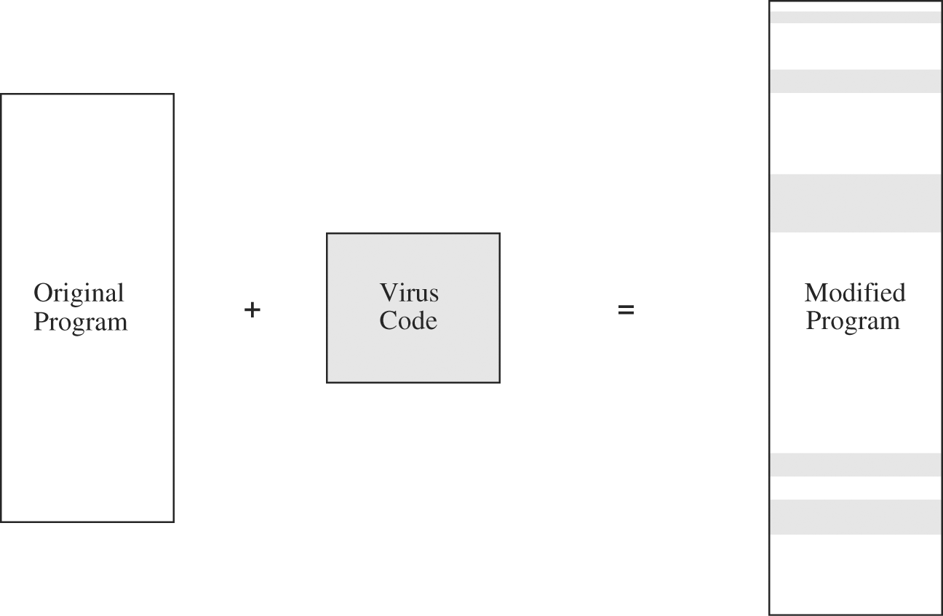
Figure 3-6 Virus Integrated into a Program.

Slide 17
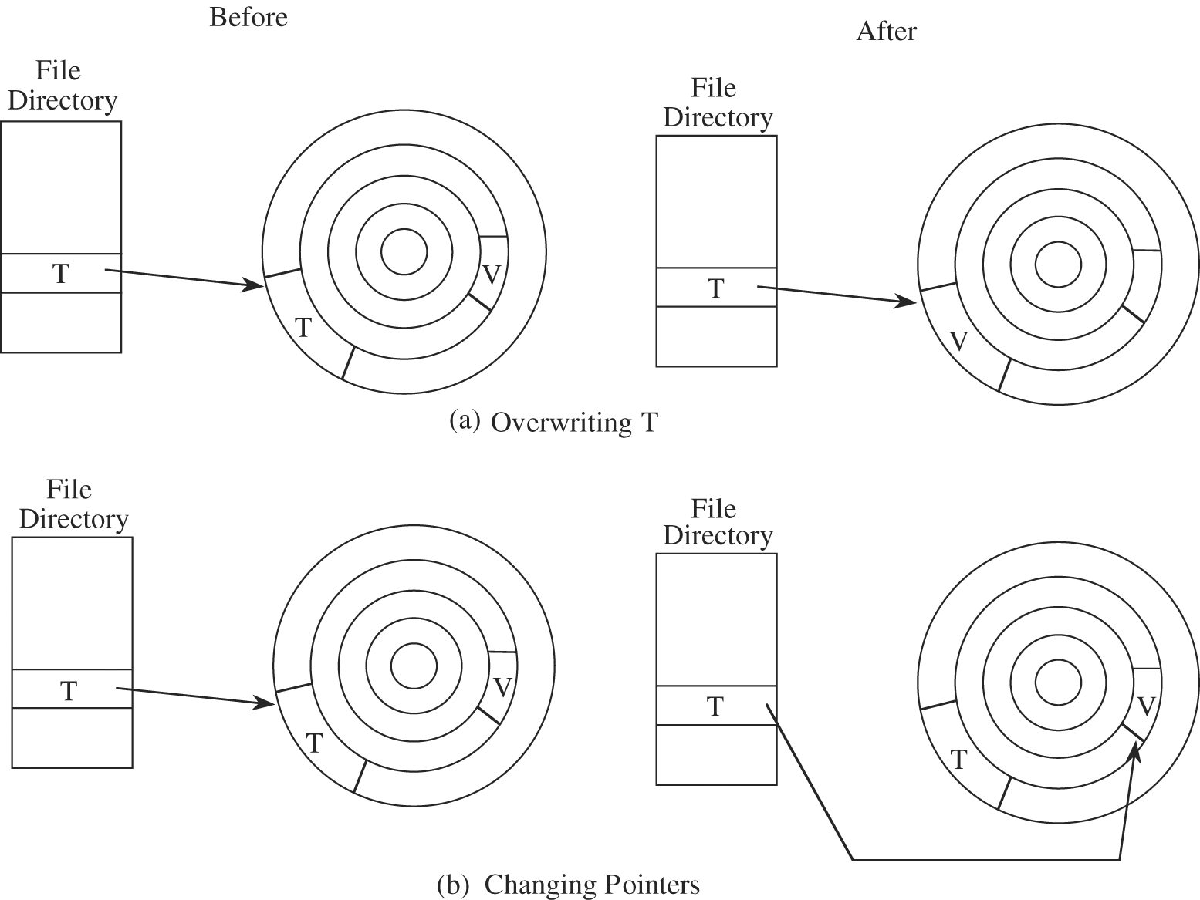
Figure 3-7 Virus Completely Replacing a Program.

Slide 18
Viruses (Continued)
Document Virus
Within the format of a document
Macro Virus
Appealing Qualities for Virus Writers
Hard to detect
Not easily destroyed
Spreads widely
Re-infects easily
Easy to create
Machine and OS independent

Slide 19
How Viruses Work, cont.
Detection
Virus signatures
Storage patterns
Execution patterns
Transmission patterns
Prevention
Don’t share executables
Use commercial software from reliable sources
Test new software on isolated computers
Open only safe attachments
Keep recoverable system image in safe place
Backup executable system file copies
Use virus detectors
Update virus detectors often

Slide 20
Q. How to protect ourselves from virus?
Open email attachments that are expected and that come from a trusted source.
Use internet security software that automatically scans email attachments for viruses and other malicious software before opening them.
Delete any suspect messages without opening them.
Do not click on web links or download files sent through emails or instant messages by someone you don’t know.

Slide 21
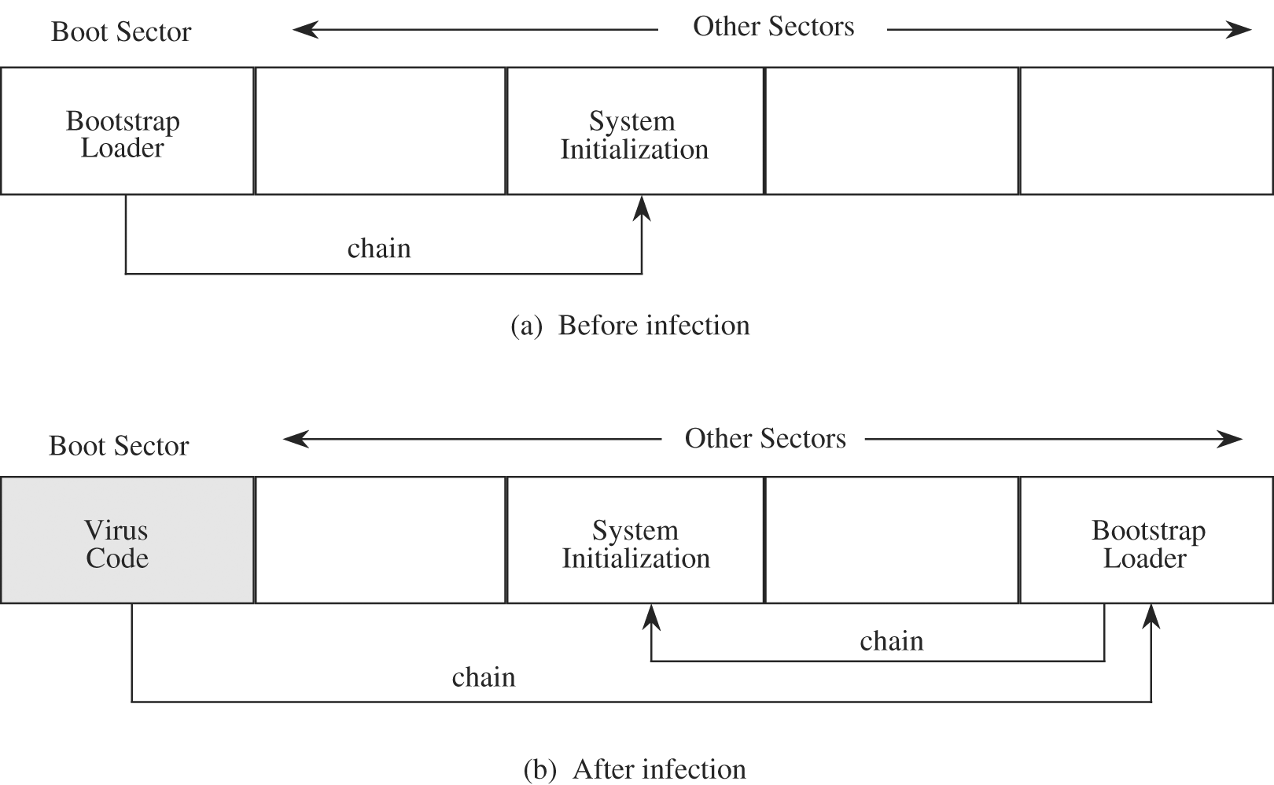
Viruses (Continued)
Where do they live?
One-Time Execution Virus – come in on EMAIL; these are popular, it is executed just by being opened.
Boot Sector Virus
From the bootsrap (bootup); bootse ctor of the hard disk

Slide 22
Viruses (Continued)
A boot sector virus alters or hides in the boot sector, usually the 1st sector, of a bootable disk or hard drive.
The boot sector is where your computer starts reading your operating system.
By inserting its code into the boot sector, a virus guarantees that it loads into memory during every boot sequence.
A boot virus does not affect files; instead, it affects the disks that contain them.
Examples: Form, Disk Killer, Michelangelo, and Stone virus

Slide 23
Worms
Autonomous, active code that can replicate to remote hosts without any triggering
Replicating but not infecting program
Because they propagate autonomously, they can spread much more quickly than viruses!
Speed and general lack of user interaction make them the most significant threats

Slide 24
Exploitation of Flaws: Targeted Malicious Code
Trapdoors
Program stubs during testing
Intentionally or unintentionally left
Forgotten
Left for testing or maintenance
Left for covert access
Salami attack
Merges inconsequential pieces to get big results
Ex: deliberate diversion of fractional cents
Too difficult to audit

Slide 25
Exploitation of Flaws: Targeted Malicious Code, cont.
Covert Channels
Programs that leak information
Trojan horse
Discovery
Analyze system resources for patterns
Flow analysis from a program’s syntax (automated)
Difficult to close
Not much documented
Potential damage is extreme

