Slide 1
System Programming and Compiler Construction
-Ms.Nabanita Mandal

Slide 2
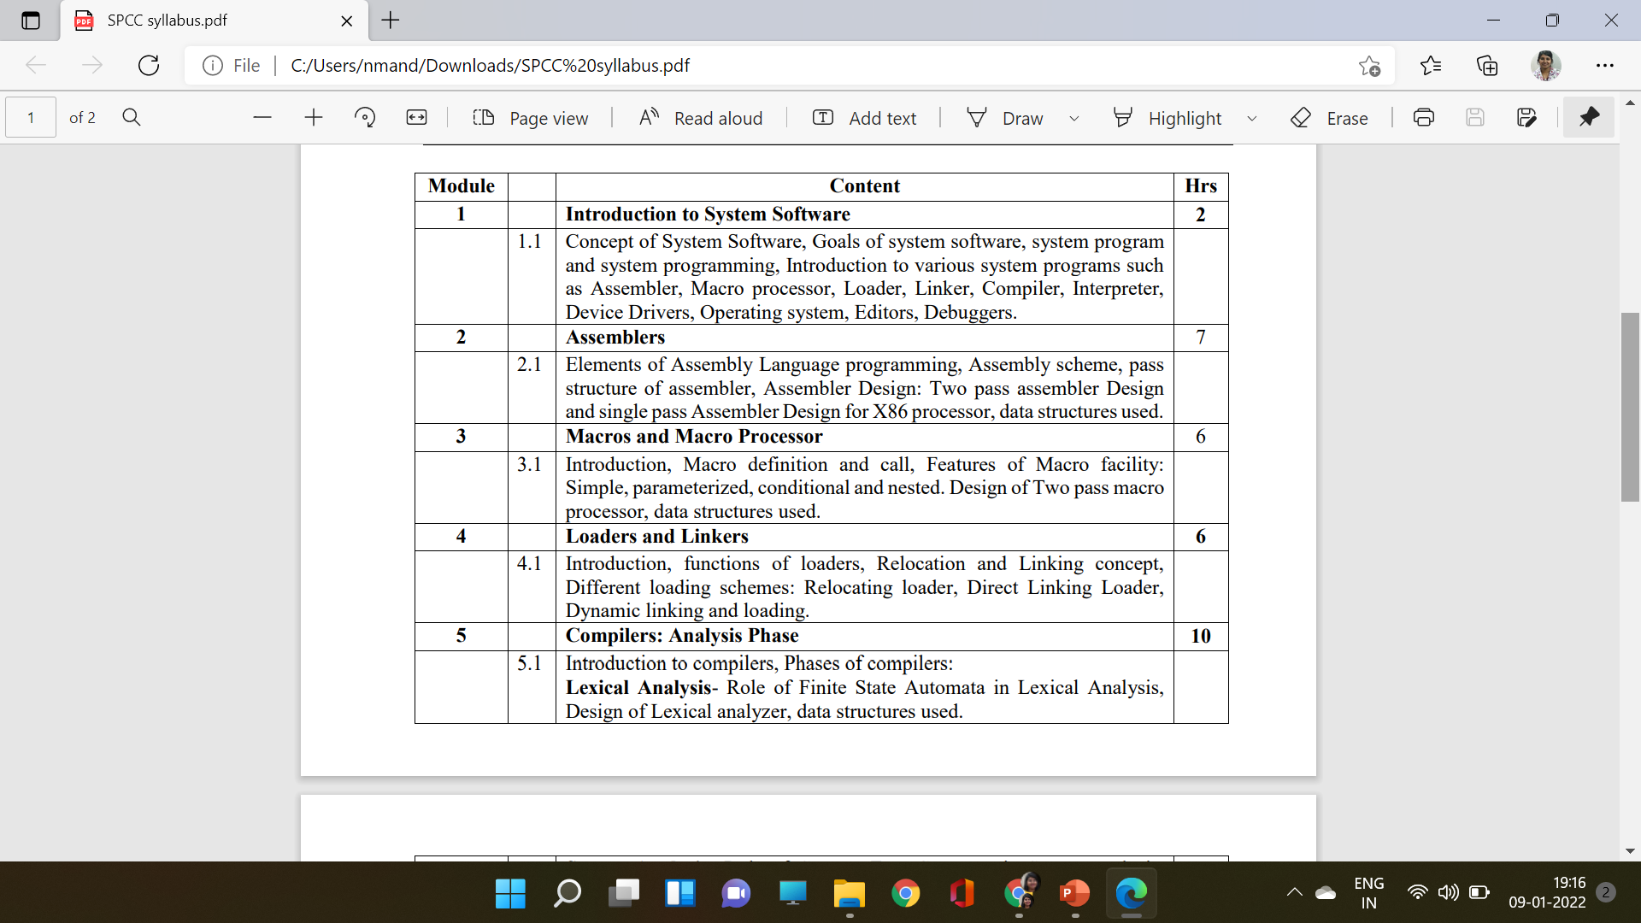
Syllabus

Slide 3
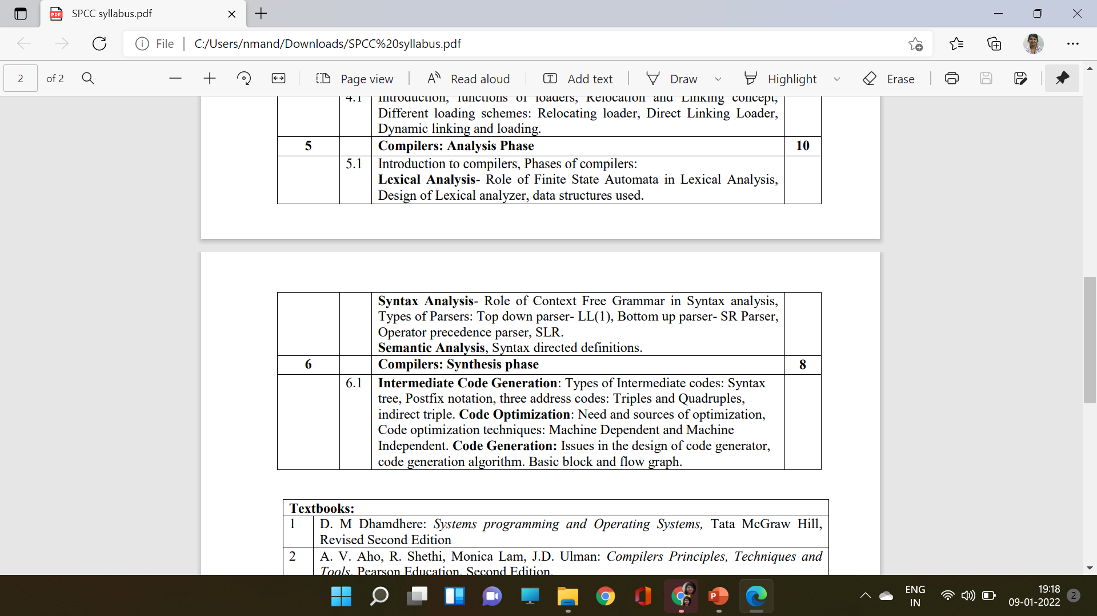
Syllabus

Slide 4
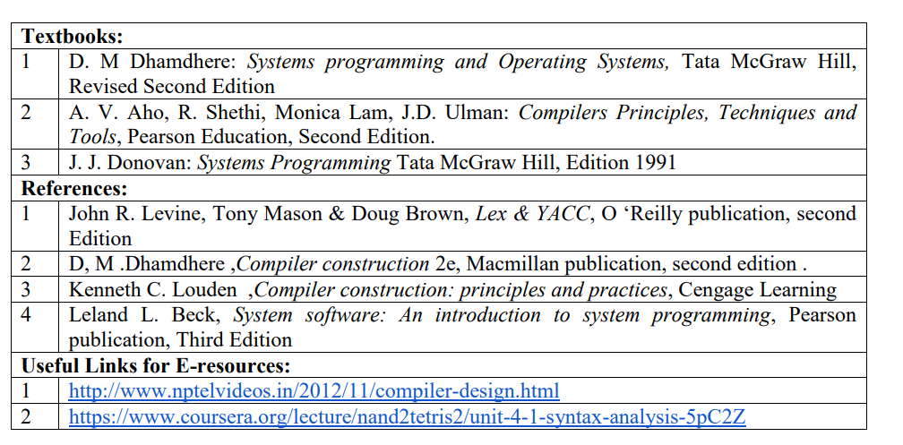
Books and E-Resources

Slide 5
Module-1: Introduction to System Software
Concept of System Software
Goals of system software
System program and system programming
Introduction to various system programs such as: Assembler, Macro processor, Loader, Linker, Compiler, Interpreter, Device Drivers, Operating system, Editors, Debuggers

Slide 6
Introduction
Application
Domain
Execution
Domain
Semantic Gap
Introducing Programming Language (PL) Domain
Application
Domain
PL
Domain
Execution
Domain
Specification Gap
Execution Gap

Slide 7
Programming Languages
Generation of Languages:
First Generation Language (Machine Language)
Second Generation Language (Assembly Language)
Third Generation Language (High Level Language)

Slide 8
First Generation Language
Also known as Machine Language
Binary Language – Uses ‘0’ and ‘1’
Easy Understandable Instructions to Computers
Used for Internal Structure of Program
Advantages
Increase speed of processing
No Need of Translation
Drawback
Difficult to Learn
Error prone

Slide 9
Second Generation Language
Also known as Assembly Language
Specific Meaningful Keywords: Mnemonics
Disadvantage:
Not easily understood by machine
Program need to be translated to Machine Language. The translator is known as Assembler

Slide 10
Third Generation Language
Also known as High Level Language
Advantage:
Syntax uses English keywords which are easy to understand
Languages are not machine oriented.
Disadvantage
Program need to be translated to Machine Language. The translator known as Compiler
Slow processing in comparison with 1st and 2nd Generation Languages.
Example: C, C++, Java

Slide 11
Language Processor
A language processor is software which bridges a specification or execution gap.
A spectrum of language processors is designed to meet practical requirements.
Language
Processor
Source Program
Target Program

Slide 12
Language Processing Activities
Program Generation Activities: Bridges Specification (Design) Gap
Program Execution Activities: Bridges Execution Gap

Slide 13
Program Generation
The program generator is system software which accepts the specification of a program to be generated and generates a program in the target language.
Errors
Program
Generator
Program
Generator
Program
Specification
Target Program

Slide 14
Program Execution
There are two modes of Program Execution
Program Translation
Program Interpretation

Slide 15
System Software
It is a collection of program that facilitates execution of programs and use of resources in a computer system
It contains a hierarchical arrangement of layers in which programs in upper layers use facilities provided by the layer below it

Slide 16
Goals of System Software
➢User Convenience:- Provide convenient methods of using a computer system
➢Efficient Use:-Ensure efficient use of a computer resources
➢Non-Interference:-Prevent interference in the activities of its users

Slide 17
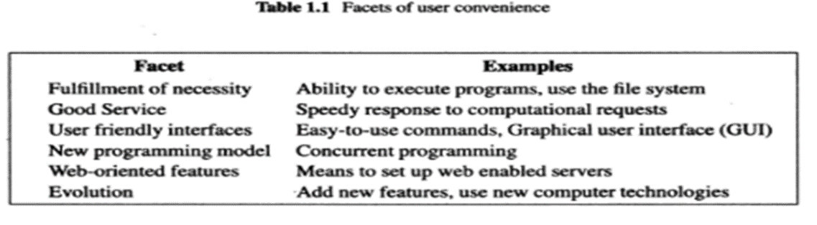
Goals of System Software
➢User Convenience:-

Slide 18
Goals of System Software
➢Efficient Use:-
System software must efficiently use fundamental computer resources like CPU, Memory, Disks and other I/O Devices.
Poor efficiency can occur if a program does not use the resource allocated to it which further results in snowballing effect.
Snowballing Effect:- If the resource is allocated to a user, it is denied to other programs that need it. These programs can’t execute and hence the resources allocated to them also remains idle
To achieve efficiency, the system software must minimize the waste of resources by programs and its own overhead.

Slide 19
Goals of System Software
➢Non Interference:-
The system software must ensure that no person can illegally use programs and resources in the system or interfere with them

Slide 20
System Programs and System Programming
System Software:- It is a collection of programs
System Program:- Each Program in the collection of system software
Design Goals
➢The program should function correctly under all conditions
➢The program should be effective in its computing environment
➢The program should be portable
➢The program should be able to evolve to provide new functionalities and adapt to new technologies
System Programming:- It is the set of techniques used to realize the design goals of system program

Slide 21
System Software
Coordinates the functions and activities of hardware and software
Controls operations of computer hardware
Supports variety of programs that enables smooth execution of computer
Provides infrastructure over which programs can operate
User can focus on application rather than internal mechanism of Machine

Slide 22
Application Software
Any tool that functions and is operated by means of computer and allow end user to accomplish specific task
Most common programs run in foreground of computer
Tend to perform useful task which are not related with hardware communication
Dependent on system software to communicate to physical components
Examples: Industrial Automation, Office Suite, Media Players, Computer Games

Slide 23
System Software
Physical Machine
System Software
OS
Device Drivers
Language
Processors
Loader
Linker
Text
Editor
Interpreter
Compiler
Assembler
Macroprocessor

Slide 24
System Software
➢ Macro Processor
➢Assembler
➢Compiler
➢Interpreter
➢Loader
➢Linker
➢Device Drivers
➢Operating System
➢Editor
➢Debugger

Slide 25
Macroprocessor
Macro: Abbreviation for small code
Macro Definition: Sequence of code that has name
Macro Processor: Program that substitutes and specializes macro definitions and Macro calls

Slide 26
Assembler
It is a language processor
It converts an assembly language code to machine code

Slide 27
Compiler
It is a language processor
It translates a source program written in some high-level programming language into machine code

Slide 28
Interpreter
It is a language processor
An interpreter translates high-level instructions into an intermediate form, which it then executes.

Slide 29
Loader
Executable file made by loader has relative memory addresses (Relocatable Code)
Loader will resolve all relocatable addresses by considering base Address
It places program in memory and prepare for its execution
Schemes: Relocating, Absolute and direct linking

Slide 30
Linker
It collects the code which are separately compiled or assembled and put into object file which is direct executable.
It connects an object program to the code for standard library and resource supplied by Operating system.

Slide 31
Device Drivers
➢A computer program that controls a particular device connected to computer.
➢Devices includes Input Output and Storage Devices

Slide 32
Operating System
➢Mediator between User Programs and Hardware
➢Allocation of Resources and Services
➢It includes: Process Management, Memory Management, File System Management, Secondary Storage Management, Program to manage these resources: Scheduler, Traffic Controller

Slide 33
Editor
Compilers usually accept source programs written using an editor that will produce a standard file such as ASCII file.
Compilers normally are bundled together with the editors and other programs into an Interactive Development Environment or IDE.

Slide 34
Debugger
Debuggers are program that can be used to determine execution errors in a compiled program.
It is also packaged with a compiler in an IDE.
The debugger keeps track of most or all source code information, such as line numbers, names of variable and procedures.
It can also halt execution at pre-specified locations called breakpoints as well as provide information on what functions have been called and what the current values of the variables are.

