Slide 1
SYNTAX ANALYSIS
Bottom-Up Parsing

Slide 2
Bottom-Up Parsing
Construction of Parse Tree for an input string beginning at leaves and working towards the root
Can be visualized as reducing a string "w" to the start symbol of Grammar
At each reduction step, a specific substring matching the body of production is replaced by Non-Terminal at the head of the production

Slide 3
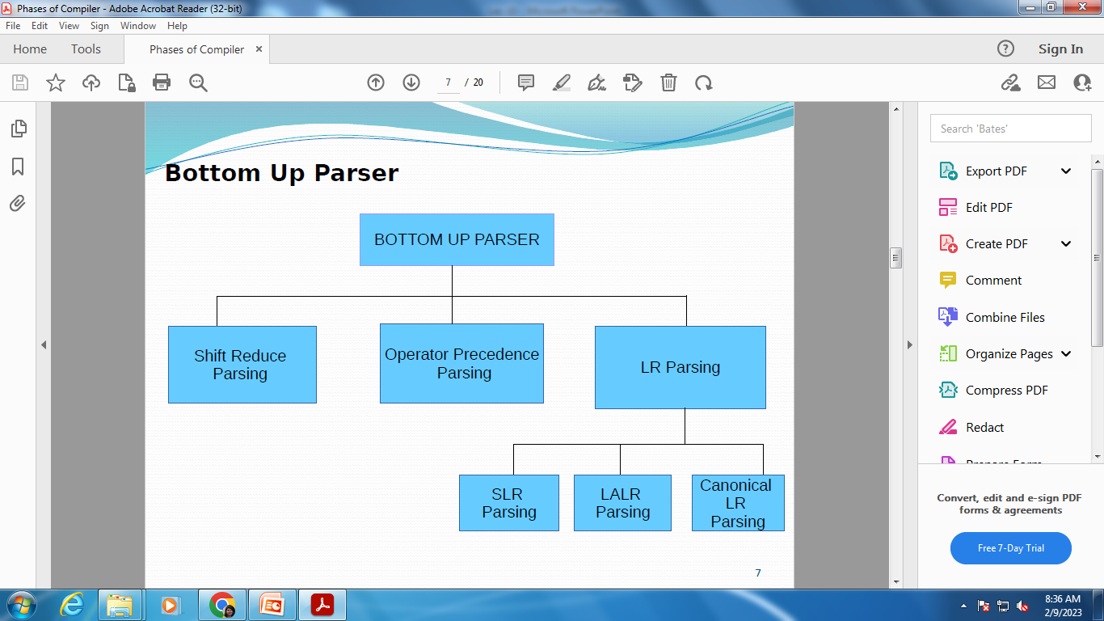
Bottom-Up Parser

Slide 4
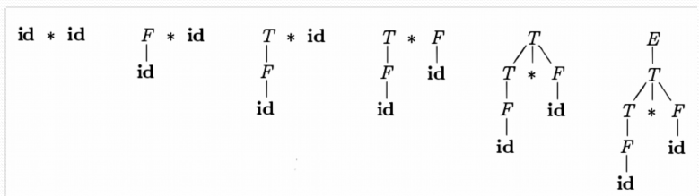
Bottom-Up Parser
Construction of Parse Tree for an input string beginning at leaves and working towards the root

Slide 5
Bottom-Up Parsing E → E + T | T
T → T * F | F
F → (E) | id
To reduce the string and move towards root symbol
id * id ⇒ F * id
⇒ T * id
⇒ T * F
⇒ T
⇒ E
Now if we write above derivation from bottom to top, we get rightmost derivation.
Conclusion: Bottom-Up parsing during left to right scan of the input constructs a rightmost derivation in reverse

Slide 6
Handle Pruning E → E + T | T
T → T * F | F
F → (E) | id
A Handle is a substring that matches the body of the production and whose reduction represents one step along the reverse of Rightmost Derivation
Right Sentential Form | Handle | Reducing Production
id1 * id2 | id1 | F → id
F * id2 | F | T → F
T * id2 | id2 | F → id
T * F | T * F | T → T * F
T | T | E → T

Slide 7
Handle Pruning
Handle Pruning:
We start with a string of terminals w to be parsed
If w is a sentence of the grammar, then let w = γn
Where γn is the nth right sentential form of some unknown right derivation as
S ⇒ γ0 ⇒ γ1 ⇒ γ2 ⇒ … ⇒ γn-1 ⇒ γn
To reconstruct this derivation in reverse order, we locate the handle βn in γn by relevant head of the production A → βn
The βn will be replaced by A to get previous right sentential form γn-1
This process we called as Handle Pruning

