Slide 1
Module 5
Compilers: Analysis Phase

Slide 2
Syllabus
Introduction to compilers, Phases of compilers:
Lexical Analysis -Role of Finite State Automata in Lexical Analysis, Design of Lexical analyzer, data structures used.
Syntax Analysis-Role of Context Free Grammar in Syntax analysis, Types of Parsers: Top down parser-LL(1), Bottom up parser-SR Parser, Operator precedence parser, SLR.
Semantic Analysis- Syntax directed definitions.

Slide 3
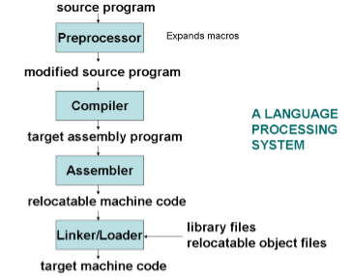
Language Processing System

Slide 4
What is Compiler?
A compiler is a language translator that converts a high-level program into low-level language program that can be easily understood by the computer
Compiler
Source program
Target program
Error messages

Slide 5
Functions of a Compiler
Translation of source language into target language
Reporting Errors and Warnings in the input source language
Helps in debugging of the execution of code
Generates extra profiling code to report the statistics on the time taken by specific functions in the input source language
Through profiling one can determine the parts in program code that are time consuming and needs to be re-written.
This helps make your program execution faster which is always desired.

Slide 6
Analysis & Synthesis Model of Compilation
Analysis-Breaking up of source program into constituent pieces and creation of intermediate representation
Synthesis-Construction of desired target program from intermediate representation

Slide 7
Phases of Compiler
Lexical Analysis
Syntax Analysis
Semantic Analysis
Intermediate code generation
Code Optimization
Code Generation
Symbol table management
Error handling and recovery

Slide 8
Phases of compiler
Source Program
Character stream
Lexical Analysis
Token stream
Syntax Analysis
Syntax tree
Symbol Table
Management
Semantic Analysis
Error Handling
and
Recovery
Annotated Syntax Tree
Intermediate Code Generator
Intermediate representation
Code Optimizer
Optimized Intermediate representation
Code Generator
Target Machine Code
Target Program

Slide 9
Phases of compiler-Front end-Back end
Source Program
Character stream
Lexical Analysis
Token stream
Syntax Analysis
Syntax tree
Symbol Table
Management
Semantic Analysis
Error Handling
and
Recovery
Annotated Syntax Tree
Intermediate Code Generator
Intermediate representation
Code Optimizer
Optimized Intermediate representation
Front end
Code Generator
both front end
and back end
Target Machine Code
Back end
Target Program

Slide 10
Lexical Analysis
This is the 1st phase
Lexical analysis is also called linear analysis or scanning, processes character from left to right & group the character stream into significant unit called lexemes
These lexemes are mapped into tokens
This phase does the additional job of removing extra white space, comments added by the user, etc. from the program

Slide 11
Syntax Analysis
This is the 2nd phase
The syntax analysis phase takes word/tokens from the lexical analyzer and checks the syntactic correctness of the input program
Syntax analysis identifies and notifies the syntactic errors in the program once the program has been broken into the tokens
It often referred as hierarchical analysis or simply parsing
The hierarchical structure of the source program can be represented by a parse tree

Slide 12
Semantic Analysis
This is the 3rd phase
Once the program is syntactically correct means grammatically correct the next task is to check semantic correctness
This phase performs the checks on the meaning of the statement and makes the necessary modification in the parse tree representation
The word semantic refers to meaning & the semantic analyzer checks the meaning of the program
This phase checks the source program for semantic error and gathers “type information” about the program element

Slide 13
Intermediate Code Generation
This is the 4th phase
This phase generates an intermediate code which helps to simplify the complexity of the code
The intermediate representation should have two important properties:-
It should be easy to produce
It should be easy to translate into the target program

Slide 14
Code Optimization
This is the 5th phase
The code optimization phase attempts to improve the intermediate code so that a faster running machine code could be generated
Code optimization is performed to:
Minimize the time taken to execute a program
Minimize the amount of memory occupied

Slide 15
Code Generation
This is the 6th phase
This phase is responsible for the generation of target code (machine language code)
Memory locations are selected for each variable
Instructions are translated into a sequence of assembly instructions
Variables and intermediate results are assigned to memory registers

Slide 16
Symbol Table Management
Symbol table is a data structure holding information about all the symbols defined in the source program
It is used as a reference table by all the phases of a compiler
The typical information stored in the symbol table includes the name of the variables, their types, sizes relative offset within the program and so on
The generation of this table is normally carried out by the lexical analyzer and syntax analyzer phases

Slide 17
Error Handling and recovery
Error handling is responsible for handling the error which can occur in any of the compilation phase
After detecting the error, a phase must deal with that error so that compilation can proceed so as to detect more errors

Slide 18
Example
Q. Illustrate compilers internal representation of source program for each phase for the following statement:-
fahrenheit=centigrade*1.8+32

Slide 19
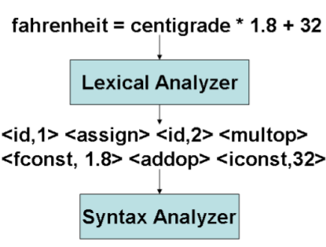
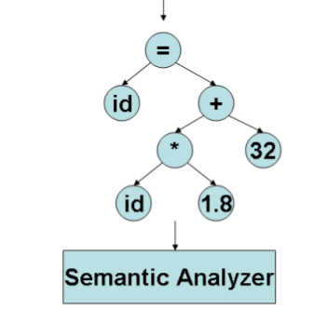
farenheit=centigrade*1.8+32

Slide 20
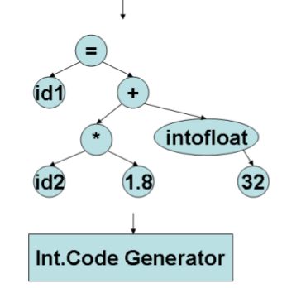
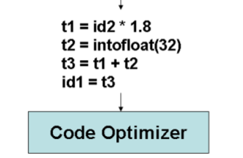
farenheit=centigrade*1.8+32

Slide 21
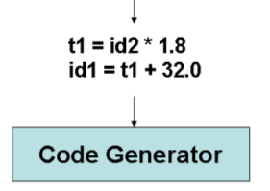
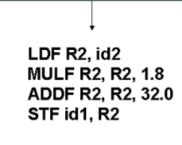
farenheit=centigrade*1.8+32

Slide 22
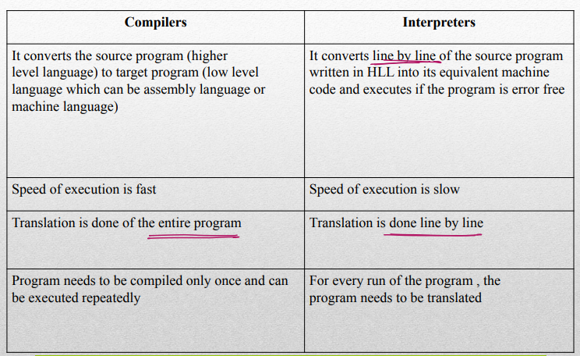
Comparison of compiler and Interpreter

