Slide 1
Module 5
Compilers: Analysis Phase

Slide 2
Role of Lexical Analyzer
Lexical analyzer is the first phase whose main task is to read the input characters and produce as output a sequence of tokens
Removal of comments and white spaces
Correlating error messages from the compiler with the source program
If source language supports some macro processor functions, then these preprocessor functions may also be implemented as lexical analysis takes place

Slide 3
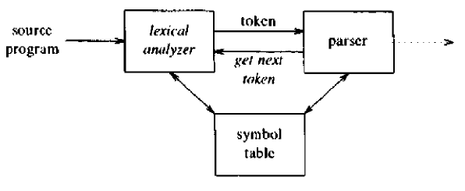
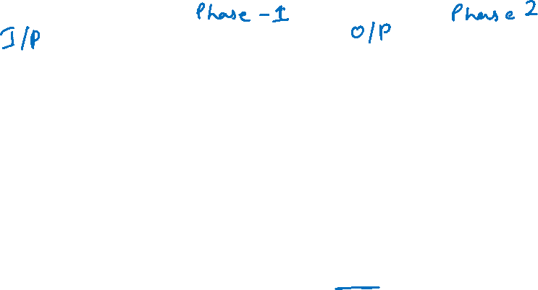
Role of Lexical Analyzer

Slide 4
Role of Lexical Analyzer
Issues in Lexical Analysis
Simpler design is the most important consideration
Compiler efficiency is improved
Compiler portability is enhanced

Slide 5
Tokens, patterns and Lexemes
Example: float abs_zero_Kelvin = -273;
Token- A string of characters which logically belong together
e.g.-float, identifier, equal, minus, number, semicolon
Tokens are treated as terminal symbols of the grammar specifying the source language
Pattern-The set of strings for which the same token is produced
The pattern is said to match each string in the set
float, l(l+d+_)*, =, -, d+, ;

Slide 6
Tokens, patterns and Lexemes
Example: float abs_zero_Kelvin = -273;
Lexeme- The sequence of characters matched by a pattern to form the corresponding token
“float”, “abs_zero_Kelvin”, “=”, “-”, “273”, “;”

Slide 7
Tokens, patterns and Lexemes
Examples of Token
Token | Sample Lexemes | Informal Description
const | const | const
If | if | if
relation | <, <=, =, <>, >, >= | < or <= or = or <> or >= or >
id | pi, count, D2 | letter followed by letters and digits
num | 3.1416, 0, 6.02E23 | Any numeric constant
literal | “core dumped” | Any characters between “ and “ except “

Slide 8
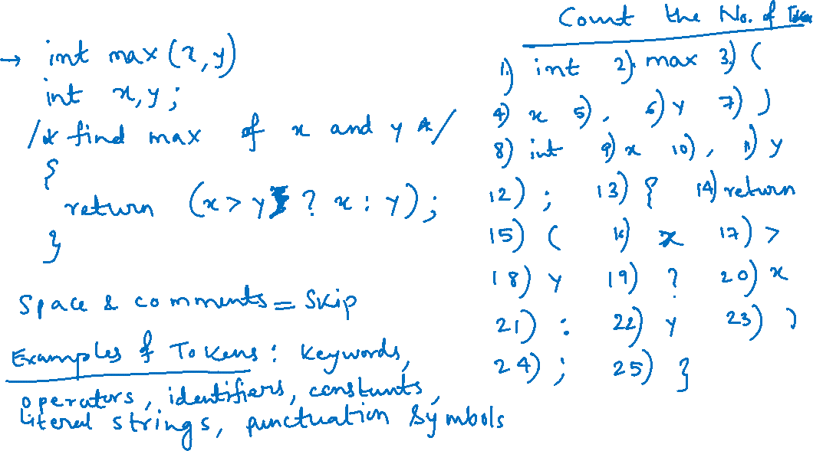
Tokens, patterns and Lexemes

Slide 9
Tokens, patterns and Lexemes
Attributes for Token
The lexical analyzer collects information about tokens into their associated attributes
Attributes help in translation of tokens
A token has a single attribute – A pointer to the symbol table entry in which the information about the token is kept
The pointer becomes attribute for the token

Slide 10






















Tokens, patterns and Lexemes
Attributes for Token

Slide 11






Tokens, patterns and Lexemes

Slide 12
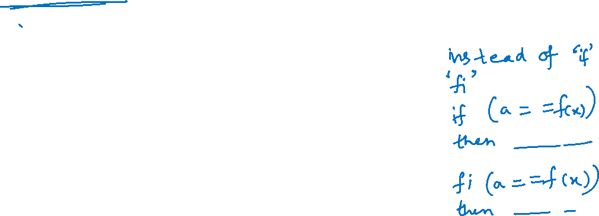
Tokens, patterns and Lexemes
Lexical Errors
Lexical analyzer can’t distinguish between misspelling of a keyword and undeclared function identifier
It can’t proceed further until the pattern for token matches a prefix of the remaining input

Slide 13
Tokens, patterns and Lexemes
Lexical Errors
Recovery Strategies
Panic Mode Recovery- Delete successive characters from the remaining input until the lexical analyzer finds a well-formed token
Deleting an extraneous character
Inserting a missing character
Replacing an incorrect character by a correct character
Transposing two adjacent characters

Slide 14
Input Buffering
The Lexical Analyzer scans the characters of the source program one at a time to discover tokens
A lot of time is consumed scanning the characters. So, specialized buffering techniques have been developed to reduce the amount of overhead required to process an input character

Slide 15
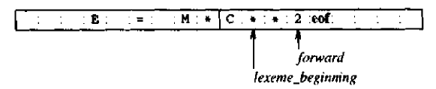
Input Buffering
Buffer Pairs
Two pointers to the input are maintained:
Pointer lexeme_beginning marks the beginning of the current lexeme, whose extent we are attempting to determine.
Pointer forward scans ahead until a pattern match is found.

Slide 16
Input Buffering
Code to advance forward pointer
if forward at end of first half then begin
reload second half;
forward:=forward + 1
end
else if forward at end of second half then begin
reload first half;
move forward to beginning of first half
end
else forward:=forward + 1;

Slide 17
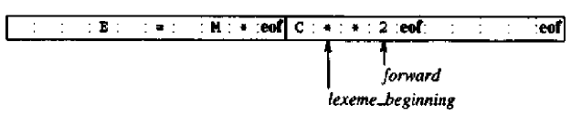
Input Buffering
Sentinels
An extra key is inserted at the end of the array
It is a special, dummy character that can’t be part of source program and works as ‘eof’

Slide 18
Input Buffering
Lookahead code with sentinels
forward:=forward+1
if forward= eof then begin
if forward at end of first half then begin
reload second half;
forward:=forward + 1
end
else if forward at end of second half then begin
reload first half;
move forward to beginning of first half
end
else /* eof within a buffer signifying end of input */
terminate
end

Slide 19
Specification of Tokens
Strings and Languages
Alphabet is any finite set of symbols.
Letters, digits and punctuation
{0,1} – binary alphabet
String over an alphabet is a finite sequence of symbols drawn from that alphabet.
“Compiler” is a string of length eight.
The empty string, denoted ε, is the string of length zero.
Language is any countable set of strings over some fixed alphabet.
Abstract languages are ø, the empty set, or {ε}

Slide 20
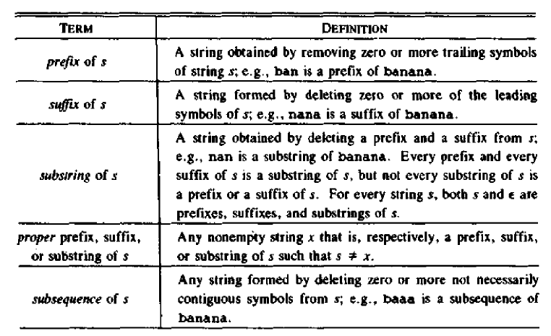
Specification of Tokens
String and Languages

Slide 21
Specification of Tokens
Operations on Languages
Union
Concatenation
Closure
Exponentiation

Slide 22
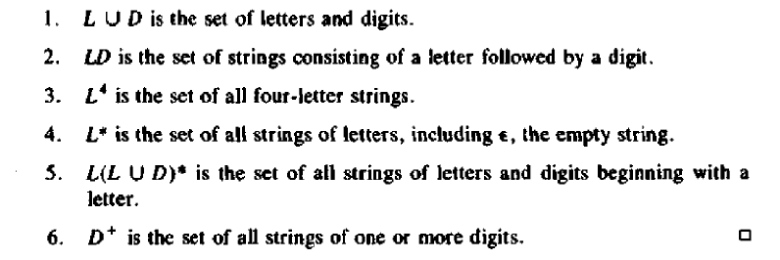
Specification of Tokens
Operations on Languages
Let L be the set {A, B,.....Z,a,b,.....z}and D be the set{0,1,....9}
L is the alphabet consisting of the set of upper and lower case letters
D is the alphabet consisting of the set of the ten decimal digits

Slide 23
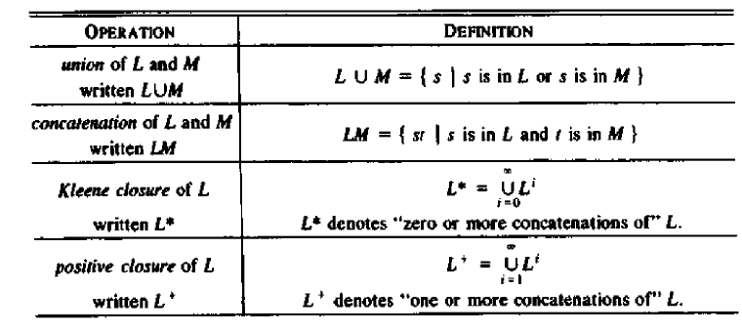
Specification of Tokens
Operations on Languages

Slide 24
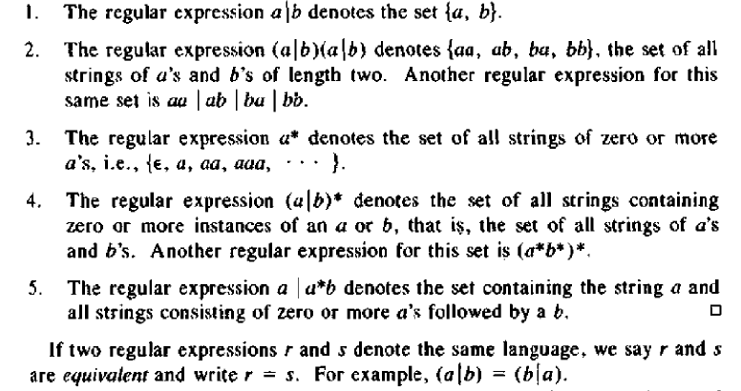
Specification of Tokens
Regular Expressions

Slide 25
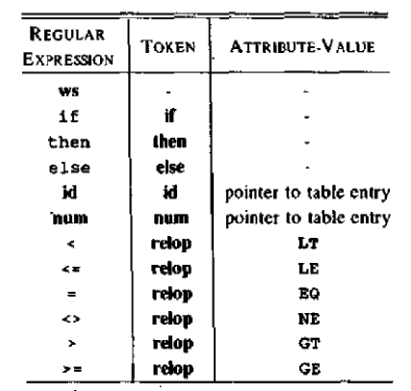
Recognition of Tokens

Slide 26
Recognition of Tokens
Transition Diagrams
We convert patterns into stylized flowcharts, called "transition diagrams"
Transition diagrams have a collection of nodes or circles, called states
Each state represents a condition that could occur during the process of scanning the input looking for a lexeme that matches one of several patterns
Edges are directed from one state of the transition diagram to another
Each edge is labelled by a symbol or set of symbols

Slide 27
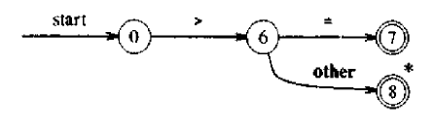
Recognition of Tokens
Transition Diagrams
Transition diagram for >=

Slide 28
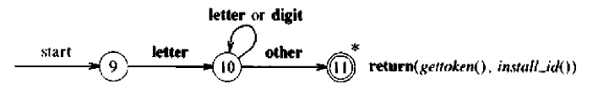
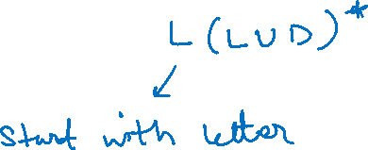
Recognition of Tokens
Transition Diagrams
Transition diagram for identifiers

Slide 29
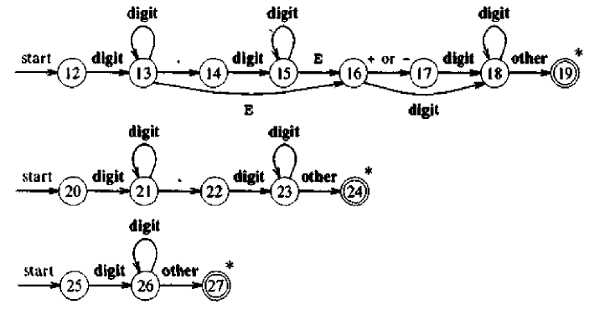
Recognition of Tokens
Transition Diagrams
Transition diagram for unsigned numbers

Slide 30
Recognition of Tokens
Transition Diagrams
Transition diagram for white spaces

Slide 31
Recognition of Tokens
Implementing a Transition diagram
Each state gets a segment of code
If there are edges leaving a state, then the code reads a character and selects an edge to follow
A function nextchar() is used to read the next character from the input buffer
The forward pointer is advanced at each call and the character that is read is returned

Slide 32
Recognition of Tokens
Implementing a Transition diagram
If there is an edge labeled by the read character, then control is transferred to the code for the state pointed to by that edge
If there is no such edge, and current state is not one that indicates a token has been found then a routine fail() is invoked
This routine retracts the forward pointer to the position of the beginning pointer and initiates a search for a token specified by the next transition diagram

Slide 33
Recognition of Tokens
Implementing a Transition diagram
If there are no transition diagrams to try,then fail() calls an error recovery routine
To return tokens a global variable lexical_value
The pointers returned by functions install_id() and install_num() are assigned to the global variable when an identifier or number is found
The token class is returned by the main procedure of the lexical analyzer known as nexttoken()

Slide 34
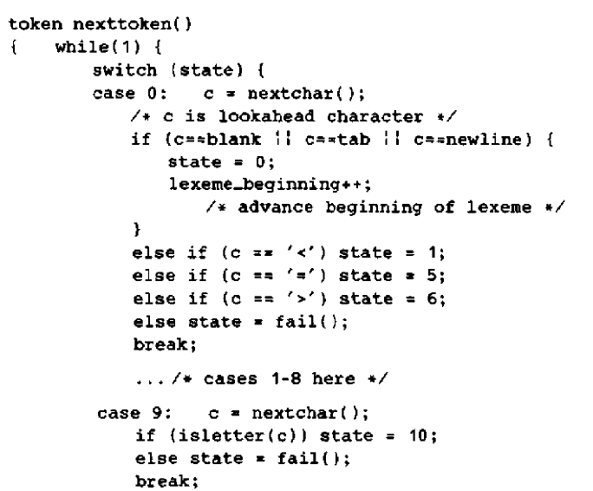
Recognition of Tokens
C code for Lexical Analyzer

Slide 35
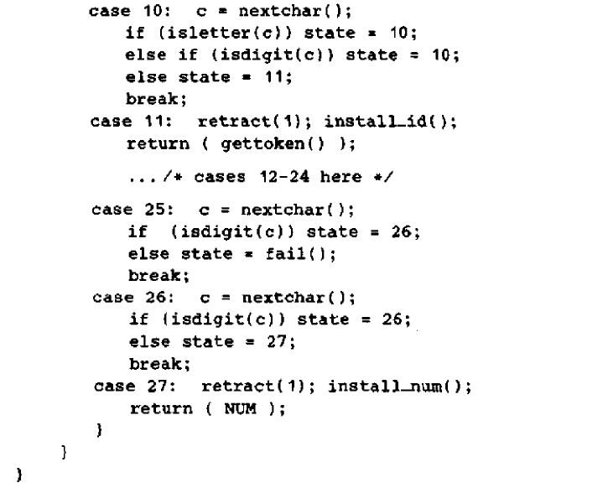
Recognition of Tokens

Slide 36
Recognition of Tokens

