Slide 1
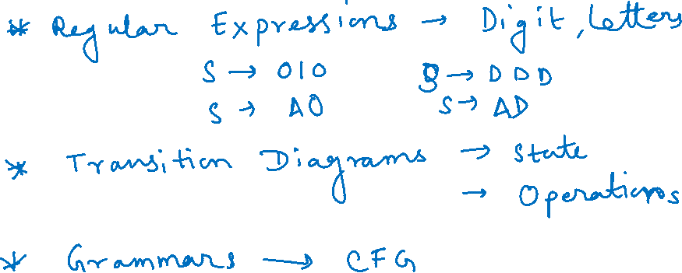
Module 5

Slide 2
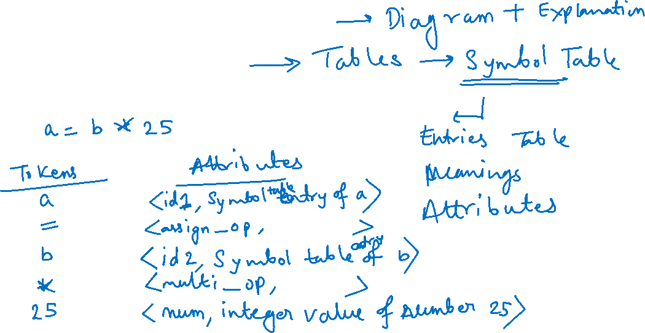
Lexical Analyzer
Design of the Lexical Analyzer
Data structures used

Slide 3
Lex Compiler
Lex Source Program
lex.l
LEX
Compiler
lex.yy.c
C
Compiler
lex.yy.c
a.out
Input Stream
a.out
Sequence
of
Tokens

Slide 4
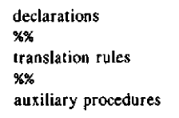
Lex Specifications
Lex program consists of three parts:-

Slide 5
Lex specifications
Declarations
It consists of variables, constants, regular definitions

Slide 6
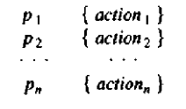
Lex specifications
Translational Rules are of the form:-
where each P_{i} is a regular expression and
each action_{i} is a program fragment describing what action the lexical analyzer should take when pattern pi matches a lexeme

Slide 7
Lex specifications
Auxiliary Procedures
This section holds whatever auxiliary functions are used in the actions
These functions can be compiled separately and loaded with the lexical analyzer

Slide 8
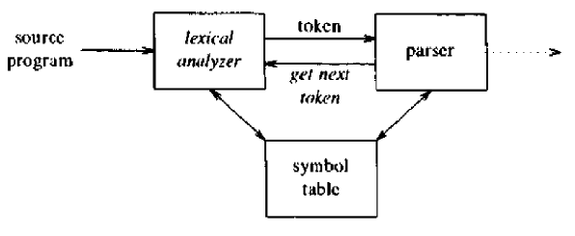
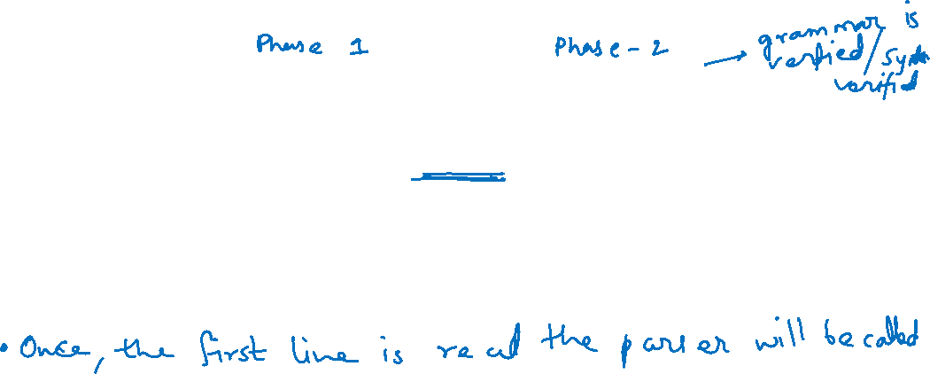
Working of Lexical analyzer with parser
When called by the parser, the lexical analyzer begins reading its remaining input, one character at a time, until it finds the longest prefix of the input that matches one of the patterns

Slide 9
Working of Lexical analyzer with parser
It then executes action_{i} which returns the control to the parser
But if it does not then the lexical analyzer proceeds to find additional lexemes, until one of the corresponding actions causes a return to the parser.
The lexical analyzer returns a single quantity i.e the token to the parser
To pass an attribute value with information about the lexeme, a global variable is set known as yylval

Slide 10
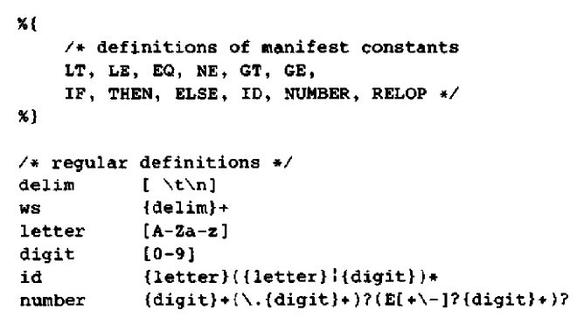
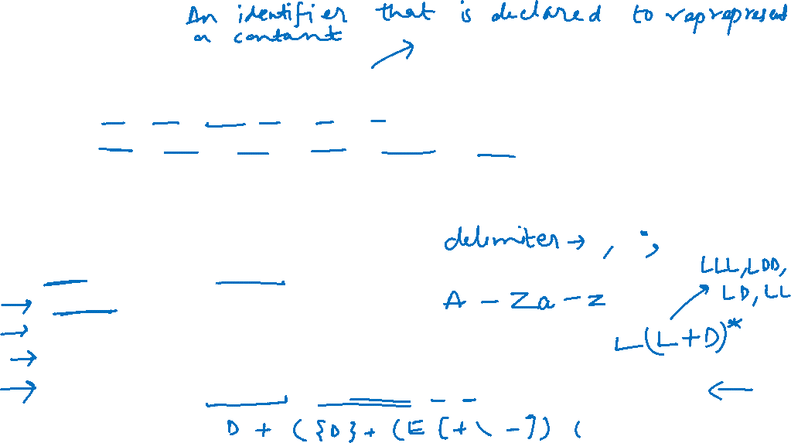
Lex Program for tokens

Slide 11
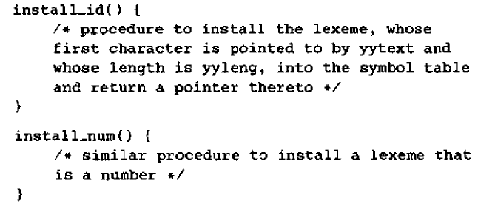
Lex Program for tokens

Slide 12
Design of Lexical analyzer generator
Aim: Design of a software tool that automatically constructs a lexical analyzer from a program in the Lex language

Slide 13
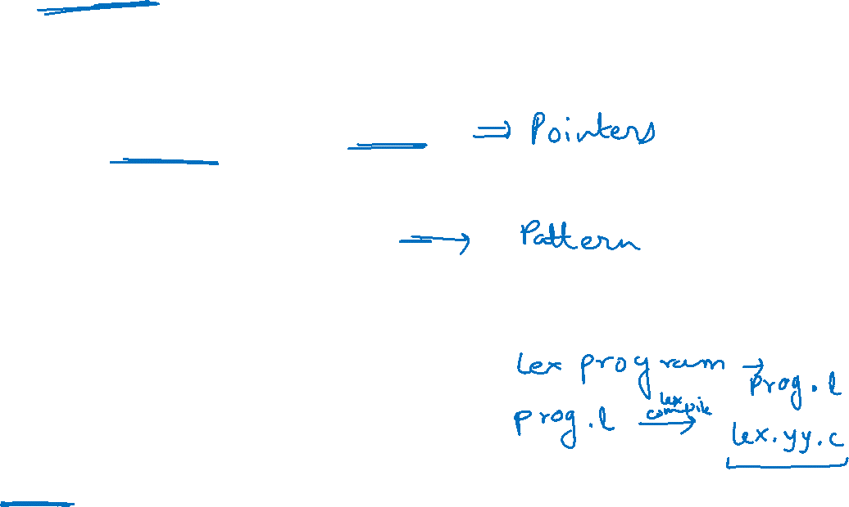
Input Buffer
Lexeme
Forward
Lexeme begin
Automaton
Simulator
Transition Table
_________
Action
Lex
Program
Lex
Compiler

Slide 14
Design of a Lexical analyzer
A Lex program is turned into a transition table and actions which are used by a finite automaton simulator
The program that serves as the lexical analyzer includes a fixed program that simulates an automaton
The rest of the lexical analyzer consists of following component
A transition table of the automaton
Those functions that are passed directly through Lex to the output
The action from the input program which is to be invoked at the appropriate time by Automaton Simulator

Slide 15
Design of a Lexical analyzer
To construct the automaton take each regular expression pattern in the Lex program and convert it using Algorithm to an NFA
We need a single automaton that will recognize lexemes matching any of the patterns in the program
Hence combine all the NFA s into one by introducing a new start state with transitions to each of the start states of the NFA s Ni for pattern pi

Slide 16
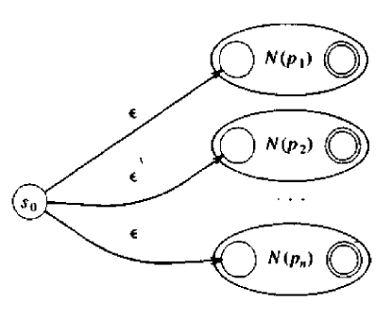
Pattern Matching Based on NFA's

Slide 17

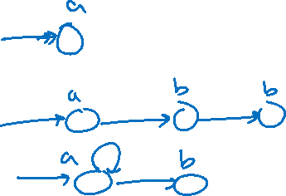
Pattern Matching Based on NFA's

Slide 18
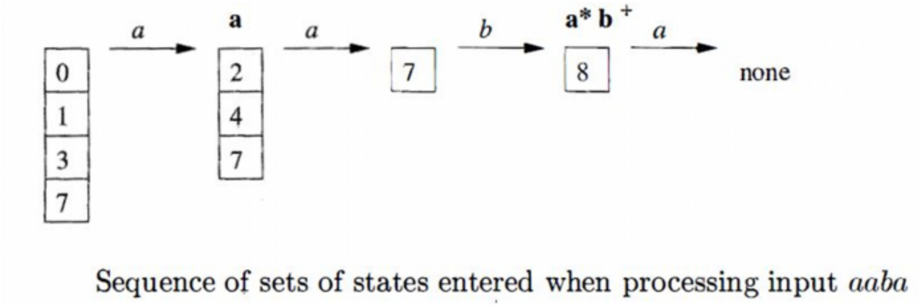
Example

Slide 19
Data structure used in Lexical Analyzer
Symbol: Identifier used in the Source Program
Examples: Names of variables, functions and Procedures
Symbol Table: To maintain information about attributes of symbol
Operations on Symbol Table:
Add a symbol and its attributes
Locate a symbol’s entry
Delete a symbol’s entry
Access a symbol’s entry

Slide 20
Data structure used in Lexical Analyzer
Design Goal of Symbol Table
The Table’s organization should facilitate efficient search
Table should be compact (Less Memory)

Slide 21
Data structure used in Lexical Analyzer
To improve search efficiency, allocate more memory to symbol table
Organization of Entries:
Linear Data Structure
Non-Linear Data Structure

Slide 22
Data structure used in Lexical Analyzer
Symbol Table Entry Format
Number of Fields to accommodate attributes of one symbol
Symbol Field: The symbol to be stored
Key Field: Basis for the search in table
Entry of Symbol is called record
Each entry can be of type fixed length, variable length or hybrid

Slide 23
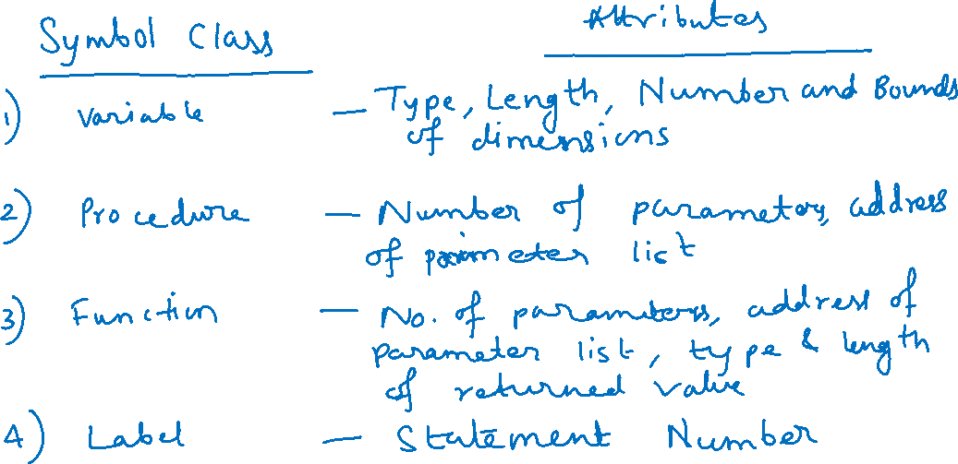
Data structure used in Lexical Analyzer

