Slide 1
Syntax Analysis

Slide 2
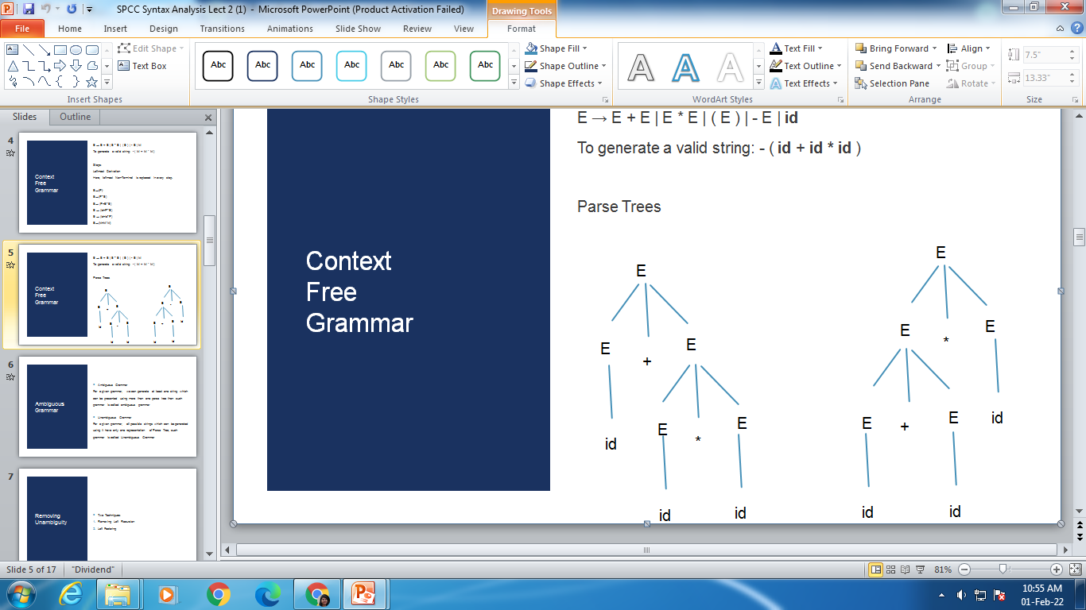
CFG
E → E + E | E * E | ( E ) | - E | id
To generate a valid string: - id + id * id

Slide 3
Ambiguous and Unambiguous Grammar
Ambiguous Grammar
For a given grammar, we can generate at least one string which can be presented using more than one parse tree then such grammar is called ambiguous grammar

Slide 4
Ambiguous and Unambiguous Grammar
Unambiguous Grammar
For a given grammar, all possible strings which can be generated using it have only one representation of Parse Tree, such grammar is called Unambiguous Grammar

Slide 5
Eliminating Ambiguity
Eliminating Left Recursion
Left Factoring

Slide 6
Eliminating Left Recursion
A grammar is left recursive if it has a non terminal A such that there is a derivation
A → A α for some string α.
Top-down parsing methods cannot handle left-recursive grammars.
Hence, left recursion can be eliminated as follows:
Left Recursion: A → A α | β
Then,
A → β A'
A' → α A' | ε

Slide 7
Eliminating Left Recursion
Arrange the non-terminals in some order A1, A2, ..., An.
for i:= 1 to n do begin
for j:= 1 to i-1 do begin
replace each production of the form Ai → Ajγ
by Ai → δ1γ | δ2γ | ... | δkγ
where Aj → δ1 | δ2 | . . . | δk are all the current Aj-productions;
end
end

Slide 8
Eliminating Left Recursion
Example 1:
S→A​
A → Ad | Ae | aB | ac ​
B → bBc | f ​
Solution:​ The grammar after eliminating left recursion is- ​
S→A​
A → aBA’ | acA’​
A’ → dA’ | eA’ | ∈ ​
B → bBc | f

Slide 9
Eliminating Left Recursion
Example 2:
A → ABd | Aa | a
B → Be | b
Solution- The grammar after eliminating left recursion is-
A → aA’
A’ → BdA’ | aA’ | ∈
B → bB’
B’ → eB’ | ∈

Slide 10
Eliminating Ambiguity
Example 3:
E → E+T | T
T → T*F | F
F → (E) | id

Slide 11
Eliminating Left Recursion
First eliminate the left recursion for E as
E → E + T | T
E → T E'
E' → + T E' | ε
Then eliminate for T as
T → T * F | F
T → F T'
T' → * F T' | ε

Slide 12
Eliminating Left Recursion
E → TE'
E' → +TE' | ε
T → FT'
T' → *FT' | ε
F → (E) | id

Slide 13
Left Factoring
Left factoring is a grammar transformation that is useful for producing a grammar suitable for predictive parsing.
When it is not clear which of two alternative productions to use to expand a non-terminal A, we can rewrite the A-productions to defer the decision until we have seen enough of the input to make the right choice.
If there is any production A → αβ1 | αβ2, then the left factored grammar is:
A → αA’
A’ → β1 | β2

Slide 14
Left Factoring
Example 1:
S → aSSbS | aSaSb | abb | b​
​Solution:​ Step-01:​
S → aS’ | b ​
S’ → SSbS | SaSb | bb​
Again, this is a grammar with common prefixes ​
​ Step-02:​
S → aS’ | b​
S’ → SA’ | bb
A’ → SbS | aSb

Slide 15
Left Factoring
Example 2:
S → a | ab | abc | abcd
Solution.- Step-1:
S → aS’
S’ → b | bc | bcd | ∈
Again, this is a grammar with common prefixes

Slide 16
Left Factoring
Example 2: contd.
Step-02:
S → aS’
S’→ bA’ | ∈
A’ → c | cd | ∈
Again, this is a grammar with common
Step-03: ​
S → aS’ ​
S’→ bA’ | ∈ ​
A’ → cB’ |∈ ​
B’ → d | ∈

