Slide 1
Intermediate Code Generation
Module 6
Synthesis Phase

Slide 2
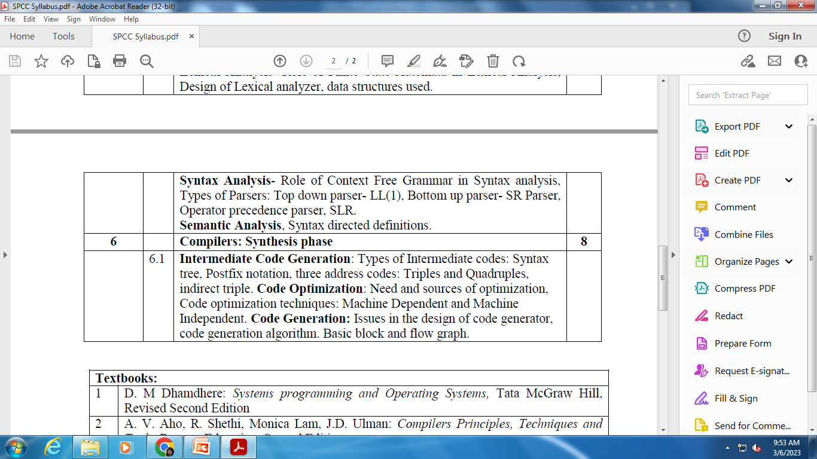
Syllabus

Slide 3
Contents
Types of Intermediate codes:
Syntax tree
Postfix notation
Three address codes:
Triples
Quadruples
Indirect triples

Slide 4
Position of Intermediate Code Generation
Parser
Static
Checker
Intermediate
Code Generator
Code
Generator
Intermediate
Code

Slide 5
Intermediate Representation
Graphical Representation
Postfix Notation
Three Address Code

Slide 6
Graphical Representation
Syntax Tree: Depicts hierarchical structure of source program
DAG (Directed Acyclic Graph): Gives information same as syntax tree but in compact form. Here the common sub expressions are identified

Slide 7
Graphical Representation
a = b * -c + b * -c
=
=
a
+
a
+
*
*
*
b
uminus
b
uminus
b
uminus
c
c
c
Syntax Tree
Directed Acyclic Graph (DAG)
Syntax Tree

Slide 8
Postfix Notation
Given Expression
a = b * -c + b * -c
Postfix Notation
a b c uminus * b c uminus * + assign

Slide 9
Three Address Code
Three-address code is a sequence of statements of the general form
x: = y op z
where x, y and z are names, constants, or compiler- generated temporaries.
Thus, a source language expression like x + y * z might be translated into a sequence
t1: = y * z t2: = x + t1 where t1 and t2 are compiler-generated temporary names

Slide 10
Three Address Code Expression: a = b * -c + b * -c
For Syntax Tree
t1: = - c
t2: = b * t1
t3: = - c
t4: = b * t3
t5: = t2 + t4
a := t5
For Directed Acyclic Graph (DAG)
t1: = - c
t2: = b * t1
t5: = t2 + t2
a: = t5

Slide 11
Implementation of Three Address Code
Quadruples
Triples
Indirect Triples

Slide 12
Quadruples
A quadruple is a record structure with four fields, which are:
op, arg1, arg2 and result
The op field contains an internal code for the operator.
The three-address statement x: = y op z is represented by placing y in arg1, z in arg2 and x in result.
The contents of fields arg1, arg2 and result are normally pointers to the symbol-table entries for the names represented by these fields.
Temporary names must be entered into the symbol table as they are created.

Slide 13
Quadruples
Three Address Code
t1: = - c
t2: = b * t1
t3: = - c
t4: = b * t3
t5: = t2 + t4
a := t5
op | arg1 | arg2 | result
uminus | c |  | t1
* | b | t1 | t2
uminus | c |  | t3
* | b | t3 | t4
+ | t2 | t4 | t5
= | t5 |  | a

Slide 14
Triples
To avoid entering temporary names into the symbol table, we might refer to a temporary value by the position of the statement that computes it
Three-address statements can be represented by records with only three fields:
op, arg1 and arg2
The fields arg1 and arg2, for the arguments of op, are either pointers to the symbol table or pointers into the triple structure (for temporary values)
Since three fields are used, this intermediate code format is known as triples.

Slide 15
Triples
Three Address Code
t1: = - c
t2: = b * t1
t3: = - c
t4: = b * t3
t5: = t2 + t4
a := t5
 | op | arg1 | arg2
(0) | uminus | c
(1) | * | b | (0)
(2) | uminus | c
(3) | * | b | (2)
(4) | + | (1) | (3)
(5) | = | (4)

Slide 16
Triples
A ternary operation like x[i]: = y requires two entries in the triple structure as shown as below
x: = y[i] is naturally represented as two operations
 | op | arg1 | arg2
(0) | [ ] = | x | i
(1) | assign | (0) | y
 | op | arg1 | arg2
(0) | [ ] = | y | i
(1) | assign | x | (0)
x [ i ] = y
x = y [ i ]

Slide 17
Indirect Triples
Another implementation of three-address code is that of listing pointers to triples, rather than listing the triples themselves.
This implementation is called indirect triples

Slide 18
Indirect Triples
Three Address Code
t1: = - c
t2: = b * t1
t3: = - c
t4: = b * t3
t5: = t2 + t4
a := t5
 | Stmt
(0) | (14)
(1) | (15)
(2) | (16)
(3) | (17)
(4) | (18)
(5) | (19)
 | op | arg1 | arg2
(14) | uminus | c
(15) | * | b | (14)
(16) | uminus | c
(17) | * | b | (16)
(18) | + | t2 | (17)
(19) | = | t5 | (18)

