Slide 1

Code Optimization
Module 6

Slide 2
Content
Need and sources of optimization
Code optimization techniques:
Machine Dependent
Machine Independent

Slide 3
Need and Sources of Optimization
High-level language constructs can introduce substantial run-time overhead if we naively translate each construct independently into machine code.
Code Improvement/Code Optimization
Elimination of unnecessary instructions in object code,
The replacement of one sequence of instructions by a faster sequence of instructions that does the same thing
Compilers that apply code-improving transformations are called optimizing compilers.

Slide 4
Need and Sources of Optimization
Local code optimization is a code improvement within a basic block.
Global code optimization deals with improvements taken into account what happens across basic blocks

Slide 5
Need and Sources of Optimization
The criteria for code improvement transformations:
The best program transformations: yield the most benefit for the least effort.
The transformation must preserve the meaning of programs.
must not change the output produced by a program for a given input
Must not cause an error that was not present in the original source program.
A transformation must, on the average, speed up programs by a measurable amount.
The transformation must be worth the effort.
The effort of compiler writer should be repaid to expend the intellectual effort to implement a code improving transformation

Slide 6
Need and Sources of Optimization
Optimizations are classified into two categories:
Machine independent optimizations: Machine independent optimizations are program transformations that improve the target code without taking into consideration any properties of the target machine.
2. Machine dependent optimizations: Machine dependent optimizations are based on register allocation and utilization of special machine-instruction sequence

Slide 7
Need and Sources of Optimization
Many transformations can be performed at both the local and global levels
Local transformations are usually performed first.
A transformation is called Local if it can be performed by looking only at the statements in a basic block otherwise it is Global

Slide 8
Machine Dependent Techniques
Register Allocation
Machine Idiom

Slide 9
Register Allocation
Registers are a scarce resource
Store words (32/64 bit)
Special registers for floating-point, SIMD (128/256/512 bits!)
The compiler tries to maximize the usage of the registers
Register allocation concept is used
If you run out of registers, you must temporarily store results back to memory and then retrieve them again
Register spill
Degrades performance

Slide 10
Register Allocation
There are two keywords that control register allocation from C
The register keyword suggests (forces) a variable to a register
Used for heavily accessed variables
Most compilers can figure this out themselves
You cannot take the address of something that is stored in a Register
The volatile keyword forces the results to be written back to memory
Used in low-level and parallel programming

Slide 11
Register Allocation
Example of register keyword
// tell compiler that a should be stored in a register
register int a = 23;
Example of volatile keyword
// force b to be read from and written back to memory
volatile int b = 43;

Slide 12
Machine Idioms
Target machines may have hardware instructions to implement certain specific operations efficiently
Detecting situations that permit the use of these instructions can reduce the execution time
Example:
Some machines have auto-increment and auto- decrement addressing modes.
Use of these modes greatly improves the quality of code when push and pop operation of stack happens, specifically in parameter passing.
These modes can also be used in code for statements like i = i +1

Slide 13
Machine Independent Techniques
Semantic or Function Preserving Transformations
Global Common Subexpressions elimination
Copy Propagation
Dead code elimination
Constant Folding
Loop Optimization
Code Motion
Induction Variable elimination
Strength reduction

Slide 14
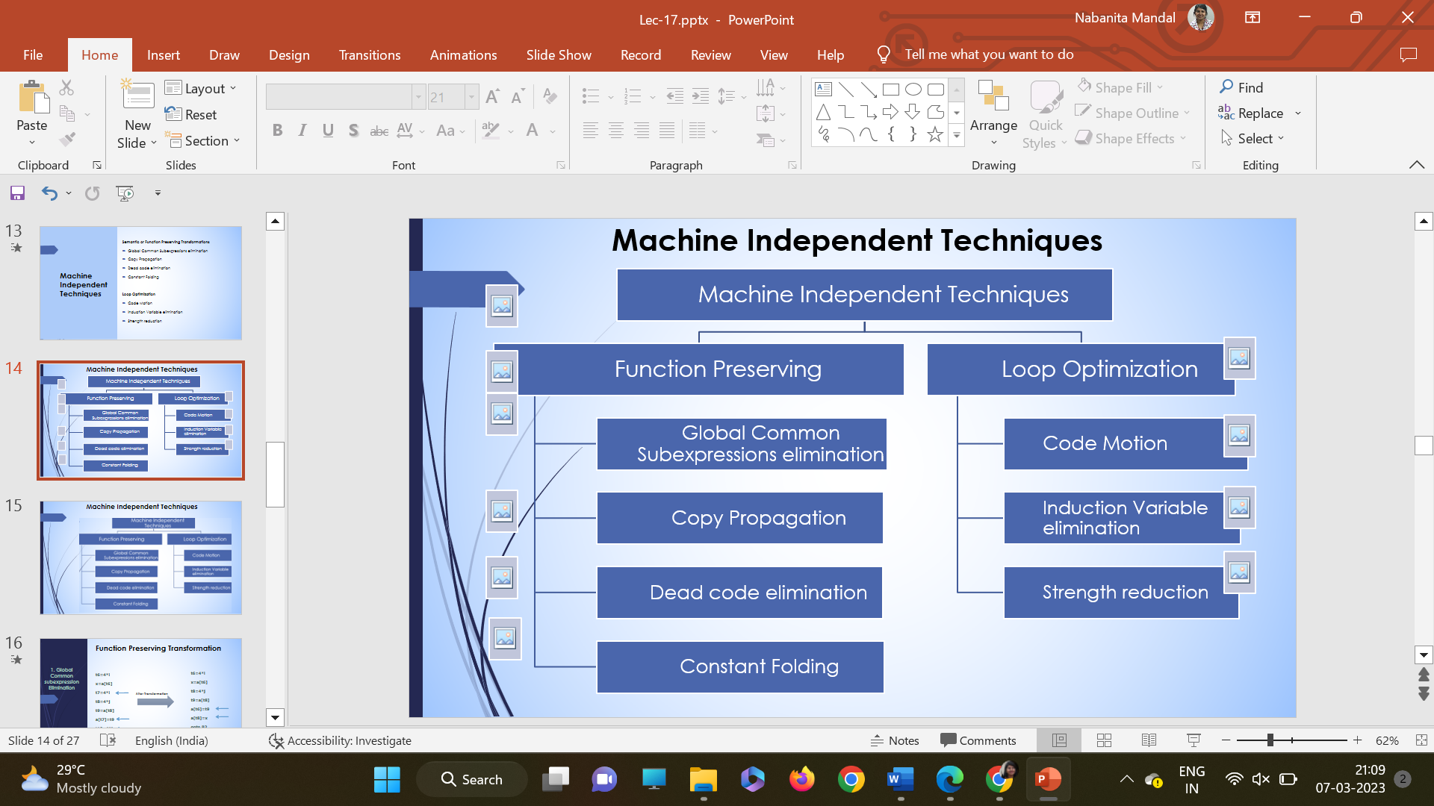
Machine Independent Techniques

Slide 15
Function Preserving Transformation
1. Global Common subexpression Elimination
t6=4*i
x=a[t6]
t8=4*j
t9=a[t8]
a[t6]=t9
a[t8]=x
goto B2
t6=4*i
x=a[t6]
t7=4*i
t8=4*j
t9=a[t8]
a[t7]=t9
t10=4*j
a[t10]=x
goto B2
After Transformation

Slide 16
Function Preserving Transformation
Assignments of the form f := g called copy statements or copies for short.
The idea behind the copy-propagation transformation is to use g for f, whenever possible after the copy statement f := g.
Copy propagation means use of one variable instead of another.
One advantage of copy propagation is that it often turns the copy statement into dead code.
For example: x = Pi; A = x * r * r;
The optimization using copy propagation can be done as follows:
A = Pi * r * r; (Here the variable x is eliminated.
2. Copy Propagation

Slide 17
Function Preserving Transformation
A variable is live at a point in a program if its value can be used subsequently; otherwise, it is dead at that point.
A related idea is dead or useless code, statements that compute values that never get used.
Not intentionally introduced by programmer
It may appear as the result of previous transformations.
An optimization can be done by eliminating dead code.
Example
i = 0;
if(i==1)
{ a=b+5;
} Here, ‘if’ statement is dead code because this condition will never get satisfied
3. Dead code elimination

Slide 18
Function Preserving Transformation
If value of an expression is constant at the time of compilation, then use of constant instead of expression is known as constant folding.
4. Constant Folding
pi =3.14
s= r * r
a = s * pi
After Transformation
pi =3.14
s= r * r
a = s * 3.14

Slide 19
Loop Optimization
This transformation takes an expression that yields the same result independent of the number of times a loop is executed
This expression is known as loop invariant computation
It moves code outside the loop.
The expression is evaluated before the loop
1. Code Motion
After Transformation
x = n-2
for (i=1; i <=x; i++)
for (i=1; i <=n-2; i++)

Slide 20
Loop Optimization
A variable x is said to be induction variable
If there is a positive or negative constant c such that each time x is assigned its value increases by c
Induction variables can be computed with a single increment addition or subtraction per loop iteration
Here i and t2 are induction variables
2. Induction
Variable
Elimination
After Transformation
t2 = t2 + 4 t3 = a[t2] if t3 < v goto B2
i = i+1 t2 = 4*i t3 = a[t2] if t3 < v goto B2

Slide 21
Loop Optimization
3. Strength
Reduction
This method replaces expensive operations by equivalent cheaper ones on the target machine.
Certain machine instructions are considerably cheaper than others
It can often be used as special cases of more expensive operators.
Example:
x² is invariably cheaper to implement as x*x than as a call to an exponentiation routine.
Fixed-point multiplication or division by a power of two is cheaper to implement as a shift.
Floating-point division by a constant can be implemented as multiplication by a constant, which may be cheaper.

Slide 22
Loop Optimization
3. Strength Reduction
i = m – 1
j = n
t1 = 4 * n
v = a[tn]
i = m – 1
j = n
t1 = 4 * n
v = a[tn]
i = m – 1
j = n
t1 = 4 * n
v = a[tn]
B1
B1
B1
t4 = 4 * j
B2
B2
B2
j = j – 1
t4 = 4 * j
t5 = a[t4]
if (t5 > v) goto B3
j = j – 1
t4 = 4 * j
t5 = a[t4]
if (t5 > v) goto B3
j = j – 1
t4 = t4 – 4
t5 = a[t4]
if (t5 > v) goto B3
B3
B3
B3
B4
B4
B4
if i >= j goto B6
if i >= j goto B6
if i >= j goto B6
B6
B5
B6
B6
B5
B5

Slide 23
Optimization of Basic Blocks
There are two types of basic block optimizations
Structure-Preserving Transformations- Can be implemented using DAG
Algebraic Transformations-This includes simplifying expressions or replacing expensive operation by cheaper ones i.e. reduction in strength

Slide 24
Peephole Optimization
A simple but effective technique for improving the target code
The performance of the target program is improved by
examining a short sequence of target instructions (called peephole)
replacing these instructions by a shorter or faster sequence, whenever possible.
The peephole is a small, moving window on the target program.
The code in the peephole need not be contiguous.
It is the characteristic of peephole optimization that each improvement may spawn opportunities for additional improvements

Slide 25
Peephole Optimization
The following examples of program transformations are characteristic of peephole optimizations:
Redundant-instructions elimination
Flow-of-control optimizations
Algebraic simplifications
Use of machine idioms
Unreachable Code
Reduction in Strength

