Slide 1
Module-4
Loaders and Linkers

Slide 2
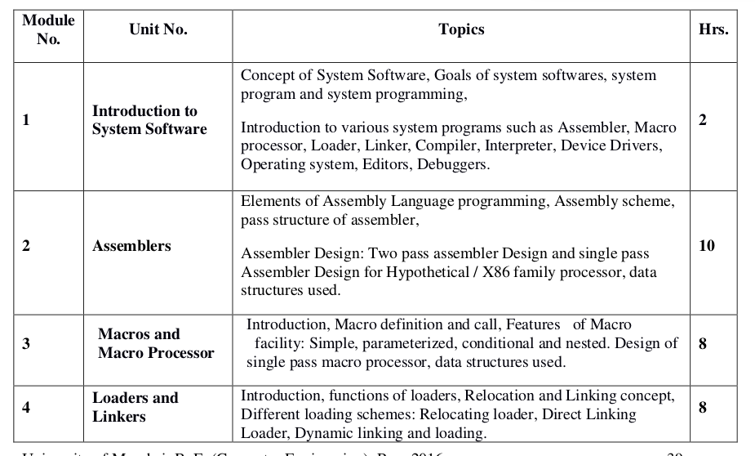
Syllabus

Slide 3
Loader
The loader is a program, which accepts the object program decks, prepares these programs for execution by the computer and initiates the execution

Slide 4
Functions of a Loader:
Allocation
Linking
Relocation
Loading

Slide 5
Functions of a Loader:
Allocation: Allocate space in memory for the programs
Linking: Resolve symbolic references between object decks.
Relocation: Adjust all address dependent locations, such as address constants, to correspond to the allocated space.
Loading: Physically place the machine instructions and data into memory.

Slide 6
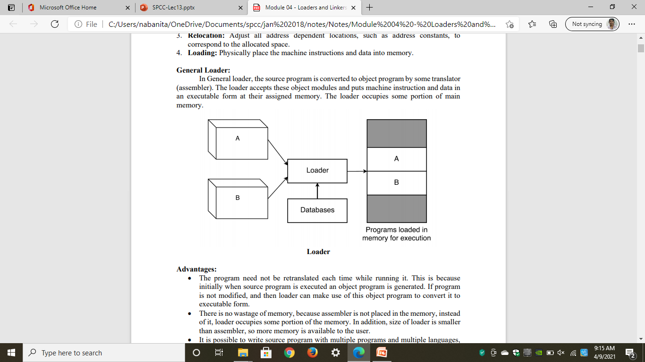
General Loading Scheme

Slide 7
General Loading Scheme
In General loader, the source program is converted to object program by some translator (assembler).
The loader accepts these object modules and puts machine instruction and data in an executable form at their assigned memory.
The loader occupies some portion of main memory

Slide 8
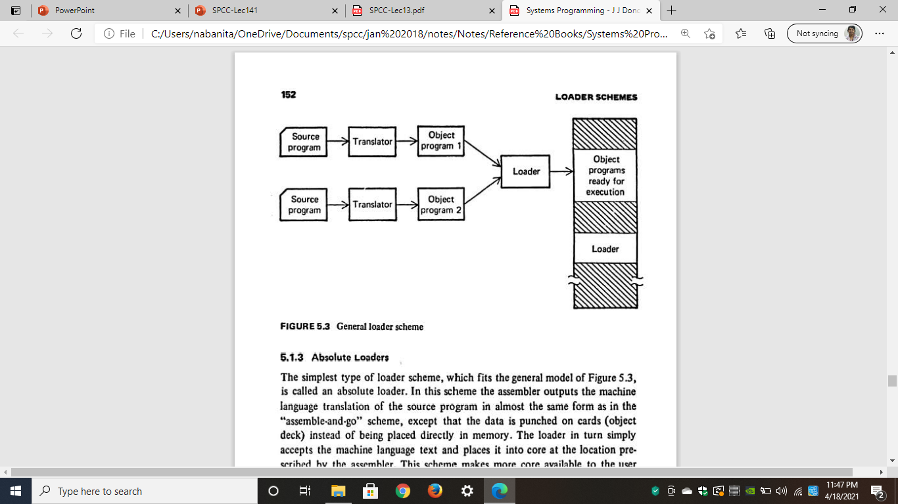
General Loading Scheme

Slide 9
Advantages:
No need of retranslation each time while running program
No wastage of Memory
Possible to write source program with multiple programs and multiple languages

Slide 10
Linking:
The execution of program can be done with the help of following steps:
1. Translation: Translation of the program (done by assembler or compiler)
2. Linking: Linking of the program with all other programs, which are needed for execution. This also involves preparation of a program called load module.
3. Loading: Loading of the load module prepared by linker to some specified memory location.

Slide 11
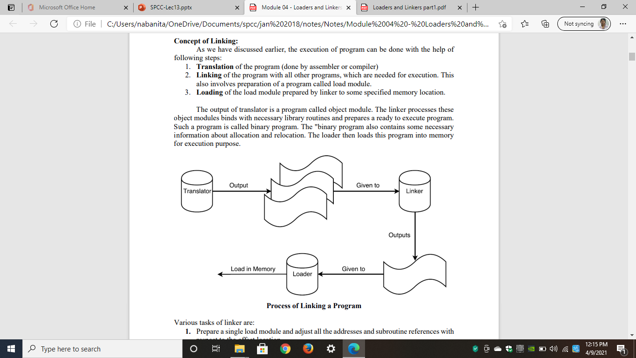
Process of Linking:

Slide 12
Process of Linking:
The output of translator is a program called object module.
The linker processes these object modules, binds with necessary library routines and prepares a ready to execute program.
Such a program is called binary program.
The "binary program also contains some necessary information about allocation and relocation.
The loader then loads this program into memory for execution purpose.

Slide 13
Tasks of a Linker
To prepare Single Load Module:
Adjust all addresses and subroutine preferences with respect to the offset location
2. To prepare a load module:
Concatenate all object modules and adjust:
a) operand address references
b) external references to the offset location
3. To prepare ready to execute module:
Copy the binary machine instructions and the constant data

Slide 14
Segment
The unit of information that can be treated as an entity.
It can be a program or data
A segment corresponds to a single source deck or object deck
It is possible to produce multiple programs or data segments in a single source deck

Slide 15
Loader Schemes
General Loader Scheme
Relocating Loaders
Compile and Go Loaders
Absolute Loaders
Subroutine Linkages
Direct Linking Loaders
Other Loader Schemes:
Dynamic Loading
Dynamic Linking

Slide 16
1. General Loader Schemes
The loader accepts the assembled machine instructions, data, and other information present in the object format, and places machine instructions and data in core in an executable computer form.
The loader is assumed to be smaller than the assembler, so that more memory is available to the user.
A further advantage is that reassembly is no longer necessary to run the program at a later date.

Slide 17
1. General Loader Schemes
4. Finally, if all the source program translators (assemblers and compilers) produce compatible object program deck formats and use compatible linkage conventions, then it is possible to write subroutines in several different languages
5. This is because the object decks to be processed by the loader will all be in the same "language" (machine language).

Slide 18
1. General Loader Schemes

Slide 19
2. Relocating Loader
To avoid possible reassembling of all subroutines when a single subroutine is changed
To perform the tasks of allocation and linking for the programmer
The object code is executed after loading at storage locations
The addresses of such object code will be specified only after the assembly process is over.
Therefore, after loading,
Address of object code = Only Address of object code + Relocation constant

Slide 20
2. Relocating Loader
Example: Binary Symbolic Subroutine (BSS) Loader
The BSS loader allows many procedure segments
It allows only one data segment (common segment)
The assembler assembles each procedure segment independently
Then it passes the text and information to the loader as relocation and intersegment references.

Slide 21
2. Relocating Loader
The output of a relocating assembler using a BSS scheme is the object program and information about all other programs it references.
In addition, there is information (relocation information) for locations in this program that need to be changed if it is to be loaded in an arbitrary place in core, i.e .. the locations which are dependent on the core allocation.
For each source program the assembler outputs a text (machine translation of the program) prefixed by a transfer vector that consists of addresses containing names of the subroutines referenced by the source program

Slide 22
2. Relocating Loader
Process of Relocating:
Example: if a square Root Routine (SQRT) was referenced and was the first subroutine called, the first location in the transfer vector would contain the symbolic name SQRT.
The statement calling SQRT would be translated into a transfer instruction indicating a branch to the location of the transfer vector associated with SQRT
The assembler would also provide the loader with additional information, such as the length of the entire program and the length of the transfer vector portion.

Slide 23
2. Relocating Loader
After loading the text and the transfer vector into core, the loader would load each subroutine identified in the transfer vector.
It would then place a transfer instruction to the corresponding subroutine in each entry in the transfer vector.
Thus, the execution of the call SQRT statement would result in a branch to the first location in the transfer vector, which would contain a transfer instruction to the location of SQRT.

Slide 24
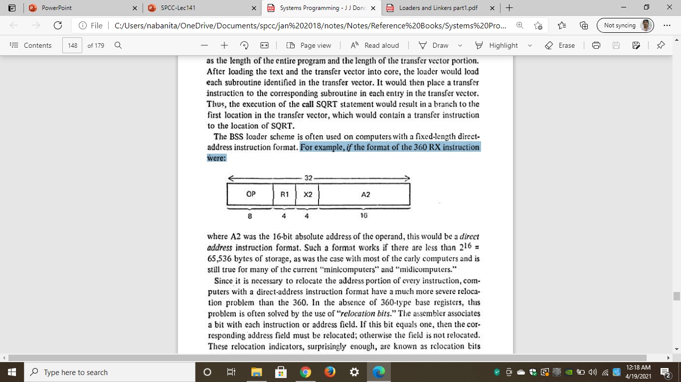
2. Relocating Loader
Application
The BSS loader scheme is often used on computers with a fixed-length direct address instruction format.
For example, if the format of the 360 RX instruction were:
where A2 was the 16 bit absolute address of the operand, this would be a direct address instruction format.
Such a format works if there are less than 2^16 = 65 ,536 bytes of storage

Slide 25
2. Relocating Loader
Problem
Since it is necessary to relocate the address portion of every instruction, computers with a direct address instruction format have a much more severe relocation problem
Solution
The assembler associates a bit with each Instruction or address field.
If this bit equals one, then the corresponding address field must be relocated otherwise the field is not relocated.
These relocation indicators, are known as relocation bits and are included in the object deck.

Slide 26
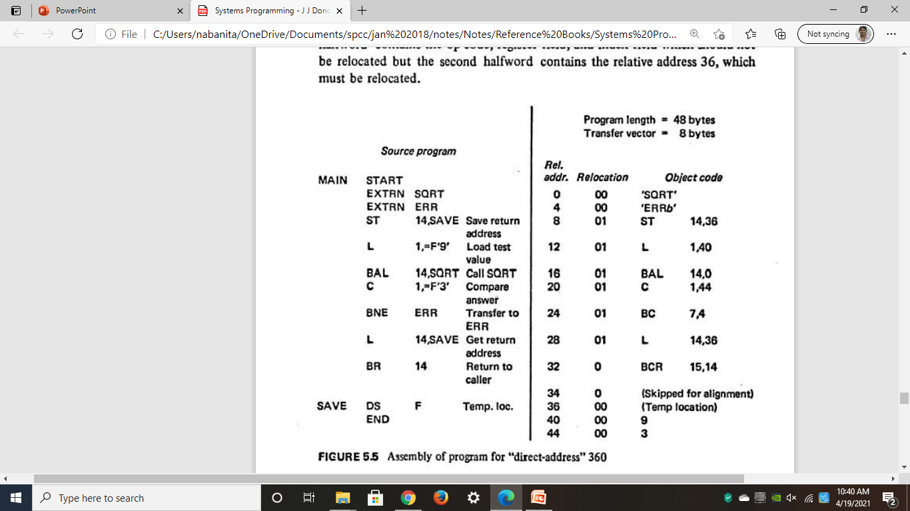
2. Relocating Loader

Slide 27
2. Relocating Loader
The figure illustrates a simple assembly language program written for a hypothetical "direct-address" 360 that uses a BSS loader.
It supposedly calls the SQRT subroutine to get the square root of 9.
If the result is not 3, it transfers to a subroutine called ERR.
Since this is a direct-address computer, there is no base register field in the object code and no need for a USING pseudo-op in the source program

Slide 28
2. Relocating Loader
4. The EXTRN pseudo op identifies the symbols SQRT and ERR as the names of other subroutines
5. Since the locations of these symbols are not defined in this subroutine, they are called external symbols.
6. For each external symbol the assembler generates a four byte fullword at the beginning of the program, containing the EBCDIC characters for the symbol
7. These extra words are called transfer vectors.

Slide 29
2. Relocating Loader
8. Every reference to an external symbol is assigned the address of the corresponding transfer vector word
9. In addition, for every halfword (two bytes) in the program, the assembler produces a separate relocation bit.
For example, the assembled instruction ST 14,36 is assigned relocation bits 01 since the first halfword contains the op-code, register field, and index field which should not be relocated but the second halfword contains the relative address 36, which must be relocated.

Slide 30
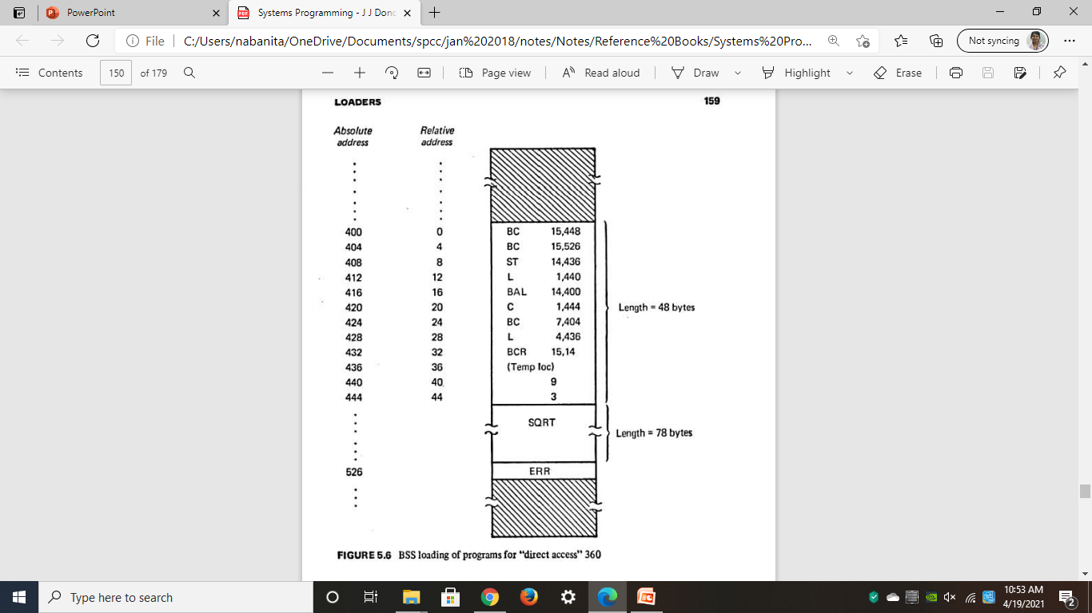
2. Relocating Loader

Slide 31
2. Relocating Loader
The figure illustrates the contents of memory after the programs have been loaded by the BSS loader.
Based upon the relocation bits, the loader has relocated the address fields to correspond to the allocated address of MAIN which is 400.
Using the program length information, the loader placed the sub routines SQRT and ERR at the next available locations which were 448 and 526, respectively
Finally, the transfer vector words were changed to contain branch instructions to the corresponding subroutines
Thus, the four functions of the loader (allocation, linking, relocation, and loading) were all performed automatically by the BSS loader.

Slide 32
2. Relocating Loader
Disadvantages:
The transfer vector linkage is only useful for transfers, and is not well-suited for loading or storing external data (data located in another procedure segment).
The transfer vector increases the size of the object program in memory.
The BSS loader, processes procedure segments but does not facilitate access to data segments that can be shared.
(This last shortcoming is overcome in many BSS loaders by allowing one common data segment, often called COMM0N. This facility is usually implemented by extending the relocation bits scheme to use two bits per halfword address field: if the bits are 01, the half word is relocated relative to the procedure segment, and if they are 10, it is relocated relative to the address of the single common data segment. If the bits are 00 or 11, the halfword is not relocated.)

