Slide 1
LOADERS AND LINKERS
Module-4

Slide 2
Bootstrap Loader
Alternatively referred to as bootstrapping, bootloader, or boot program
Bootstrap loader is a program that resides in the computer's EPROM, ROM, or other non-volatile memory.
It is automatically executed by the processor when turning on the computer.
The bootstrap loader reads the hard drives boot sector to continue the process of loading the computer's operating system.

Slide 3
Bootstrap Loader
The bootstrap loader is stored in the master boot record (MBR) on the computer's hard drive.
When the computer is turned on or restarted, it first performs the power-on self-test, also known as POST.
If the POST is successful and no issues are found, the bootstrap loader will load the operating system for the computer into memory.
The computer will then be able to quickly access, load, and run the operating system.

Slide 4
Bootstrap Loader
Function of Bootstrap Loader:
Enable the user to select the OS to start
Loading the OS file from the boot partition
Controls the OS selection process and hardware detection prior to kernel initialization.

Slide 5
Design of a Direct Linking Loader (DLL)
The direct linking loader is a re-locatable loader.
The loader cannot have the direct access to the source code.
To place the object code in the memory there are two situations:
either the address of the object code could be absolute which then can be directly placed at the specified location
or the address can be relative.
If at all the address is relative, then it is the assembler who informs the loader about the relative addresses.

Slide 6
Specification of problem
The assembler should give the following information to the loader
The length of the object code segment
The list of all the symbols, which are not defined in the current segment but can be used in the current segment.
The list of all the symbols, which are defined in the current segment but can be referred by the other segments.

Slide 7
Specification of Data Structures
The next step in our design procedure is to identify the databases required by each pass of the loader.
Pass 1 databases:
1. Input object decks.
2. A parameter, the Initial Program Load Address (IPLA) supplied by the programmer or the operating system, that specifies the address to load the first segment.
3. A Program Load Address (PLA) counter, used to keep track of each segment's assigned location

Slide 8
Specification of Data Structures
4. A table, the Global External Symbol Table (GEST), that is used to store each external symbol and its corresponding assigned core address.
5. A copy of the input to be used later by pass 2. This may be stored on an auxiliary storage device, such as magnetic tape, disk, or drum, or the original object decks may be reread by the loader a second time for pass 2.
6. A printed listing, the load map, that specifies each external symbol and its assigned value.

Slide 9
Specification of Data Structures
Pass 2 data bases:
1. Copy of object programs inputted to pass 1
2. The Initial Program Load Address parameter (IPLA)
3. The Program Load Address counter (PLA)
4. The Global External Symbol Table (GEST), prepared by pass I, containing each external symbol and its corresponding absolute address value
5. An array, the Local External Symbol Array (LESA), which is used to establish a correspondence between the ESD ID numbers, used on ESD and RLD cards, and the corresponding external symbol's absolute address value

Slide 10
Format of databases
Object Deck
External Symbol Dictionary cards (ESD)
Instructions and data cards, called "text" of program (TXT)
Relocation and Linkage Directory cards (RLD)
End card (END)
End of File (EOF)/ Loader Terminate(LDT)
Global External Symbol Table(GEST)
Local External Symbol Array (LESA)

Slide 11
Object deck
Direct Linking Loader uses four types of records in the object decks (files) which contains all information needed for relocation and linking.
These four sections are:
External Symbol Dictionary cards (ESD)
Instructions and data cards, called "text" of program (TXT)
Relocation and Linkage Directory cards (RLD)
End card (END)

Slide 12
External Symbol Dictionary cards (ESD)
The ESD cards contain the information necessary to build the external symbol dictionary or symbol table.
External symbols are symbols that can be referred beyond the subroutine level.
The normal labels in the source program are used only by the assembler, and information about them is not included in the object deck.

Slide 13
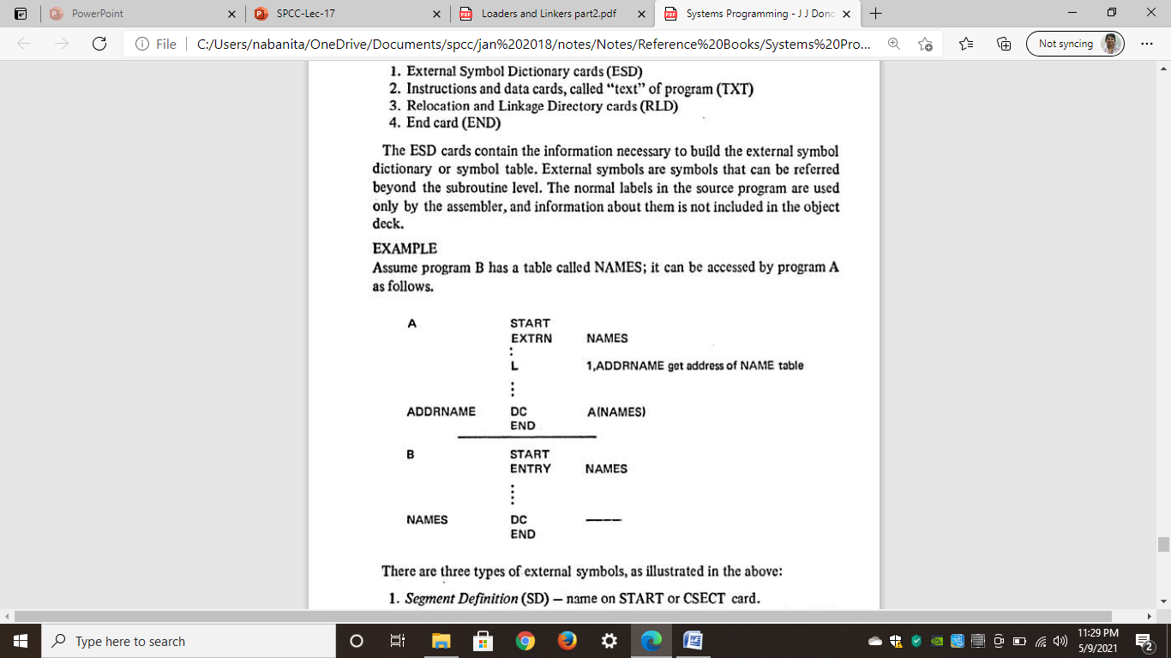
External Symbol Dictionary cards (ESD)
Example: Assume program B has a table called NAMES; it can be accessed by program A as follows.
EXTRN: It is followed by a list of Symbols which indicates that these Symbols are defined in other programs but referenced in the present program.
ENTRY: It is followed by a list of Symbols which indicates that these Symbols are defined in same programs but referenced in the other program.

Slide 14
External Symbol Dictionary cards (ESD)
There are three types of external symbols:
Segment Definition (SD): name on START or CSECT card.
Local Definition (LD): specified on ENTRY card. There must be a label in same program with same name. ·
External Reference (ER): specified on EXTRN card. There must be a corresponding ENTRY, START, or CSECT card. In another program with same name.
Each SD and ER symbol is assigned a unique number (e.g., 1,2,3, ... ) by the assembler. This number is called the symbol's identifier, or ID, and is used in conjunction with the RLD cards.

Slide 15
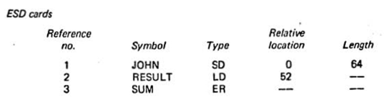
External Symbol Dictionary cards (ESD)
Example:

Slide 16
Instructions and data cards, called "text" of program (TXT):
The TXT cards contain blocks of data and the relative address at which the data is to be placed.
Once the loader has decided where to load the program, it merely adds the Program Load Address (PLA) to the relative address and moves the data into the resulting location.

Slide 17
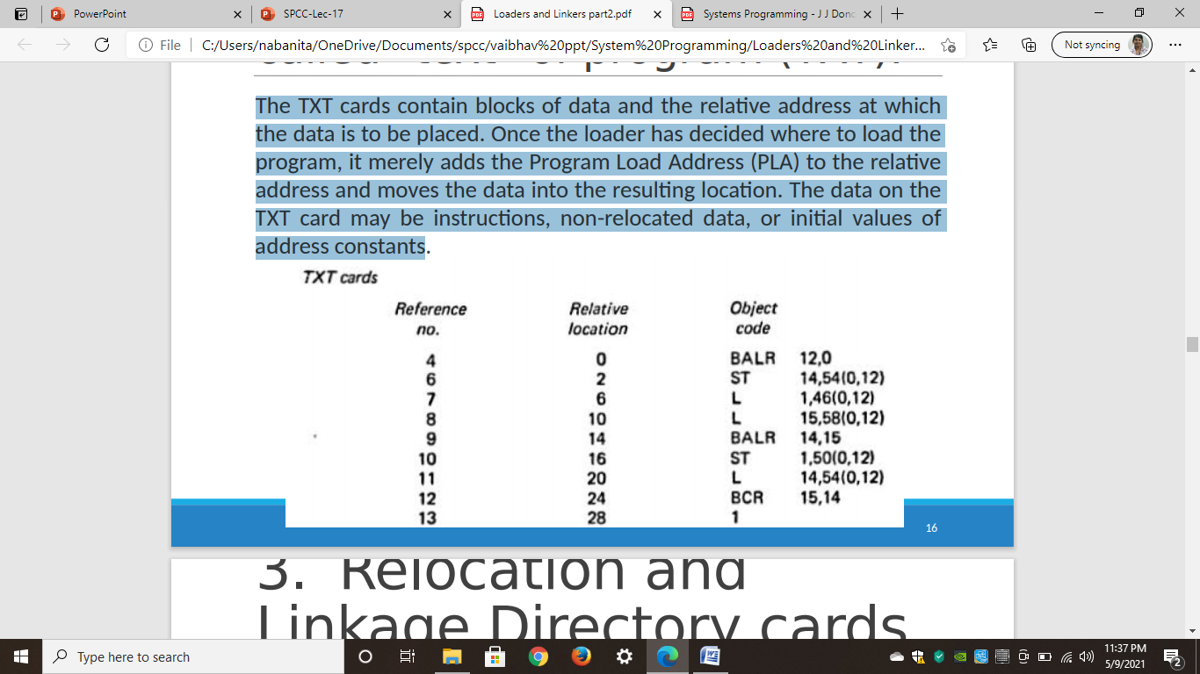
Instructions and data cards, called "text" of program (TXT):
The data on the TXT card may be instructions, non-relocated data, or initial values of address constants

Slide 18
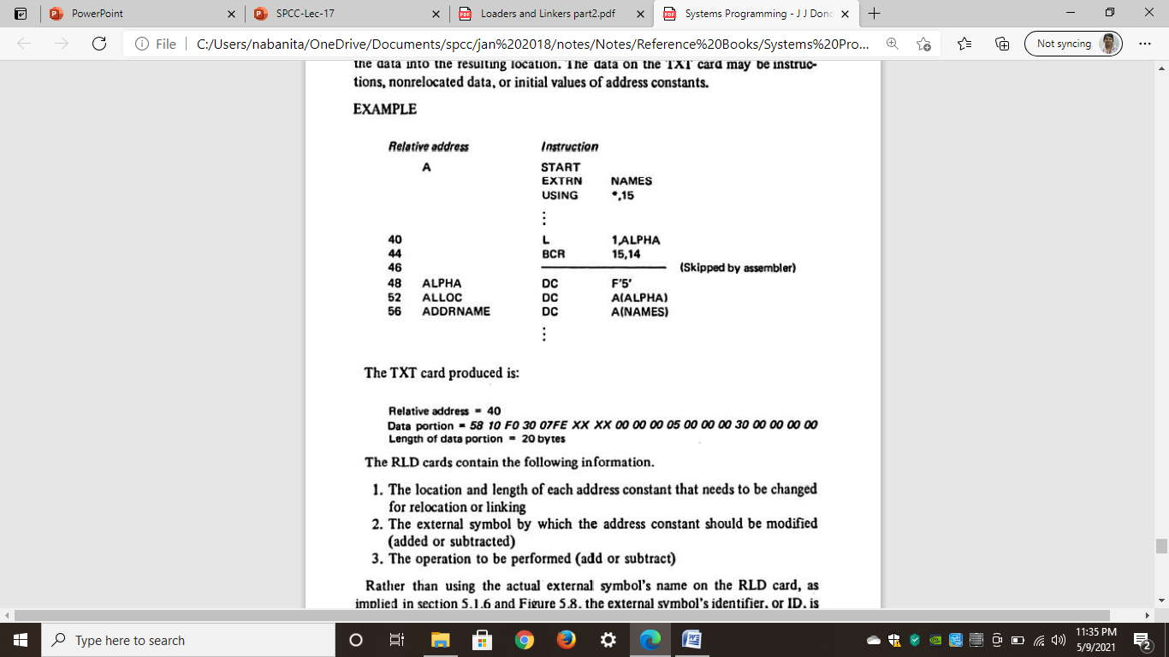

Instructions and data cards, called "text" of program (TXT):
Example:

Slide 19
Relocation and Linkage Directory cards (RLD):
The RLD cards contain the following information.
The location and length of each address constant that needs to be changed for relocation or linking
The external symbol by which the address constant should be modified (added or subtracted)
The operation to be performed (add or subtract)

Slide 20
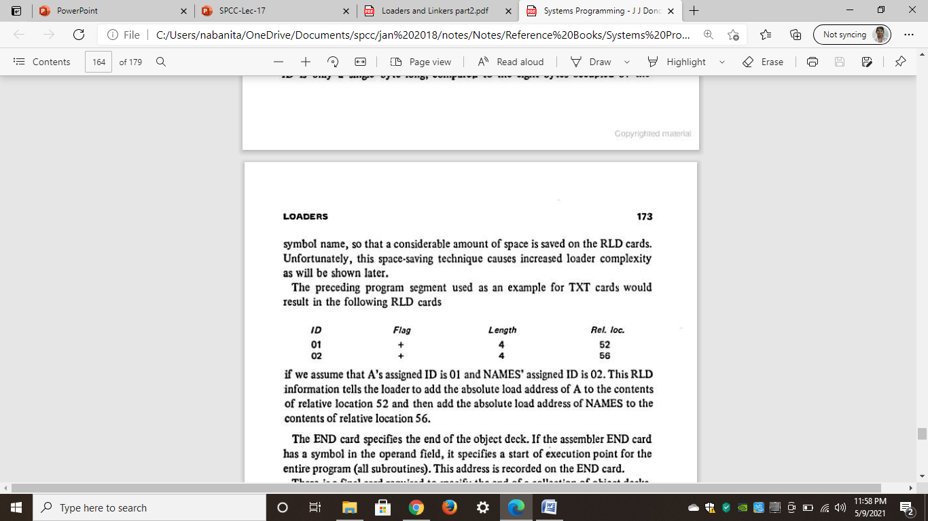
Relocation and Linkage Directory cards (RLD):
Example:
If we assume that A's assigned ID is 01 and NAMES' assigned ID is 02.
This RLD information tells the loader to add the absolute load address of A to the contents of relative location 52 and then add the absolute load address of NAMES to the contents of relative location 56.

Slide 21
End card (END)
The END card specifies the end of the object deck.
If the assembler END card has a symbol in the operand field, it specifies a start of execution point for the entire program (all subroutines).
This address is recorded on the END card.

Slide 22
End of File (EOF) / Loader Terminate(LDT)
There is a final card required to specify the end of a collection of object decks.
The loaders usually use either a loader terminate (LDT) or End of File (EOF) card.

Slide 23
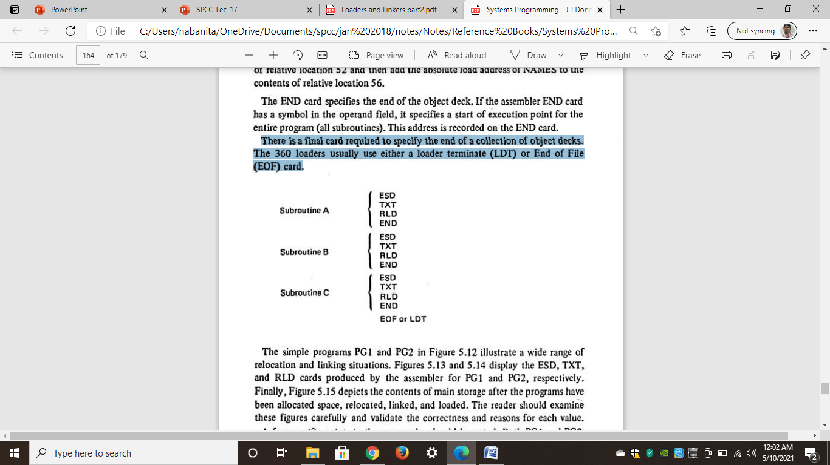
End of File (EOF) / Loader Terminate(LDT)
Example:

Slide 24
Global External Symbol Table (GEST)
The Global External Symbol Table (GEST) is used to store the external symbols.
These symbols are defined by means of a Segment Definition (SD) or Local Definition (LD) entry on an External Symbol Dictionary (ESD) card.
When these symbols are encountered during pass 1, they are assigned an absolute core address
This address is stored, along with the symbol, in the GEST

Slide 25
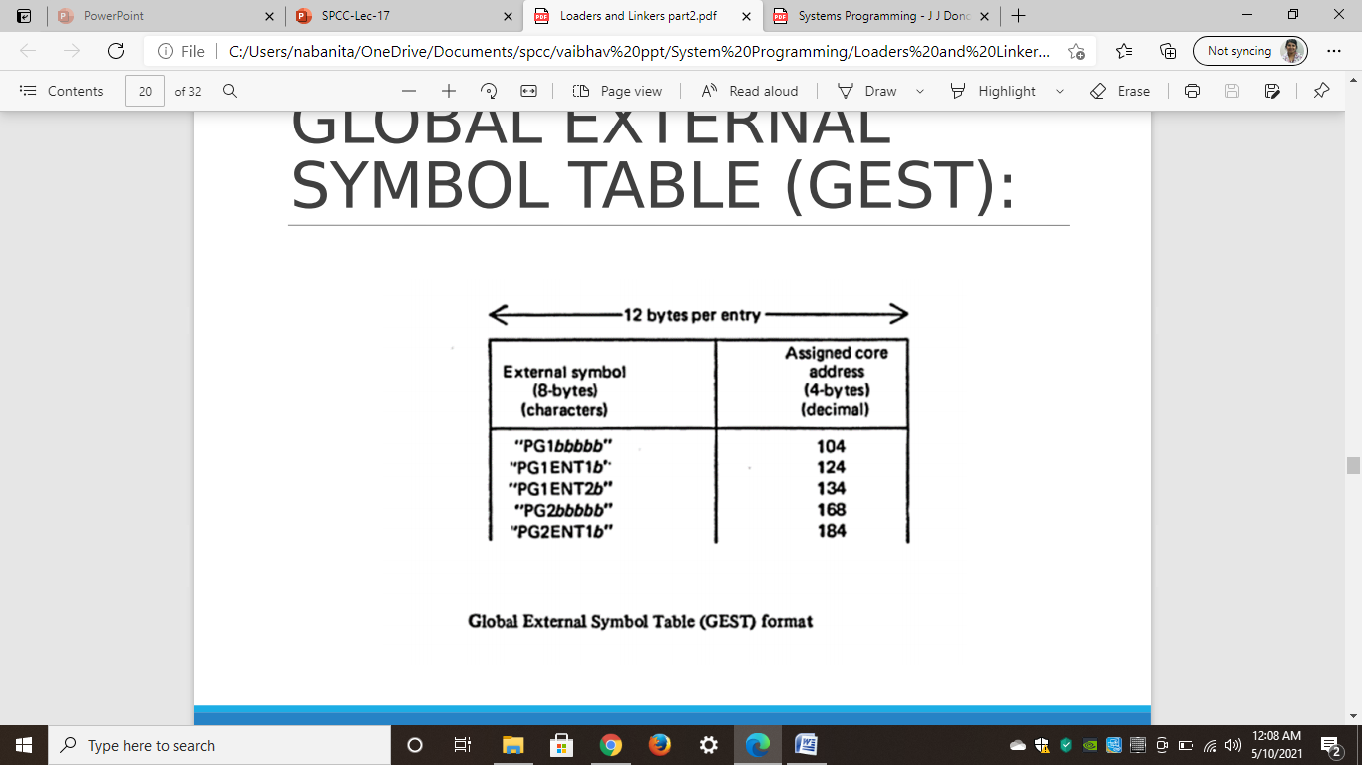
Global External Symbol Table (GEST)
Example:

Slide 26
LOCAL EXTERNAL SYMBOL ARRAY
It is necessary to create a separate LESA for each segment, but since the LESAs are only produced one at a time, the same array can be reused for each segment.
It is not necessary to search the LESA;
Given an ID number, the corresponding value is written as LESA(ID) and can be immediately obtained.

Slide 27
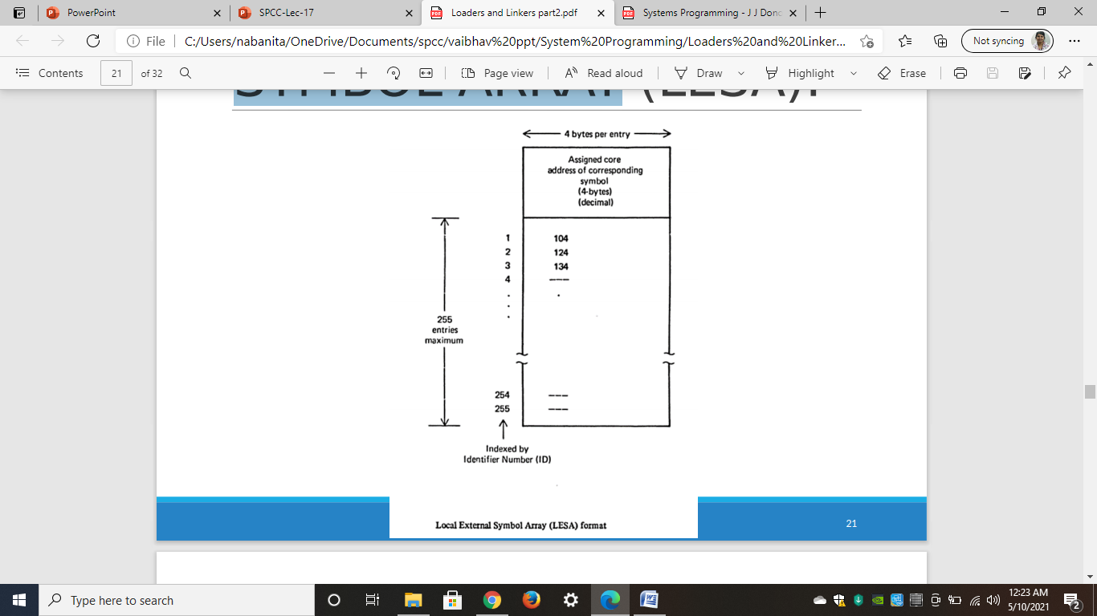
LOCAL EXTERNAL SYMBOL ARRAY
Example:

Slide 28
algorithm
Pass 1
Allocate segments and define symbols
Function:
Assign a location to each segment
Define the values of all external symbols

Slide 29
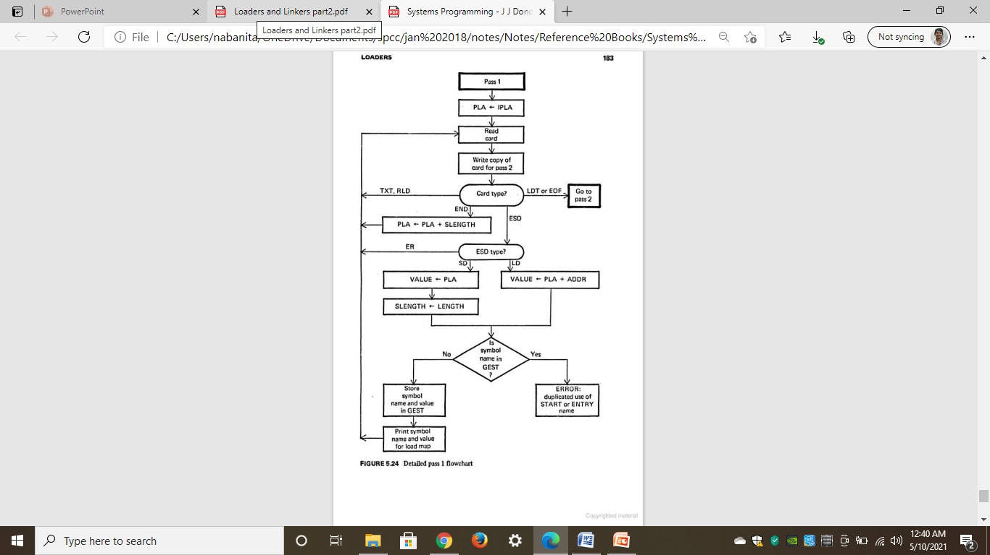
Flowchart for Pass-1

Slide 30
algorithm
Pass 2:
Load Text and Relocate/Link Address content
Functions:
Complete the loading process by loading the text and adjusting (Relocation or Linking) address constant

Slide 31
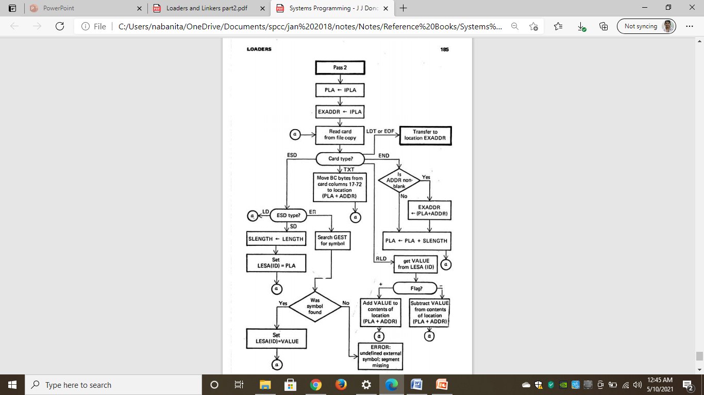
Flowchart for Pass-2

Slide 32
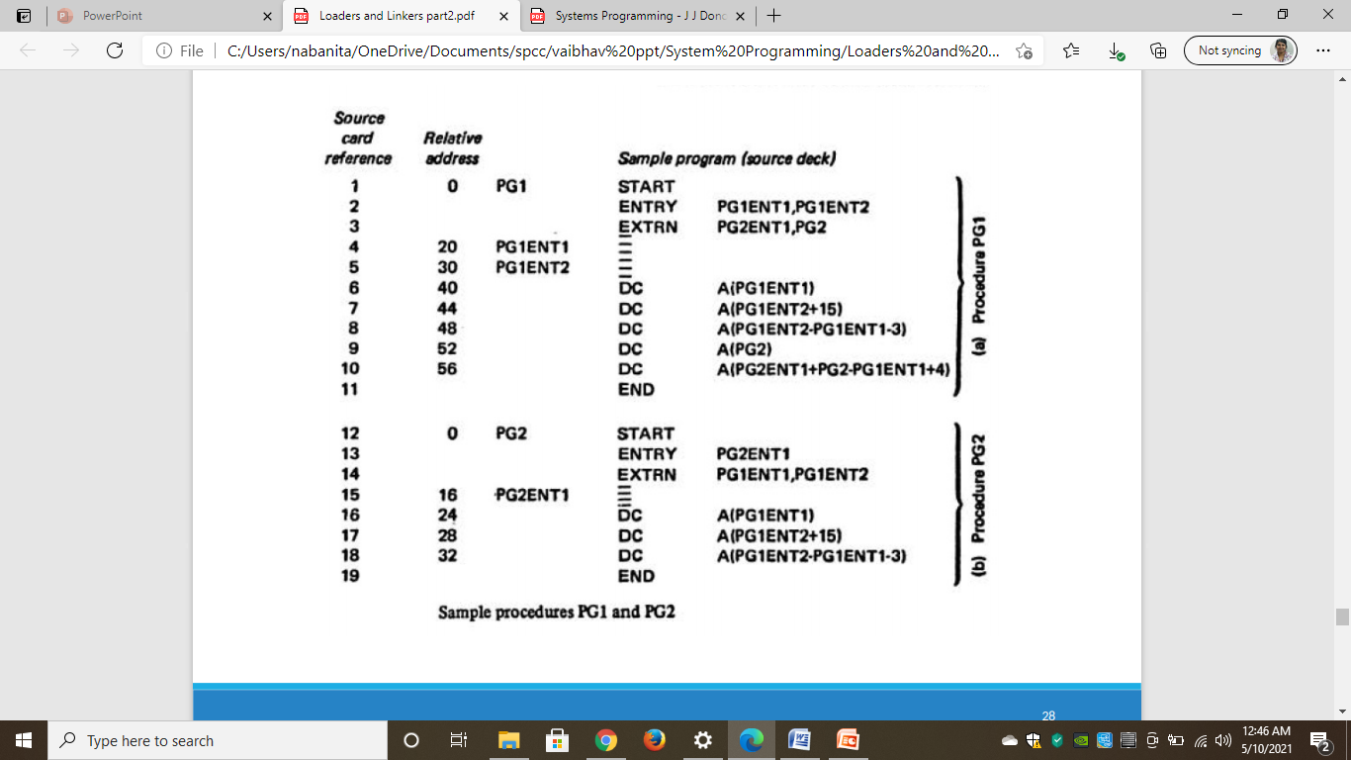
Example

Slide 33
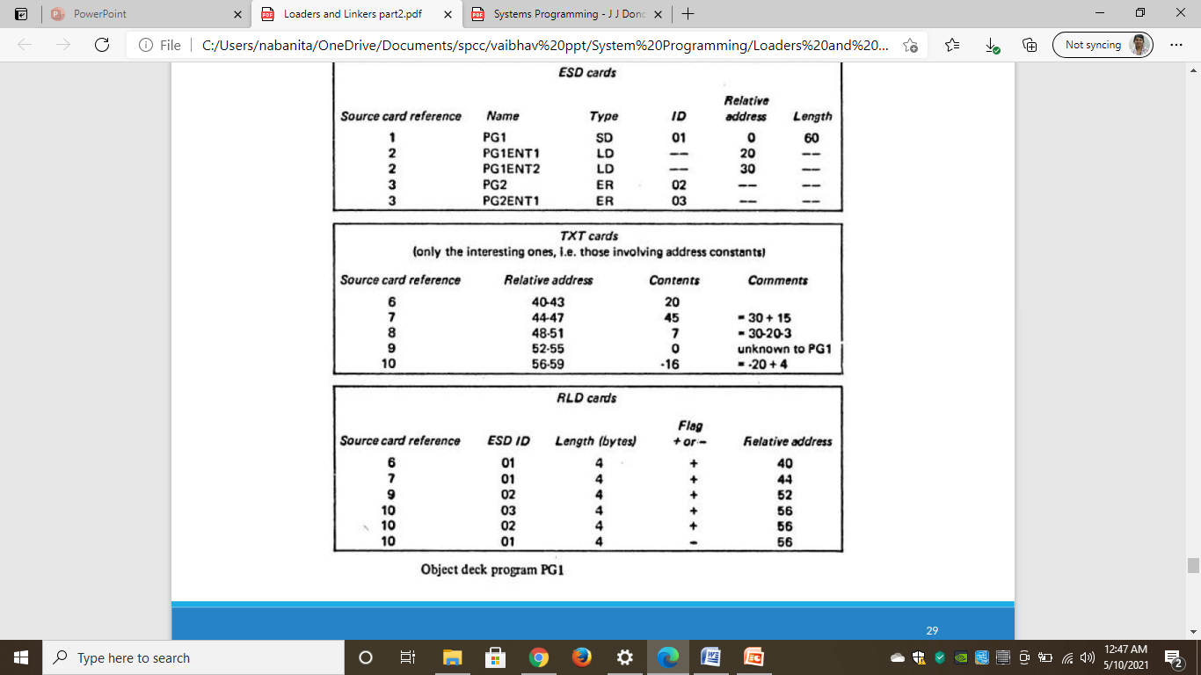
Example

Slide 34
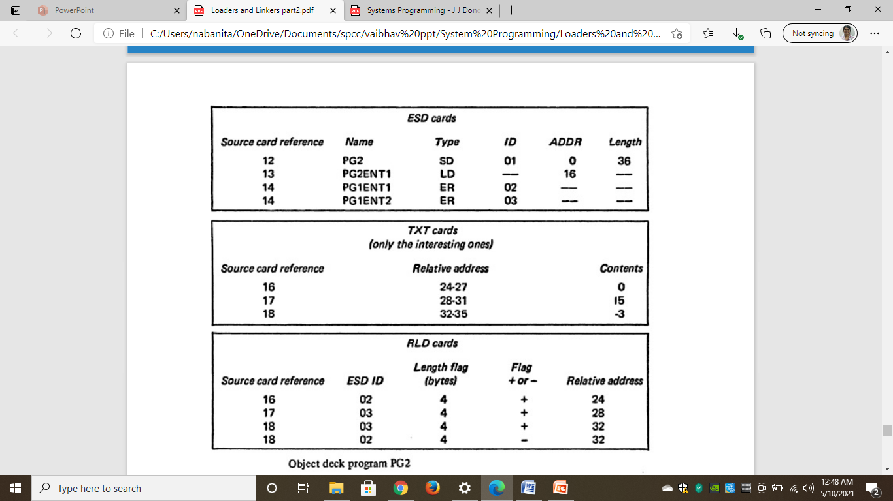
Example

Slide 35
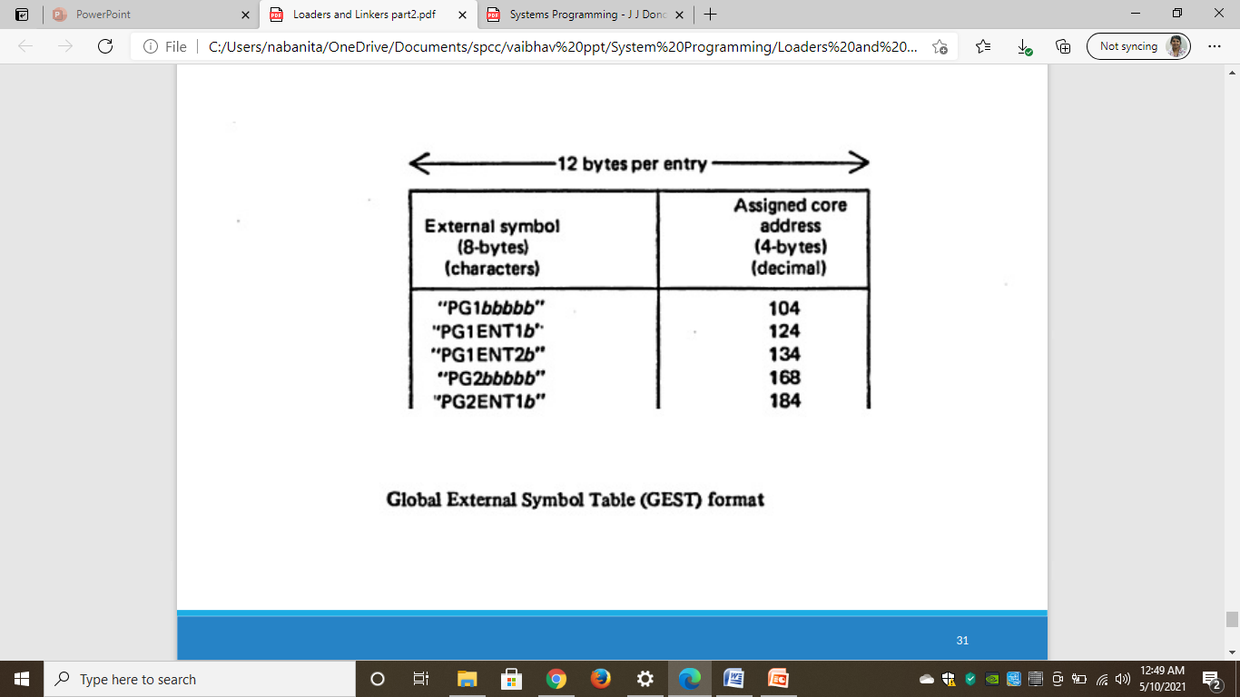
Example

Slide 36
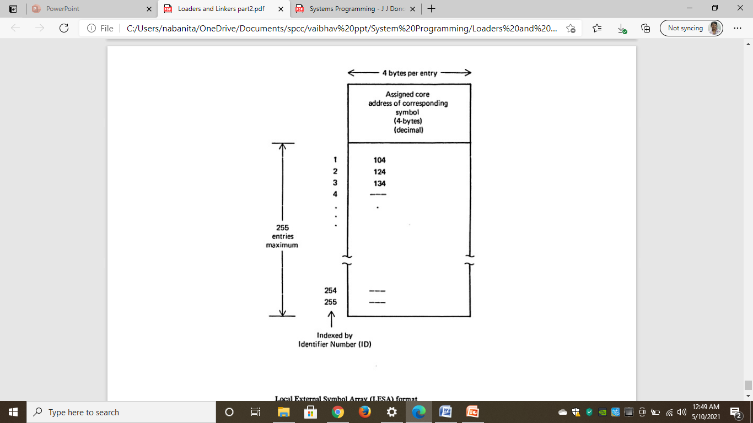
Example
Local External Symbol Array (LESA) format

