Slide 1
Module-3
Macros and Macroprocessor

Slide 2
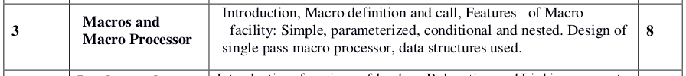

Syllabus

Slide 3
Macro Instructions
Macro instructions are single-line abbreviation for groups of instructions in sequential order
In employing a macro, the programmer essentially defines a single “instruction” to represent a block of code.
For every occurrence of this one-line macro instruction in his program, the macro processing assembler will substitute the entire block.

Slide 4
Macros
The purpose of the macros is to either automate frequently used sequences or enable a more powerful abstraction
Integral macro operations simplify debugging and program modification and they facilitate standardization.

Slide 5
Macro Instructions & Macro Processor
Macro instructions are usually considered an extension of the basic assembler language, and the macro processor is viewed as an extension of the basic assembler algorithm.

Slide 6
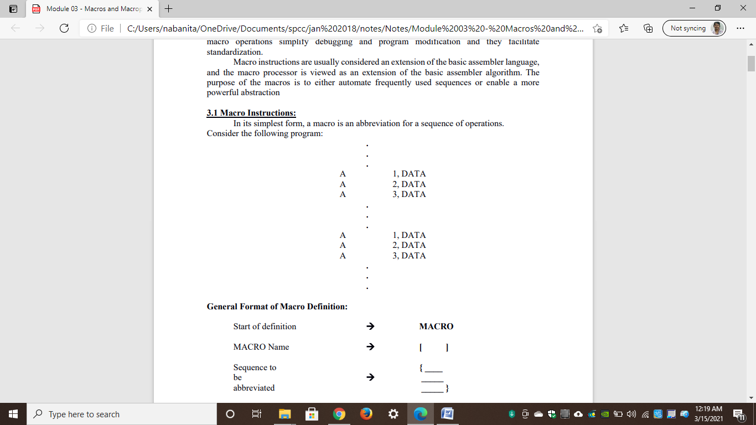
Example:
Set of instructions occurred twice: Macro can be defined
Macro Processor: A Separate Language Processor with its own language

Slide 7
Macros
We can invent a macro language that:
Allows us to specify the above as a macro definition and
Allows us to refer to the definition later
A macro processor effectively constitutes a separate language processor with its own language

Slide 8
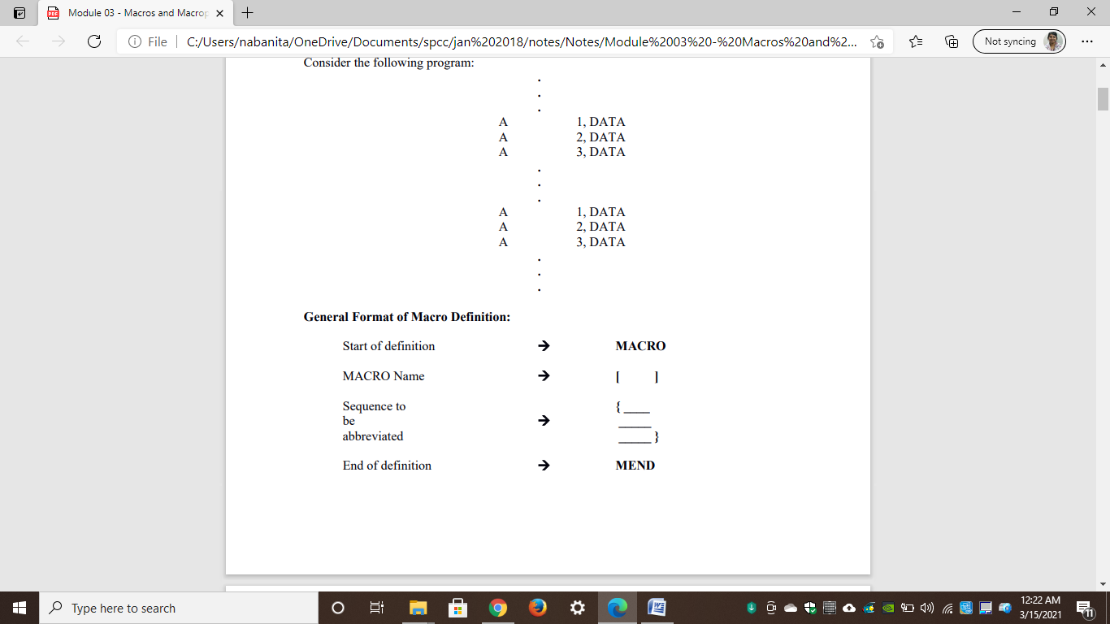

General Format of Macro Definition:
Use of Macro Name: Operation Mnemonic in Assembly Program
Equivalent to use of corresponding instruction sequence

Slide 9
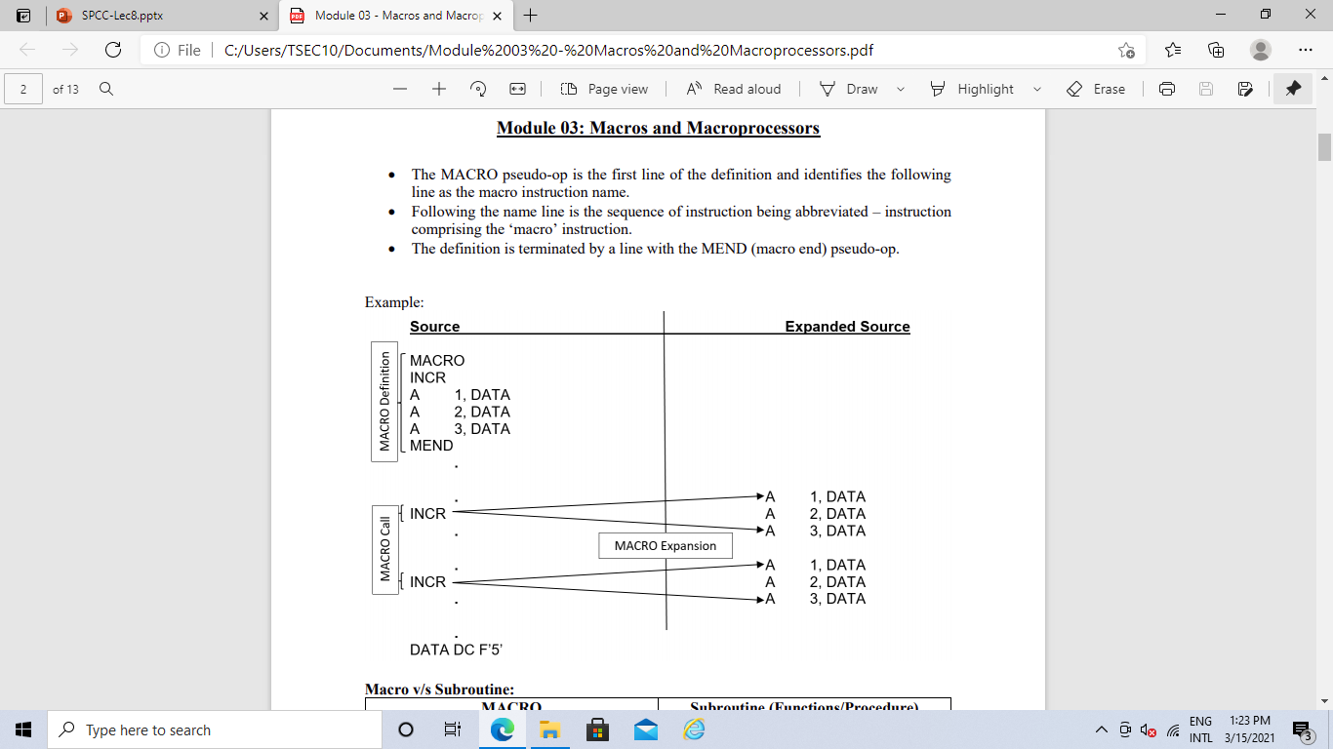
Example

Slide 10
Macros
The MACRO pseudo-op is the first line of the definition
INCR is the macro instruction name.
Following the name line is the sequence of instruction being abbreviated – instruction comprising the ‘macro’ instruction.
The definition is terminated by a line with the MEND (macro end) pseudo-op.
Once the macro has been defined, the use of macro name as an operation mnemonic in an assembly program is equivalent to the use of the corresponding sequence

Slide 11
Macros
Macro Call
Macro Expansion

Slide 12
Macro vs Sub-Routine
Macro | Sub-Routine
MACRO name in the mnemonic field that leads to expansion only. | Subroutine name is a call statement in the program which leads to execution
MACROs are completely handled by the Assembler (Preprocessor) during assembly time. | Subroutine are completely handled by the hardware at runtime.
Macro definition and macro expansion are executed by the assembler. So, the assembler has to know all the features, options, and exceptions associated with them. | Hardware executes the subroutine call instruction. So, it has to know how to save the return address and how to branch to the subroutine.
The hardware knows nothing about macros. | The assembler knows nothing about subroutines
The macro processor generates a new copy of the macro and places it in the program. | The subroutine call instruction is assembled in the usual way and treated by the assembler as any other instruction

Slide 13
Macro vs Sub-Routine
Macro | Sub-Routine
Macro should be used for small tasks. | Functions should be used for the complex tasks.
Macro does not alter the flow of execution | Function does alters the flow of execution.
Macro calls a process at the translation time. | Function calls a process at the execution time.
Debugging in macro is difficult as compared to function as size of the code grows. | Debugging is comparatively easy.
Macros check the number of arguments; they do not check argument types. | Function checks both number of arguments and argument type

Slide 14
Benefits of Macros
By defining the appropriate macro instructions, an assembly language programmer can create his own higher level facility in a convenient manner without any cost in control over the structure of his program
The programmer can achieve the conciseness and ease in coding of high level languages without losing the basic advantage of assembly language programming.
Integral macro operations simplify debugging and program modification and they facilitate standardization

Slide 15
Features of Macro Facility/Different types of Macro:
Process of replacing Macro Call with Macro Definition
No Other processing or replacement is required
Conditional Macros
Nested Macros
Simple Macros
Parameterized Macros
Instructions are very similar but NOT Identical
Operations are same but with different parameter
Such parameter is called MACRO INSTRUCTION ARGUMENT or DUMMY ARGUMENT
Two important macro processor pseudo-ops AIF and AGO, permit conditional reordering of the sequence of macro expansion.
It can be of two types:
Macro calls within Macro
Macro instructions defining Macro

Slide 16
Simple Macro
The macro facility is capable of inserting blocks of instruction in place of macro calls.
All of the calls to any given macro will be replaced by identical blocks.
Suitable for identical instructions

Slide 17
Simple Macro-Example

Slide 18
Simple Macro
Disadvantage:
This macro facility lacks flexibility: there is no way for a specific macro call to modify the coding that replaces it.
Solution:
Provide arguments or Parameters in Macro Calls
Corresponding Macro dummy arguments will appear in Macro Definition

Slide 19
Parameterized Macro/Macro Instruction Arguments
It consists of the facility for providing for arguments, or parameters, in macro calls.
Corresponding macro dummy arguments (preceded by ‘&’ symbol) will appear in macro definitions.
Sequence of instructions are very similar but not identical

Slide 20
Parameterized Macro/Macro Instruction Arguments
They perform the same operation with a variable parameter or argument
Such a parameter is called the Macro Instruction Argument or Dummy Argument
This dummy argument is specified on the Macro Name line and distinguished by the “&” symbol which is always the first character

Slide 21
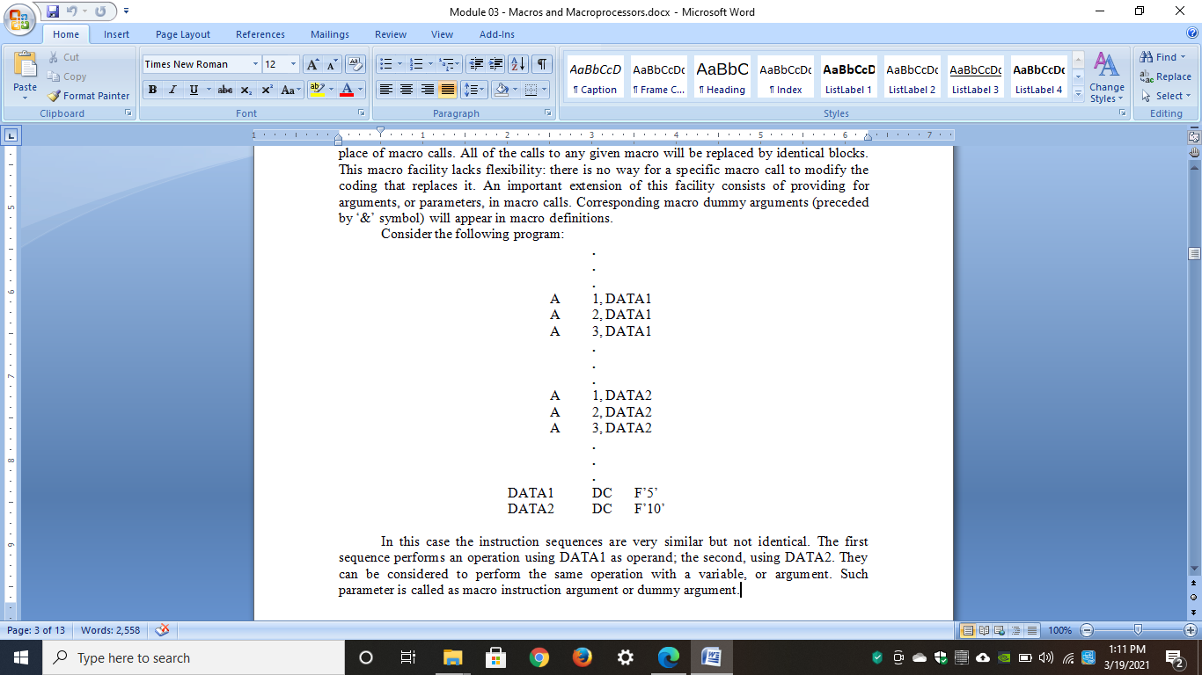
Parameterized Macro-Example
Consider the sample program

Slide 22
Parameterized Macro-Example
In this case the instruction sequences are very similar but not identical.
The first sequence performs an operation using DATA1 as operand; the second, using DATA2.
They can be considered to perform the same operation with a variable, or argument.
Such parameter is called as macro instruction argument or dummy argument.

Slide 23
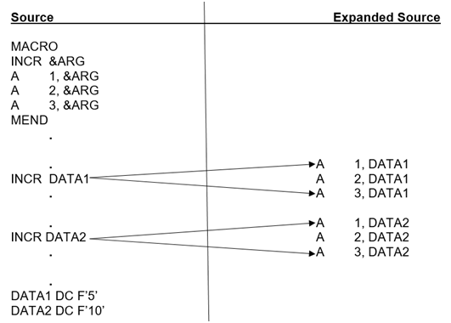
Parameterized Macro-Example1
Resultant Program
Example 1:

Slide 24
Parameterized Macro
It is possible to have more than one argument in a macro call
Each argument must correspond to a dummy argument in the macro definition
When a macro call is processed, the arguments supplied are substituted for the respective dummy arguments in macro definition

Slide 25
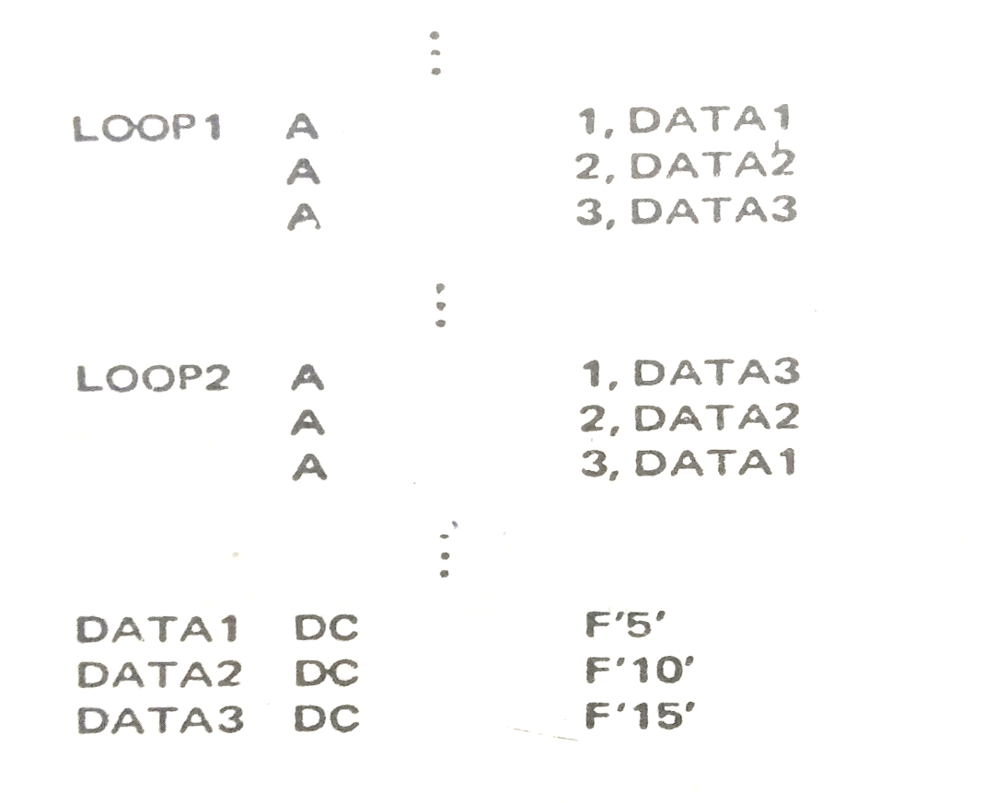
Parameterized Macro-Example2
Example 2:
Program can be rewritten using MACRO with MORE THAN ONE dummy arguments
Label arguments can be put in Label Location
Here both sequences are similar but not identical
Labels are also different

Slide 26
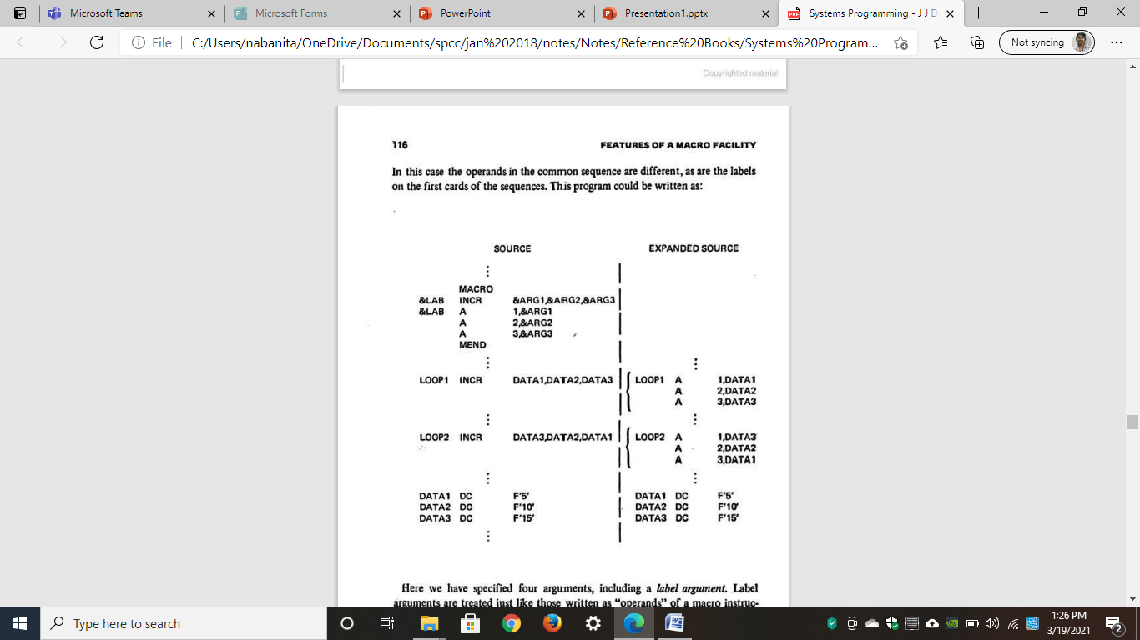
Parameterized Macro-Example2
Example 2:

Slide 27
Parameterized Macro
There are generally two ways of specifying arguments to a macro call:
Positional arguments:
Keyword arguments

Slide 28
Parameterized Macro
Positional arguments:
In this arguments are matched with the dummy arguments according to the order in which they appear with the positional parameter
OR
The way of Specifying argument with their position in Macro Definition is known as POSITIONAL ARGUMENTS

Slide 29
Parameterized Macro: Positional Argument Example
The first A replaces the first dummy argument &ARG1, second A replaces the second dummy argument &ARG2 and third A replaces the third dummy argument &ARG3
MACRO
&LAB INCR &ARG1, &ARG2, &ARG3
&LAB A 1, &ARG1
A 2, &ARG2
A 3, &ARG3
MEND
. . .
. . .
LOOP1 INCR DATA1, DATA2, DATA3
. . .
LOOP2 INCR DATA3, DATA2, DATA1

Slide 30
Parameterized Macro
Keyword arguments:
They allow reference to the dummy arguments by name as well as by the position.
Both the calls are valid and performing same expansion
If any argument is not supplied, then it is presumed blank by Macro Processor

Slide 31
Parameterized Macro: Keyword Argument Example
'INCR &ARG1 = A, &ARG3 = C, &ARG2 = B’
Or
'INCR &ARG1 = A, &ARG2 = &ARG3 = C'
MACRO
INCR &ARG1, &ARG2, &ARG3
A 1, &ARG1
A 2, &ARG2
A 3, &ARG3
MEND
. . .
. . .
INCR &ARG1 = A, &ARG2 = B, &ARG3 = C
. . .
INCR &ARG1 = A, &ARG3 = C, &ARG2 = B

Slide 32
Conditional Macro
Two important macro processor pseudo-ops AIF and AGO, permit conditional reordering of the sequence of macro expansion.
These allows conditional selection of the machine instruction that appears in expansions of macro call.
AIF and AGO controls the sequence in which the macro processor expand the statement in MACRO Instruction
Labels starting with period (Example .FINI) are Macro Labels and do not appear in output of Macro Processor

Slide 33
Conditional Macro
AIF
It is conditional branch pseudo-op
It performs arithmetic test and branches only if tested condition is true
AGO
It is an unconditional branch on pseudo-op
It is also called as the 'goto' statement

Slide 34
Conditional Macro-Example
. . .
. . .
. . .
LOOP1 A 1, DATA1
A 2, DATA2
A 3, DATA3 . . .
. . .
. . .
LOOP2 A 1, DATA3
A 2, DATA2
. . .
. . .
. . .
LOOP3 A 1, DATA1
. . .
. . .
DATA1 DC F'5'
DATA2 DC F'10'
DATA3 DC F'15'
MACRO
&ARG0 VARY &COUNT, &ARG1, &ARG2, &ARG3
&ARG0 A 1, &ARG1
AIF (&COUNT EQ 1) .FINI
A 2, &ARG2
AIF (&COUNT EQ 2).FINI
A 3, &ARG3
.FINI MEND
. . .
. . .
LOOP1 VARY 3, DATA1, DATA2, DATA3
. . .
. . .
LOOP2 VARY 2, DATA3, DATA2
. . .
. . .
LOOP3 VARY 1, DATA1
. . .
. . .
DATA1 DC F'5'
DATA2 DC F'10'
DATA3 DC F'15'
The operand, labels and number of instructions generated, change in each sequence
if AIF condition is true then control is transferred to Macro label .FINI

Slide 35
Nested Macro
In this feature of macro facility when one MACRO expansion is taking place we can encounter another macro call or during one macro call another macro call is invoked.
In this macro, bodies contain macro calls and processes macro definition during expansion time
It can be of two type:
Macro calls within Macros
Macro instructions defining Macros

Slide 36
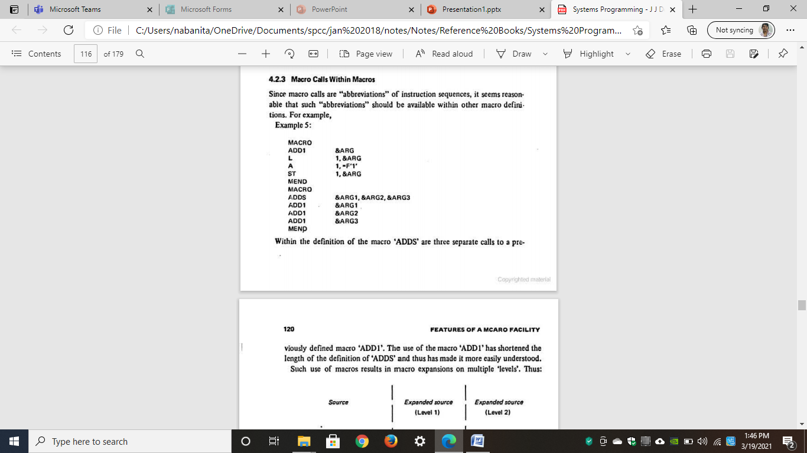
Nested Macro-Example: Macro calls within Macros
Within definition of the macro 'ADDS’ there are three separate calls to previously defined macro 'ADD1’.
Due to this, length of Macro ADDS is shortened
Previously defined
Macro

Slide 37
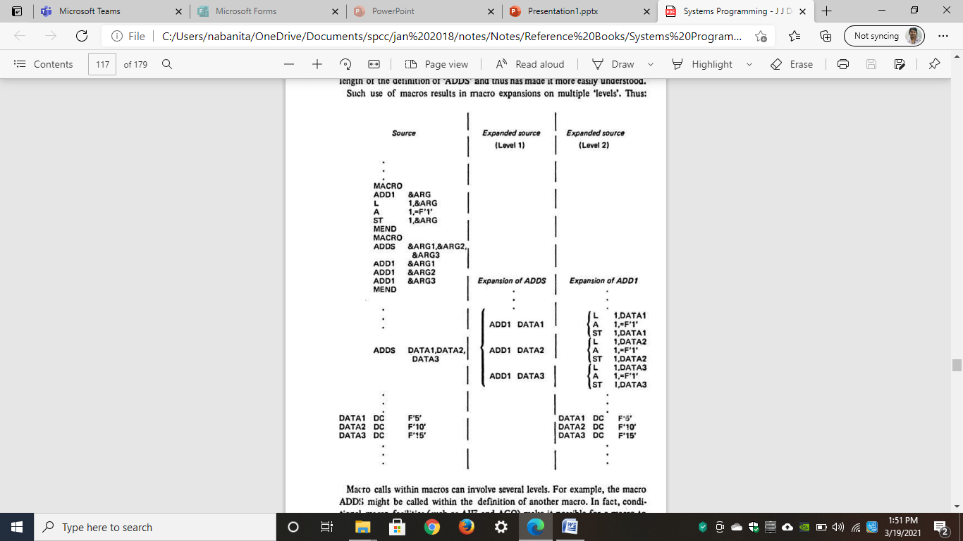
Nested Macro-Example: Expansion of Previous Macro

Slide 38
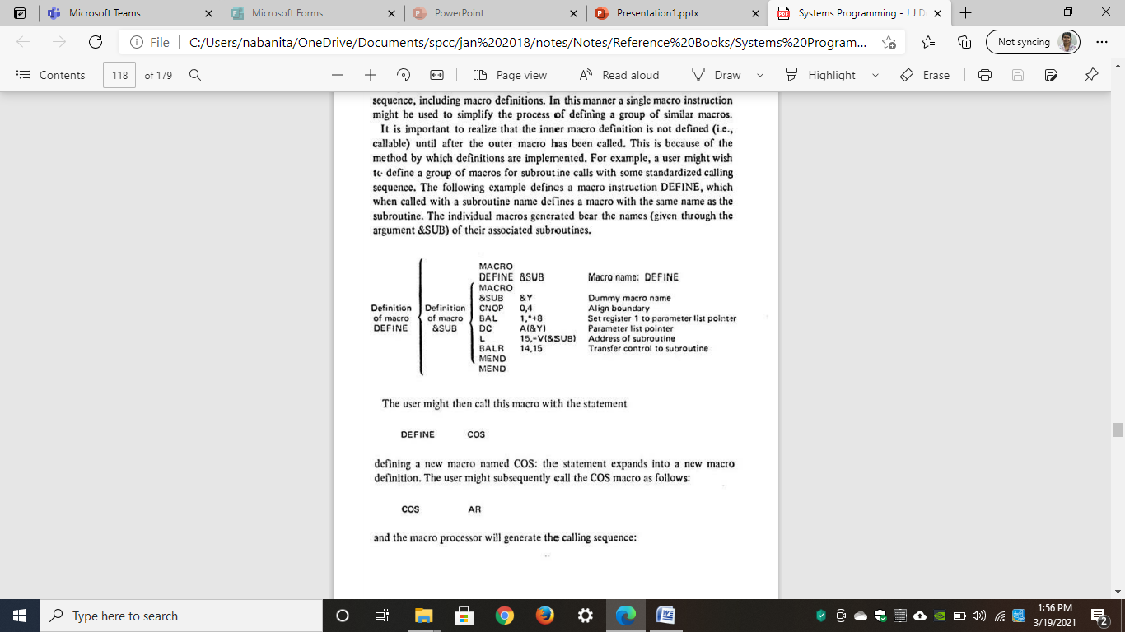
Nested Macro-Example: Macro instructions defining Macros
Macro definition can also be abbreviated using Macros.
It also be called as 'Macro Definition within Macros'
Single Macro Instructions can be used to simplify the process of defining a group of similar macros
To call the inner macro it is necessary to define the outer macro first.

Slide 39
Nested Macro-Example: Macro instructions defining Macros
Macro definition can also be abbreviated using Macros.
It also be called as 'Macro Definition within Macros'
Single Macro Instructions can be used to simplify the process of defining a group of similar macros
To call the inner macro it is necessary to define the outer macro first.

Slide 40
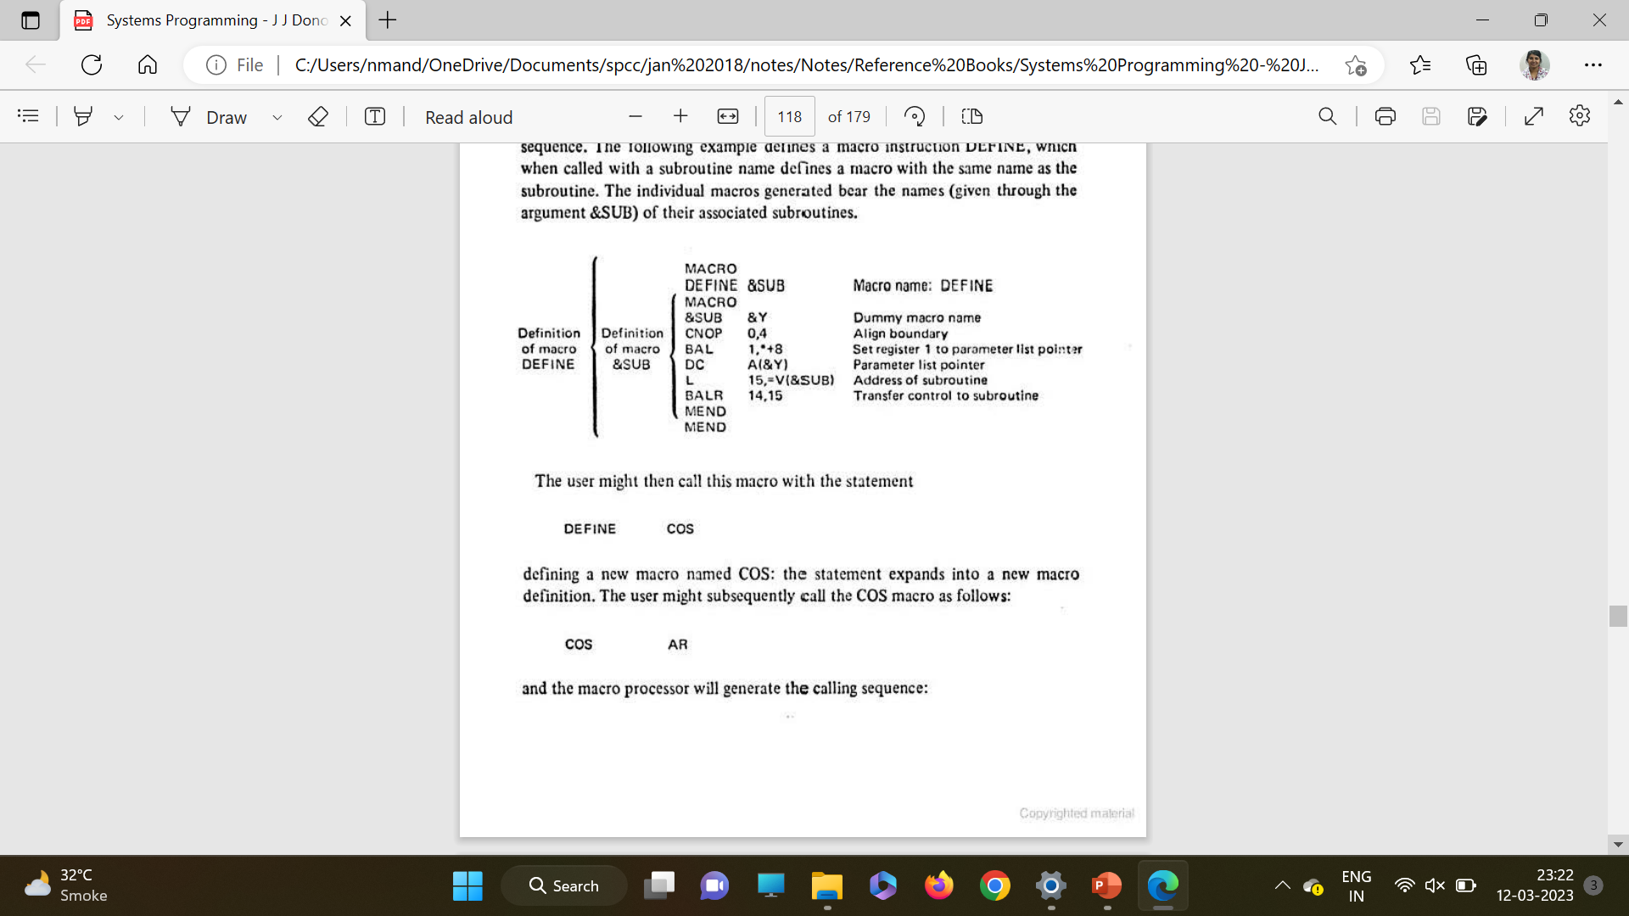
Nested Macro-Example: Macro instructions defining Macros
Source Code
Expanded Source Code (Level1)
Expanded Source Code (Level2)
MACRO
DEFINE &SUB
MACRO
&SUB &Y
CNOP 0, 4
BAL 1,*+8
DC A (&Y)
L 15, =V(&SUB)
BALR 14,15
MEND
MEND
. . .
. . .
DEFINE COS
. . .
. . .
COS AR
MACRO
COS &Y
CNOP 0, 4
DC A (&Y)
L 15, =V(COS)
MEND
. . .
. . .
COS AR
CNOP 0, 4
DC A (AR)
L 15, =V(COS)

Slide 41
Task of a Macroprocessor
Recognize Macro Definition
A macro instruction processor must recognize macro definitions identified by the MACRO and MEND pseudo-ops. This task can be complicated when macro definitions appear within macros.
Save the definitions
The processor must store the macro instruction definitions, which it will need for expanding macro calls.
Recognize Calls
The processor must recognize macro calls that appear as operation mnemonics. This suggests that macro names be handled as a type of op-code.
Expand Calls and substitute arguments
The processor must substitute for dummy or macro definition arguments the corresponding arguments from a macro call; the resulting symbolic text in then substituted for the macro call.

