Slide 1
Parul Jain
Assistant Professor
Please use anti glare blue rays protector glasses.

Slide 2
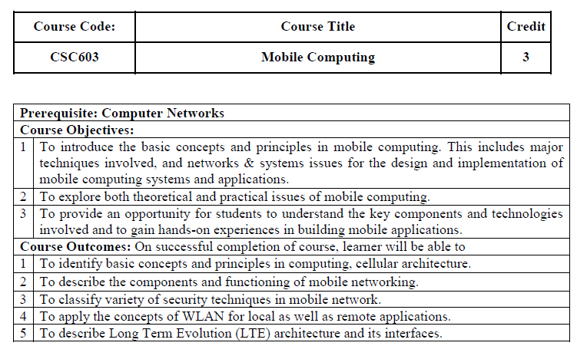

Slide 3
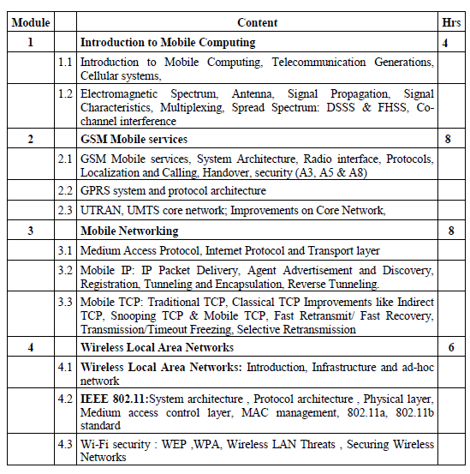

Slide 4
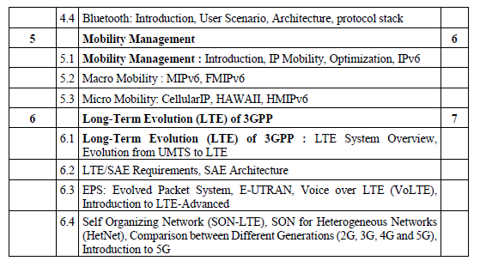

Slide 5
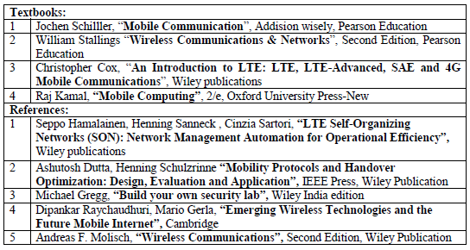

Slide 6
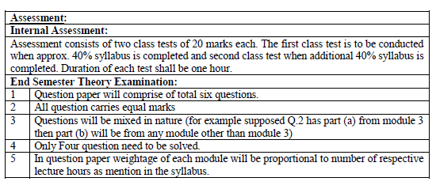

Slide 7
There are two different kinds of mobility:
User mobility
Device portability
User mobility: refers to a user who has access to the same or similar telecommunication services at different places, i.e., the user can be mobile, and the services will follow him or her.

Slide 8
Device portability or mobile :
The communication device moves (with or without a user). Many mechanisms in the network and inside the device have to make sure that communication is still possible while the device is moving.

Slide 9
A communication device can thus exhibit one of the following characteristics:
● Fixed and wired
● Mobile and wired
● Fixed and wireless
● Mobile and wireless

Slide 10
● Fixed and wired:
This conﬁguration describes the typical desktop computer.
Neither weight nor power consumption of the devices allow for mobile usage.
The devices use ﬁxed and wired networks for performance reasons.

Slide 11
● Mobile and wired:
Many of today’s laptops fall into this category
Users carry the laptop from one place to the next
Re-connecting to the company’s network via the telephone network and a modem.

Slide 12
● Fixed and wireless
This mode is used for installing networks ( wireless ) , e.g., in historical buildings to avoid damage by installing wires, or at trade shows to ensure fast network setup.

Slide 13
● Mobile and wireless
This is the most interesting case.
No cable restricts the user, who can roam between different wireless networks.
Today’s most successful example for this category is Global System for Mobile communication (GSM)

Slide 14
The basic reference model
Fig. below taken from Jochen Schiller’s book Mobile Communications shows a personal digital assistant (PDA) which provides an example for a wireless and portable device.
This PDA communicates with a base station in the middle of the picture.
The base station consists of a radio transceiver (sender and receiver) and an interworking unit connecting the wireless link with the fixed link.
The communication partner of the PDA, a conventional computer, is shown on the right-hand side.

Slide 15
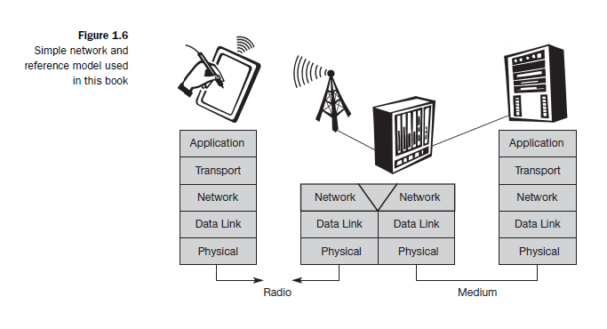
Mobile Communications by Jochen Schiller

Slide 16
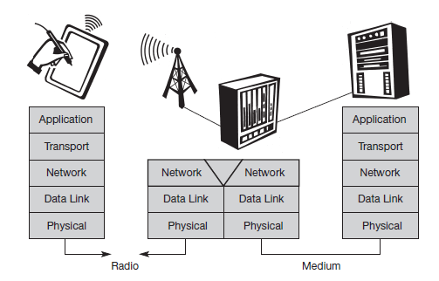
End-systems, such as the PDA and computer
in this example, need a full protocol stack comprising
Application layer
Transport layer
Network layer
Data link layer
Physical layer

Slide 17
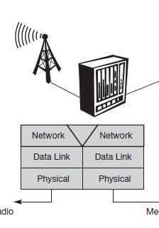
Applications on the end-systems communicate with each other using the lower layer services.
Intermediate systems, such as the interworking unit, do not necessarily need all of the layers. Figure only shows
Network
Data link
Physical

Slide 18
Physical layer: This is the lowest layer in a communication system
For wireless communication it is responsible for Frequency selection
Generation of the carrier frequency
Signal detection
Modulation of data onto a carrier frequency Encryption

Slide 19
● Data link layer: The main tasks of this layer include
Accessing the medium
Multiplexing of different data streams
Correction of transmission errors,
Synchronization ( i.e., detection of a data frame)

Slide 20
The data link layer is responsible for a reliable point-to point connection between two devices
OR
A point-to-multipoint connection between one sender and several receivers.

Slide 21
Network layer: This third layer is responsible for routing packets through a network
Important tasks of network layer are
Addressing
Routing
Device location
Handover between different networks

Slide 22
Transport layer: This layer is used in the reference model to establish an end-to-end connection.
Important tasks of transport layer are
Quality of service
Flow and Congestion control

Slide 23
Application layer: The applications are situated on top of all transmission oriented layers.
Important tasks of application layer are
Service location
Support for multimedia applications
Wireless access using a portable device.
Video (high data rate) and interactive gaming

