Slide 1
Spread spectrum
Techniques involve spreading the bandwidth
needed to transmit data
The main advantage is the resistance to narrowband interference
Figure below shows an idealized narrowband signal from a sender of user data (here power density dP/df versus frequency f).

Slide 2
Figure below shows an idealized narrowband signal from a sender of user data
Power density dP/df versus frequency f

Slide 3
The sender now spreads the signal i.e., converts the narrowband signal into a broadband signal
The energy needed to transmit the signal is the same
But it is now spread over a larger frequency range

Slide 4
During transmission, narrowband and broadband interference add to the signal in next step

Slide 5
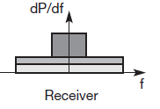
The sum of interference and user signal is received
The receiver now knows how to despread the signal
Converts the spread user signal into a narrowband signal again

Slide 6
The receiver applies a band pass filter to cut off frequencies left and right of the narrowband signal
Finally, the receiver can reconstruct the original data

Slide 8
To separate different channels, CDM is used
The tight coupling of CDM and spread spectrum
Spreading of a narrowband signal is achieved using a special code as shown in
Each channel is allotted its own code, which the receivers have to apply to recover the signal.
Without knowing the code, the signal cannot be recovered and behaves like background noise.
This is the security effect of spread spectrum if a secret code is used for spreading.

Slide 9
Spreading the spectrum can be achieved in two different ways
Direct Sequence Spread Spectrum (DSSS)
Frequency Hoping Spread Spectrum (FHSS)

Slide 11
Multiplexing
Multiplexing is a fundamental mechanism in communication systems
Multiplexing describes how several users can share a medium with minimum or no interference.
For wireless communication, multiplexing can be carried out in four dimensions:
Space
Time
Frequency
Code

Slide 12
Space division multiplexing
Figure below shows six channels ki and introduces a three dimensional coordinate system.
This system shows the dimensions of code c, time t andfrequency f.
The (3 D) space si is also shown.
Here space is represented via circles indicating the interference range.

Slide 13
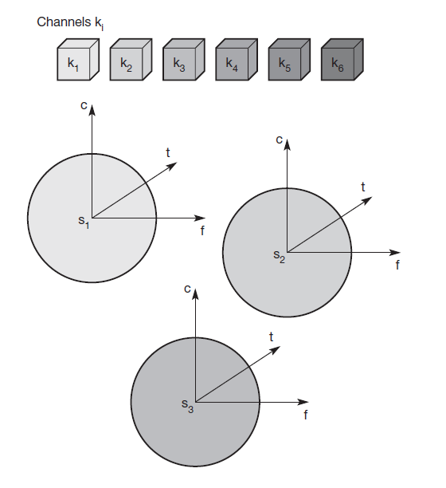

Slide 14
The channels k1 to k3 can be mapped onto the three ‘spaces’ s1 to s3 which clearly separate the channels and prevent the interference ranges from overlapping.
The space between the interference ranges is sometimes called guard space.
For the remaining channels (k4 to k6) three additional spaces would be needed
This principle used by the old analog telephone system: each subscriber is given a separate pair of copper wires to the local exchange.

Slide 15
In wireless transmission, SDM implies a separate sender for each communication channel with a wide enough distance between senders.
SDM is used, for example, at FM radio stations
- transmission range is limited to a certain region
- many radio stations can use the same frequency without interference.

Slide 16
Frequency division multiplexing
FDM describes schemes to subdivide the frequency dimension into several non-overlapping frequency bands as shown

Slide 17
Each channel ki is allotted its own frequency band
Senders using a certain frequency band can use this band
Guard spaces are needed to avoid frequency band overlapping or adjacent channel interference

Slide 18
FDM is used for radio stations within the same region, where each radio station has its own frequency.
Very simple multiplexing scheme does not need complex coordination between sender and receiver
Receiver only has to tune in to the specific sender.
However, mobile communication typically takes place for only a few minutes at a time.
Assigning a separate frequency for each possible communication scenario would be a tremendous waste of frequency resources.

Slide 19
Additionally, the fixed assignment of a frequency to a sender makes the scheme very inflexible and limits the number of senders.

Slide 20
Time division multiplexing
In TDM a channel ki is given the whole bandwidth
for a certain amount of time
It means all senders use the same frequency but at different points in time as shown below
Again, guard spaces, which now represent time gaps, have to separate the different periods when the senders use the medium

Slide 22
If two transmissions overlap in time, this is called co-channel interference
To avoid this type of interference, precise synchronization between different senders is necessary.
All senders need precise clocks or, distribute a synchronization signal to all senders.
For a receiver tuning in to a sender involves
adjusting the frequency
listening at exactly the right point in time

Slide 23
For a receiver tuning in to a sender involves
adjusting the frequency
listening at exactly the right point in time
Assign more sending time to senders with a heavy load and less to those with a light load.

Slide 24
Frequency and time division multiplexing
A channel ki can use a certain frequency band for a certain amount of time as shown
Guard spaces are needed both in the time and in the frequency dimension.
GSM uses this for transmission between a mobile phone and a base station

Slide 25
Two senders will interfere as soon as they select the same frequency at the same time.

Slide 26
If the frequency change k/as frequency hopping
is fast enough, the periods of interference may be small
A receiver can still recover the original data.

Slide 27
Code Division Multiplexing
CDM is first used in military applications due to its inherent security features together with spread spectrum techniques
Figure on next slide shows how all channels ki use the same frequency at the same time for transmission

Slide 29
Each channel has its own code
Guard spaces are realized by using codes with the necessary ‘distance’ in code space, e.g., orthogonal
codes.
In wireless transmission CDM gives good protection against interference and tapping.
Code space is huge compared
High complexity of the receiver

Slide 30
Limitation
- relatively high complexity of the receiver
- separate the channel with user data from the background noise
- a receiver must be precisely synchronized with the transmitter to apply the decoding correctly

