Slide 1
UNIT-I Overview: Introduction: Professional Software Development, Software Engineering Ethics, Case studies. Software Processes: Models, Process activities, Coping with Change, Process improvement. Requirements Engineering and System Modelling: Software Requirements: Functional and Non-functional requirements, Requirements Elicitation, Specification, Validation and Change

Slide 2
Topics covered
Software Processes
Software process models
Process activities
Coping with change
Process improvement

Slide 3
The software process
A structured set of activities required to develop a software system.
Many different software processes but all involve:
Specification – defining what the system should do;
Design and implementation – defining the organization of the system and implementing the system;
Validation – checking that it does what the customer wants;
Evolution – changing the system in response to changing customer needs.
A software process model is an abstract representation of a process. It presents a description of a process from some particular perspective.

Slide 4
Software process descriptions
When we describe and discuss processes, we usually talk about the activities in these processes such as specifying a data model, designing a user interface, etc. and the ordering of these activities.
Process descriptions may also include:
Products, which are the outcomes of a process activity;
Roles, which reflect the responsibilities of the people involved in the process;
Pre- and post-conditions, which are statements that are true before and after a process activity has been enacted or a product produced.

Slide 5
Plan-driven and agile processes
Plan-driven processes are processes where all of the process activities are planned in advance and progress is measured against this plan.
In agile processes, planning is incremental and it is easier to change the process to reflect changing customer requirements.
In practice, most practical processes include elements of both plan-driven and agile approaches.
There are no right or wrong software processes.

Slide 6
Software process models
The waterfall model
Plan-driven model. Separate and distinct phases of specification and development.
Incremental development
Specification, development and validation are interleaved. May be plan-driven or agile.
Reuse-oriented software engineering
The system is assembled from existing components. May be plan-driven or agile.
In practice, most large systems are developed using a process that incorporates elements from all of these models.

Slide 7
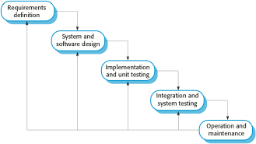
The waterfall model

Slide 8
Waterfall model phases
There are separate identified phases in the waterfall model:
Requirements analysis and definition
System and software design
Implementation and unit testing
Integration and system testing
Operation and maintenance
The main drawback of the waterfall model is the difficulty of accommodating change after the process is underway. In principle, a phase has to be complete before moving onto the next phase.

Slide 9
Waterfall model problems
Inflexible partitioning of the project into distinct stages makes it difficult to respond to changing customer requirements.
Therefore, this model is only appropriate when the requirements are well-understood and changes will be fairly limited during the design process.
Few business systems have stable requirements.
The waterfall model is mostly used for large systems engineering projects where a system is developed at several sites.
In those circumstances, the plan-driven nature of the waterfall model helps coordinate the work.

Slide 10
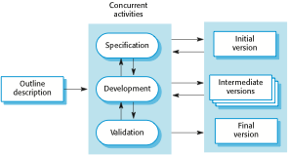
Incremental development

Slide 11
Incremental development benefits
The cost of accommodating changing customer requirements is reduced.
The amount of analysis and documentation that has to be redone is much less than is required with the waterfall model.
It is easier to get customer feedback on the development work that has been done.
Customers can comment on demonstrations of the software and see how much has been implemented.
More rapid delivery and deployment of useful software to the customer is possible.
Customers are able to use and gain value from the software earlier than is possible with a waterfall process.

Slide 12
Incremental development problems
The process is not visible.
Managers need regular deliverables to measure progress. If systems are developed quickly, it is not cost-effective to produce documents that reflect every version of the system.
System structure tends to degrade as new increments are added.
Unless time and money is spent on refactoring to improve the software, regular change tends to corrupt its structure. Incorporating further software changes becomes increasingly difficult and costly.

Slide 13
Reuse-oriented software engineering
Based on systematic reuse where systems are integrated from existing components or COTS (Commercial-off-the-shelf) systems.
Process stages
Component analysis;
Requirements modification;
System design with reuse;
Development and integration.

Slide 14

Reuse-oriented software engineering

Slide 15
Types of software component
Web services that are developed according to service standards and which are available for remote invocation.
Collections of objects that are developed as a package to be integrated with a component framework such as .NET or J2EE.
Stand-alone software systems (COTS) that are configured for use in a particular environment.

Slide 16
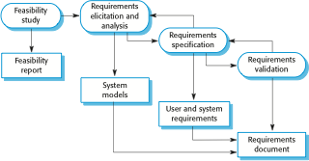
The requirements engineering process

Slide 17
Software design and implementation
The process of converting the system specification into an executable system.
Software design
Design a software structure that realises the specification;
Implementation
Translate this structure into an executable program;
The activities of design and implementation are closely related and may be inter-leaved.

Slide 18
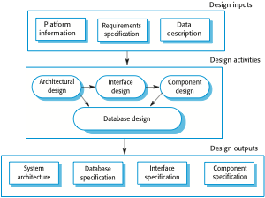
A general model of the design process

Slide 19
Design activities
Architectural design, where you identify the overall structure of the system, the principal components (sometimes called sub-systems or modules), their relationships and how they are distributed.
Interface design, where you define the interfaces between system components.
Component design, where you take each system component and design how it will operate.
Database design, where you design the system data structures and how these are to be represented in a database.

Slide 20
Software validation
Verification and validation (V & V) is intended to show that a system conforms to its specification and meets the requirements of the system customer.
Involves checking and review processes and system testing.
System testing involves executing the system with test cases that are derived from the specification of the real data to be processed by the system.
Testing is the most commonly used V & V activity.

Slide 21

Stages of testing

Slide 22
Testing stages
Development or component testing
Individual components are tested independently;
Components may be functions or objects or coherent groupings of these entities.
System testing
Testing of the system as a whole. Testing of emergent properties is particularly important.
Acceptance testing
Testing with customer data to check that the system meets the customer’s needs.

Slide 23
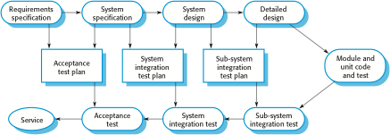
Testing phases in a plan-driven software process

Slide 24
Coping with change
Change is inevitable in all large software projects.
Business changes lead to new and changed system requirements
New technologies open up new possibilities for improving implementations
Changing platforms require application changes
Change leads to rework so the costs of change include both rework (e.g. re-analysing requirements) as well as the costs of implementing new functionality

Slide 25
Reducing the costs of rework
Change avoidance, where the software process includes activities that can anticipate possible changes before significant rework is required.
For example, a prototype system may be developed to show some key features of the system to customers.
Change tolerance, where the process is designed so that changes can be accommodated at relatively low cost.
This normally involves some form of incremental development. Proposed changes may be implemented in increments that have not yet been developed. If this is impossible, then only a single increment (a small part of the system) may have be altered to incorporate the change.

Slide 26
Software prototyping
A prototype is an initial version of a system used to demonstrate concepts and try out design options.
A prototype can be used in:
The requirements engineering process to help with requirements elicitation and validation;
In design processes to explore options and develop a UI design;
In the testing process to run back-to-back tests.

Slide 27
Benefits of prototyping
Improved system usability.
A closer match to users’ real needs.
Improved design quality.
Improved maintainability.
Reduced development effort.

Slide 28

The process of prototype development

Slide 29
Prototype development
May be based on rapid prototyping languages or tools
May involve leaving out functionality
Prototype should focus on areas of the product that are not well-understood;
Error checking and recovery may not be included in the prototype;
Focus on functional rather than non-functional requirements such as reliability and security

Slide 30
Throw-away prototypes
Prototypes should be discarded after development as they are not a good basis for a production system:
It may be impossible to tune the system to meet non-functional requirements;
Prototypes are normally undocumented;
The prototype structure is usually degraded through rapid change;
The prototype probably will not meet normal organisational quality standards.

Slide 31
Incremental delivery
Rather than deliver the system as a single delivery, the development and delivery is broken down into increments with each increment delivering part of the required functionality.
User requirements are prioritised and the highest priority requirements are included in early increments.
Once the development of an increment is started, the requirements are frozen though requirements for later increments can continue to evolve.

Slide 32
Incremental development and delivery
Incremental development
Develop the system in increments and evaluate each increment before proceeding to the development of the next increment;
Normal approach used in agile methods;
Evaluation done by user/customer proxy.
Incremental delivery
Deploy an increment for use by end-users;
More realistic evaluation about practical use of software;
Difficult to implement for replacement systems as increments have less functionality than the system being replaced.

Slide 33
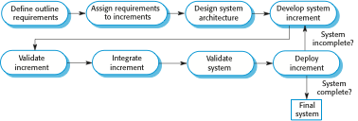
Incremental delivery

Slide 34
Incremental delivery advantages
Customer value can be delivered with each increment so system functionality is available earlier.
Early increments act as a prototype to help elicit requirements for later increments.
Lower risk of overall project failure.
The highest priority system services tend to receive the most testing.

Slide 35
Incremental delivery problems
Most systems require a set of basic facilities that are used by different parts of the system.
As requirements are not defined in detail until an increment is to be implemented, it can be hard to identify common facilities that are needed by all increments.
The essence of iterative processes is that the specification is developed in conjunction with the software.
However, this conflicts with the procurement model of many organizations, where the complete system specification is part of the system development contract.

Slide 36
Process Improvement

Slide 37
Process Improvement
Understanding, Modelling and Improving the Software Process

Slide 38
Objectives
To explain the principles of software process improvement
To explain how software process factors influence software quality and productivity
To introduce the SEI Capability Maturity Model and to explain why it is influential. To discuss the applicability of that model
To explain why CMM-based improvement is not universally applicable

Slide 39
Topics covered
Process and product quality
Process analysis and modelling
Process measurement
The SEI process maturity model
Process classification

Slide 40
Process improvement
Understanding existing processes
Introducing process changes to achieve organisational objectives which are usually focused on quality improvement, cost reduction and schedule acceleration
Most process improvement work so far has focused on defect reduction. This reflects the increasing attention paid by industry to quality
However, other process attributes can be the focus of improvement

Slide 41
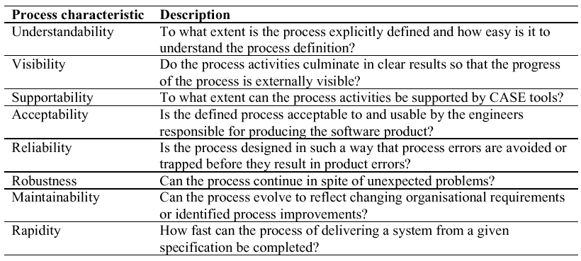
Process attributes

Slide 42
Process improvement stages
Process analysis
Model and analyse (quantitatively if possible) existing processes
Improvement identification
Identify quality, cost or schedule bottlenecks
Process change introduction
Modify the process to remove identified bottlenecks
Process change training
Train staff involved in new process proposals
Change tuning
Evolve and improve process improvements

Slide 43
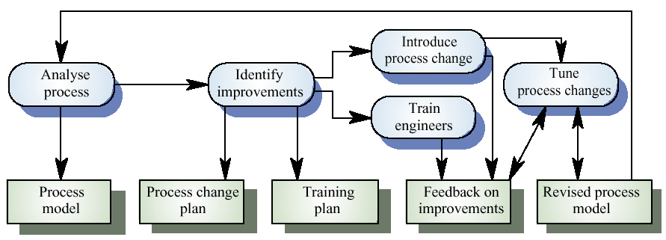
The process improvement process

Slide 44
Process and product quality
Process quality and product quality are closely related
A good process is usually required to produce a good product
For manufactured goods, process is the principal quality determinant
For design-based activity, other factors are also involved especially the capabilities of the designers

Slide 45
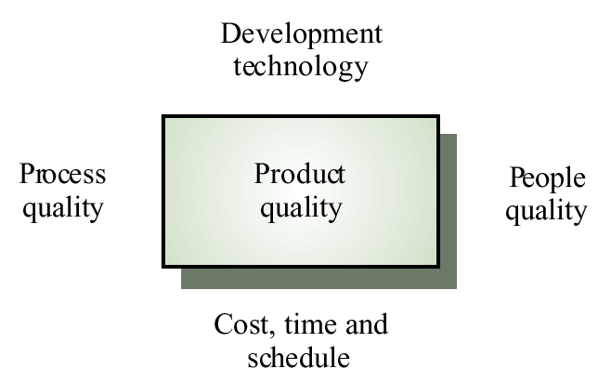
Principal product quality factors

Slide 46
Quality factors
For large projects with ‘average’ capabilities, the development process determines product quality
For small projects, the capabilities of the developers is the main determinant
The development technology is particularly significant for small projects
In all cases, if an unrealistic schedule is imposed then product quality will suffer

Slide 47
Process analysis and modelling
Process analysis
The study of existing processes to understand the relationships between parts of the process and to compare them with other processes
Process modelling
The documentation of a process which records the tasks, the roles and the entities used
Process models may be presented from different perspectives

Slide 48
Process analysis and modelling
Study an existing process to understand its activities
Produce an abstract model of the process. You should normally represent this graphically. Several different views (e.g. activities, deliverables, etc.) may be required
Analyse the model to discover process problems. Involves discussing activities with stakeholders

Slide 49
Process analysis techniques
Published process models and process standards
It is always best to start process analysis with an existing model. People then may extend and change this.
Questionnaires and interviews
Must be carefully designed. Participants may tell you what they think you want to hear
Ethnographic analysis
Involves assimilating process knowledge by observation

Slide 50
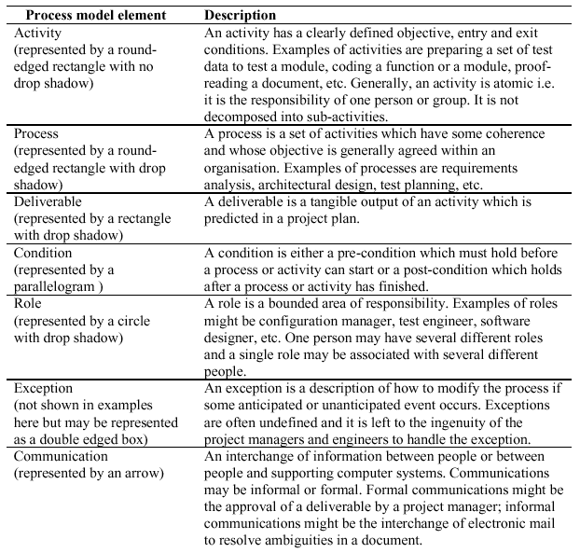
Elements of a process model

Slide 51
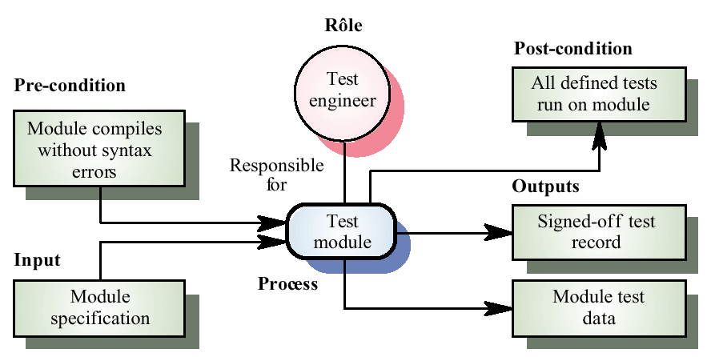
The module testing activity

Slide 52
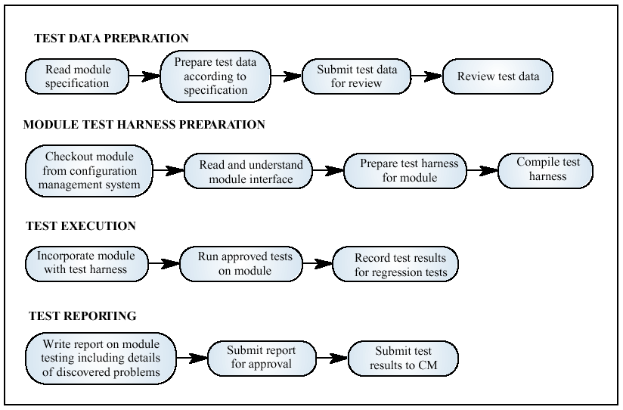
Activities in module testing
©Ian Sommerville 1995 Software Engineering, 5th edition. Chapter 31. Slide ##

Slide 53
Process exceptions
Software processes are complex and process models cannot effectively represent how to handle exceptions
Several key people becoming ill just before a critical review
A complete failure of a communication processor so that no e-mail is available for several days
Organisational reorganisation
A need to respond to an unanticipated request for new proposals
Under these circumstances, the model is suspended and managers use their initiative to deal with the exception

Slide 54
Process measurement
Wherever possible, quantitative process data should be collected
However, where organisations do not have clearly defined process standards this is very difficult as you don’t know what to measure. A process may have to be defined before any measurement is possible
Process measurements should be used to assess process improvements
But this does not mean that measurements should drive the improvements. The improvement driver should be the organizational objectives

Slide 55
Classes of process measurement
Time taken for process activities to be completed
E.g. Calendar time or effort to complete an activity or process
Resources required for processes or activities
E.g. Total effort in person-days
Number of occurrences of a particular event
E.g. Number of defects discovered

Slide 56
Goal-Question-Metric Paradigm
Goals
What is the organisation trying to achieve? The objective of process improvement is to satisfy these goals
Questions
Questions about areas of uncertainty related to the goals. You need process knowledge to derive these
Metrics
Measurements to be collected to answer the questions

Slide 57
The Software Engineering Institute
US Defense Dept. funded institute associated with Carnegie Mellon
Mission is to promote software technology transfer particularly to defense contractors
Maturity model proposed in mid-1980s, refined in early 1990s.
Work has been very influential in process improvement

Slide 58
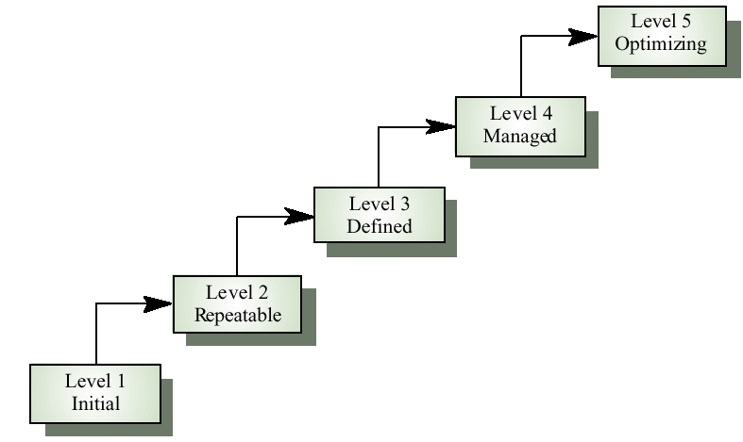
The SEI process maturity model

Slide 59
Maturity model levels
Initial
Essentially uncontrolled
Repeatable
Product management procedures defined and used
Defined
Process management procedures and strategies defined and used
Managed
Quality management strategies defined and used
Optimising
Process improvement strategies defined and used

Slide 60
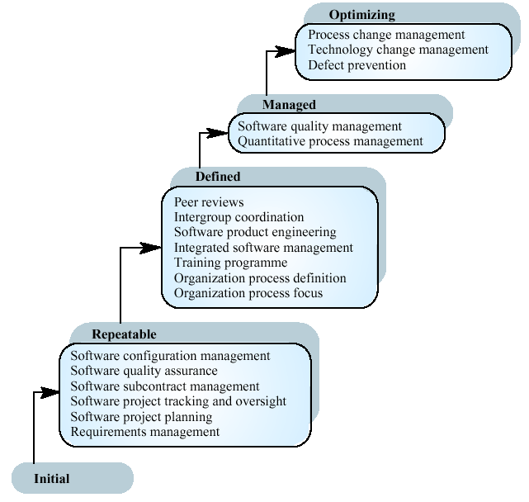
Key process areas

Slide 61
SEI model problems
It focuses on project management rather than product development.
It ignores the use of technologies such as rapid prototyping.
It does not incorporate risk analysis as a key process area
It does not define its domain of applicability

Slide 62
The CMM and ISO 9000
There is a clear correlation between the key processes in the CMM and the quality management processes in ISO 9000
The CMM is more detailed and prescriptive and includes a framework for improvement
Organisations rated as level 2 in the CMM are likely to be ISO 9000 compliant

Slide 63
Capability assessment
An important role of the SEI is to use the CMM to assess the capabilities of contractors bidding for US government defence contracts
The model is intended to represent organisational capability not the practices used in particular projects
Within the same organisation, there are often wide variations in processes used
Capability assessment is questionnaire-based

Slide 64
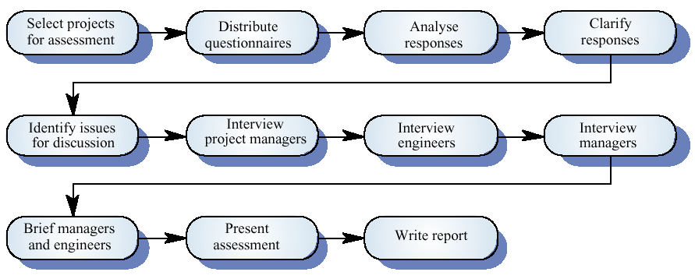
The capability assessment process

Slide 65
Process classification
Informal
No detailed process model. Development team chose their own way of working
Managed
Defined process model which drives the development process
Methodical
Processes supported by some development method such as HOOD
Supported
Processes supported by automated CASE tools

Slide 66
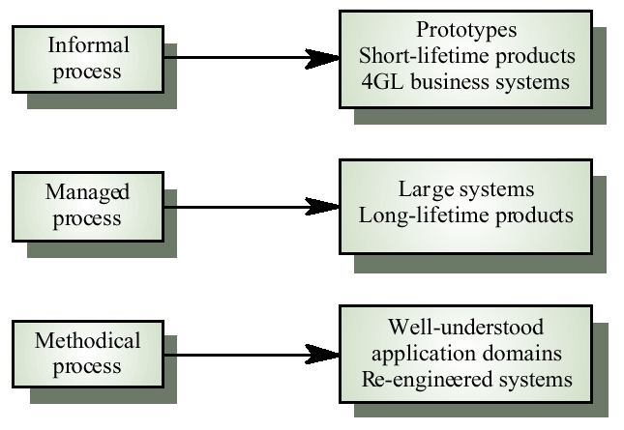
Process applicability

Slide 67
Process choice
Process used should depend on type of product which is being developed
For large systems, management is usually the principal problem so you need a strictly managed process. For smaller systems, more informality is possible.
There is no uniformly applicable process which should be standardised within an organisation
High costs may be incurred if you force an inappropriate process on a development team

Slide 68
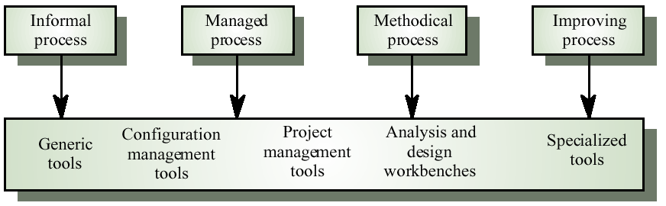
Process tool support

Slide 69
Key points
Process improvement involves process analysis, standardisation, measurement and change
Process models include descriptions of tasks, activities, roles, exceptions, communications, deliverables and other processes
Measurement should be used to answer specific questions about the software process used
The three types of process metrics which can be collected are time metrics, resource utilisation metrics and event metrics

Slide 70
Key points
The Software Engineering Institute (SEI) model classifies software processes as initial, repeatable, defined, managed and optimising. It identifies key processes which should be used at each of these levels
The SEI model is appropriate for large systems developed by large teams of engineers. It cannot be applied without modification in other situations
Processes can be classified as informal, managed, methodical and improving. This classification can be used to identify process tool support

