Slide 1

MUTUAL FUND ANALYTICS
Risk Modeling & Portfolio Optimization System
Capstone Project I — Bluestock Fintech
Presented by Priyansh Sharma

Slide 2




Problem & Strategic Objective
The Challenge
The Solution
Retail investors often focus on raw historical returns, ignoring underlying systemic risks and management inefficiencies that erode capital during market corrections.
An automated analytical ecosystem to audit 40 schemes using risk-adjusted metrics (Sharpe, Alpha, Beta) and composite scorecards for objective fund selection.

Slide 3

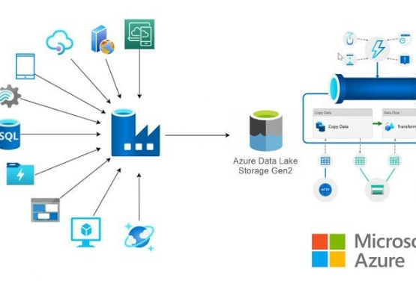
Data Ingestion Framework
Historical NAV: Trailing data from nav_history.csv
Benchmarks: Nifty 50 and Nifty 100 daily returns
Master Data: fund_master and scheme_sectors mapping
Live API: Dynamic ingestion via mfapi.in REST endpoints

Slide 4
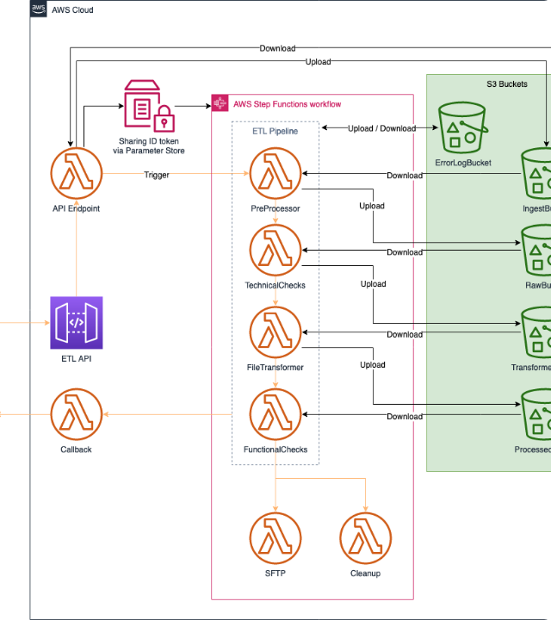
Pipeline Architecture
A robust ETL pipeline designed for scalability and data integrity:
Extraction: Memory-safe chunked loading of large financial history arrays.
Transformation: Automated cleaning, outlier detection, and return vectorization.
Modeling: Relational Star-Schema mapping for efficient cross-category queries.

Slide 5
EDA: Industry Scale Analysis
₹81L
₹31K
26.1M
Total Industry AUM (Cr)
Monthly SIP Inflows (Cr)
Active Investor Folios
Insights: SBI AMC dominates market share with ₹12.5L Cr AUM, while thematic funds show highest growth velocity.

Slide 6
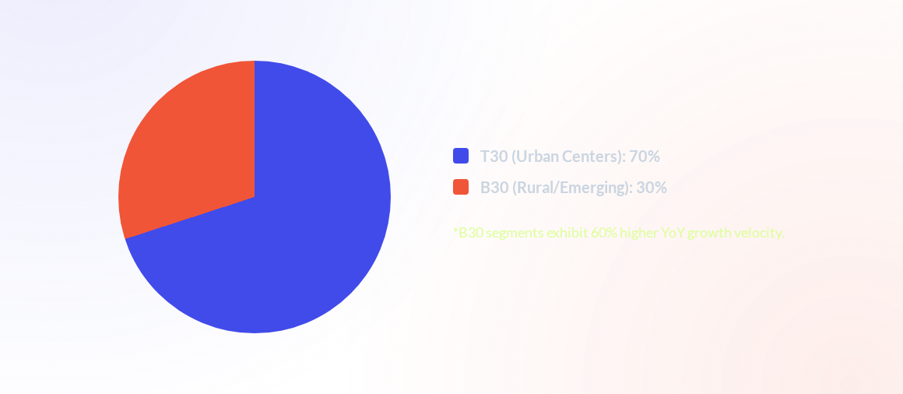
EDA: Geographic & Demographic Mix

Slide 7



Risk-Adjusted Performance Models
Sharpe Ratio
CAGR
Measures excess return per unit of total risk using 6.5% risk-free rate.
Smoothed annualized growth rate across multi-year evaluation horizons.

Slide 8
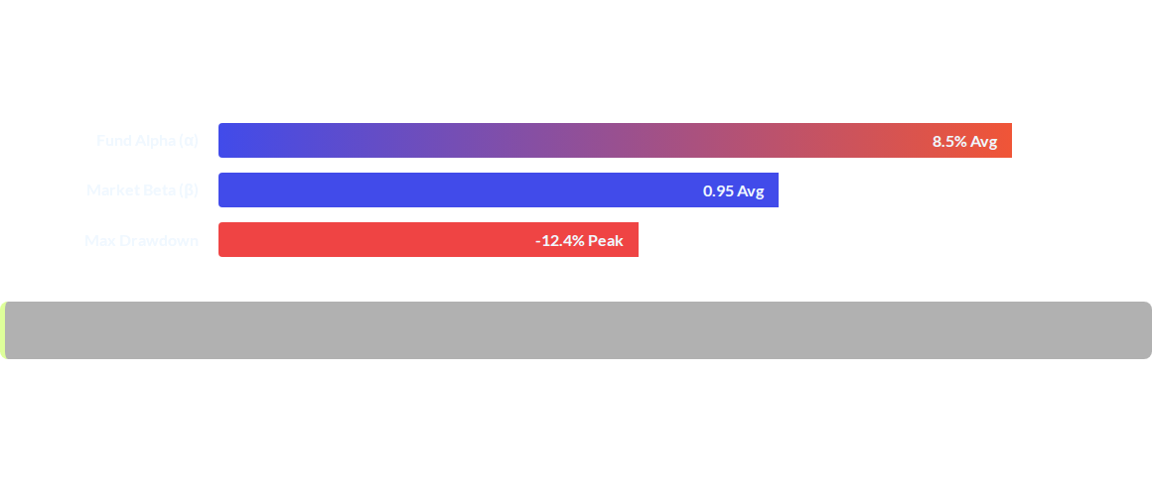
Systemic Risk Registry

Slide 9

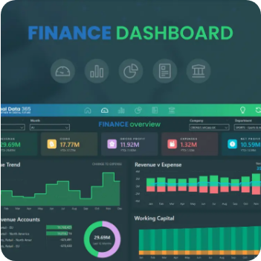
Dashboard: Industry Intelligence
Macro Insights
The first interface delivers high-level KPI visibility for the C-Suite, tracking aggregate capital migrations and market share dominance in real-time.
Real-time SIP Milestone tracking
Interactive AMC Market Slicers

Slide 10
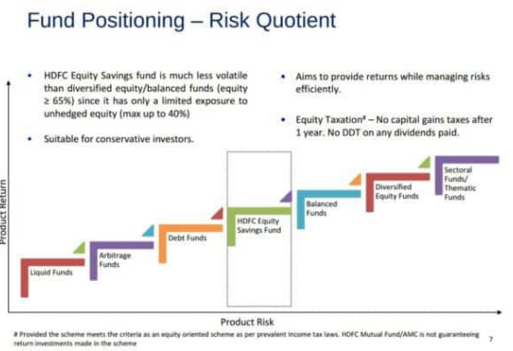
Dashboard: Performance Sandbox
Risk-Reward Profiling
An interactive scatter-plot environment for analysts to identify high-efficiency managers.
•
X-Axis: Annualized Return
•
Y-Axis: Total Volatility
•
Bubble Size: Fund AUM Magnitude
*Allows for benchmark-specific alpha auditing.

Slide 11
Key Findings & Strategy
CRM Churn Protocol: Subscription gaps > 35 days trigger a 60% escalation in cancellation risk; proactive re-engagement required at Day 25.
HHI-Based Allocation: Enforce strict 0.25 HHI caps to protect portfolios against idiosyncratic sector volatility.
B30 Market Vector: Redirect digital acquisition capital to Tier-2/3 segments where retail micro-investing growth is highest.
Sortino-Centric Ranking: Prioritize downside-variance metrics in scorecards to avoid penalizing growth-driven upside volatility.

Slide 12

Questions?
Thank you for your attention
github.com/priyanshsharma2/mutual_fund_analytics
contact@bluestock.in

