Slide 1

APPLICATION OF MACHINE LEARNING IN COGNITIVE LOAD DETECTION AND ANALYSIS OF MENTAL STATES USING BRAINWAVES
PRIYANSH SINGH
210775
priyanshs21singh@gmail.com

Slide 2
Problem statement
TRACK 1:Design and train a ML model to predict the cognitive states of the subjects.
TRACK 2:Analyse the relation between various brainwaves frequencies and the various cognitive states (focused , unfocussed, or drowsy) .
TRACK 3:Analyse the relation between the brainwaves and their dominant locations in brain.

Slide 3
Dataset and repository
For this, a public dataset was utilised. It was made up of five subjects' combined 25-hour EEG records while they were performing a low-intensity control task. The task involved utilising the "Microsoft Train Simulator" programme to steer a computer-simulated train. In each trial, participants used the aforementioned computer simulation programme to operate a train for 35 to 55 minutes over a largely featureless course. The three mental states that were looked at in this study were passive but focused attention (0–10 minutes of job), alert but unfocused (10–20 minutes of task), and drowsy (20– 30 minutes of task).
Link for the repository:::
https://drive.google.com/drive/folders/1r3_Z0q7PVbn073B3-m5pxr2i8DS5mpZ6?usp=sharing

Slide 4
Basic Pre-processing
Noisy channels and channels with little to no signal range were ignored.(7 channels out of the 14 were relevant.
The data was splitted into three parts :: focused state(0-10 min) of each day experiment,unfocussed state(10-20 min) ,drowsy state(20-30 min).
Removing the days with unuseful data finally each state above had 5 days data for first 3 subjects and 4 days for next 2 subjects.
The following days belonged to each user:
Subject 1: 3,4,5,6,7(1 and 2 ignored)
Subject 2:10, 11, 12, 13, 14(9 and 8 ignored)
Subject 3: 17,18,19,20,21(15 and 16 ignored)
Subject 4: 24,25,26,27(22 ,23 and 28 ignored)
Subject 5 :31,32,33,34(29,30,35 ignored)
Thus ,Overall each state had 23 files of eeg data.
The data was pre-processed by using butterworth highpass filter(of 5th order and high pass of 0.16hz).
.

Slide 5
Task 1
We used the data after basic pre-processing to perform our task 1 of cognitive states identification for which a pipeline of STFT (Blackman window) was employed for further data processing.
The EEG data is very user specific and to test the model for a user on which the model was never trained give very low accuracies.
So,we followed two paradigms
1) we trained and tested on same subjects individually giving the following test accuracies for each subject using SVM model. Subject 1(92.5%),subject 2(94.5%),subject 3(92.5%),subject 4(95.85%),subject 5(92.6%).
2) we trained and tested on combined user data of all 5 users.There 4 models were compared –SVM(support vector machine)-linear, SVM-RBF(Radial basis function), KNN(K-nearest neighbours), and decision trees ;with SVM-RBF, and KNN performing the best. Each had the following test accuracies:SVM-linear(73.34%),SVM-RBF(93.12%),KNN(94.31%),Decision Trees(84.95%).

Slide 6
Task 2 and 3
Then for the task 2,3 ,the previous data was passed through a pipeline of FFT and Kmeans clustering to extract the % of alpha ,low- beta, theta frequencies in various mental states.
The frequencies of all the days of a single user were plotted for a particular state.
Overall 7 electrodes were used: names according to the 10-20 system:
[ 'F7', 'F3', 'AF4’]-Frontal channels
['P7', 'P8’,]-Parietal channels
['O1', 'O2’,]-Occipital channels

Slide 7
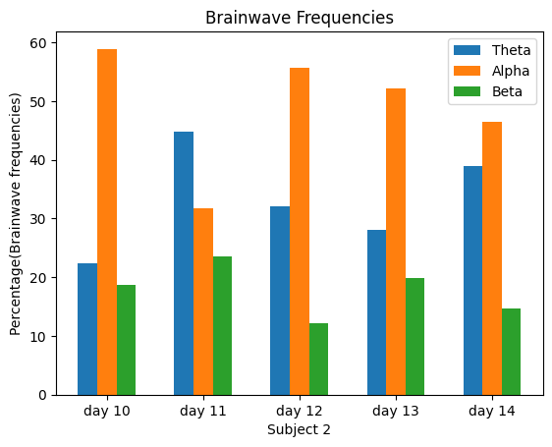
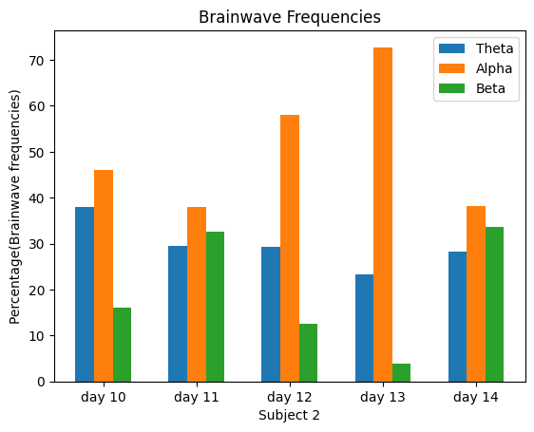
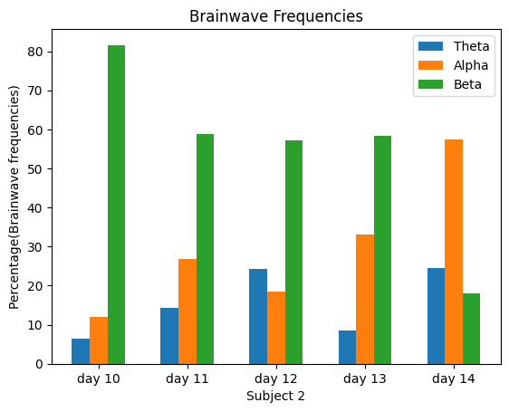
Brainwaves frequencies spectrum over mental states(Using all channels)
Drowsy state
Unfocus state
Focus state
Drowsy state is marked by high presence of theta and alpha waves. While unfocus state show a mixture of all but slightly increased beta waves than drowsy state.while the focus state shows the highest presence of beta waves.

Slide 8
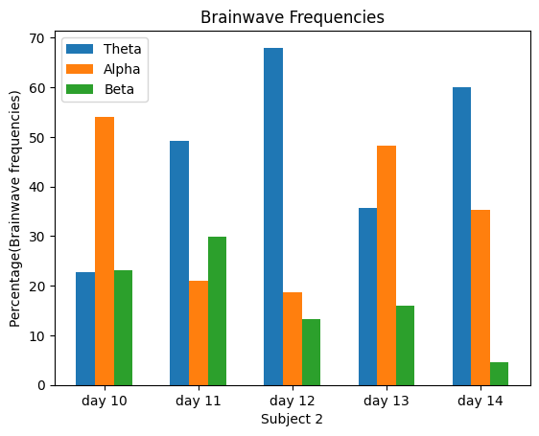
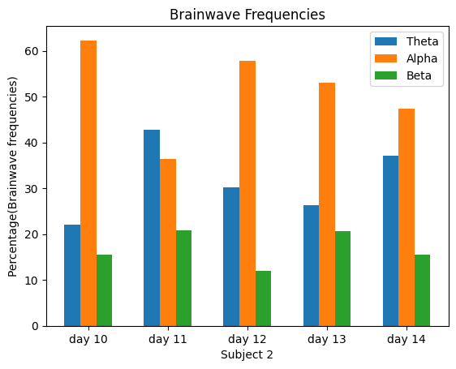
Alpha waves frequencies spectrum over Brain lobes
Frontal electrodes(F7,F3,AF4)
Pareital and occipital (P7,P8,O1,O2)
The given two plot are for drowsy states of subject 2.Left plot uses only Frontal electrodes while the right one uses Pareital and occipital electrodes.We can infer that the presence of the alpha waves(orange ) is significantly high in the parietal and occipital lobes of brain.

Slide 9
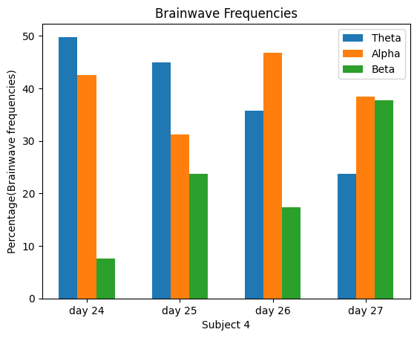
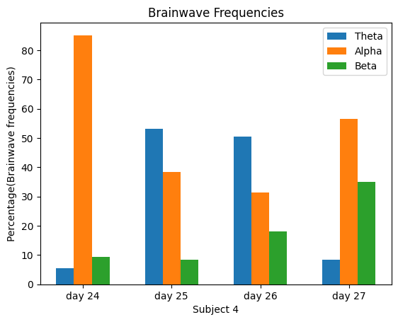
Beta waves frequencies spectrum over Brain lobes
Frontal electrodes(F7,F3,AF4)
Pareital and occipital (P7,P8,O1,O2)
The given two plot are for unfocus states of subject 4.Left plot uses only Frontal electrodes while the right one uses Pareital and occipital electrodes.We can infer that the presence of the low-beta waves(green ) is significantly high in the frontal lobes of brain.

Slide 10
Contributions & Learnings
The task 1 of cognitive load detection was pre-decided from the proposal but the task 2 was suggested by my mentor(Ms. Swathi Pratapa).She also cleared some of my doubts in the pre-processing of task 1 code. I came upon and decided to work on task 3.
All the work is my own.I even worked on a task 4 which was to predict the schizophrenic patients from a different public dataset on eeg signals of healthy patients and schizophrenic patients.
I searched various datasets and codes , learned to apply various new things, and got hands on new concepts.

Slide 11
Next set of actions
Emotion state detection.
working on functional linkages

