Slide 1


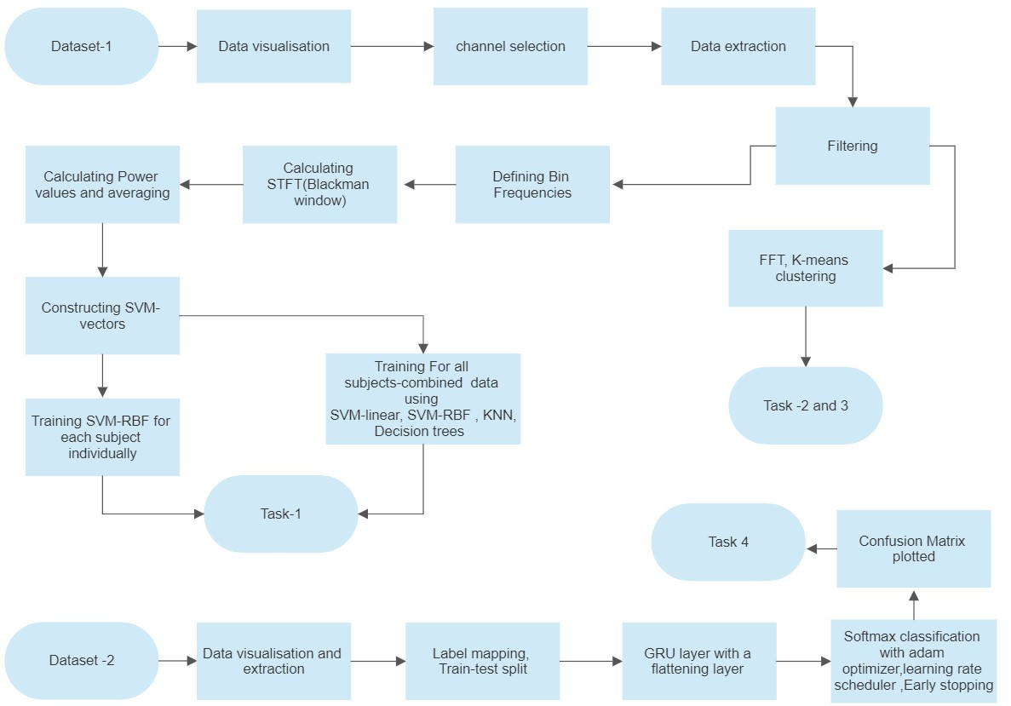
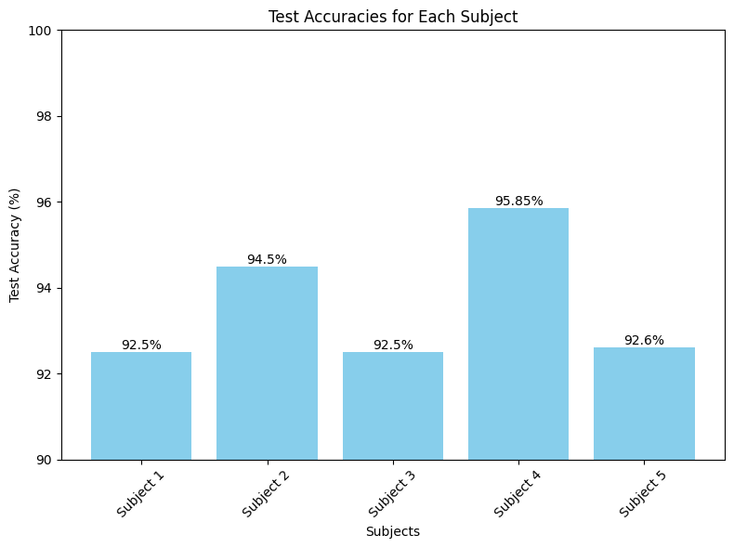
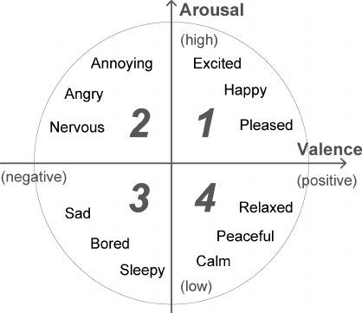
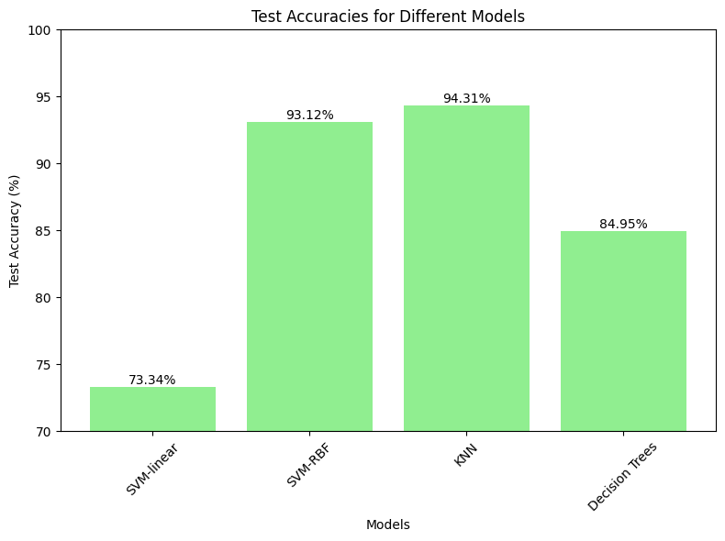
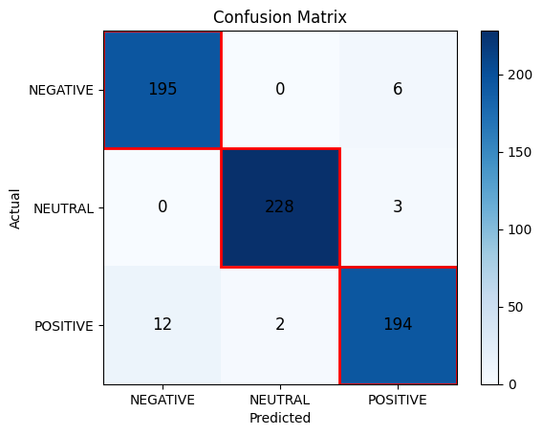
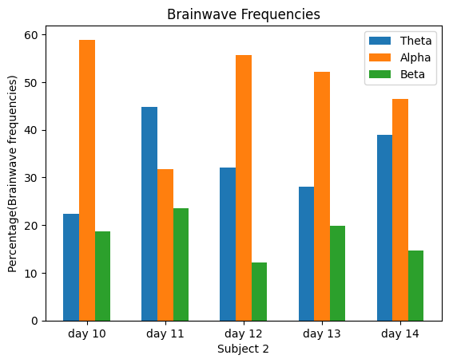
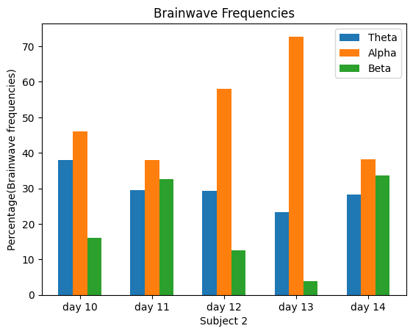
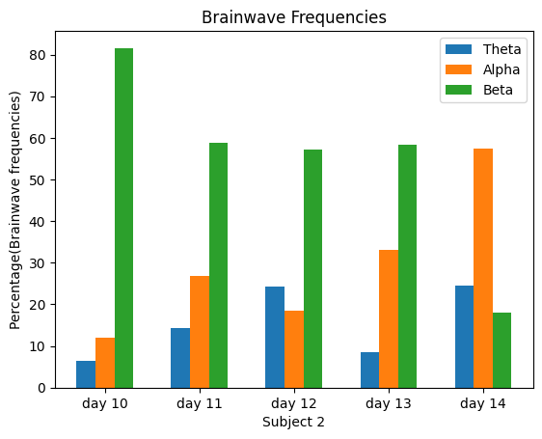
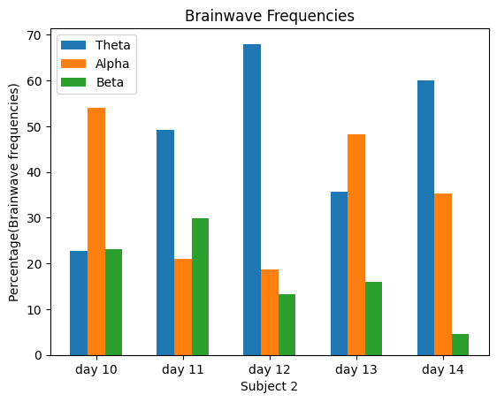
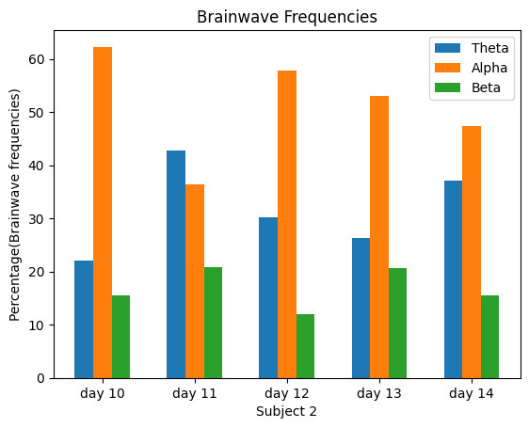
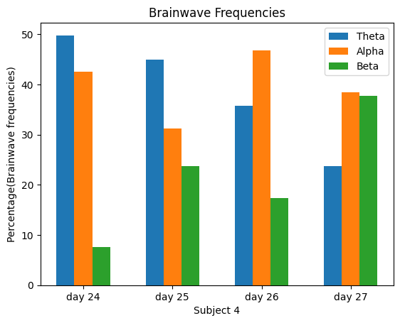
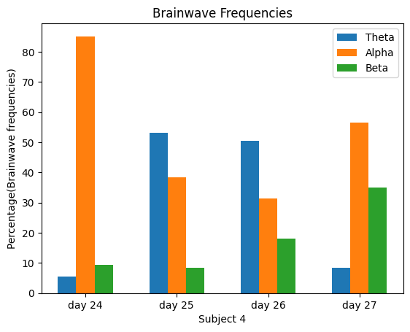
EEG-Based Analysis of Cognitive States and Emotional Valence: Predictive Modelling, Brainwave Frequencies, and Dominant Brain Locations
Priyansh Singh, Department of Chemical Engineering ,IIT Kanpur
Mentor: Prof. Tushar Sandhan ,Department of Electrical Engineering ,IIT Kanpur
1. ABSTRACT
2. INTRODUCTION
This report presents a comprehensive investigation into the analysis of cognitive states and emotion valence using electroencephalogram (EEG) data. The study encompasses four distinct tracks aimed at gaining insights into the prediction of cognitive states, exploring the relationship between EEG-based brainwave frequencies and cognitive states, examining the association between brainwaves and their dominant locations in the brain, and predicting emotion valence states using EEG data.
Track 1:A public dataset made up of five subjects’ combined 25-hour EEG records while they were performing a low-intensity control task, was utilized. The task involved utilizing the "Microsoft Train Simulator" program to steer a computer-simulated train. A pipeline consisting of a Butterworth high pass filter and an STFT (Blackman window) was employed for data pre-processing. The model utilized features extracted from the EEG signals captured during focused, unfocused, and drowsy states. .Finally, 4 models were compared –SVM-linear, SVM-RBF, KNN, and decision trees. The model achieved best final accuracy of 94.31 %.
Track 2: This track focused on analyzing the relationship between EEG-based brainwave frequencies and their varying presence in different cognitive states. Same dataset of track 1 was used .Through spectral analysis of EEG data, distinct patterns of brainwave frequencies associated with different cognitive states were identified, providing insights into attention, concentration, and drowsiness. “Focused” state was marked with dominant presence of the beta and alpha waves . “Unfocused” state had decreased presence of the beta waves with increasingly dominant alpha and theta waves. “drowsy” state had huge presence of the theta waves.
Track 3 : In this track ,the investigation explored the association between EEG- based brainwaves and their dominant locations in the brain. The dataset of track 1 was used for this purpose. Presence of the alpha waves was found significantly high in the parietal and occipital (P7,P8,O1,O2) lobes of brain. Similarly, presence of the low-beta waves was found significantly high in the frontal (F7,F3,AF4) lobes of brain.
Track 4: A different EEG dataset was utilized for emotional valence prediction. The data was collected from two people (1 male, 1 female) for 3 minutes per state -positive, neutral, negative . Stimuli to evoke the emotions were given in the form of visual movie clips marked as positive and negative. This was used to predict emotion valence as positive, negative, or neutral based on the EEG patterns. The results demonstrated the feasibility of using EEG data for emotion valence prediction, providing valuable insights into the neural correlates of emotions.
Track-1:Neuroscience has proved that continuous exposure to mental load may affect the brain dynamics . These variations are reflected in the electroencephalography (EEG) signal. Therefore, analysis of EEG signals is often utilized for cognitive load recognition .EEG represents the electrical activity of brain that varies if there is any change occurs in the input conditions .Detecting mental state changes in human individuals who need to remain dormant or passive while also having to maintain a continuous significant level of concentration or attention is the problem of the day. An example of such a scenario can be supervising automated processes or systems. In all these cases, non-interfering supervision of processes is desired, while also alertness and a quick reaction is required of the involved individuals. With this study, we aimed to demonstrate that it is possible to identify pure mental states such as engaged and focused attention versus detached and unfocused monitoring from EEG data .
Track-2:The various cognitive states of brain are marked by presence of spectrum of various brainwave frequencies. Brainwaves are divided into delta (0–4 Hz), theta (4–8 Hz), alpha (8–12Hz), low beta (12–16 Hz), high beta (16–25 Hz), and gamma (25–50 Hz) waves, depending on their frequency. The intensity of brainwaves varies according to the state of human mental activity, and the degree of human cognitive load can be estimated based on this measurement. Theta waves are present in deeply relaxed , inward focused state with delta waves being prevalent in sleep state. Alpha waves appear mainly in relaxed with passive attention, beta waves appear in problem solving, and gamma waves appear mainly in more complex mental functions.
Track-3:Presence of the alpha waves are found significantly high in the parietal and occipital lobes of brain. Thus , the EEG electrodes in that locations show dominant presence of alpha waves .Similarly, presence of the low-beta waves is significant in the frontal lobes of brain .
Track-4:Emotion is a complicated condition that expresses human awareness and is described as a reaction to environmental stimuli . Emotions are, in general, reactions to ideas, memories, or events that occur in our environment. Russell’s 2D emotion model is used most frequently. The vertical axis represents the arousal dimension (expressing the emotional intensity of the experience, ranging from low to excitement), and the horizontal axis represents the valence dimension (showing the degree of cheerfulness or joy, ranging from negative to positive). There are four categories of emotions in the arousal-valence coordinate system. The negative emotions are represented on the left side of the coordinate and the positive emotions are shown on the right. The valence axis represents both positive and negative emotions, and the arousal axis varies from inactive to active emotions(intensities).Emotional valence detection can help in detecting depression and other mental problems in patients.
3. METHODOLOGY AND IMPLEMENTATION
TRACK 1
TRACK 4
TRACK2
Drowsy
Unfocused
Focused
4. RESULTS AND CONCLUSION
Training and testing on same subjects individually gave the following test accuracies for each subject using SVM-RBF. Subject 1(92.5%),subject 2(94.5%),subject 3(92.5%),subject 4(95.85%),subject 5(92.6%). While training and testing on combined user data of all 5 users gave the following test accuracies: SVM-linear(73.34%),SVM-RBF(93.12%),KNN(94.31%),Decision Trees(84.95%).
Drowsy state is marked by high presence of theta and alpha waves. While unfocussed state show a mixture of all but slightly increased beta waves than drowsy state . while the focus state shows the highest presence of beta waves.
The presence of the alpha waves is significantly high in the parietal and occipital lobes of brain . The presence of the low-beta waves is significantly high in the frontal lobes of brain.
The model for emotional valence detection gave an average accuracy of 96% on predicting the valence states.
TRACK3
5. REFERENCES
[1] Distinguishing mental attention states of humans via an EEG-based passive BCI using machine learning methods.BY- ÇigdemInan Acı, Murat Kayaa , Yuriy Mishchenko
[2] Prediction of Cognitive Load from Electroencephalography Signals Using Long Short-Term Memory Network .BY-Gilsang Yoo,Hyeoncheol Kim and Sungdae Hong
[3] Mental arithmetic task load recognition using EEG signal and Bayesian optimized K-nearest neighbor. Lakhan Dev Sharma1 • Himanshu Chhabra2 • Urvashi Chauhan3 •Ritesh Kumar Saraswat2 • Ramesh Kumar Sunkaria
[4] Mental Emotional Sentiment Classification with an EEGbased Brain-Machine Interface ,Jordan J. Bird,Anikó Ekárt,Christopher D. Buckingham,Diego R. Faria
Drowsy state using Frontal channels (F7,F3,AF4)
Drowsy state using Parietal and occipital channels (P7,P8,O1,O2)
Unfocussed state using Frontal channels (F7,F3,AF4)
Unfocussed state using Parietal and occipital channels (P7,P8,O1,O2)

