Slide 1
On-chip DDR4 memory controller design
EE492 : B.Tech. Project - II
Priyansh Singh 22B1856
Guide: Prof. Laxmeesha Somappa
IIT Bombay

Slide 2
Objective – Digital design
Building an on-chip digital circuit for a DDR4 SDRAM memory controller
Takes Simple memory read/write commands from the CPU
Handles DDR4 complexity and maintains bank status for Precharge, Activation, Refresh, Calibration and Configuration requirements along with read/write handling
Essentially hides DDR4 SDRAM specs from the CPU for simpler access

Slide 3
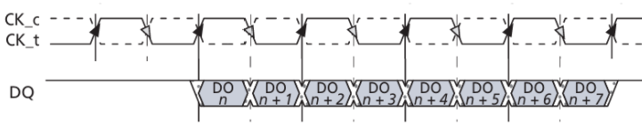
DDR functionality
DDR (Double Data Rate) is a type of an SDRAM device. The term “double data rate” indicates data transfers at both edges of the clock.
It is configured in a hierarchically addressed structure. The top level of this hierarchy is the “Rank”, within which multiple “Bank Groups” are found. Each “Bank Group” consists of multiple “Banks”. Each Bank is an array of “1T1C” cells.
This 1T1C cell holds data in a capacitor and the transistor is a switch to access this data. Due to leakage, these capacitors need to be periodically “Refreshed”.
Read/write operations require the bitlines in the array to be precharged to Vdd/2 and turning on the transistors in a row perturbs the bitline voltage which is amplified by a positive feedback circuit called the “Sense amplifier”.
Source: Micron DDR4 Specification

Slide 4
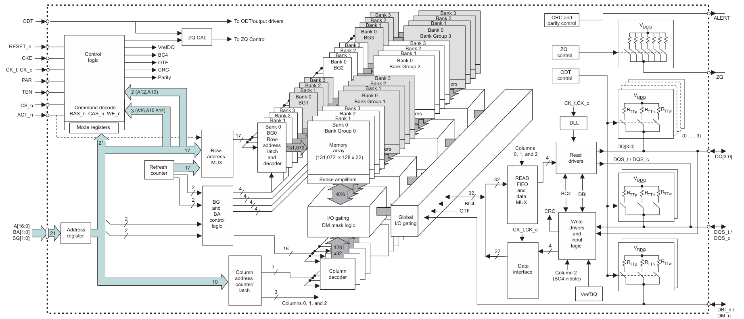
DDR4 Block diagram (2Gig x4 configuration)
Source: Micron DDR4 Specification

Slide 5
Design Specifications
MEMORY SPECIFICATION
The primary design and testing of the controller was done with the following memory specifications:
Configuration: x4 – 4 data lines (DQ)
Chip Density: 2Gb
Clock Frequency: 800MHz
Single chip configured as one rank in the RAM
ADDRESS TRANSLATION
32 bit data – 8 consecutive physical addresses each storing 4 bits
ROW BUFFER MANAGEMENT
Open page policy

Slide 6
Memory controller description
CPU
Controller FSM
(Digital design)
Datapath (PHY)
(Digital)
DDR4
Datapath (PHY)
(Analog)

Slide 7
Controller FSM
0.INIT0
1.INIT1
2.INIT_MRS
3.INIT_ZQ
4.WAIT
Waits (for t_spec) for memory
Return to spec. state after spec. delay
8.REFRESH
5.IDLE
Talks to CPU
Refresh check
Bank Status
7.WRITE
6.READ

Slide 8
Refresh interval
What makes DRAM “Dynamic” is the fact that the capacitors need to be recharged periodically to account for data fade due to leakage. This is the “Refresh” functionality.
This has to be done at intervals of T_{REFI}. However, in case of clashes between CPU read/write and refresh interval, CPU commands can be given precedence for up to 9* T_{REFI}, after which Refresh must be performed.

Slide 9
Optimizations for Read/Write
The controller follows an open-page row-buffer management policy – keeping the rows open for read/write rather than precharging right away.
This was decided as our system is built only for one CPU, so a high locality in memory references can be assumed.
Another optimization involves keeping the status of the memory banks stored based on previous transactions. This leads to three cases, in an increasing order of severity:
CASE 1: Row addressed by the current command is already open => Controller issues a Read/Write right away.
CASE 2: Bank addressed by the current command is precharged => Controller issues an Activate command.
CASE 3: A Different Row addressed is open in the addressed bank => Controller issues a Precharge followed by an Activate.

Slide 10
Address translation
The 32-bit CPU sends the 32 bits of data to the controller together.
Since the DQ bus is 4 bits wide, data transfer is done in bursts of 8.
This coincides with the burst mechanism of DDR read/write operations.
CPU
DDR4
DDR4
DDR4
BG = 2
BA = 3
Address = [2][3][2][0]
Data = 8’h50505050
Column address:
0 1 2 3 4 5 6 7
32
0
1
2
3
Controller
Data:
0 5 0 5 0 5 0 5
4
n

Slide 11
Controller testing
DIRECT PINOUT TESTING
The first set of tests involved Modelsim simulations for verification of the control pins.
After verification, we moved to testing with a Verilog memory model.
MEMORY MODEL TESTING
We used Micron’s DDR4 Verilog memory model for testing with Modelsim simulations.
We have built a digital datapath for data transfers on the DQ lines and driving the DQS strobe lines.
The initialization sequence works correctly – initializing the memory, performing calibrations and setting the DRAM mode registers.
Read/Writes are also working as intended.

Slide 12
Memory model testing - initialization
Modelsim simulation transcript
# tb.default_period at time 0.0 ns: INFO: Default Clock Period to TS_1250 (1250 ps)
# Model:Cleared MemoryArray @0.0 ns
# Setting Timeset:TS_1250 with tCk:1250 @3.1 ns
# Setting Timeset:TS_1250 with tCk:1250 @5.6 ns
# Forcing model configuration
# Controller State = init0, time = 7.5 ns
# Controller State = init1, time = 210.0 ns
# Controller State = init_mrs, time = 312.5 ns
# TB issues first MRS at 1229.4 ns
# MRS1 IN CONTROLLER AT TIME = 1235.0 ns
# Controller State = init_mrs, time = 1236.3 ns
# MRS2 IN CONTROLLER AT TIME = 1267.5 ns
# Controller State = init_mrs, time = 1268.8 ns
# MRS3 IN CONTROLLER AT TIME = 1300.0 ns
# Controller State = init_mrs, time = 1301.3 ns
# MRS4 IN CONTROLLER AT TIME = 1332.5 ns
# Controller State = init_mrs, time = 1333.8 ns
# MRS5 IN CONTROLLER AT TIME = 1365.0 ns
# Controller State = init_mrs, time = 1366.3 ns
# MRS6 IN CONTROLLER AT TIME = 1397.5 ns
# Controller State = init_mrs, time = 1398.8 ns
# MRS7 IN CONTROLLER AT TIME = 1430.0 ns
# Controller State = init_mrs, time = 1431.3 ns
# tb.golden_model.<protected>.<protected>:Initialization complete @1431.3 ns
# TB issues Precharge at 1448.1 ns
# TB issues ZQ at 1463.1 ns, increased waiting from 1024 to 1040
# Controller State = init_zq, time = 1463.8 ns
# Controller State = init_zq, time = 1480.0 ns
# Controller State = idle, time = 2762.5 ns
Memory model displays this on successful
completion of initialization

Slide 13
Memory model testing – Read/Writes
Testing:
(address = [Bank Group][Bank address][Row][Column])
WRITE : address = [2][3][0][0] data = 8’h12345678 CASE 2
WRITE : address = [2][3][0][0] data = 8’h50505050 CASE 1
WRITE : address = [2][3][2][0] data = 8’h50505050 CASE 3
WRITE : address = [2][2][2][0] data = 8’h89abcdef CASE 2
READ : address = [2][3][0][0] CASE 3
READ : address = [2][3][2][0] CASE 3
READ : address = [2][2][2][0] CASE 1
The Modelsim simulation transcripts have been uploaded on the documentation drive

Slide 14
Summary - Tasks done (1/2)
Modules
DDR4_cont: The main controller module FSM that performs the operations and controls the data path. Designed using DDR4 timing specs.
Datapath: Drives the DQ and DQS lines for writes to the memory and samples these lines for reads from the memory.
Debugging/New features
Mode register value adjustments for the assumed model specs.
Added a controller ready bit and command register functionality. The command register stores the latest unserved CPU command. This register can be made into a queue as well for queuing and scheduling functionalities.
tWR & tRTP (Recovery): Govern the issuing of precharge immediately after read/write commands – there has to be a time gap before precharge – useful for refresh and CASE 3 read/write.
Tested all cases for recovery – W--W/R/Refresh, R--W/R/Refresh

Slide 15
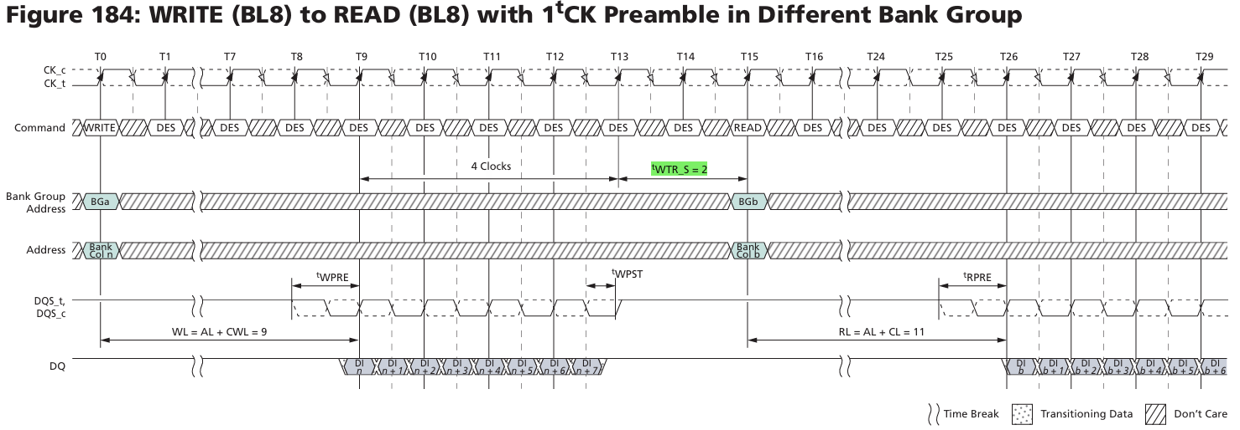
Summary - Tasks done (2/2)
Debugging/New features
tWTR_L/S: Write to Read timing constraint – tWTR_L for same bank group and tWTR_S for different bank groups.
Driving shared lines: Added tristate functionality for shared lines – DQ, DQS – these are driven by both, the controller and DDR sides – the module not driving the line sets the line to High Z for the other module to drive it.

Slide 16
References & Project Repository
https://github.com/priyanshsingh1765/DDR4_SDRAM_Contoller
Project GitHub repository
EE492 – OneDrive
Project drive folder
https://in.micron.com/search-results?&activeTab=search-tech-docs
Micron DDR4 Verilog simulation model
https://youtu.be/7J7X7aZvMXQ?si=_BlvQHyWFMEiSphZ
For DRAM basics
https://www.mouser.com/datasheet/2/671/Micron_05092023_8gb_ddr4_sdram-3175546.pdf?srsltid=AfmBOooknNrnQ-ZQcWp1XN1gYvKwkCZpKJ7HuCSPsIsDoUlWzrAQltqR
Micron DDR4 specification
https://www.systemverilog.io/design/understanding-ddr4-timing-parameters/
DDR4 timing parameters

