Slide 1


Slide 2

CONTACT MANAGEMENT SYSTEM
BY:
Bipesh Paudel
Priyanshu Kushawaha
Sushmita Lama
Taweshal Dev Thakur

Slide 3

Table of Contents
Introduction
Project Description
Objectives
Problem Statement
Advantages of CMS
Working Principle
Algorithm
Flowchart
System Methodology
Future Scope
Conclusion

Slide 4



Introduction
In today's interconnected world, managing contact information efficiently is more critical than ever. We introduce you to the concept of a Contact Management System (CMS).
CMS is a specialized software solution designed to simplify contact-related tasks and activities. It is highly relevant in our modern era, where individuals and organizations maintain extensive networks of contacts, including clients, colleagues, suppliers, and personal connections.
This presentation aims to provide a comprehensive understanding of CMS, including its key objectives, functionalities, and benefits.

Slide 5

Project Description
A contact management system in C is a software application designed to efficiently store, organize, and manage contact information, including names, phone numbers, email addresses, and more. This system enables users to add, edit, delete, and search for contacts, providing a user-friendly interface for seamless contact management.

Slide 6

Objectives
The primary objectives of a Contact Management System (CMS) are to simplify and optimize contact-related tasks and activities. Here are the key objectives of a CMS:
Efficient Contact Management
Data Accuracy
Quick Access
Improved Communication
Customization
User-Friendly Interface

Slide 7


Problem Statement
Here are some of the problem statement for Contact Management System:
Challenge: Managing a growing network of diverse contacts is increasingly challenging for individuals and organizations.
Data Overload: Contacts include clients, colleagues, suppliers, and personal connections, leading to data overload and potential errors.
Inefficiency: Traditional contact management methods, like paper-based systems or fragmented digital tools, are often inefficient.
Data Accuracy: Ensuring data accuracy, security, and accessibility across various devices and platforms is essential.

Slide 8

Advantages Of CMS
A contact management system (CMS) offers several advantages for individuals and organizations:
Efficient Organization
Time-Saving
Improved Communication
Centralized Data
Customization
Data Security

Slide 9

Working Principle
The working principle of a Contact Management System (CMS) involves a series of steps and processes. Here's an overview of the working principle of CMS:
Data Input
Data Storage
Data Editing
Customization
Accessibility
User Interface (UI)

Slide 10
Algorithm
Step 1: Start.
Step 2: : Login
Enter username and password
Step 3: Shows Main menu.
Step 4: For condition of menu program further shows option as:
    Add contacts
    Show available contacts
    Search contact
    Edit contact
    Delete contact
    Exit
Step 5: The program provides functions to run on the basis of options chosen by the user.
Step 6: If the user chooses option 6, the user is asked for confirmation.
Then if chosen to exit go to step 7.
Else go to step 3.
Step 7: Stop.

Slide 11
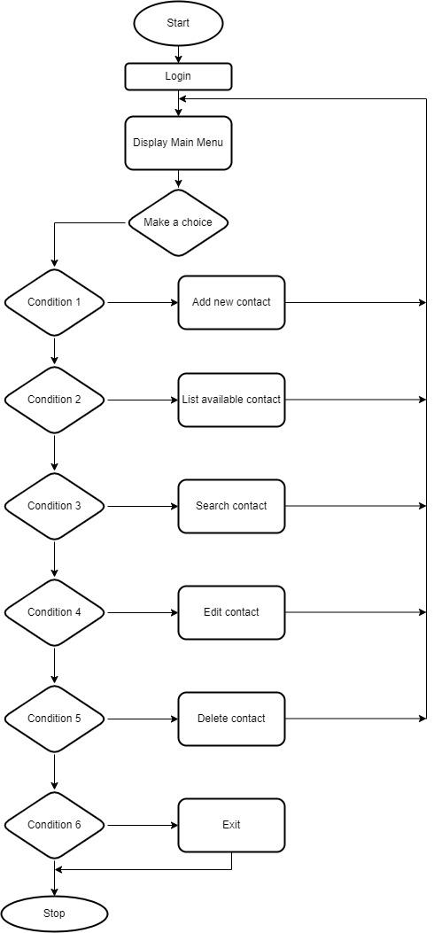
Flowchart

Slide 12
System Methodology
Waterfall approach was the first SDLC Model to be used widely in Software Engineering to ensure success of the project. In “The Waterfall” approach, the whole process of the software development is divided into separate phases. In this Waterfall Model, typically, the outcome of one phase acts as the input for the next phase sequentially. The phases of waterfall model are as follows:

Slide 13
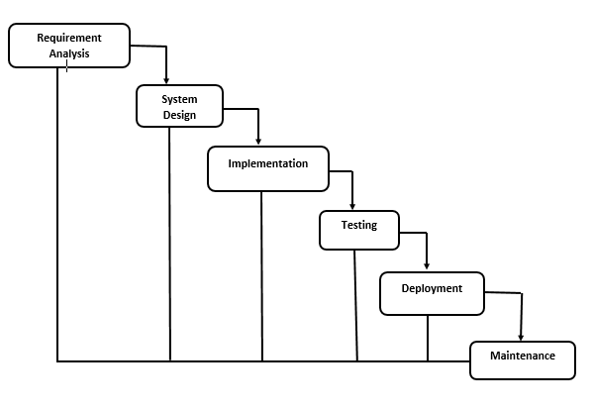
System Methodology

Slide 14

Future Scope
Advanced Data Analytics
Enhanced Integration
Data Privacy and Security
Voice and Natural Language Progressing
User Experience (UX) Design

Slide 15
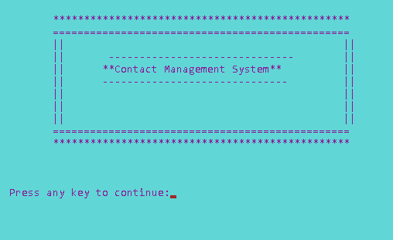
Screenshots
First Page:

Slide 16
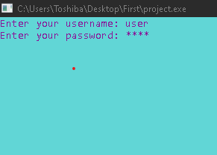
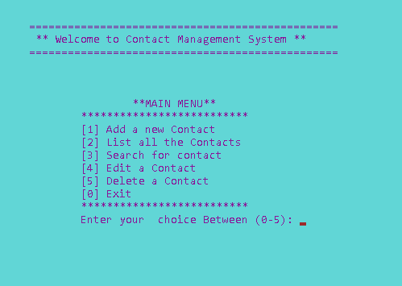
Login page:
Main Menu

Slide 17
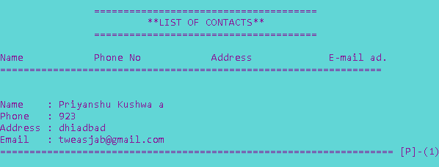
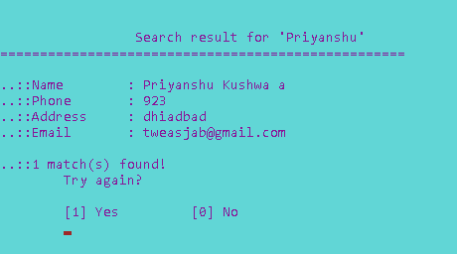
Listing Records Searching Contacts

Slide 18
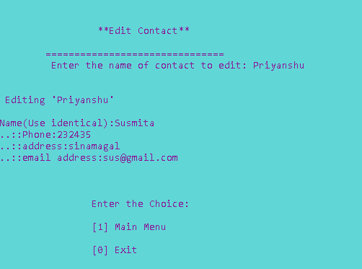
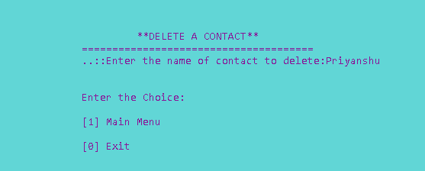
Edit a contact Delete Contact

Slide 19

DEMO

Slide 20

Conclusion
In conclusion, our project is only a humble venture to satisfy the needs to manage the project work. Several user-friendly coding have also been adopted. This package shall prove to be a powerful package in satisfying all the requirements of the school. The objective of software planning is to provide a framework that enables the manager to make reasonable estimates made within a limited time frame at the beginning of the software project and should be updated regularly as the project progresses.
We extend our heartfelt gratitude to you for your time and attention.

Slide 21
REFERENCES
Valuable insights and mentorship, guidance and feedback from Seniors, Friends and Teachers
https://youtu.be/irqbmMNs2Bo?si=-XJ2y39l_6rwHdhs
www.w3schools.com
www.sites.google.com/site/completelearning.com
www.sourcecodesworld.com
www.cprogramming.com
WWW.programiz.com

Slide 22


