Slide 1


UNSTABLE VITALS
Exercise safer - one rep at a time.

Slide 2
AGENDA
  Our Mission
  Products and Services
  Competitors
  Size of Market
  Our Future Path
  Revenue model

Slide 3
OUR MISSION
To revolutionize home rehabilitation by building an intelligent AI platform where mobility-impaired individuals can exercise safely, independently, and confidently. Our platform serves as a 24/7 guardian—combining real-time form correction, emotion detection, and instant fall alerts to guardians—ensuring patients stay safe while reclaiming their freedom to exercise without fear.

Slide 4


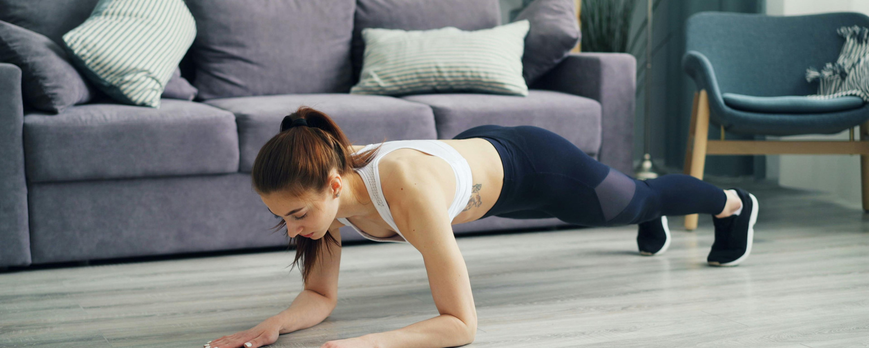
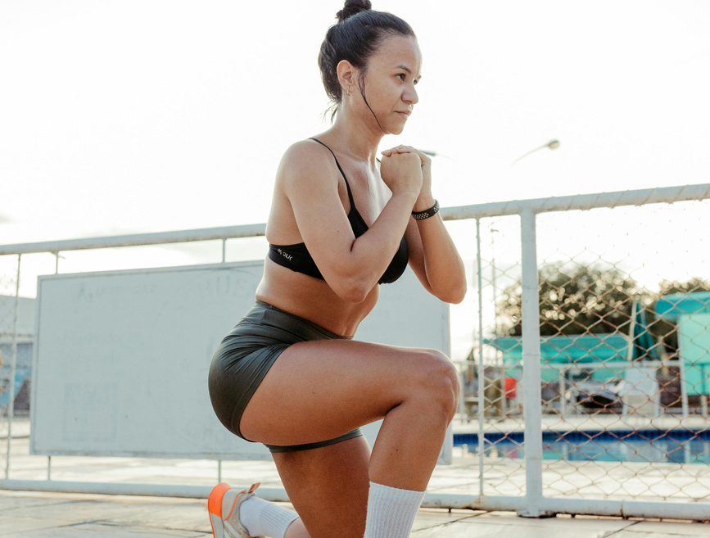

FEATURES
FORM POLICE
EMOTION READER
FALL DETECTIVE
DISAPPEARANCE TRACKER
→ Real-time exercise correction
→ Prevents injury before it happens
→ Detects pain/frustration
→ Sends encouraging messages
→ 20-second fall warning
→ Auto-alerts guardians
→ Alerts if person leaves frame
→ 20s countdown before emergency

Slide 5
SIZE OF MARKET
GLOBAL
The global telerehabilitation market is valued at $16.67 billion, growing at 13-15% annually. While competitors charge $2,400+ per user, a $30 billion gap exists for affordable solutions. Over 1 billion people with mobility limitations lack access to affordable physical therapy. AI Exercise Guardian fills this gap at ₹99/month, making safe, independent rehabilitation accessible to everyone.
INDIA
India's elderly and mobility-impaired population exceeds 200 million, with 80% unable to afford in-person physical therapy costing ₹2,000-5,000 per session. The telehealth market is expanding rapidly, yet no affordable solution exists for safe, independent home rehabilitation. AI Exercise Guardian captures this ₹5,000+ crore opportunity by delivering clinical-grade exercise monitoring at ₹99/month, making rehabilitation accessible across tier-2 cities where traditional PT services are unavailable.

Slide 6
OUR FUTURE PATH
M1
M2
M3
M4
M5
SMARTWATCH INTEGRATION
MULTIPLAYER CHALLENGES
VOICE COACH AI
HOSPITAL INTEGRATION
PREDICTIVE HEALTH AI
⌚ Connect Apple Watch, Fitbit, Garmin
❤️ Real-time heart rate during exercises
📊 Log vitals with session data
🚨 Advanced fall detection (accelerometer)
Transform wearables into safety devices
that enhance our AI detection
👥 Exercise with friends/family simultaneously
🏆 Live leaderboards & competition
🎁 Social rewards & achievement badges
💬 Cheer each other on in real-time
Turn solo rehabilitation into a social
experience that increases motivation & adherence
🎤 Conversational voice guidance
🗣️ Natural language instructions
💬 Real-time motivation & encouragement
🎯 Personalized coaching style
Hands-free guidance that responds to
user needs, perfect for people unable to look at screens
🏥 Connect with healthcare providers
📋 Digital PT prescriptions
📊 Share progress reports with doctors
👨‍⚕️ Licensed physiotherapist oversight
Enterprise B2B solution that hospitals
can use for patient monitoring & home rehab programs
🔮 Predict health decline before symptoms
📉 Forecast fall risk 2-3 weeks ahead
💊 Recommend preventive exercises
🚨 Alert guardians of emerging risks
Description: ML model that learns individual patterns
to prevent emergencies, not just respond to them

Slide 7
REVENUE MODEL
1. MODEL 1: FREEMIUM + SUBSCRIPTION
Our primary revenue stream follows a freemium model where patients access basic features free while premium users pay ₹99/month for unlimited exercises, emotion detection, and 24/7 guardian alerts. This mirrors successful apps like MyFitnessPal ($310M revenue) with a 2-3% conversion rate. We project ₹50 lakh in Year 1 (5,000 premium users) scaling to ₹5 crore in Year 2 (50,000 users).
2. MODEL 2: B2B ENTERPRISE & HOSPITAL PARTNERSHIPS
We license our platform to hospitals (₹5-10 lakh annually), insurance companies (revenue-sharing), and corporate wellness programs (₹50K-2L per company). Each hospital contract represents 1,000+ patient users. This provides predictable recurring revenue with higher margins than B2C. Target: ₹1 crore Year 1 (10 contracts) scaling to ₹10 crore Year 2 (100 contracts).
3. MODEL 3: COMMISSION-BASED MARKETPLACE
We create a marketplace where licensed physiotherapists offer paid video consultations (20-30% commission) and sell equipment through affiliate partnerships (5-15% commission from Decathlon, Amazon). Additional revenue from in-app purchases like advanced exercise packs (₹299-499). This generates ₹20 lakh Year 1, scaling to ₹2 crore Year 2 with zero inventory costs.

Slide 8
=> UNstable Vitals
Invest in the future of rehabilitation where AI empowers independence, prevents injuries, and saves lives—creating a purpose-driven, high-growth healthcare ecosystem that turns ₹17 crore revenue into social impact for 1 billion mobility-impaired people globally.

Slide 9
Thank you.
UNstable Vitals
Priyanshu, Mohit,
Pranjal, Charan

