Slide 1

Maulana Azad National Institute of Technology, Bhopal
Line Following Robot with Obstacle Avoidance
Guided By-
Dr. Vijay Bhaskar Semwal Assistant Professor(CSE),
MANIT Bhopal
Presented By -
Jatin Sharma ( 24216061101 )
Priyanshu Buwade ( 24216061108 )
Prashik Burbure ( 24216061112 )
Branch : Automation & Robotics
Subject : FAI-563 (SMES)

Slide 2
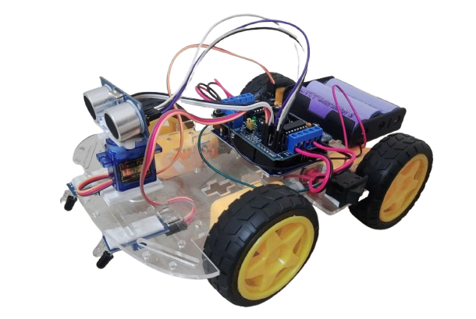
Contents
Introduction
Objective
Hardware Components Used
Circuit Diagrams
How Line Following Works
How Obstacle Avoidance Works
Flowchart
Code Overview
Challenges
Applications
Conclusions
References
i

Slide 3
Introduction to Line Following & Obstacle Avoiding Robots
What is a Line Following Robot?
A robot designed to follow a pre-defined path, typically a black line on a white surface.
Uses Infrared sensors to detect and stay aligned with the path.
What is Obstacle Avoidance?
Enables the robot to detect and bypass obstacles in its path using Ultrasonic sensor.
Enhances the robot's capability to navigate dynamic environments.
1

Slide 4
Objective
Combine line-following capability with obstacle avoidance to create an efficient and adaptive navigation system.
Implement real-time decision-making for handling obstacles while maintaining line-following accuracy.
2

Slide 5
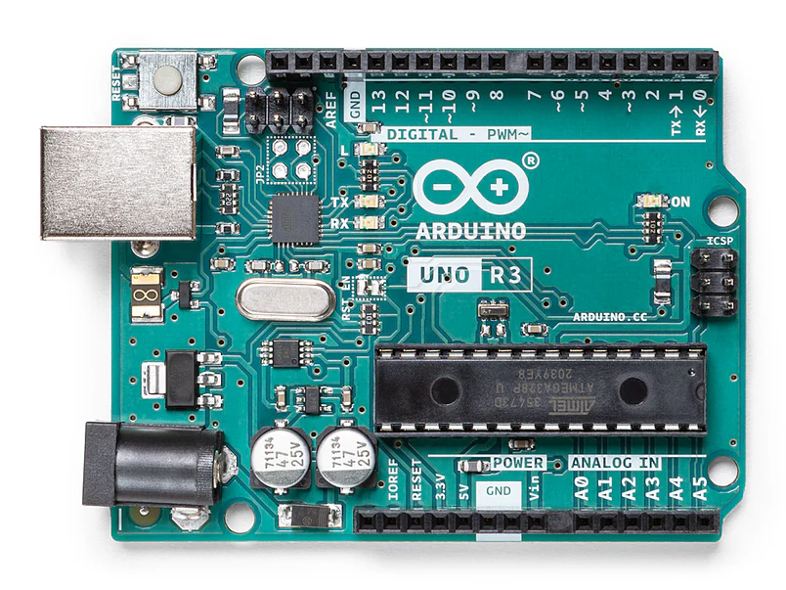
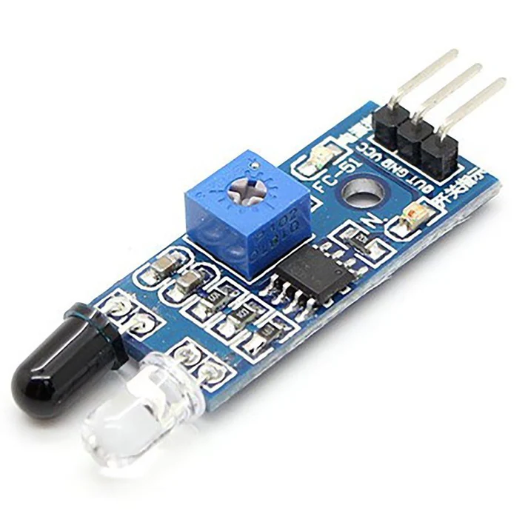
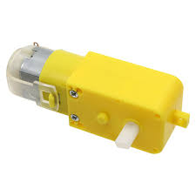
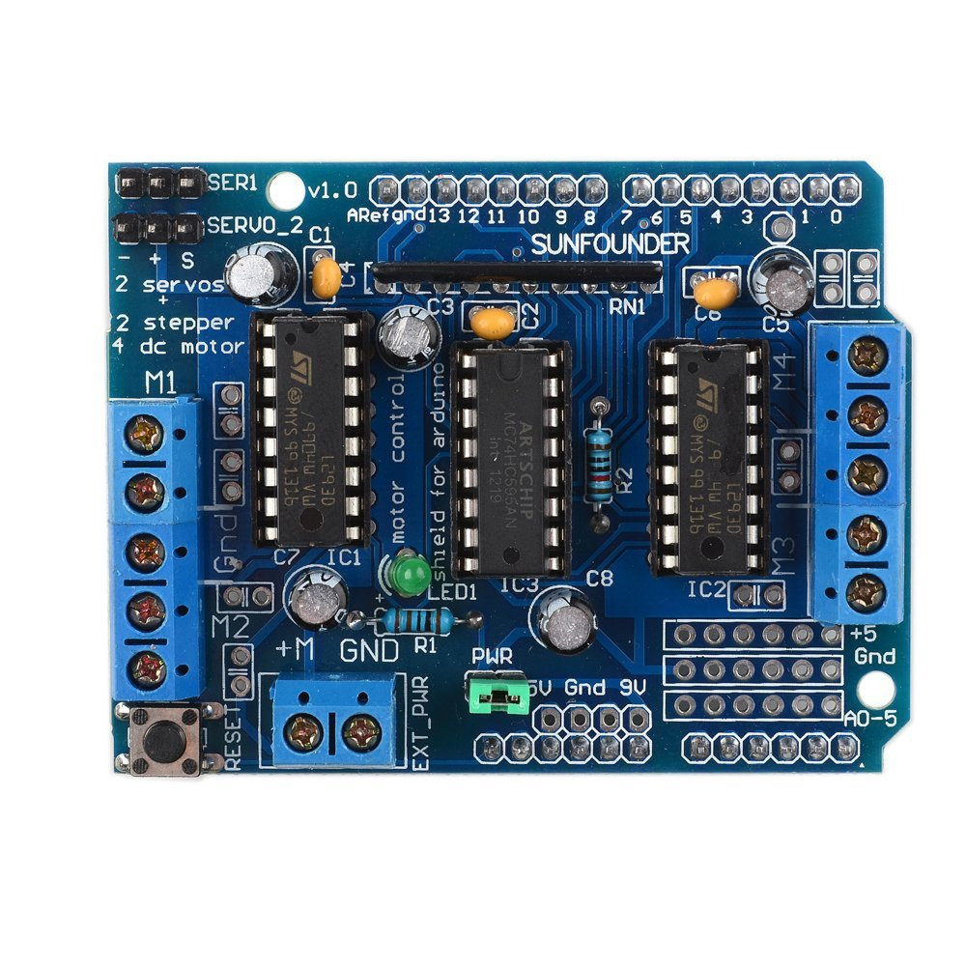
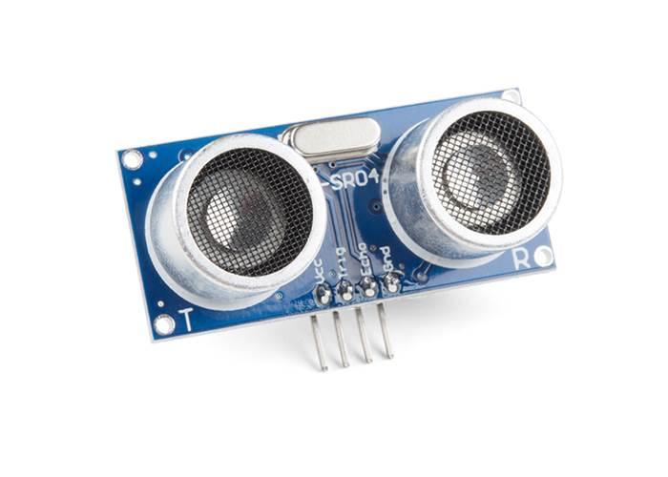
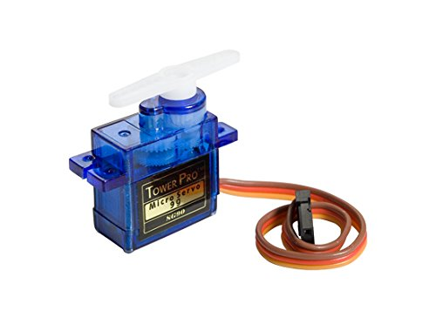
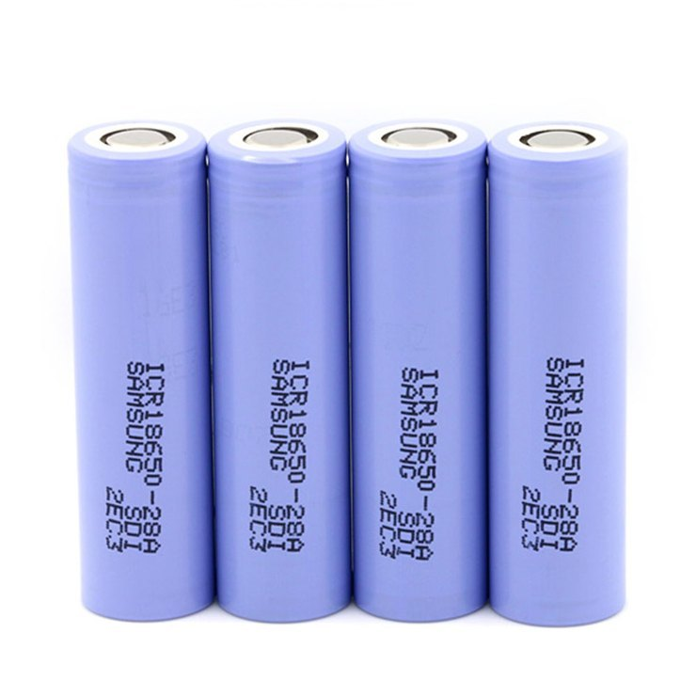
Hardware Components Used
Microcontroller
Motors & Drivers
IR Sensors
Arduino Uno is used as microcontroller.
4 DC motors and L293D motors driver are used.
To detect and follow the line.
Ultrasonic Sensor
Servo Motor
Power Supply
To detect obstacle and avoid it.
To adjust ultrasonic sensor's position for scanning.
To provide energy to the robot.
3

Slide 6
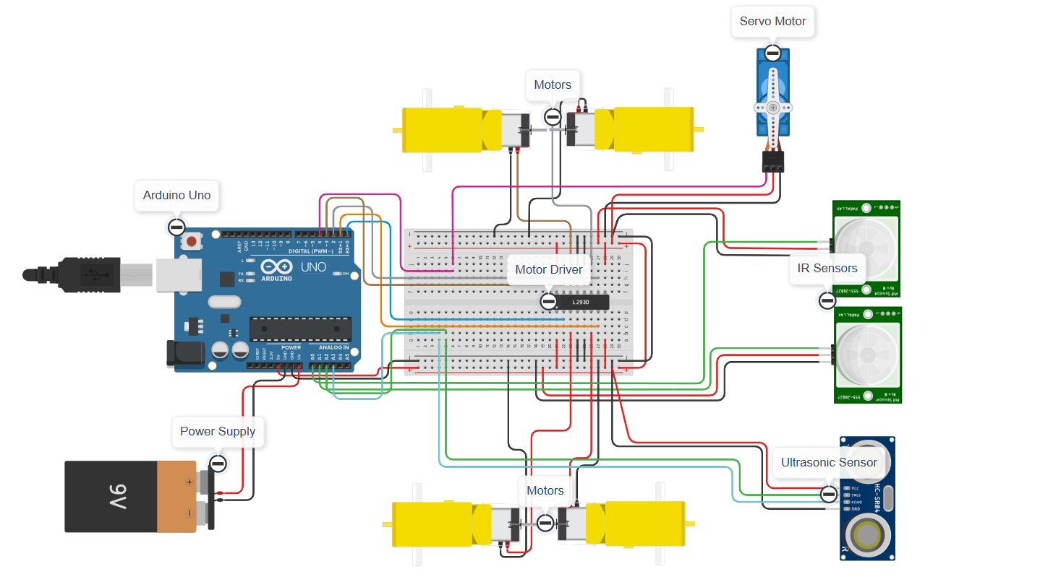
Robot Circuit
4

Slide 7
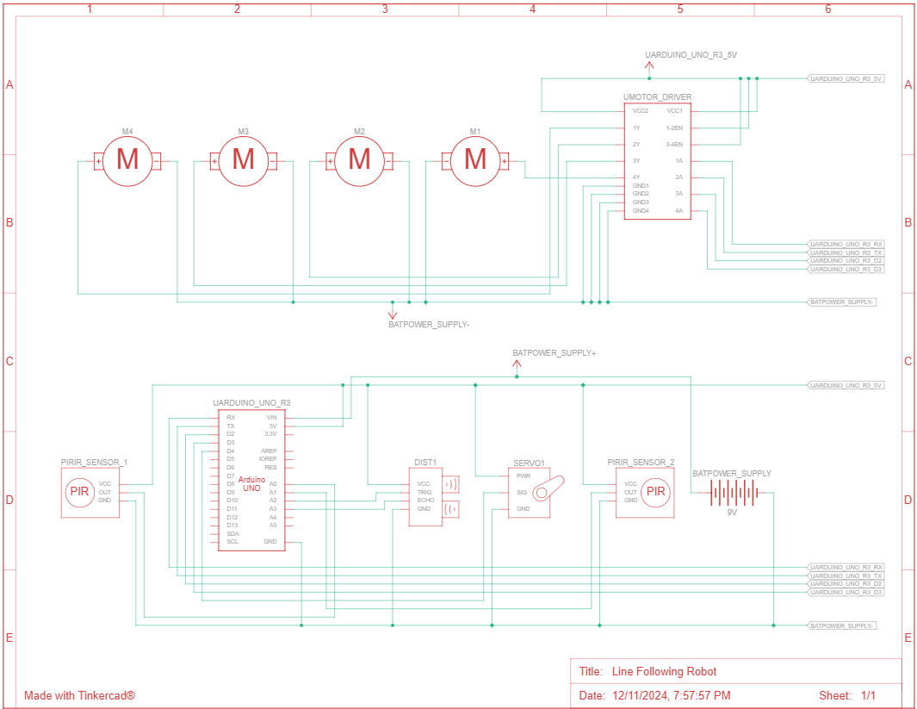
Circuit Diagram
5

Slide 8
How Line Following Works
Basic Principle :
Utilize infrared sensors to detect the line.
Adjust movement based on sensor feedback to stay on course.
1. Following a Straight Line
6

Slide 9
How Line Following Works
Basic Principle :
Utilize infrared sensors to detect the line.
Adjust movement based on sensor feedback to stay on course.
1. Following a Straight Line
6

Slide 10
How Line Following Works
2. Following Left Curve
3. Following Right Curve
7

Slide 11
How Line Following Works
2. Following Left Curve
3. Following Right Curve
7

Slide 12
How Obstacle Avoidance Works
Basic Principle :
Utilize ultrasonic sensor to detect the obstacle.
Scan left and right using servo motor to detect obstacle on sides.
Avoid obstacle by going from side with no other obstacle.
1. Detecting Obstacle and scanning sides
8

Slide 13
How Obstacle Avoidance Works
Basic Principle :
Utilize ultrasonic sensor to detect the obstacle.
Scan left and right using servo motor to detect obstacle on sides.
Avoid obstacle by going from side with no other obstacle.
1. Detecting Obstacle and scanning sides
8

Slide 14
How Obstacle Avoidance Works
Basic Principle :
Utilize ultrasonic sensor to detect the obstacle.
Scan left and right using servo motor to detect obstacle on sides.
Avoid obstacle by going from side with no other obstacle.
1. Detecting Obstacle and scanning sides
8

Slide 15
How Obstacle Avoidance Works
2. Avoiding Obstacle
9

Slide 16
How Obstacle Avoidance Works
2. Avoiding Obstacle
9

Slide 17
How Obstacle Avoidance Works
2. Avoiding Obstacle
9

Slide 18
How Obstacle Avoidance Works
2. Avoiding Obstacle
9

Slide 19
How Obstacle Avoidance Works
2. Avoiding Obstacle
9

Slide 20
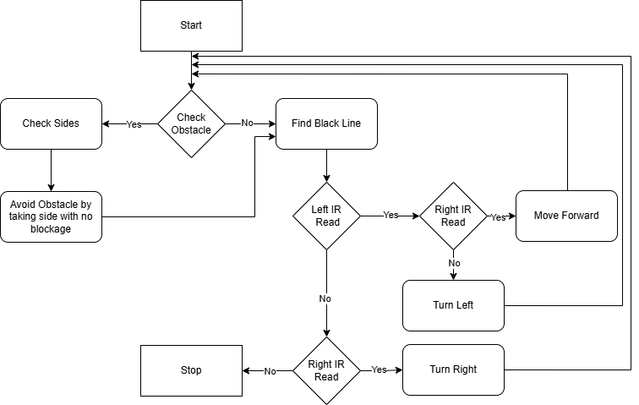
Flowchart
10

Slide 21
Code Overview
Code for Line Following
if (leftSensor == LOW && rightSensor == LOW){
moveForward(); // Both sensors detect the line
}
else if (leftSensor == HIGH && rightSensor == LOW) {
turnRight(); // Left sensor off the line
}
else if (leftSensor == LOW && rightSensor == HIGH) {
turnLeft(); // Right sensor off the line
}
else if (leftSensor == HIGH && rightSensor == HIGH) {
releaseMotors(); // Both sensors off the line, stop
}
11

Slide 22
Code Overview
Code for Obstacle Avoidance
if (distanceLeft > distanceRight) {
turnLeft();
delay(500);
moveForward();
delay(1000);
turnRight();
}
else {
turnRight();
delay(500);
moveForward();
delay(1000);
turnLeft();
}
12

Slide 23
Challenges
Coordination between Line Following & Obstacle Avoidance:
Maintaining line detection during obstacle avoidance.
Real-time obstacle detection and response.
Speed Control:
Maintaining speed while ensuring accurate line following.
Handling sharp turns, intersections, and obstacles.
Surface Variability:
Different floor colours and textures can affect line detection.
13

Slide 24
Applications
Industrial Automation
Industrial automation for material handling.
Transporting materials along predefined paths in factories.
In Hazardous environments
Navigation in dynamic environments.
Pathfinding in hazardous areas.
Education & Competitions
Robotics competitions and educational projects.
Participating in robotics contests to test design and coding skills.
14

Slide 25
Conclusions
A line-following robot with obstacle avoidance demonstrates an advanced integration of sensor technology and control systems.
Offers a practical solution for autonomous navigation in dynamic environments.
Future scope includes AI integration for more complex decision-making.
Coordination between multiple robots for complex tasks.
15

Slide 26
References
https://www.tinkercad.com/things/d4iIEqQIvXp-line-following-robot/
https://www.fypsolutions.com/robotics/line-following-algorithm-one-sensor/#google_vignette
https://marobotic.com/2023/10/22/line-follower-obstacle-avoiding-robot-using-arduino-and-l298-motor-driver/
https://www.instructables.com/Arduino-Obstacle-Avoidance-Line-Follower-Robot-Pro/
https://iarjset.com/wp-content/uploads/2023/06/IARJSET.2023.10670.pdf
https://www.youtube.com/watch?v=t7k9D1jDEtk&t=77s
https://www.youtube.com/watch?v=1n_KjpMfVT0
https://projecthub.arduino.cc/lightthedreams/line-following-robot-34b1d3
ii

Slide 27
Thanks!

